Slide 1
TE Challenge Abstract Component Model (TEM)

Slide 2
Purpose and Scope
Transactive Energy (TE) is a metaphor for the changing nature of the business and technical dimensions of the distribution of electric power. Transactive energy is a new approach for managing the electric power distribution system based on principles of economic value, with engineering constraints.
Purpose:
Measuring performance of the grid to assess different market-based grid-control mechanisms.
Measure the performance differences between fixed price, time of use, real-time price, and dynamic bidding on UCEF Testbed.
Scope:
Utilize the CPS Testbed to simulate transactive energy models varying the grid, control algorithms, and market designs.
Implement the Abstract Component Model for Transactive Energy in UCEF
Allows separate federate models that can be composed for various scenarios.
Separate models for loads, generators, grid, local controllers (e.g. thermostat), supervisory controllers (bas or ha system), weather, transactive agents
For each pricing scheme a separate supervisory controller/transactive agent pair is constructed to model the behavior
Research Questions –
What are the relative benefits in saving and/or regulation based on different pricing schemes to drive consumption patterns?
Operational cost benefits
Capital cost benefits/risks
What complexity does each method require for their realization?
Can the schemes coexist in the same place?
Produce supervisory controller/transactive agents for:
Fixed price
Time of use
Realtime price
Double auction TE
Compute a constant set of metrics across each test case
Perform a comparative analysis of the four models

Slide 3
Steps
Build Federate Models
Use new GridlabD federate adaptor to model grid
Factor 30 house all-in one simulation in Gridlab-D to just grid
Arrange for 1 second power stepping, 1 minute control stepping, and 5 minute TE stepping for multi-time resolution simulation
Implement a federation with 30 house model grid and instantiation
Stretch goal – 8500 node simulation federation with cloud overhead
Construct data analytics from measurements based on TE Challenge Phase II
Each House:
Power load, kW
Solar generation source, kW
Temperature indoor, T ‘C
Temperature setpoint, T’C
Each power system node
Power, kW
Voltage
Bulk Energy Feed, Power, kW

Slide 4
Measurements
For each grid node
Voltage at each time step
Current at each time step
Impedance at each node
For each resource
Current at each time step
Impedance at node connection
For each supervisory controller
Current setpoint to local controller
Net Power flow for collection of resources
For each transactive agent
Current bid price and quantity
Current settlement price
For bulk supply (what is not provided by local resource generation)
Voltage
Current
LMP (locally marginalized price from grid)

Slide 5
Metrics
Economic
Wholesale price (defaults to the input LMP player file)
Cleared price(s) on the feeder
Price, quantity, and status (accepted, not accepted) for each bid
Revenue at each meter, separable by load and resource
Substation
Real and reactive power
Real and reactive energy
Real and reactive losses
At each feeder capacitor bank and voltage regulator
Count of control actuations
At each meter (i.e. house)
Voltage magnitude, line-to-neutral, averaged over all phases
Voltage magnitude, line-to-line, averaged over all phases
For three-phase loads only, line-to-line voltage unbalance as defined in ANSI C84.1: $100{\max_{p=1..3}{({|V}_{p}−V_{avg}|)}}/{V_{avg}}$ [%]
Severity index for the fluctuation in V_{avg} on per-unit basis at uniform time step. Similar to an L2 norm; $SI=\sum_{k=1}^{n}{\sqrt{{\left(V_{k}−V_{k−1}\right)}^{2}+1}}$ . This metric has also been used to quantify fluctuations in solar irradiance. IEEE Std. 1453 is less applicable because cloud-induced fluctuations are generally too slow.
Violations of ANSI C84.1 voltage limits at the meter. The duration of time in each range should be accumulated. An event count occurs when the voltage transitions from normal to A Range, or from A Range to B Range.
Total duration and event counts below 110 V (B Range)
Total duration and event counts below 114 V (A Range)
Total duration and event counts above 126 V (A Range)
Total duration and event counts above 127 V (B Range)
Total duration and event counts below 10 V (Outage; none expected)
Total house load (real power)
Total HVAC load (real power)
Total water heater load (real power)
Solar inverter real and reactive power
Battery inverter real and reactive power
House air temperature, and its deviation from scheduled set point
Water heater temperature, and its deviation from scheduled set point
Total bill, synchronized to the cleared market price

Slide 6

Composability of TE Simulations
Distribution System Operator
Transactive Broker - Aggregator
Bulk Generator
Grid Controller
Aggregator TA
Weather
2
Microturbine
3
Industrial Load
Industrial Customer
Grid
Auction
Storage
Market Maker
1
Residence Load
Retail Customer
Building/Home with Automation System
Microgrid PCC
Grid Link
Resources
Transactive Appliance
Key
Resource: Load
Resource: DER
Grid + Controls
Manages
Weather
Controllers
Local Controller
Supervisory Controller
Transactive Agent
Transactive
Notes:
Transactive Energy (TE) is a metaphor for the changing nature of the business and technical dimensions of the distribution of electric power. Transactive energy is a new approach for managing the electric power distribution system based on principles of economic value, with engineering constraints.
Purpose:
Measuring performance of the grid to assess different market-based grid-control mechanisms.
Measure the performance differences between fixed price, time of use, real-time price, and dynamic bidding on UCEF Testbed.
Scope:
Utilize the CPS Testbed to simulate transactive energy models varying the grid, control algorithms, and market designs.
Implement the Abstract Component Model for Transactive Energy in UCEF
Allows separate federate models that can be composed for various scenarios.
Separate models for loads, generators, grid, local controllers (e.g. thermostat), supervisory controllers (bas or ha system), weather, transactive agents
For each pricing scheme a separate supervisory controller/transactive agent pair is constructed to model the behavior

Slide 7


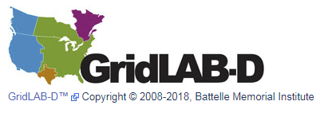
Common Platform Canonical Simulation
Database
Weather
Federation Manager
Grid
Resource
Local Controller
Supervisory Controller
Transactive Agent
Physics
Frequent
Control
Often
Markets
Periodic
HLA Pub/Sub Bus
Notes:
The TE Challenge Component Model was designed to mix and match components from different simulation environments, platforms, scale and location.
The HLA Publish and Subscribe mechanism focuses on the data exchanged and the name of the published instance which is decoupled from the software components that emit and consume them.
This allows:
One simulation to be run the same way regardless of how many different kinds of loads, controllers, and markets are present.
The uniform capture of all data exchange supports a single method of running the simulation and postprocessing on any experimental instance.
UCEF has:
GridLAB-D Federate Model that allows simple to complex grid models to simulated
Ucef-database Federate Model provides for universal data acquisition for results analysis
Gridlab-D
Powerful discrete event simulator for Smart Grid from PNNL
C++ based solver can solve very large grid models with very few computing resources
Tested and validated models of most grid components
Simple Federate Model
Configuration file contains description of interactions and objects published and subscribed.
Mapping to GridLAB-D object model components in XML
Drop in and use like any other federate in WebGME
Database
Simple Federate Model
Gets a configuration file describing all interactions and objects
Listens on the HLA bus
Creates one table per information component published by any federate
Records time ordered results of message traffic
Each experiment creates own schema
MySQL Database
Default database – can be modified to other Java SQL Connections
MySQL Workbench included in UCEF
Database Tools transform SQL into JSON objects for later processing

Slide 8
Core Modeling Components of Common Platform

Slide 9
Common Platform Canonical Simulation

Slide 10
How Simulation Components Get Realized in Simulators
Experiment Manager
Weather
Grid
Resource
Local Controller
Supervisory Controller
TransactiveAgent
Auction
Comms Simulator
Analytics
Simulation Interaction Bus (HLA, FNCS, SGRS)

Slide 11
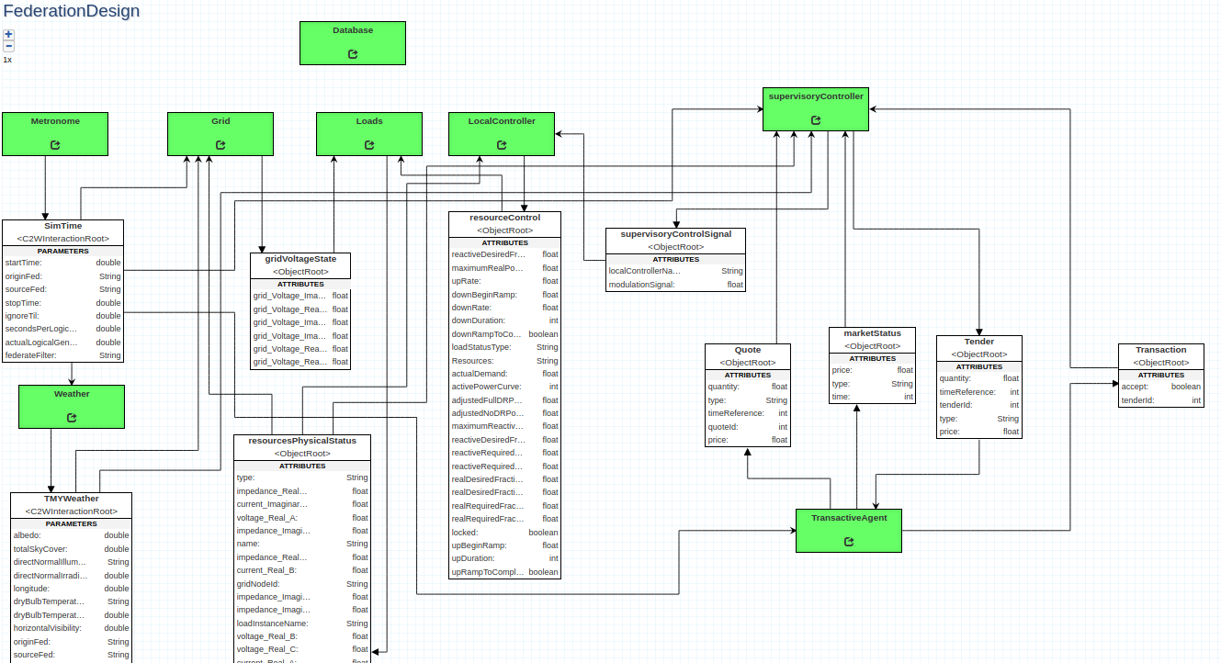
TE Challenge Federation on UCEF
Database
Supervisory Controller
Metronome
Grid
Loads
Local Controller
Weather
Transactive Agent

Slide 12
Baseline Reference Scenario
X10 for each phase
30 houses divided among three phases on one distribution transformer.
The distribution system has one uncontrollable load (Resource) and one source of bulk power (Resource).
There is a weather feed of TMY3 Data for a single locale (Weather).
Each house has:
A solar panel (Resource)
A controllable load – HVAC (Resource)
A non-controllable load (Resource)
A home automation system (SupervisoryController)
A thermostat (LocalController)
A transactive agent (TransactiveAgent)
AS
ABC
BS
CS
ABC
{Desired Setpoint,
State}
Grid
{Setpoint}
{TMY3 Data}
{Quote: Cleared Price, Marginal Quantity}
{Weather}
{Tender: Bid Price, Bid Quantity, State}
Resources
Nodes
Links
Logical Connectors
LocalController
Transactive Agents
PV Panel (+inverter)
Bulk Power
Meter (triplex)
Transformer
Power Flow
Thermostat
Bidding Controller
Dummy Grid Load
Node (triplex)
Triplex cable
Data
SupervisoryController
Controllable Load (HVAC)
Node (three-phase)
Auction
Weather
Uncontrollable Load

Slide 13
Risks
Being able to factor out loads, generators, and controllers from Gridlab-D and still have a valid power simulation
Performance of having a large number of federates
Federate message exchange delays
Note: We might need to use NextEventRequestAvailable instead of TimeAdvanceRequest to mitigate delays and resolve delta cycles at a logical time-point.
Possible desirability of being able to factor out only subsets of the Gridlab-D models.
If multiple Gridlab-D models are used, how to ensure consistent data exchange among them by ensuring causality of events and reaching consensus (i.e., equilibrium).
Any delays that might occur by running gridlabd in server mode (ideally the delay will be only wall-clock time and none in the logical time).
How should model extensions work -- inheritance or additional interactions/objects?

Slide 14
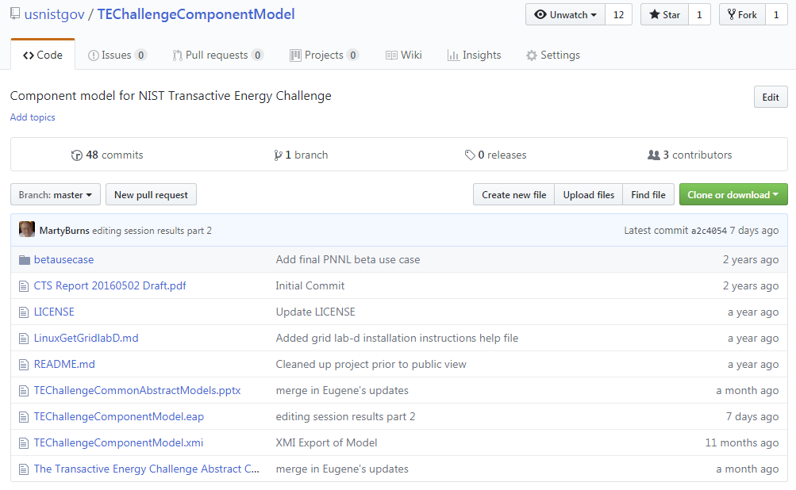
Use TEChallengeComponentModel for Project

