Slide 1

UCEF Use Case
Transactive Energy
Marty Burns, Tom Roth, David Holmberg
May 8, 2018

Slide 2
Agenda
Introductions
Project Overview [Marty 20min]
TE Challenge Phase I and II intro [David H 10 min]
Brief UCEF intro and Gridlab-D Wrapper and UCEF-Gateway [Tom 10 min]
TE Challenge Component Model [Marty 20 min]
Discussion of Issues [All 30 min]
Develop Plan and Responsibilities to Complete by 9/30/2018 [All 30 min]

Slide 3
Purpose and Scope
Transactive Energy (TE) is a metaphor for the changing nature of the business and technical dimensions of the distribution of electric power. Transactive energy is a new approach for managing the electric power distribution system based on principles of economic value, with engineering constraints.
Purpose:
Measuring performance of the grid to assess different market-based grid-control mechanisms.
Measure the performance differences between fixed price, time of use, real-time price, and dynamic bidding on UCEF Testbed.
Scope:
Utilize the CPS Testbed to simulate transactive energy models varying the grid, control algorithms, and market designs.
Implement the Abstract Component Model for Transactive Energy in UCEF
Allows separate federate models that can be composed for various scenarios.
Separate models for loads, generators, grid, local controllers (e.g. thermostat), supervisory controllers (bas or ha system), weather, transactive agents
For each pricing scheme a separate supervisory controller/transactive agent pair is constructed to model the behavior
Research Questions –
What are the relative benefits in saving and/or regulation based on different pricing schemes to drive consumption patterns?
Operational cost benefits
Capital cost benefits/risks
What complexity does each method require for their realization?
Can the schemes coexist in the same place?
Produce supervisory controller/transactive agents for:
Fixed price
Time of use
Realtime price
Double auction TE
Compute a constant set of metrics across each test case
Perform a comparative analysis of the four models

Slide 4
Steps
Build Federate Models
Use new GridlabD federate adaptor to model grid
Factor 30 house all-in one simulation in Gridlab-D to just grid
Arrange for 1 second power stepping, 1 minute control stepping, and 5 minute TE stepping for multi-time resolution simulation
Implement a federation with 30 house model grid and instantiation
Stretch goal – 8500 node simulation federation with cloud overhead
Construct data analytics from measurements based on TE Challenge Phase II
Each House:
Power load, kW
Solar generation source, kW
Temperature indoor, T ‘C
Temperature setpoint, T’C
Each power system node
Power, kW
Voltage
Bulk Energy Feed, Power, kW

Slide 5
Measurements
For each grid node
Voltage at each time step
Current at each time step
Impedance at each node
For each resource
Current at each time step
Impedance at node connection
For each supervisory controller
Current setpoint to local controller
Net Power flow for collection of resources
For each transactive agent
Current bid price and quantity
Current settlement price
For bulk supply (what is not provided by local resource generation)
Voltage
Current
LMP (locally marginalized price from grid)

Slide 6
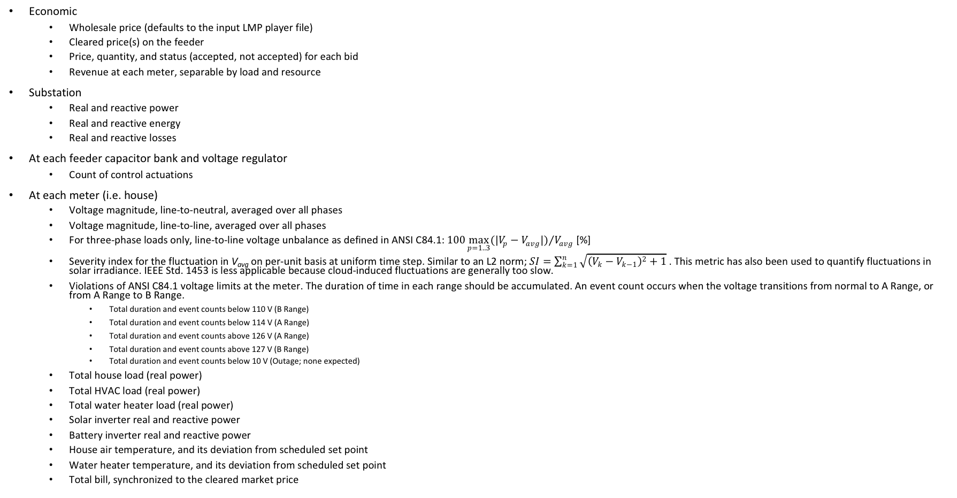
Metrics
Economic
Wholesale price (defaults to the input LMP player file)
Cleared price(s) on the feeder
Price, quantity, and status (accepted, not accepted) for each bid
Revenue at each meter, separable by load and resource
Substation
Real and reactive power
Real and reactive energy
Real and reactive losses
At each feeder capacitor bank and voltage regulator
Count of control actuations
At each meter (i.e. house)
Voltage magnitude, line-to-neutral, averaged over all phases
Voltage magnitude, line-to-line, averaged over all phases
For three-phase loads only, line-to-line voltage unbalance as defined in ANSI C84.1: $100{\max_{p=1..3}{({|V}_{p}−V_{avg}|)}}/{V_{avg}}$ [%]
Severity index for the fluctuation in V_{avg} on per-unit basis at uniform time step. Similar to an L2 norm; $SI=\sum_{k=1}^{n}{\sqrt{{\left(V_{k}−V_{k−1}\right)}^{2}+1}}$ . This metric has also been used to quantify fluctuations in solar irradiance. IEEE Std. 1453 is less applicable because cloud-induced fluctuations are generally too slow.
Violations of ANSI C84.1 voltage limits at the meter. The duration of time in each range should be accumulated. An event count occurs when the voltage transitions from normal to A Range, or from A Range to B Range.
Total duration and event counts below 110 V (B Range)
Total duration and event counts below 114 V (A Range)
Total duration and event counts above 126 V (A Range)
Total duration and event counts above 127 V (B Range)
Total duration and event counts below 10 V (Outage; none expected)
Total house load (real power)
Total HVAC load (real power)
Total water heater load (real power)
Solar inverter real and reactive power
Battery inverter real and reactive power
House air temperature, and its deviation from scheduled set point
Water heater temperature, and its deviation from scheduled set point
Total bill, synchronized to the cleared market price

Slide 7
Core Modeling Components of Common Platform

Slide 8
A Composable Model
The abstract interfaces are based on a publish/subscribe model
Therefore composite devices that publish and subscribe the same message constructs are indistinguishable from the specific class models that realize them
This fits well into the HLA model of Interactions and Objects

Slide 9

Composability of TE Simulations
Distribution System Operator
Transactive Broker - Aggregator
Bulk Generator
Grid Controller
Aggregator TA
Weather
2
Microturbine
3
Industrial Load
Industrial Customer
Grid
Auction
Storage
Market Maker
1
Residence Load
Retail Customer
Building/Home with Automation System
Microgrid PCC
Grid Link
Resources
Transactive Appliance
Key
Resource: Load
Resource: DER
Grid + Controls
Manages
Weather
Controllers
Local Controller
Supervisory Controller
Transactive Agent
Transactive

Slide 10
Common Platform Canonical Simulation

Slide 11
How Simulation Components Get Realized in Simulators
Experiment Manager
Weather
Grid
Resource
Local Controller
Supervisory Controller
TransactiveAgent
Auction
Comms Simulator
Analytics
Simulation Interaction Bus (HLA, FNCS, SGRS)

Slide 12
Risks
Being able to factor out loads, generators, and controllers from Gridlab-D and still have a valid power simulation
Performance of having a large number of federates
Federate message exchange delays
Note: We might need to use NextEventRequestAvailable instead of TimeAdvanceRequest to mitigate delays and resolve delta cycles at a logical time-point.
Possible desirability of being able to factor out only subsets of the Gridlab-D models.
If multiple Gridlab-D models are used, how to ensure consistent data exchange among them by ensuring causality of events and reaching consensus (i.e., equilibrium).
Any delays that might occur by running gridlabd in server mode (ideally the delay will be only wall-clock time and none in the logical time).
How should model extensions work -- inheritance or additional interactions/objects?

Slide 13
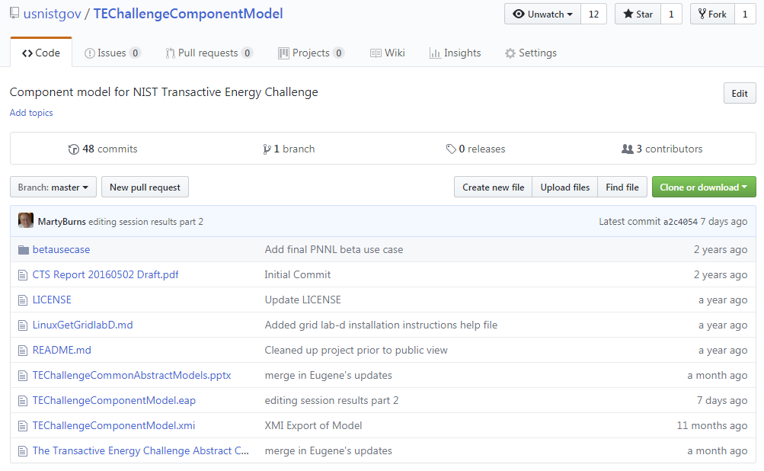
Use TEChallengeComponentModel for Project

Slide 14
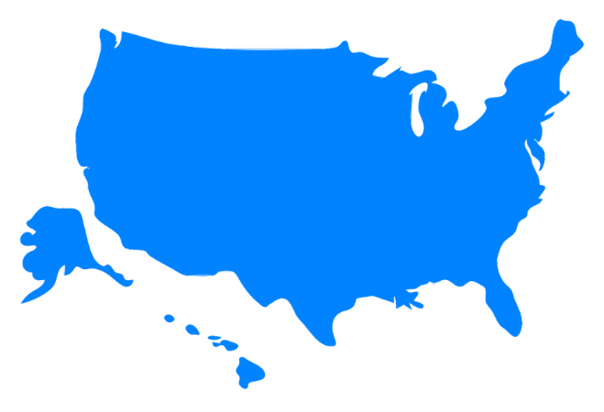

Transactive Energy 30 House Simulation
Houses
Weather
Each house has:
A Meter
A solar panel
A controllable HVAC load
A thermostat
A non-controllable load
A home automation system
A transactive agent
Grid
Market

