Slide 1
Media-Management-Platform
WT WS24/25

Slide 2
Authentication

Slide 3
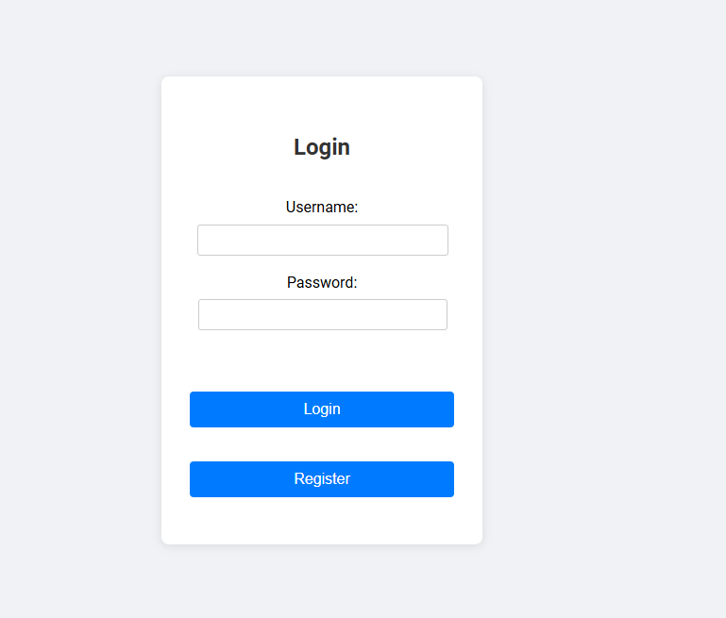
Goals
- Require user to authenticate
- Show different streams based on user

Slide 4
Media Processing

Slide 5
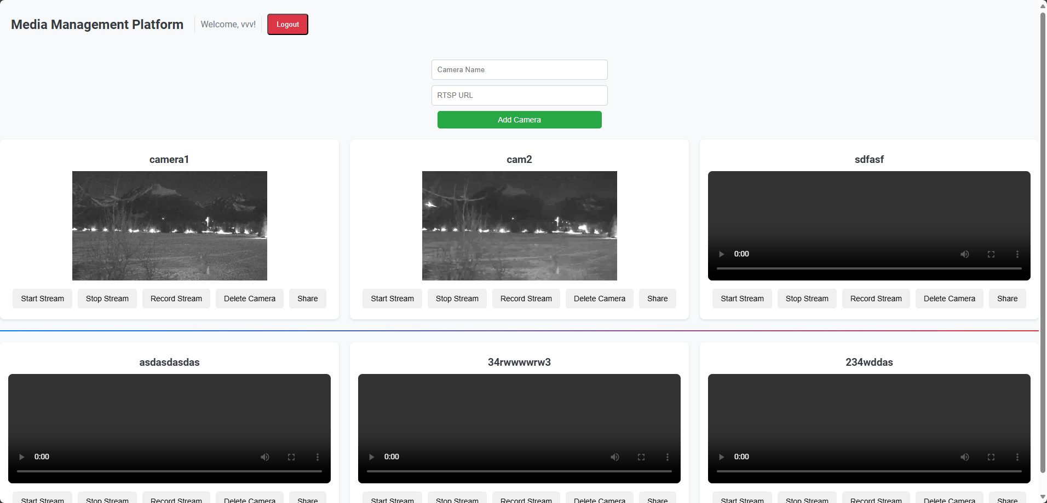
Goals
Stream media over http
Record the stream
Store camera details
User-friendly UI for end-user

Slide 6
Backend

Slide 7
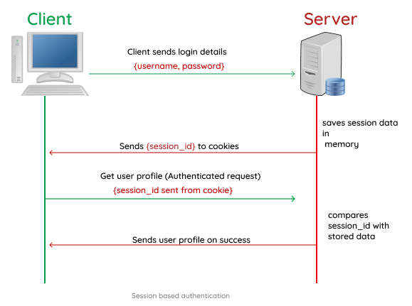
Authentication
At first: Session based
Too complicated with frontend ➔ JWT

Slide 8
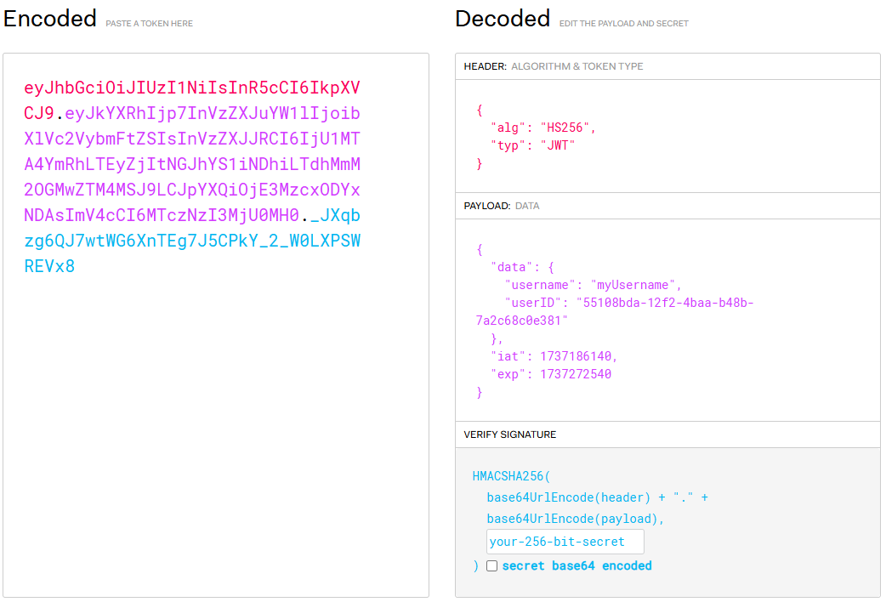
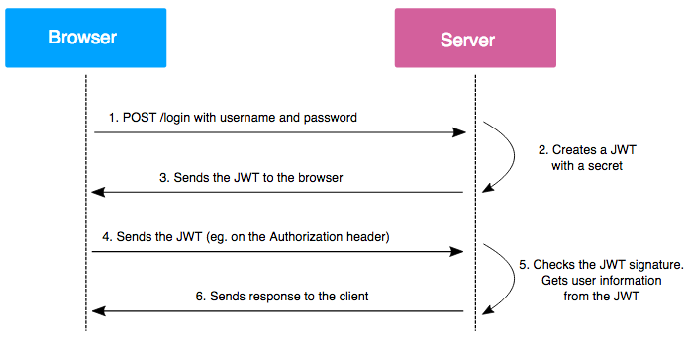
JsonWebToken

Slide 9





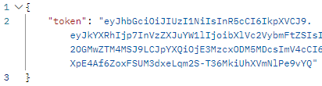
API

Slide 10
Access streams from different cameras
RTSP – Widely used protocol by manufacturers
Gstreamer – A robust media processing framework
HLS – A apple made media format for live streaming on html
- Have playlists
- Have segments
- shareable stream bucket
- prebuilt buffering
- supported by almost all .js based video players

Slide 11
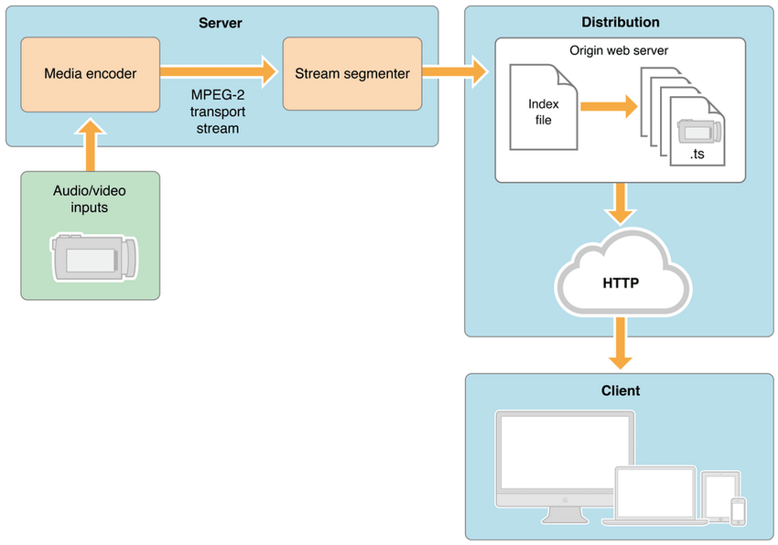
HLS

Slide 12
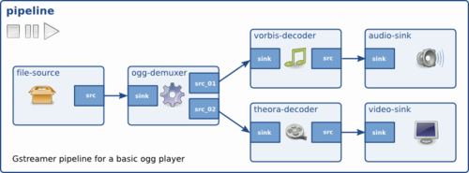
Gstreamer
Pipelines
Media Elements
Caps
Sink-point

Slide 13
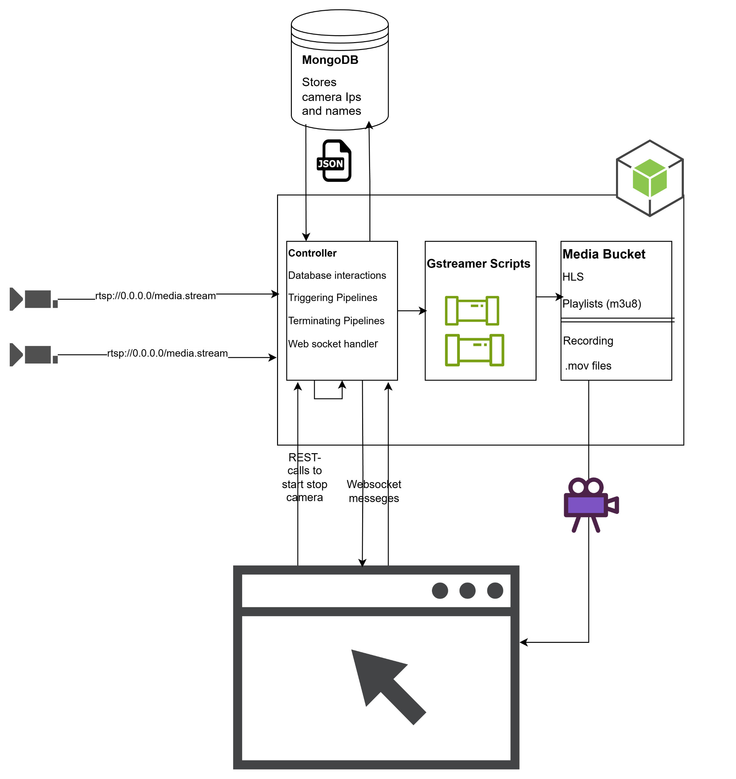


Full Architechture

Slide 14
Frontend

Slide 15
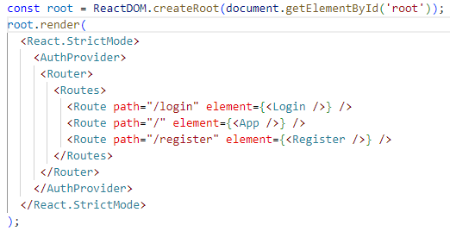
Index.js
AuthProvider: Attempts to authenticate user
Router: Displays different elements depending on Route

Slide 16
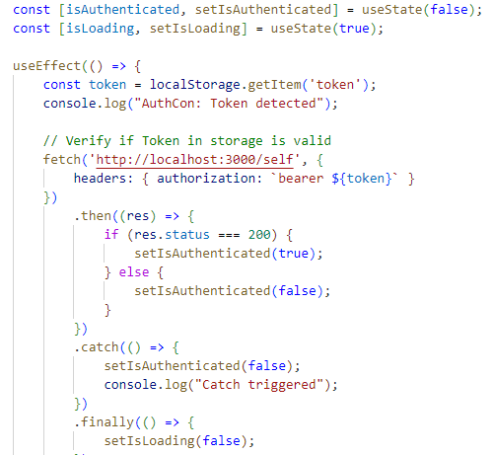
AuthContext.js
Verifies if token in storage is valid
Sets authenticated state

Slide 17
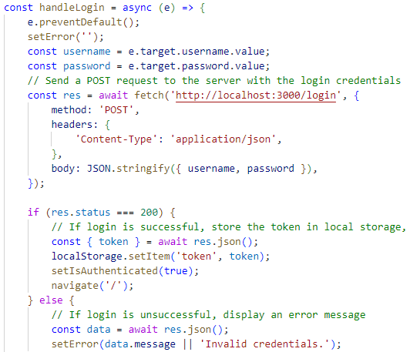
Login.js
Attempts to log user in
Display error message if unsuccessful

Slide 18
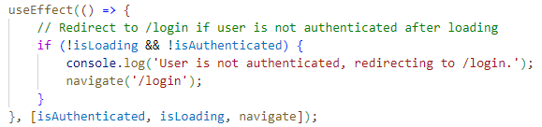

App.js
Wait for AuthContext
Redirect if not authenticated

Slide 19
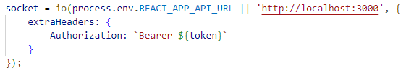
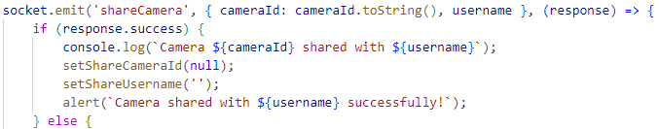
App.js socket
Use Token in header
Use sockets normally

Slide 20
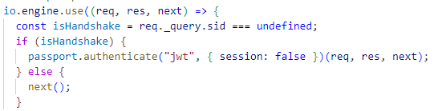
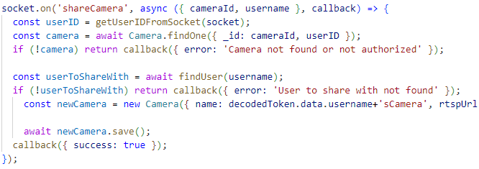

Server.js socket
Authenticate using passport
Use token payload

Slide 21
App.css
Designed a responsive grid layout for displaying camera consoles
Unified the styling of Start, Stop, Record, Delete, and Share buttons
a loading spinner for better user feedback when streams or dashboards are being initialized

Slide 22
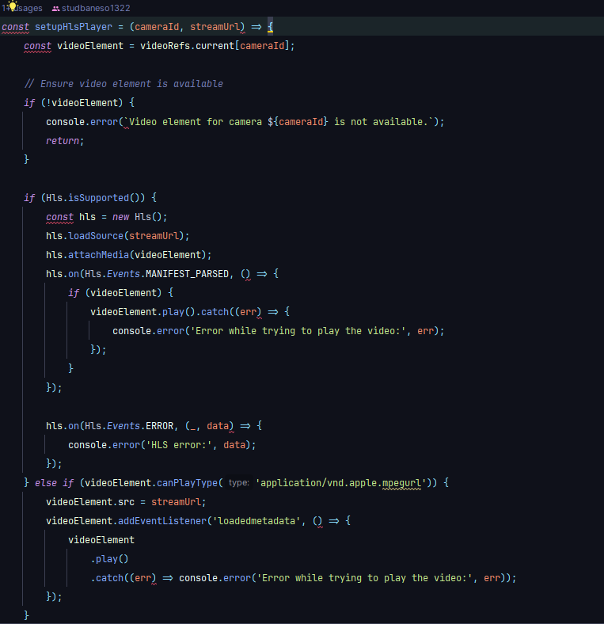
App.js HLS player
Open source video player with simple setup

Slide 23
Deployment

Slide 24
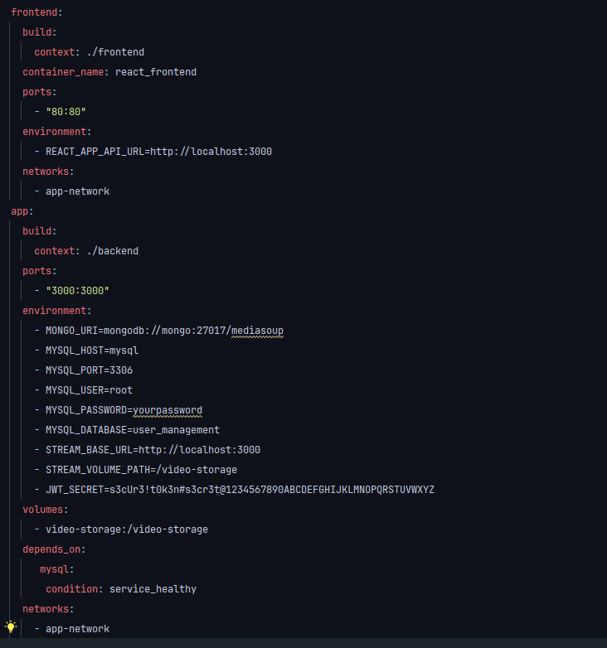
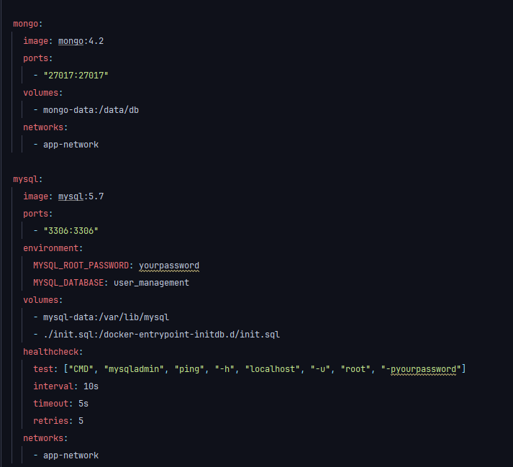
Docker
Docker images for easy-deployment ☺

Slide 25
Demo

Slide 26
Image sources:
http live streaming frame work diagram - Search Images
Introduction to network streaming using GStreamer - RidgeRun Developer Wiki
Apple HTTP Live Streaming (Apple HLS)
GStreamer C++ - Stream Webcam over TCP Tutorial - DEV Community

