Slide 1
Media-Management-Platform
WT WS24/25

Slide 2
Goals:

Slide 3
Authentication

Slide 4
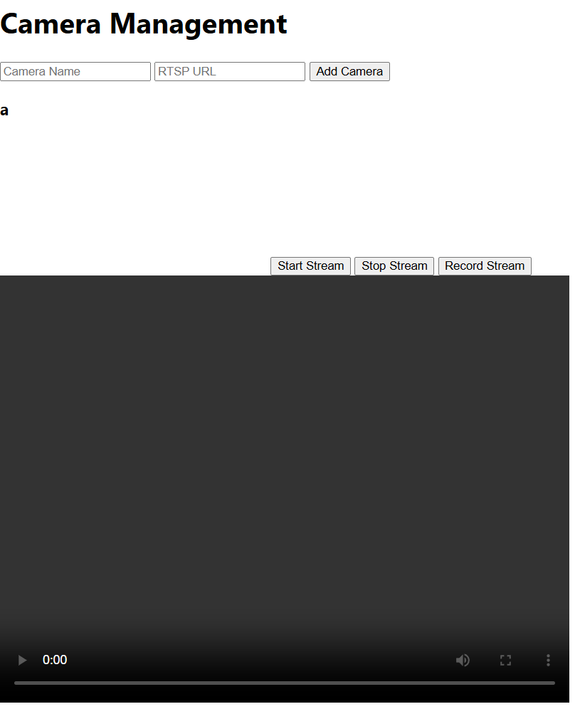
Goals
- Require user to authenticate
- Show different streams based on user

Slide 5
Backend

Slide 6
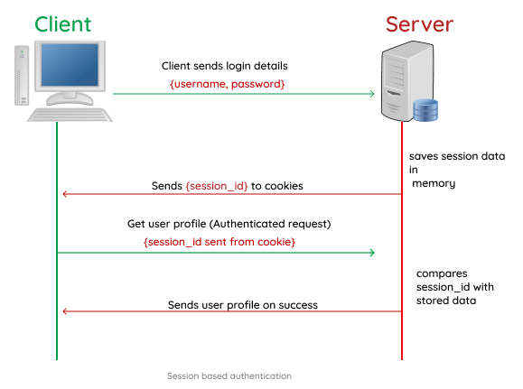
Authentication
At first: Session based
Too complicated with frontend ➔ JWT

Slide 7
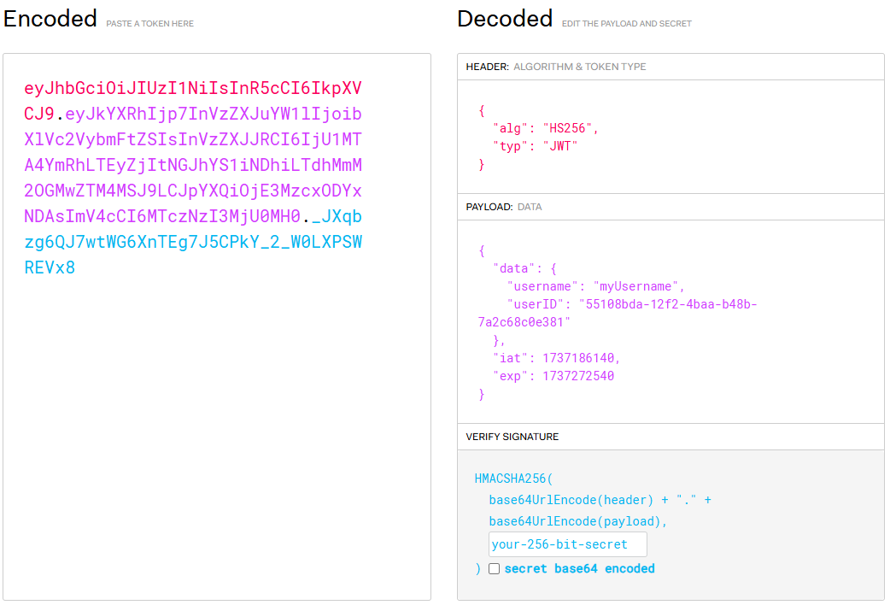
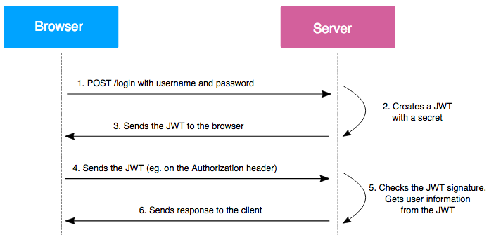
JsonWebToken

Slide 8





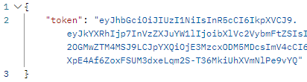
API

Slide 9
Frontend

Slide 10
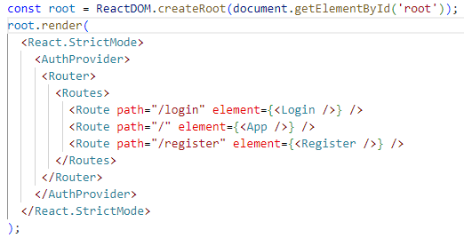
Index.js
AuthProvider: Attempts to authenticate user
Router: Displays different elements depending on Route

Slide 11
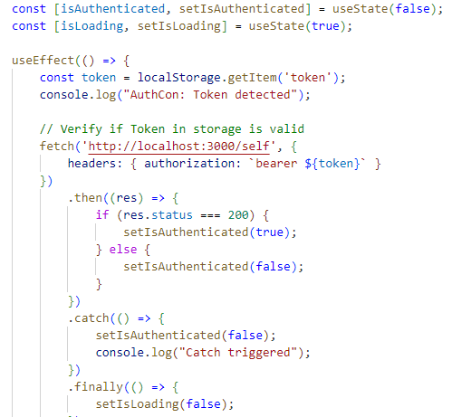
AuthContext.js
Verifies if token in storage is valid
Sets authenticated state

Slide 12
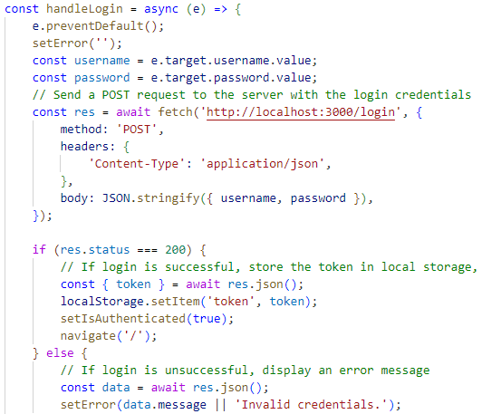
Login.js
Attempts to log user in
Display error message if unsuccessful

Slide 13
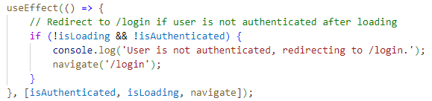

App.js
Wait for AuthContext
Redirect if not authenticated

Slide 14
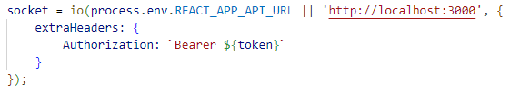
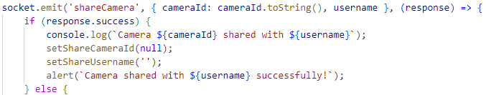
App.js socket
Use Token in header
Use sockets normally

Slide 15
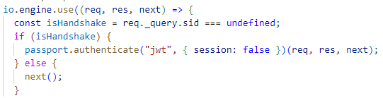
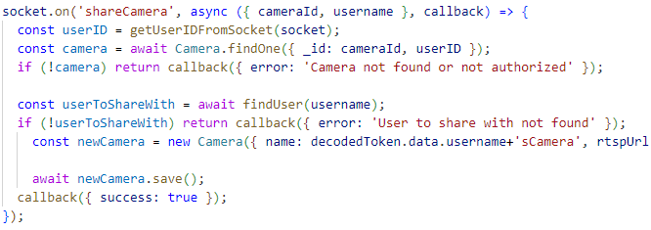

Server.js socket
Authenticate using passport
Use token payload

Slide 16
Demo

