Slide 1
Lecture notes
CDS 302
Scientific Data and Databases
Fall Semester 2020
Lecture 1: Introduction
Lecture: Joe Boone

Slide 2
Week 1 - Topics
Syllabus Review
Tools
An Introduction to Databases?
An Introduction to Scientific Articles
Introduction to LaTeX and Overleaf (Part 1)
Assignments

Slide 3
Who am I?
Joe Boone - GMU Graduate Lecturer
jboone@gmu.edu
Academic Career
BS and MS in Computer Science from GMU
Currently a Computational Science and Informatics Ph.D. Student at GMU
Professional Career
30+ Years of Systems Development and Engineering Leadership
Satellite Telecommunication Applications
Geospatial Applications
Extensive Software Development Experience
Graduate Lecturer at GMU

Slide 4
Syllabus Review

Slide 5
Tools

Slide 6







Software
www.overleaf.com
www.sqlite.org/download.html www.sqlitebrowser.org/dl/
www.anaconda.com/distribution/

Slide 7
An Introduction to Databases

Slide 8

Some Definitions
Database
Data collection, typically stored in secondary memory
Usually, it contains a sample of all data we could possibly collect in the real world
DBMS
Database Management System: a software package (i.e., collection of programs) designed to define, manipulate, retrieve and manage data in a database
Database System
DBMS + Database
Slide from Katerina Doka, Introduction to Databses
36

Slide 9
Why do we need Database Systems?

Slide 10
Types of Database Systems?
Relational
Hierarchical
Network
Object Oriented
Graph
Column Oriented
Document Oriented

Slide 11
Leve 1
Leve 2
Level 3
Level 4

Slide 12
Why do we need Database Systems?
Early Database Systems
Required writing application code to access
Proprietary systems – No standards meant re-writing application code resulting in platform ‘lock-in’
The relational database model was designed to solve the problem of multiple arbitrary data structures. The relational model provided a standard way of representing and querying data that could be used by any application

Slide 13








Data is Everywhere
Huge flood of data
Modern technology
New user mentality
2.5 Exabytes of new data every day
New applications
Innovative research
Economic Boost
“$600 billion potential annual consumer surplus from using personal location data” [1]
[1] McKinsey Global Institute. Big data: The next frontier for innovation, competition, and productivity. June 2011.

Slide 14
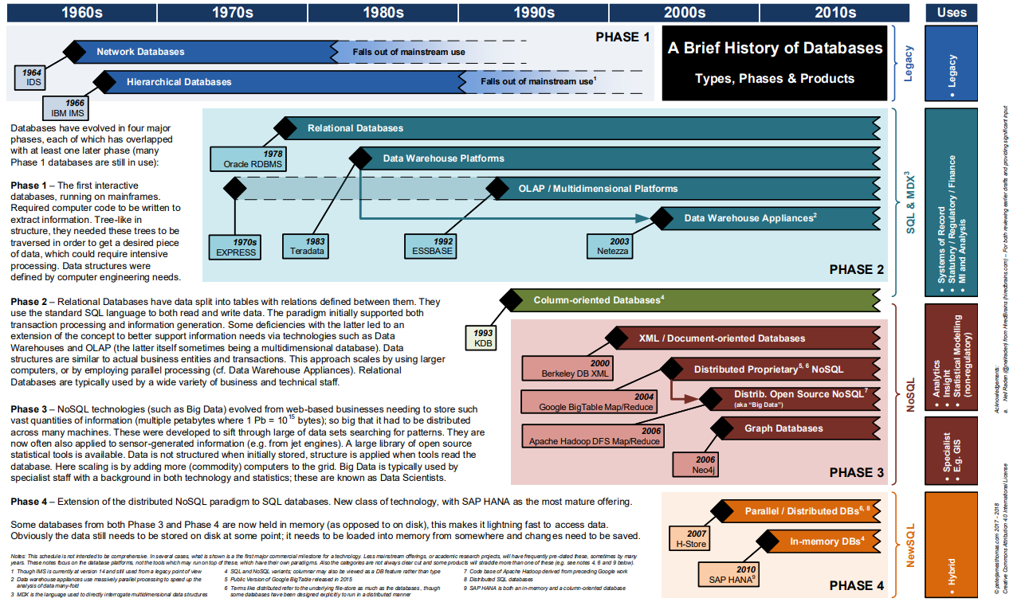
History of Database Systems
Slide from https://peterjamesthomas.com/2018/02/06/a-brief-history-of-databases/

Slide 15
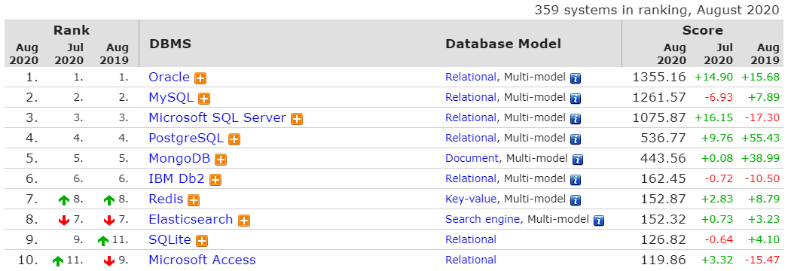
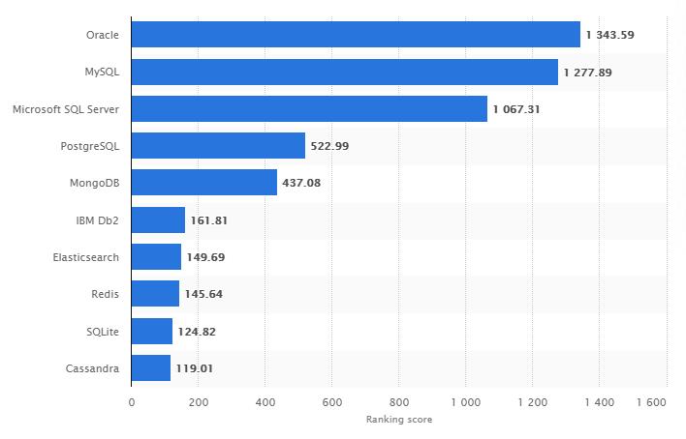
Database Systems by Popularity
https://db-engines.com/en/ranking
Relational databases are still dominant and provide a foundation to build on…
https://www.statista.com/statistics/809750/worldwide-popularity-ranking-database-management-systems/

Slide 16
Why do we need Database Systems?
Early Data Systems
Required writing application code to access
Proprietary systems – No standards meant re-writing application code resulting in platform ‘lock-in’
The relational database model was designed to solve the problem of multiple arbitrary data structures. The relational model provided a standard way of representing and querying data that could be used by any application
Efficient Query Processing
Indexing
Optimization
Operating Accuracy
Error recovery - Atomicity
Concurrent access by multiple users
Security Issues
Control access rights
Standards Based
Structured Query Language(SQL)is an ANSI and ISO standard
Kind of…
Large legacy base
Lots and lots of relational databases are out there…

Slide 17
Why Relational DBMS?
Data Modeling
Redundancy Control
Referential Integrity / Consistency Constraints
Efficient Query Processing
Indexing
Optimization
Operating Accuracy
Error recovery - Atomicity
Concurrent access by multiple users
Security Issues
Control access rights
Standards Based
Structured Query Language(SQL)is an ANSI and ISO standard
Kind of…
Large legacy base
Lots and lots of relational databases are out there…

Slide 18
Why not Relational DBMS?
Relational DBMS are designed for structured design and development
Rigidly enforced rules for data integrity
This is not applicable for all situations
In modern systems, data is often generated initially in an unstructured format:
Examples include: text, documents, log files
Or the data may consist of “BLOBS” (binary large objects) for example: images, video, audio files, etc…
While these can sometimes be held within a relational database – these data do not neatly fall into the relational model
May not require inherent Relational DBMS features: e.g. Atomicity

Slide 19
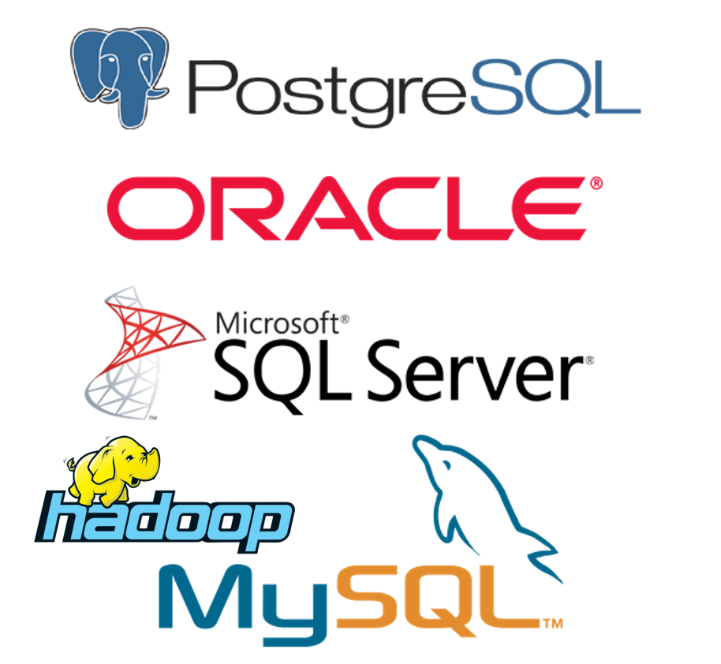


Types of DBMS Summary
Classic Relational
Oracle, IBM/DB2, MS SQL-server, Terradata, EMC
PostgreSQL (UCB), MySQL, SQLite
New Relational
In-memory, column store, streaming
Non-Relational
Graph, geographic, scientific
NoSQL
Hbase, Cassandra, MongoDB
DBMS as a service
MS Azure, Google Big Query

Slide 20
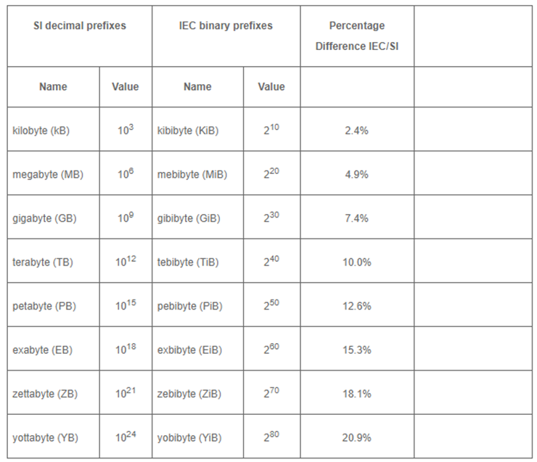
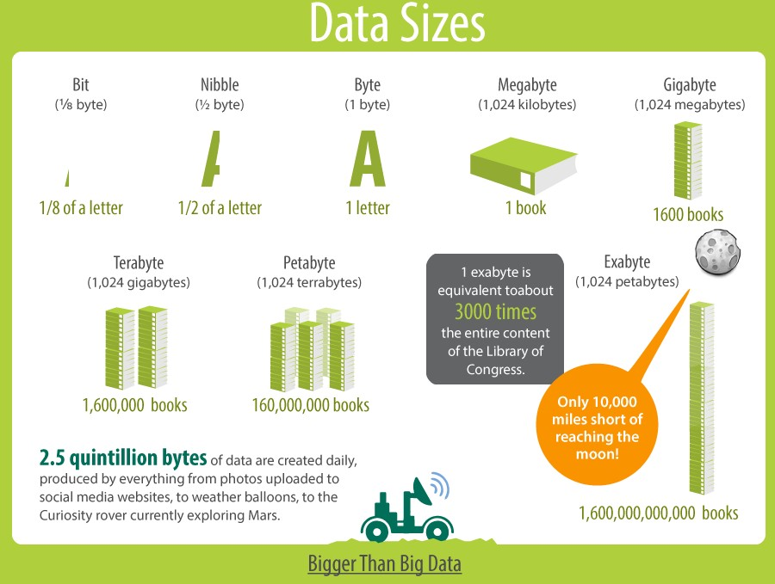
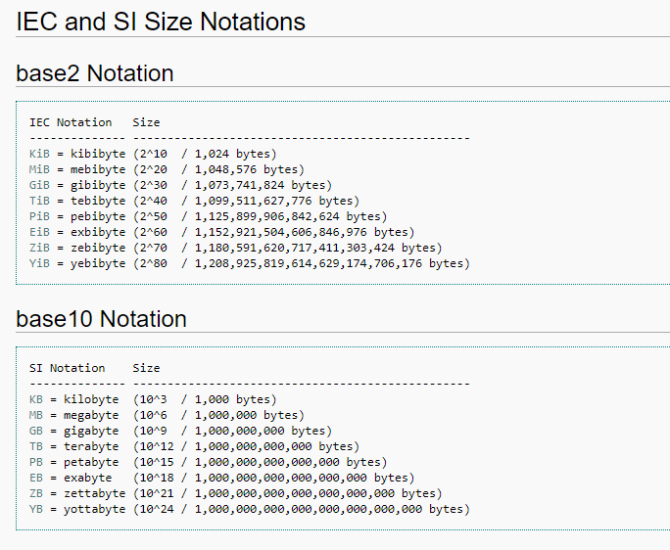
Data Sizes Reference

Slide 21
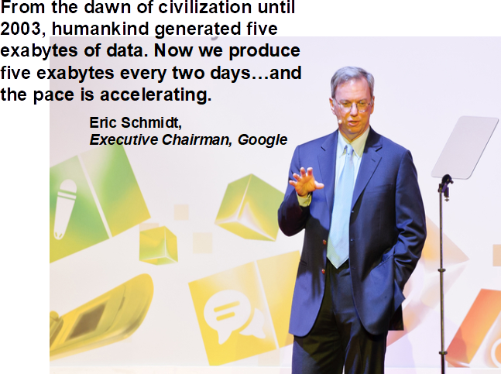
Data Production is Accelerating
21

Slide 22
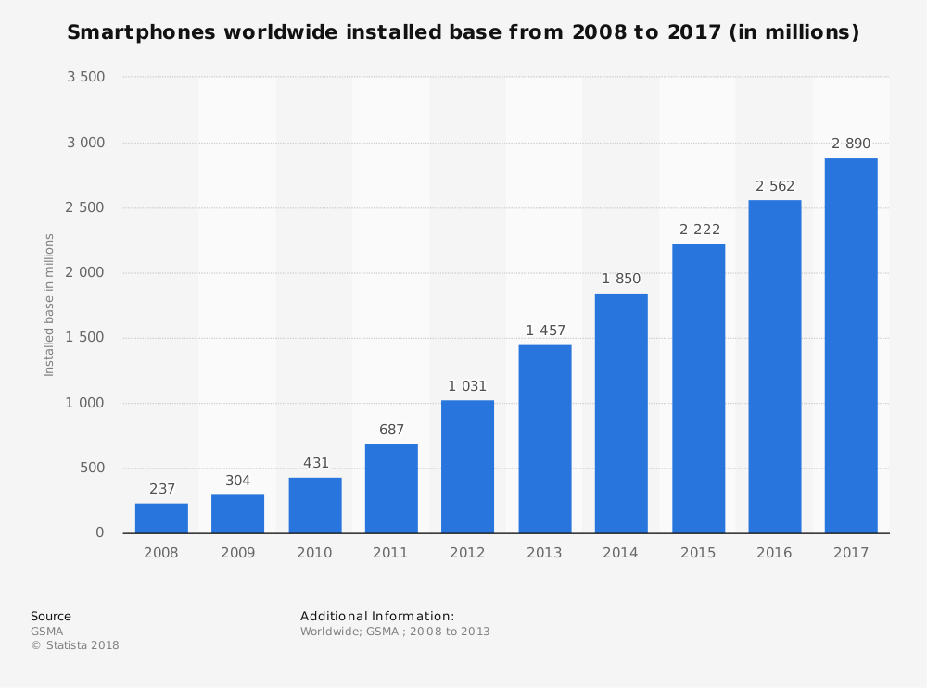
Data Production is Accelerating
22

Slide 23
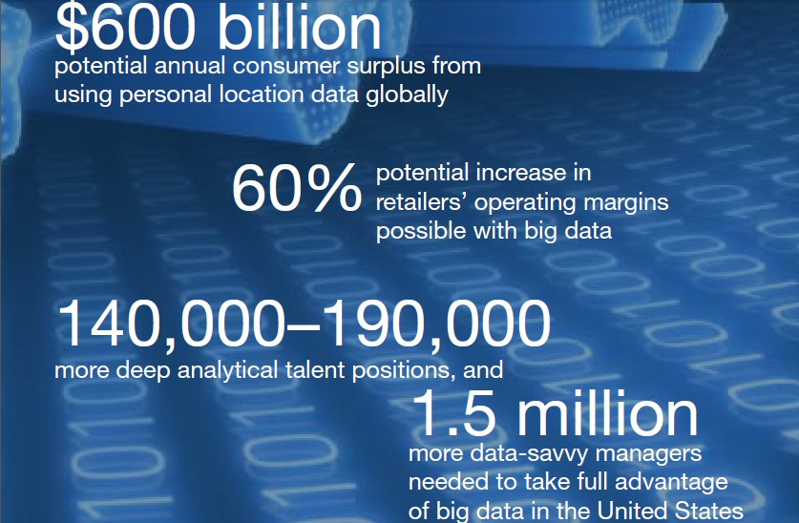
Big Data = $$$
[1] McKinsey Global Institute. Big data: The next frontier for innovation, competition, and productivity. June 2011.
23

Slide 24
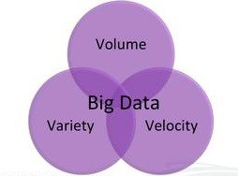
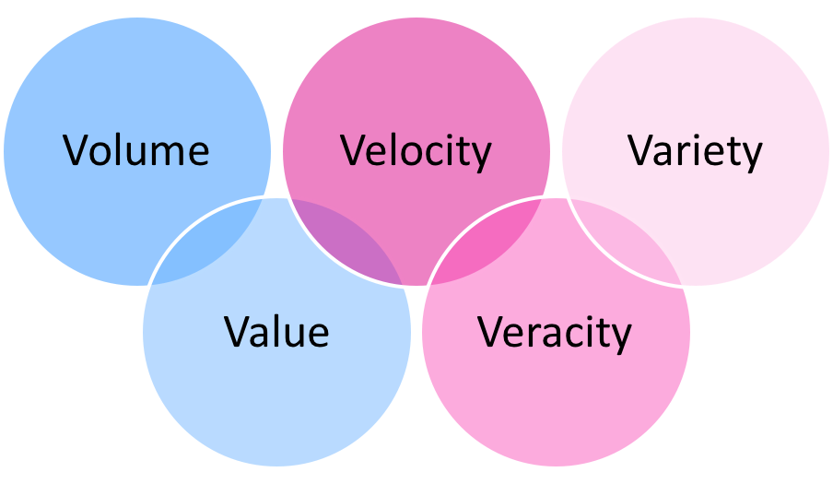
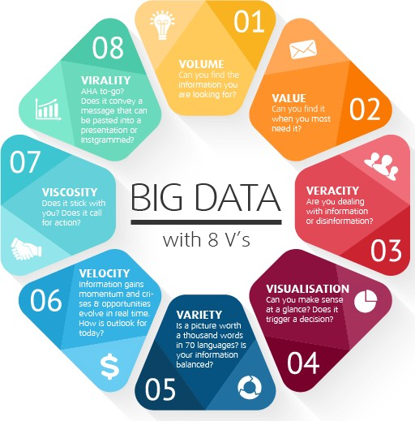

Big Data Hype
The 3-ish V’s of Big data…
Volume
Velocity
Variety
Veracity
Variability
Visualization
Value
…
24

Slide 25


Big Data Hype
Big Data analytics is a fancy new word for Knowledge Discovery in Databases!
KDD has focused on large data for decades:
VLDB since 1975
Big Data is not new
25

Slide 26


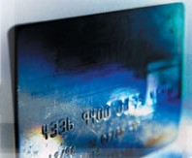
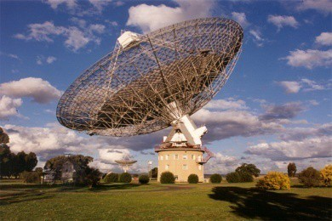









Data Collection
Digital cameras
Banks
Cash register
Astronomy
Telecommunication
Remote Sensing
WWW
Huge amounts of data are collected nowadays from different application domains
Is not feasible to analyze all these data manually
26

Slide 27

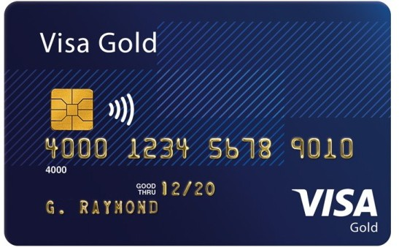




Who uses databases?
ATM
Slide from Katerina Doka, Introduction to Databases

Slide 28
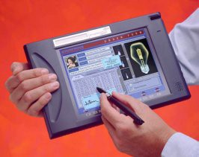

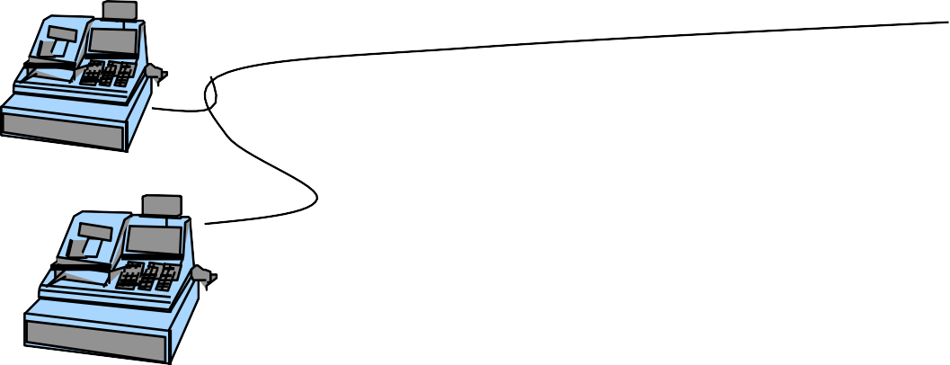
How does a DBMS work?
Queries and Views
Database
DBMS
Pro | gra | ms
Transactions
Slide from Katerina Doka, Introduction to Databases

Slide 29

Why do I want to learn it?
[1]
If this means having rare qualities that are much in demand, data scientists are already there. They are difficult and expensive to hire and, given the very competitive market for their services, difficult to retain.
[1] Harvard Business Review. Data Scientist: The Sexiest Job of the 21st Century. October 2012.

Slide 30
An Introduction to
Scientific Articles

Slide 31
Why read journal articles?
To update oneself with progress in a particular specialty/ field of study
To find out a solution for a specific problem
– test / methods
To understand certain fundamental aspects of the study area
To get an idea for carrying out a research work
You have been assigned to review the article (e.g. by a Professor or journal Editor)
To find support for one’s views
To impress others
Adapted from: How to read clinical journals: I. why to read them and how to start reading them critically. Can Med Assoc J. 1981 Mar 1; 124(5):555-8; Durbin CG., Jr How to read a scientific research paper. Respir Care. 2009;54:1366–71.

Slide 32
Types of articles published in a scientific journal
Primary literature
“core” of scientific publications
present findings on new scientific discoveries
or describe earlier work to acknowledge it and place new findings in the proper perspective
Original research articles
Surveys
Case report/case series
Conference proceedings and abstracts
Editorial
Correspondence/letters to the Editor
Secondary literature
original research information is reviewed
Narrative reviews
Systematic reviews
Meta-analysis
Book reviews
Guidelines
Commentary

Slide 33
Structure of a journal article
Title: Topic and information about the authors.
Abstract: Brief overview of the article.
Introduction: Background information, gap in research, and statement of the research hypothesis. Also: Motivation – why is this work important?
Methods: Details of how the study was conducted, procedures followed, instruments used and variables measured. Must be systematic.
Results / Experimental Evaluation: All the data of the study along with figures, tables and/or graphs.
Discussion: The interpretation of the results and implications of the study. Were the objectives met? Limitations and Future work.
Conclusion: What does all this mean?
References / Bibliography: Citations of sources from where the information was obtained.

Slide 34
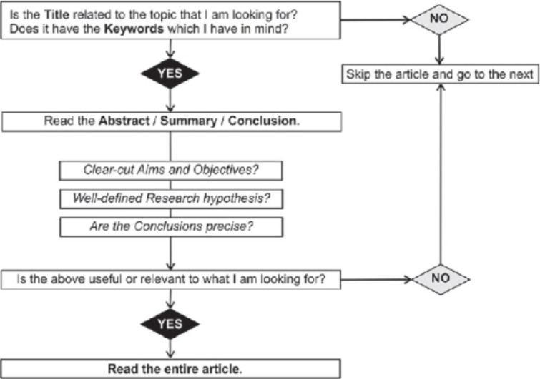
Process

Slide 35
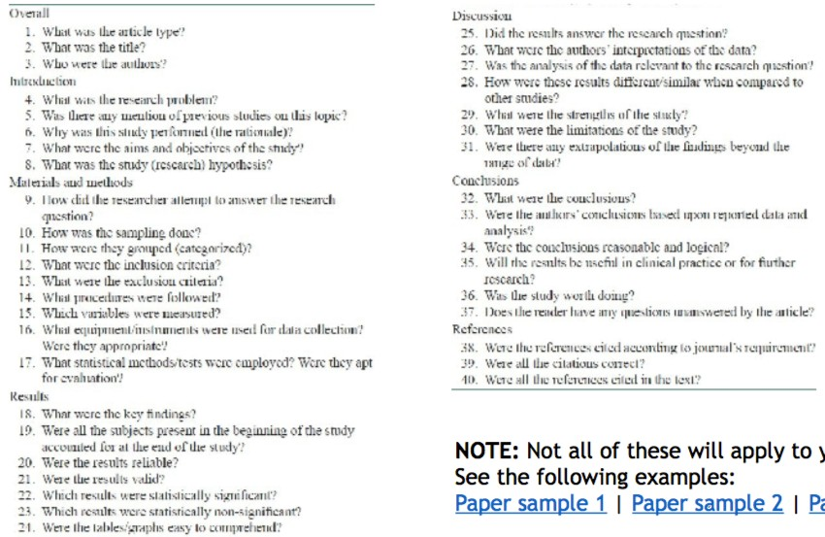
Research Questionnaire

Slide 36
It takes time
It the not the same as reading a novel or a blog
It’s a skill
It gets better with practice
It gets better as you become more familiar with the research area
The first paper may take some time
You may have to look at other resources to understand some of the paper’s content
Be patient....you’ll get there!

Slide 37
Additional resources
Google search
Google Scholar
GMU Library resources (library.gmu.edu)
Academia.edu
ResearchGate
Reddit Scholar
Email scholars if you can’t get their articles freely
Connect through VPN
– Check the following webpage for more information:
https://itservices.gmu.edu/services/view-service.cfm?customel_dataPageID_4609=6169

Slide 38

Introduction to

Slide 39

LaTeX
LaTeX is “Lamport” “TeX”
Leslie Lamport
Computer Scientist, Distributed Systems (2013 Turing Award)
Initial Developer / Inventor of LaTeX (1983)
It is a macro package built on top of the typesetting system TeX
It is the standard for scientific journal articles
Pronounced (“la” or “lay”) “tech”
TeX
Late 1970’s
Donald Knuth, Computer Scientist
Author of The Art of Computer Programming (A Computer Science Classic)
Typesetting engine that drives LaTeX (and many other macro packages)

Slide 40
Assignments

Slide 41
Assignments
Silberschatz, H.F. Korth, S. Sudarshan, Database Systems Concepts, McGraw-Hill
Read Chapter 1 “Introduction”
Setup a free account with Overleaf (www.overleaf.com)
Follow along with the recorded lectures covering LaTeX
Explore LaTeX capabilities on your own…
Next week: LaTeX (Part 2), Introduction to the Relational Model

Slide 42
Other Resources
COMPUTATIONAL AND DATA SCIENCES
Introduction to Databases class by Jennifer Widom, Stanford
http://www.db-class.org/course/auth/welcome
LaTeX tutorials
https://www.overleaf.com/learn/latex/Tutorials
https://www.latex-tutorial.com/tutorials/
List of LaTeX Math Symbols
https://www.caam.rice.edu/~heinken/latex/symbols.pdf

