Slide 1
Lecture notes
CDS 302
Scientific Data and Databases
Fall Semester 2020
Lecture 1: Introduction
Lecture: Joe Boone

Slide 2
Who am I?
Joe Boone – GMU Graduate Lecturer
jboone@gmu.edu
Academic Background
BS and MS in Computer Science from GMU
Currently a Computational Science and Informatics Ph.D. Student at GMU
Professional Career
30+ years of Systems Development and Engineering
Satellite Telecommunication Applications
Geospatial Applications
Extensive Software Development Experience
Graduate Lecturer at GMU

Slide 3
Week 1 Topics
Syllabus Review
Tools
Introduction to Database Systems
Introduction to Scientific Writing
Introduction to LaTeX and Overleaf (Part 1)
Week 1 Assignments
Notes:
Each week I’ll indicate the topics we’re covering and order in which it makes the most sense to watch

Slide 4
Syllabus Review

Slide 5
Tools

Slide 6







Software You Will Need
www.overleaf.com
www.sqlite.org/download.html www.sqlitebrowser.org/dl/
www.anaconda.com/distribution/
Notes:
We need
Overleaf
SQLite and SQLite Browser
Python – recommend Anaconda

Slide 7
An Introduction to Database Systems

Slide 8
Some Basic Terminology
Database
Database: Data collection, typically large and stored in secondary memory
Contains interrelated data on some enterprise
Database Management System (DBMS)
Database Management System: a software package (i.e., collection of programs) designed to define, manipulate, retrieve and manage data in a database
Provides an environment that is convenient and efficient to use for multiple users and applications simultaneously
Database System
DBMS + Database
Notes:
We make a distinction between Database and Database management systems
These are fuzzy definitions and you will hear them used interchangeably, usually it will be clear from the context which the speaker is referring to…

Slide 9
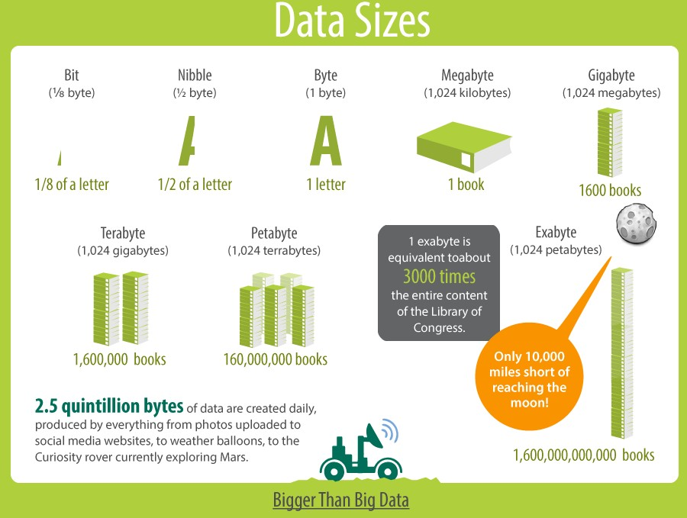
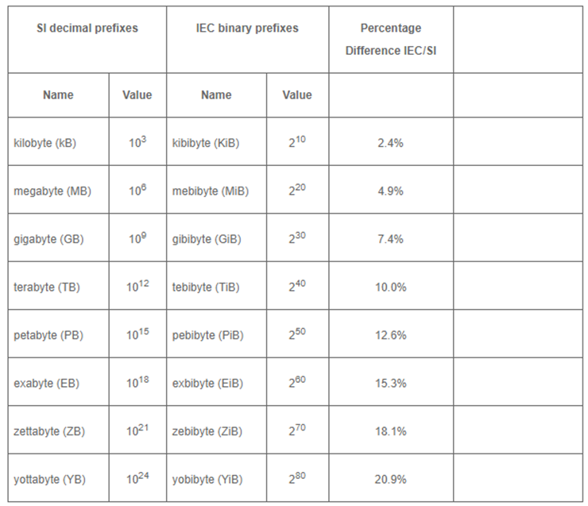
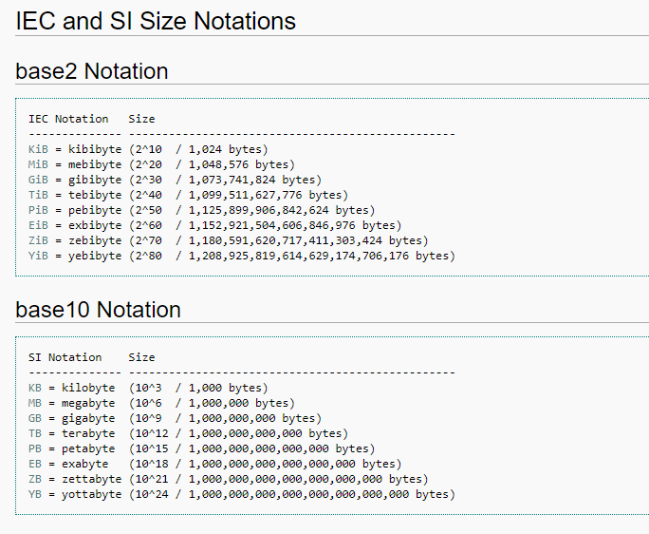
Data Sizes Reference
Notes:
Note that there are two systems used when discussing data
SI units uses base 10
IEC uses base 2
The infographic on the left is trying to develop an intuitive sense regarding by relating this to the notion of a book – so this is imprecise – but again they are just going for giving you the sense of scale involved…
Walkthrough slide…

Slide 10








Why do we need Database Systems? Data is Everywhere
Huge flood of data
Modern technology
New user mentality
2.5 Exabytes of new data every day
New applications
Innovative research
Economic Boost
“$600 billion potential annual consumer surplus from using personal location data” [1]
[1] McKinsey Global Institute. Big data: The next frontier for innovation, competition, and productivity. June 2011.
Notes:
Data is everywhere
Data is not static and is being generated continually
It represents a huge opportunity…

Slide 11
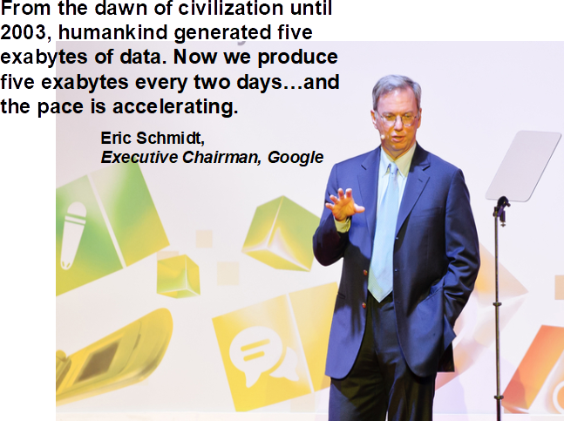
Why do we need Database Systems? Data Production is Accelerating
Quoted in 2010…
Notes:
To give you a sense in which data generation is accelerating…

Slide 12
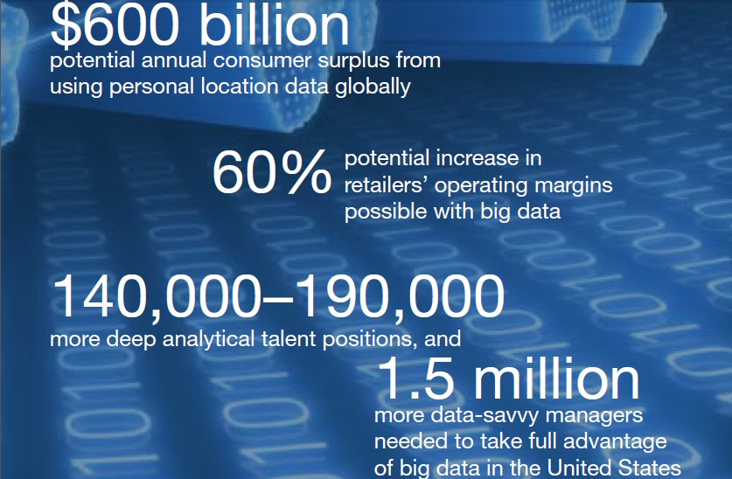
Why do we need Database Systems? Big Data = $$$
Opportunity…
[1] McKinsey Global Institute. Big data: The next frontier for innovation, competition, and productivity. June 2011.
Notes:
Opportunity…

Slide 13
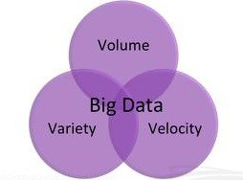
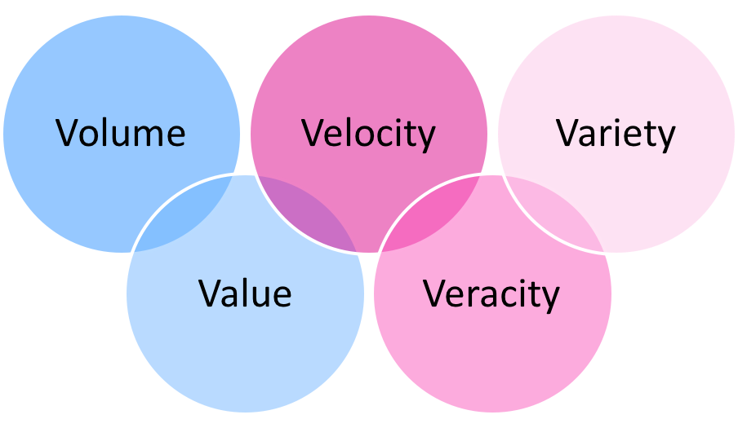
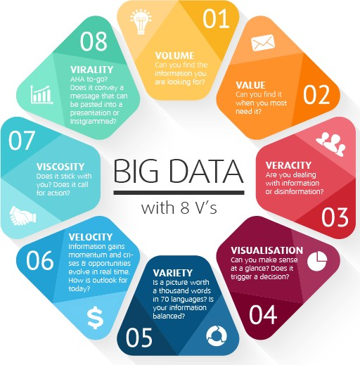

Why do we need Database Systems?
Big Data Hype
The 3-ish V’s of Big data…
Volume
Velocity
Variety
Veracity
Variability
Visualization
Value
…
Notes:
There is some hype and buzzwords associated with Big Data
The 3-ish V’s
Volume – the amount of data
Velocity – the rate at which new data is introduced
Variety – varying types of data
Etc…

Slide 14


Why do we need Database Systems? Big Data Hype
Big Data analytics is a fancy new word for Knowledge Discovery in Databases!
KDD has focused on large data for decades:
VLDB since 1975
Big Data is not new
Notes:
Not all of these ideas are new VLDB has been around since 1975
Of course what we mean by “Big” has changed over the years…

Slide 15


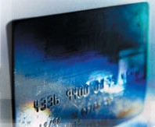
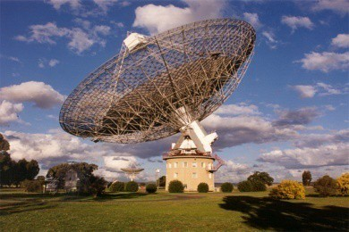



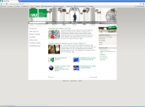





Why do we need Database Systems? Data Collection
Digital cameras
Banks
Cash register
Astronomy
Telecommunication
Remote Sensing
WWW
Huge amounts of data are collected nowadays from different application domains
Is not feasible to analyze all these data manually
Notes:
Where is data collected from…

Slide 16


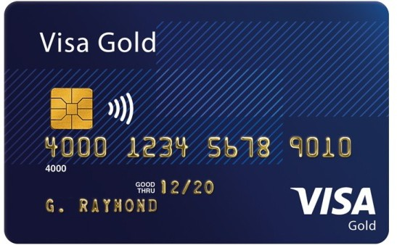






Why do we need Database Systems?
Who uses databases?
Everyone…
Slide from Katerina Doka, Introduction to Databases
Notes:
And who uses that data

Slide 17
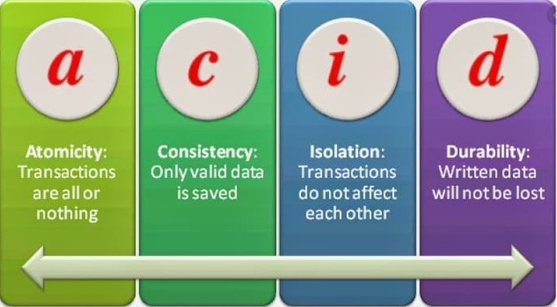
Why do we need Database Systems?
What problems do database systems solve:
Data redundancy and inconsistency
Duplication of data, different values for the same variable
Difficulty in accessing the data
Data isolation
Different files and formats complexity is hidden from users (abstracted)
Data integrity
Data is not logically consistent and rules to enforce are encoded in program code
Hard to add/modify constraints
Atomicity
Failures in the middle of a transaction leave the system in an inconsistent state
Concurrent access by multiple users
Managing security
Need to manage who has access to what data
Proprietary systems lead to vendor “lock-in” and other problems
Performance and scalability
Terminology: ACID Transaction,
Atomicity, Consistency, Isolation, Durability
Notes:
Why do we need Database Systems?
These are difficult to achieve in an adhoc fashion…

Slide 18
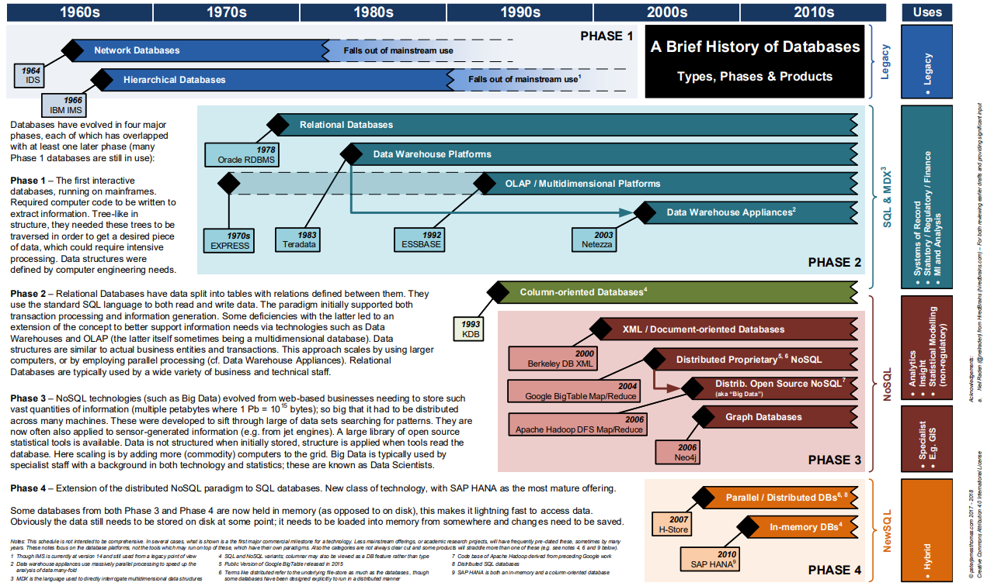
History of Database Systems
Slide from https://peterjamesthomas.com/2018/02/06/a-brief-history-of-databases/

Slide 19
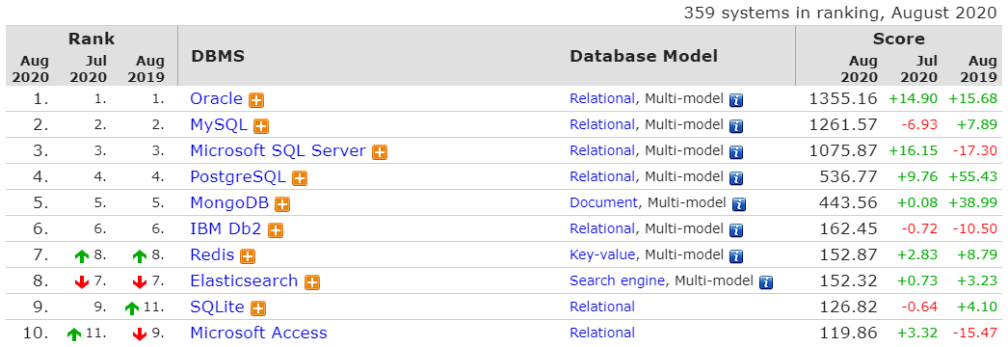
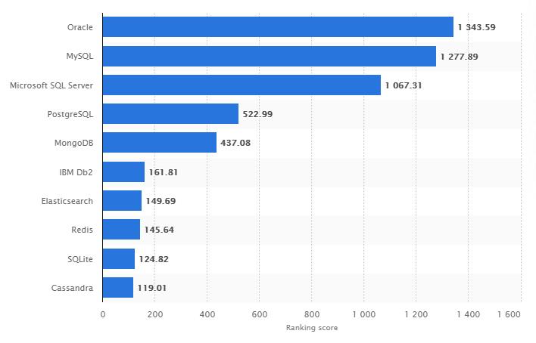
Database Systems by Popularity
https://db-engines.com/en/ranking
Relational databases are still dominant and provide a foundation to build on…
https://www.statista.com/statistics/809750/worldwide-popularity-ranking-database-management-systems/

Slide 20
Why Relational DBMS?
In our course we will be focusing on Relational Database Systems:
Data Modeling
Redundancy Control
Referential Integrity / Consistency Constraints
Efficient Query Processing
Indexing
Optimization
Operating Accuracy
Error recovery - Atomicity
Concurrent access by multiple users
Security Issues
Control access rights
Standards Based
Structured Query Language(SQL)is an ANSI and ISO standard
Kind of…
Large Legacy Base
Lots and lots of relational databases are out there…

Slide 21
Why not Relational DBMS?
Relational DBMS are designed for structured design and development
Rigidly enforced rules for data integrity
This is not applicable for all situations
In modern situations, valuable data is often generated in a relatively unstructured format:
Examples: text, log files, documents, BLOBS(binary large objects) like pictures, videos, audio, etc…
While these can sometimes be held within a relational database – these data do not neatly fall into the relational model
The system being designed not require inherent Relational DBMS features: e.g. Atomicity, data integrity checking, or may have asymmetric requirements between storing and retrieving functions

Slide 22
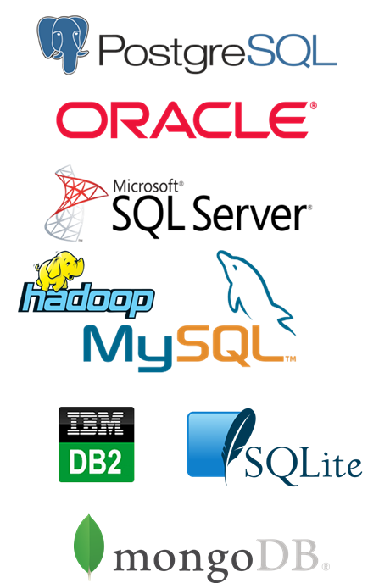
Types of Database Systems?
Relational (Classic Relational)
Oracle, IBM/DB2, MS SQL Server
PostgreSQL, MySQL, SQLite
Non-Relational (NoSQL “Not Only SQL”)
Key-Value Store (e.g. AWS DynamoDB, redis)
Document Store (e.g. MongoDB)
Wide-Column Stores (examples: Bigtable, Cassandra, Apache Hbase)
Graph Database (e.g. Neo4j)
Object-Oriented Databases
Object-Oriented Store (e.g. InterSystems Cache)
Geographic Databases
Vectors/Raster Store (e.g. ESRI Geodatabases / SpatiaLite)
First Databases…(1960s)
Network (IDS, Many-to-many relationship)
Hierarchical (IBM IMS, Parent-child relationship)
DBMS as a Service (Not really a type of database…)
Google
AWS
Notes:
Classic relational databases
New relational databases still can be accessed using standard SQL, but for column store databases, they stores data in columnar format rather than rows improving often performed queries. In-memory, and streaming databases improve are performance oriented improvements
Non-Relational, Neo4j for example is a graph database where data elements are nodes in a graph (for example people in a social network) and contains the relationships (friends)…and is optimized for storing these structures.
NoSQL – “Not Only SQL”

Slide 23
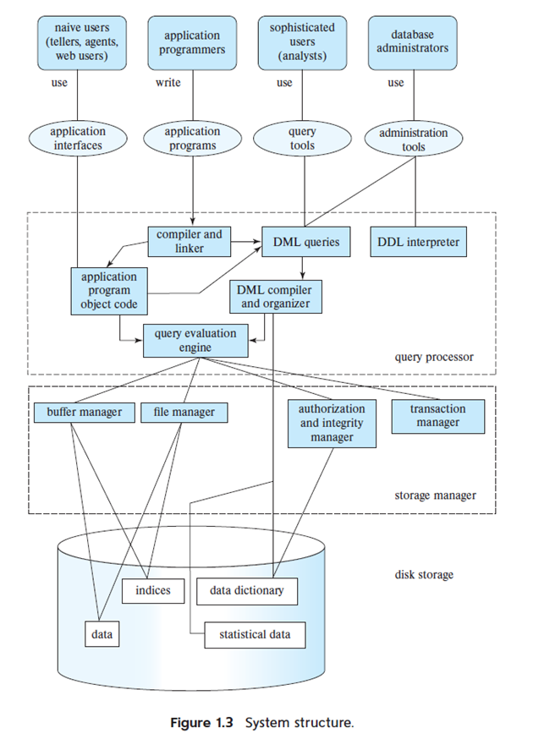
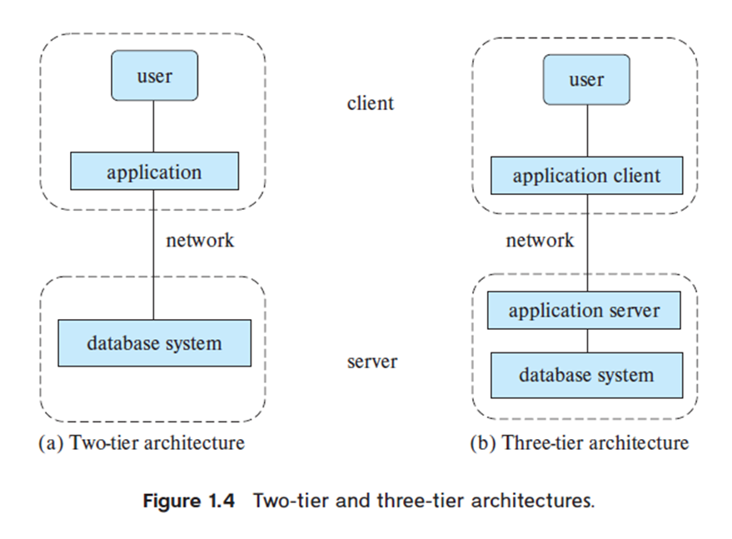
DBMS Architecture (briefly…)
From: Silberschatz et. al., Database System Concepts, McGraw-Hill

Slide 24
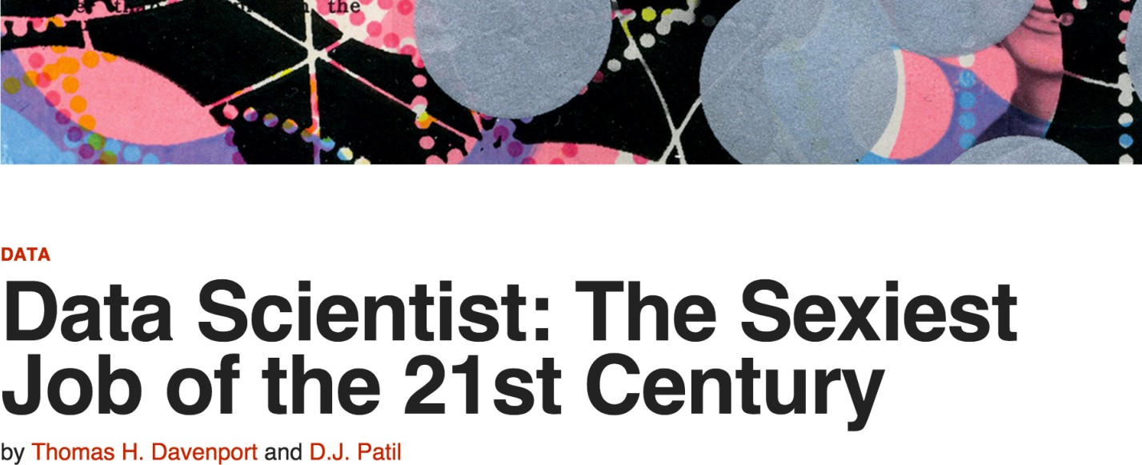
Why do I want to learn it?
[1]
If this means having rare qualities that are much in demand, data scientists are already there. They are difficult and expensive to hire and, given the very competitive market for their services, difficult to retain.
[1] Harvard Business Review. Data Scientist: The Sexiest Job of the 21st Century. October 2012.

Slide 25
An Introduction to
Scientific Writing

Slide 26
Why read journal articles?
To stay current with the progress in a field of study
To find the solution for a specific problem
Test / Methods
To understand the fundamental background in an area of study
To get an idea for carrying out further research
You have been assigned to review the article by a Professor or Journal Editor
To support, refine, refute your scientific beliefs or views
To impress others…
Adapted from: How to read clinical journals: I. why to read them and how to start reading them critically. Can Med Assoc J. 1981 Mar 1; 124(5):555-8; Durbin CG., Jr How to read a scientific research paper. Respir Care. 2009;54:1366–71.

Slide 27
Types of articles published in a scientific journal
Primary literature
“Core” of scientific publications
Present findings on new scientific discoveries
Describe earlier work to acknowledge it and place new findings in the proper perspective
Original research articles
Surveys
Case report/case series
Conference proceedings and abstracts
Editorial
Correspondence/letters to the Editor
Secondary literature
Original research information is reviewed
Narrative reviews
Systematic reviews
Meta-analysis
Book reviews
Guidelines
Commentary

Slide 28
Structure of a journal article
Title: Topic and information about the authors.
Abstract: Brief overview of the article.
Introduction: Background information, gap in research and statement of the research hypothesis. Include motivation – why is this important.
Methods: Details on how the study was conducted, procedures followed, instruments used, and variables measured. Must be systematic.
Results/Experimental Evaluation: All the data of the study along with figures, tables and/or graphs.
Discussion: The interpretation of the results and implications of the study. Were the objectives met? Limitations and future work.
Conclusion: What does all this mean?
References/Bibliography: Citations of sources from where the information was retained.

Slide 29
Reading (Filtering) process
Is the Title related to the topic that I am looking for? Does it have the Keywords which I have in mind?
No
Skip the article and go to the next
Yes
Read the Abstract/Summary/Conclusion
Are the aims and Objectives clear?
Is the Research Hypothesis well-defined?
Are the Conclusions precise?
No
Is the above useful or relevant to what I am looking for?
Yes
Read the entire article

Slide 30
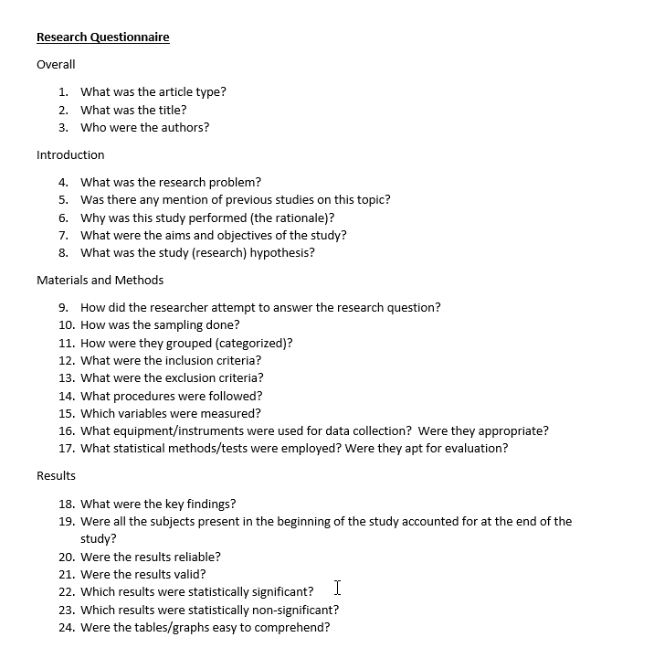
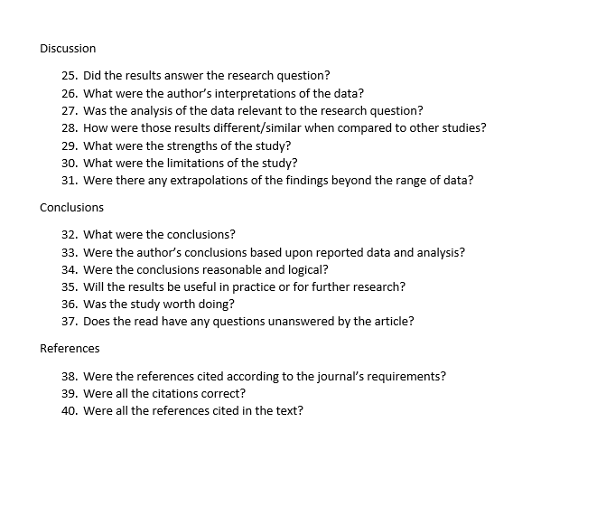
Research Questionnaire

Slide 31
It takes time…
It the not the same as reading a novel or a blog
It’s a skill
It gets better with practice
It gets better as you become more familiar with the research area
The first paper may take some time
You may have to look at other resources to understand some of the paper’s content
Be patient....you’ll get there!

Slide 32
Additional resources
Google Search
Google Scholar
GMU Library resources (library.gmu.edu)
Academia.edu
ResearchGate
Reddit Scholar
Email scholars if you can’t get their articles freely
Citations managers like Zotero or Mendeley
Help you keep your research materials organized and in one place
Help you generate a bibliography

Slide 33

Introduction to

Slide 34

LaTeX
LaTeX is “Lamport” + “TeX”
Leslie Lamport
Computer Scientist, Distributed Systems (2013 Turing Award)
Initial Developer / Inventor of LaTeX (1983)
LaTeX is a tool for document preparation built on top of the typesetting system TeX
It is the standard for scientific journal articles
Pronounced (“la” or “lay”) + “tech”
TeX
Late 1970’s
Donald Knuth, Computer Scientist (Turing Award 1974, many awards…)
Author of The Art of Computer Programming (classic CS text)
Typesetting engine that drives LaTeX and other higher-level packages

Slide 35
Assignments
Notes:
Each week I’ll review the assignments for next week
These are not always graded assignments but will include suggested readings, etc…

Slide 36
Assignments Week 1
Setup a free account with Overleaf (www.overleaf.com)
Follow along with the recorded lectures covering LaTeX
Explore LaTeX on your own…(Next week we will cover Part 2)
Suggested reading: Silberschatz et. al., Database System Concepts, McGraw-Hill, Chapter 1
Notes:
No graded assignments this week
You’ll need Overleaf for next weeks assignments and to follow along with the lectures this week
Suggested reading from Silberschatz (slides are online, you may be able to find the book online as well)

Slide 37
Other Resources
COMPUTATIONAL AND DATA SCIENCES
Introduction to Databases class by Jennifer Widom, Stanford
http://www.db-class.org/course/auth/welcome
LaTeX tutorials
https://www.overleaf.com/learn/latex/Tutorials
https://www.latex-tutorial.com/tutorials/
List of LaTeX Math Symbols
https://www.caam.rice.edu/~heinken/latex/symbols.pdf
Notes:
Some other resources…
LaTeX Math Symbols will be covered in Week 2 lectures, but if you follow my lectures and the suggested tutorials you probably be able to begin using these right away

