Slide 1

PharmaSafe OCR
Automated prescription information extraction
ROI Detection → Handwritten OCR → Drug Name Correction
Technical Documentation Presentation
PharmaSafe OCR
01

Slide 2
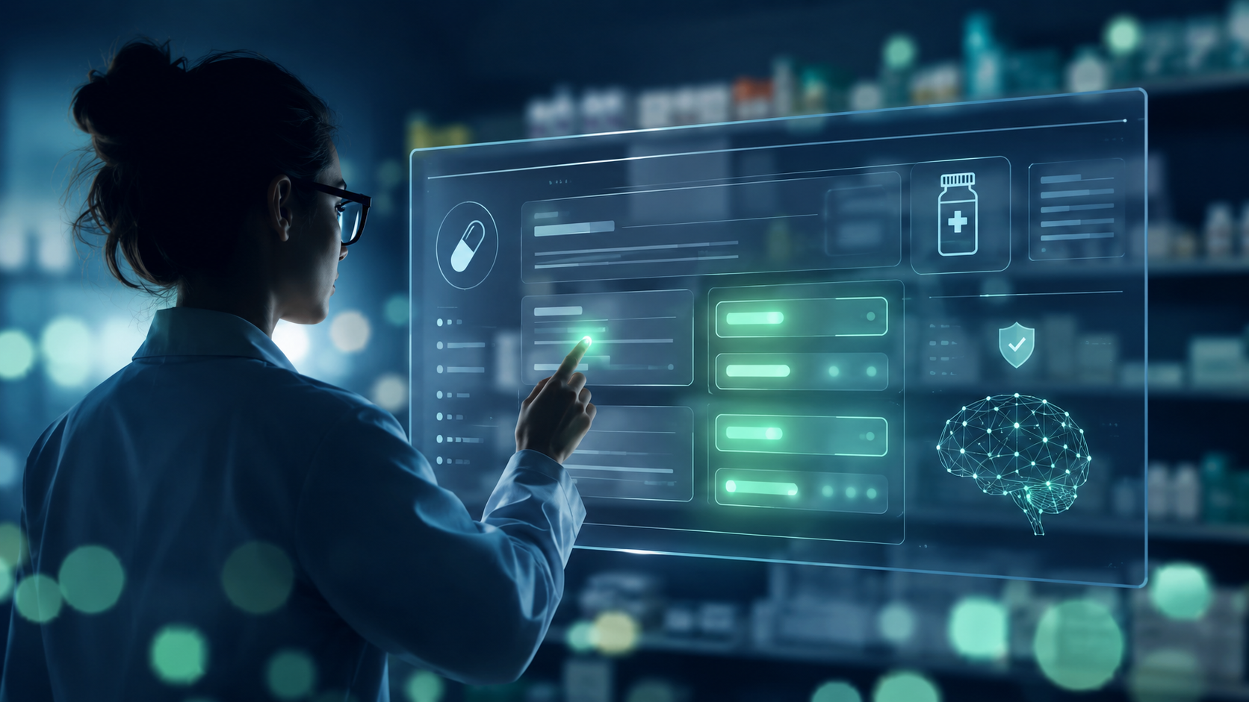
The clinical problem
Handwritten prescriptions are high-variance documents in a safety-critical workflow
Prescriptions are often written quickly, contain abbreviations, use mixed languages, and vary heavily by physician layout. PharmaSafe turns that messy document into structured medication information that can be reviewed and used downstream.
3
1,213
90.8%
target fields: name, dose, type
detections in pipeline test run
TrOCR exact match on test set
Goal: readable, standardized medication data
PharmaSafe OCR
02

Slide 3
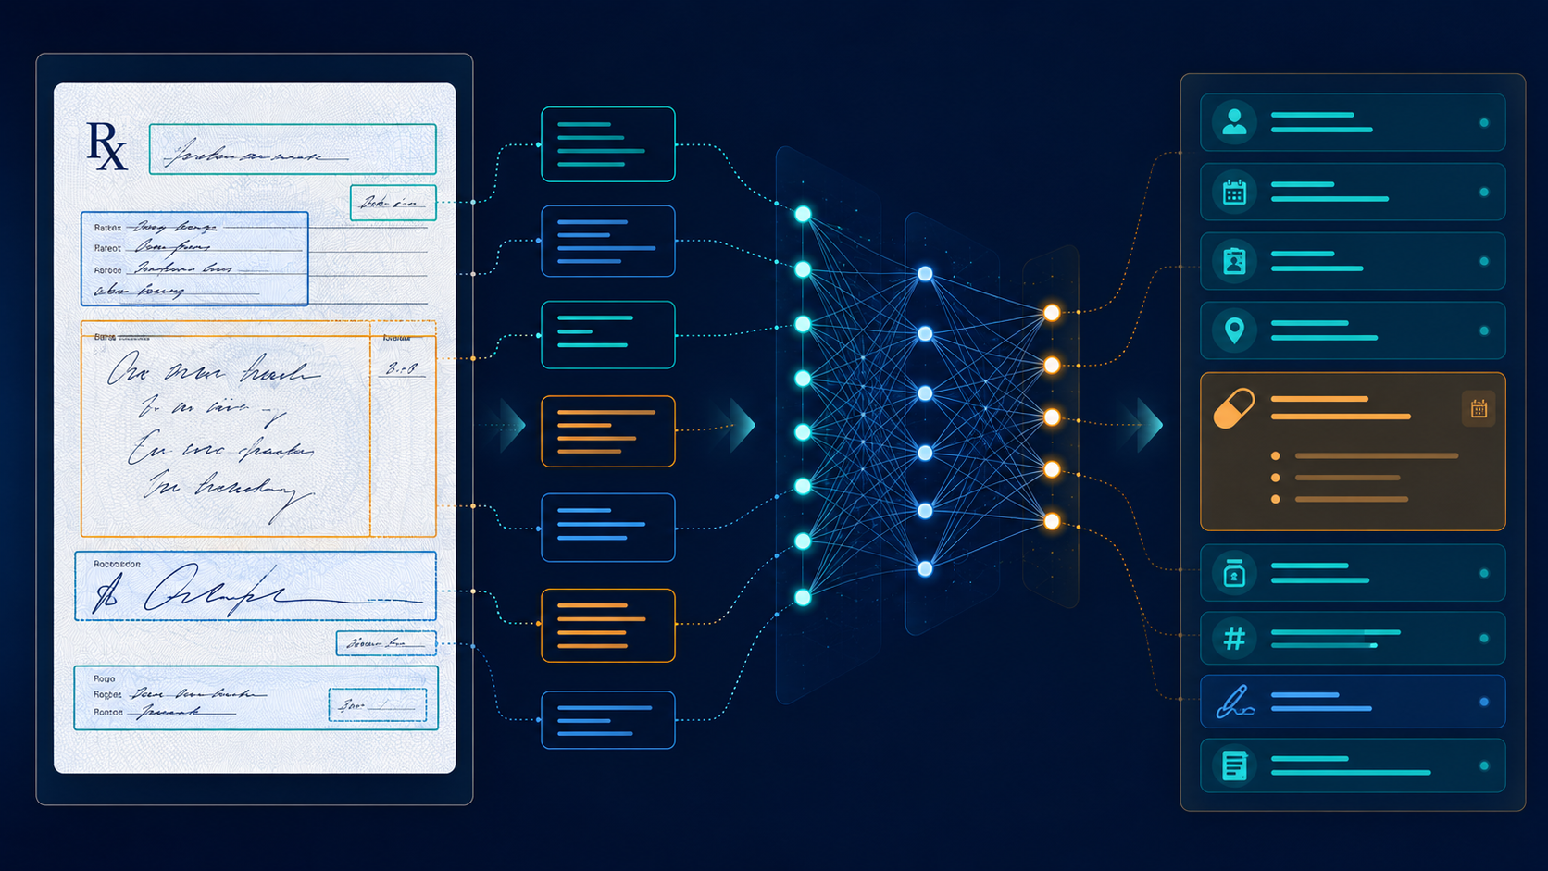
System architecture
A modular three-stage pipeline built for traceability and independent improvement
1
ROI Detection
YOLO11n
2
Handwritten OCR
TrOCR
3
Drug Correction
DrugBank + Local BD
INTERMEDIATE OUTPUTS
Bounding boxes + class labels
Raw OCR strings per crop
Corrected drug names + confidence
Why modular? each stage can be trained, evaluated, debugged and improved independently.
Conceptual pipeline: prescription image to structured data
PharmaSafe OCR
03

Slide 4
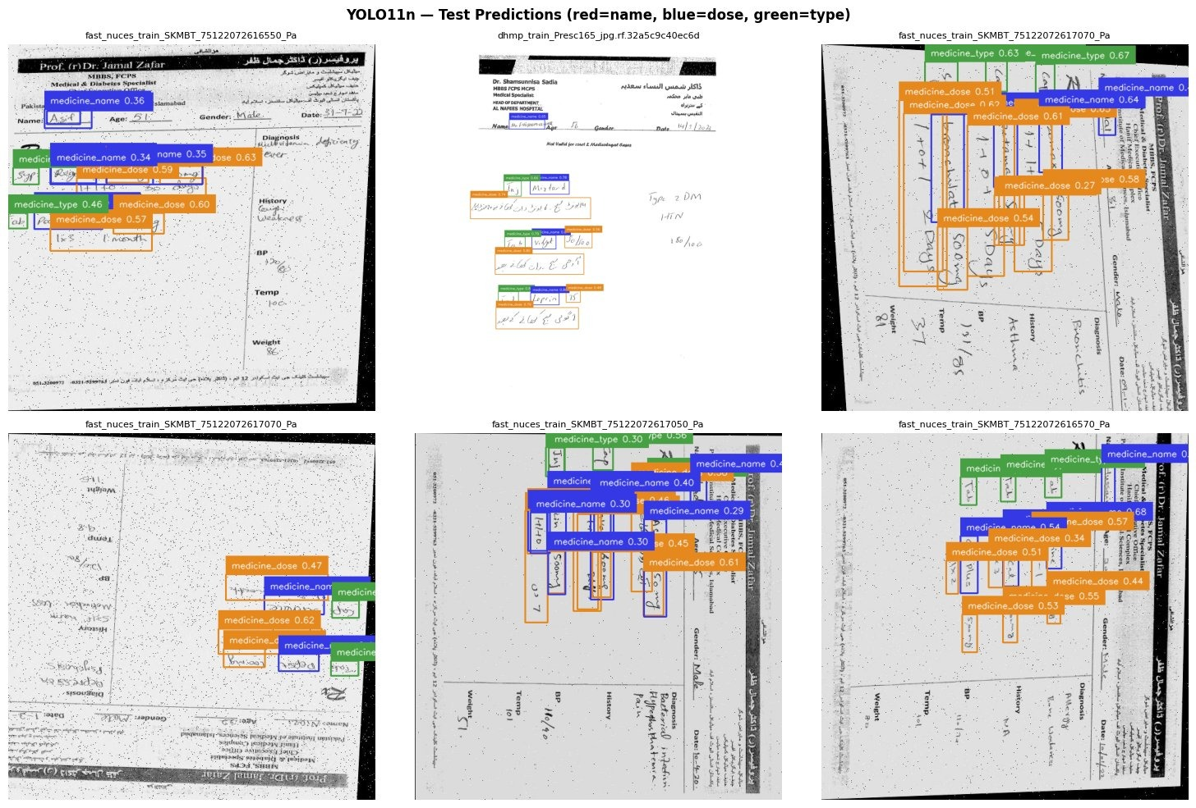
Stage 1 — ROI detection with YOLO11n
Locating medicine name, dose and type regions inside full prescription images
MODEL CHOICE
YOLO11n was selected because it gives fast single-pass detection, has fewer parameters for the small-data setting, and supports efficient transfer learning.
TRAINING DATA
• 3 Roboflow prescription datasets merged • Labels remapped into medicine_name, medicine_dose, medicine_type • Stratified 70/15/15 split; ~1,200 images total
0.7094
0.7840
0.7959
overall mAP@50
mean F1 score
mean recall
YOLO11n test predictions; colors represent field classes
PharmaSafe OCR
04

Slide 5
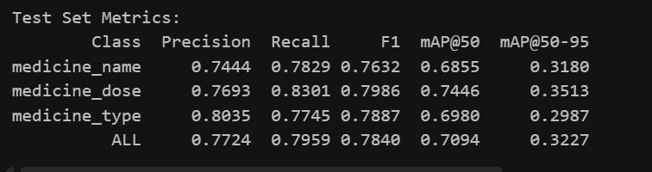
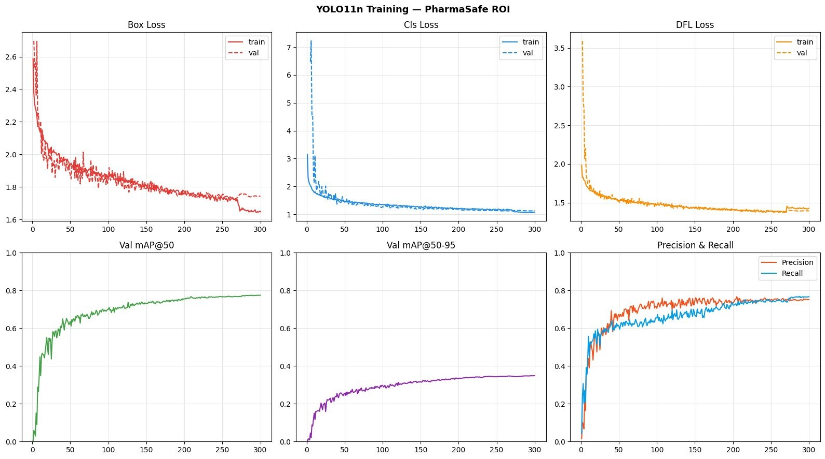
Stage 1 performance profile
Detection quality is strongest at the practical IoU@50 threshold
Printed test-set metrics
Training curves across 300 epochs
Losses converge cleanly. The mAP@50-95 values are lower mainly because tight localization is hard with loosely annotated handwritten regions.
PharmaSafe OCR
05

Slide 6
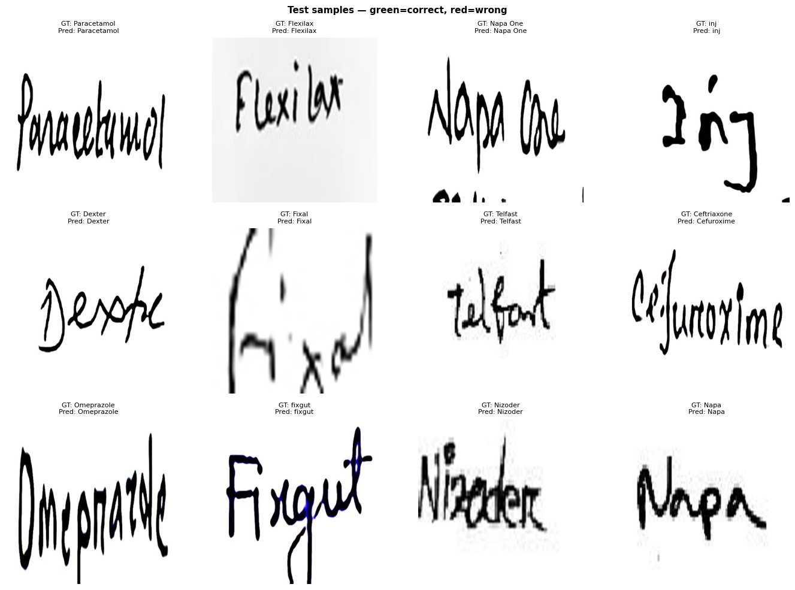
Stage 2 — handwritten OCR with TrOCR
Reading each cropped text region using a transformer OCR model
INPUT / OUTPUT
Input: 384×384 RGB crop from Stage 1
Output: raw text string per crop
WHY TROCR?
• Traditional OCR struggles with handwriting • TrOCR is pre-trained for handwritten text • Encoder-decoder design handles variable-length drug names
FINE-TUNING STRATEGY
Stage A: decoder only, 5 epochs
Stage B: full model, lower LR
TrOCR test samples: green = exact match, red = incorrect
PharmaSafe OCR
06

Slide 7
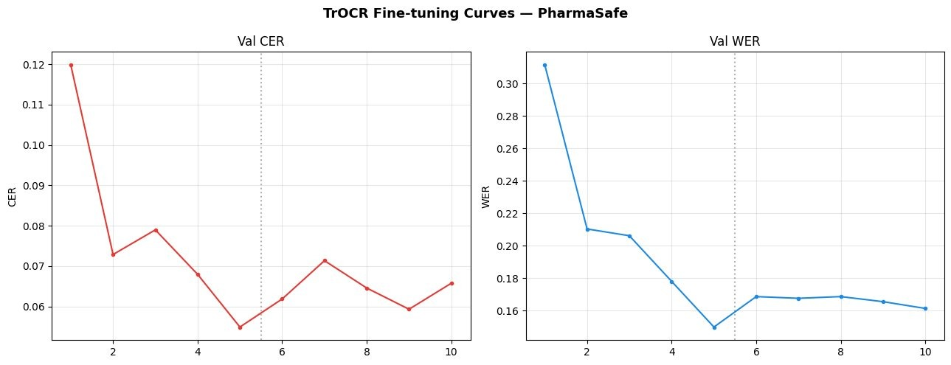
Stage 2 results
Strong word-level performance on handwritten drug names
90.8%
0.0647
exact match on test set (830/914)
character error rate
0.161
~0.91
word error rate
Drug F1 using rapidfuzz ≥ 90
Validation CER and WER during fine-tuning
Main failure mode: visually similar drug names, e.g., cephalosporin antibiotics that look close in handwriting.
Known limitation: numeric dosage OCR can suffer from TrOCR letter bias, e.g., 500mg → SOO mg.
PharmaSafe OCR
07

Slide 8
Stage 3 — drug name spell correction
Converting raw OCR into standardized pharmaceutical names
DrugBank + local BD vocabulary
270,000+ entries
Raw OCR text
Corrected drug name
+ confidence tier
TWO-PASS ALGORITHM
VOCABULARY COMPOSITION
• Pass 1: exact case-insensitive lookup • Pass 2: fuzzy matching with token_sort_ratio • High confidence ≥95; low confidence 75–94; below 75 stays unrecognized
Generic names
Chemical synonyms
Commercial brands
Local Bangladeshi drug labels
PharmaSafe OCR
08

Slide 9
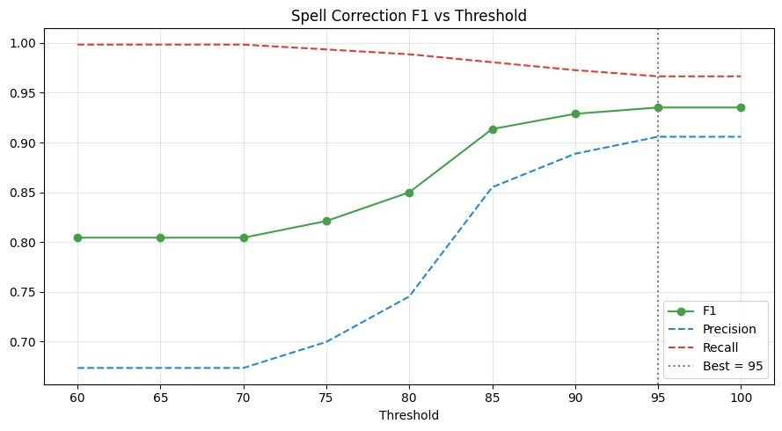
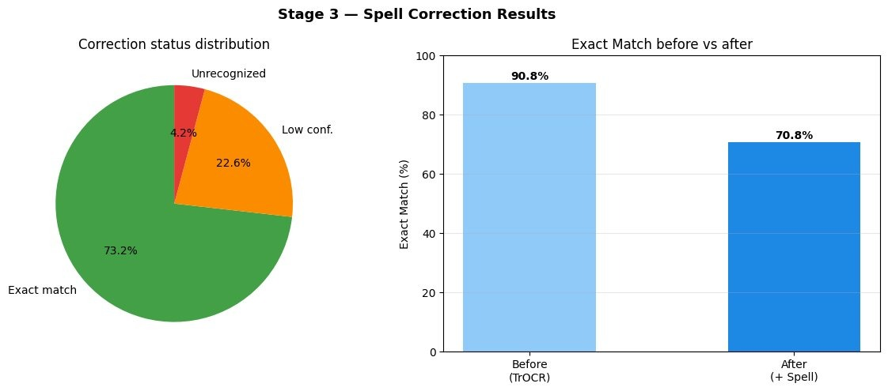
Stage 3 impact
Correction improves standardization while flagging uncertain cases
Threshold tuning for precision/recall/F1
Correction status distribution and before/after exact match
73.2%
669 / 914
Low-confidence corrections are intentionally flagged for review instead of silently accepted, which is safer for medical workflows.
DrugBank exact match after correction
exact corrected predictions
PharmaSafe OCR
09

Slide 10
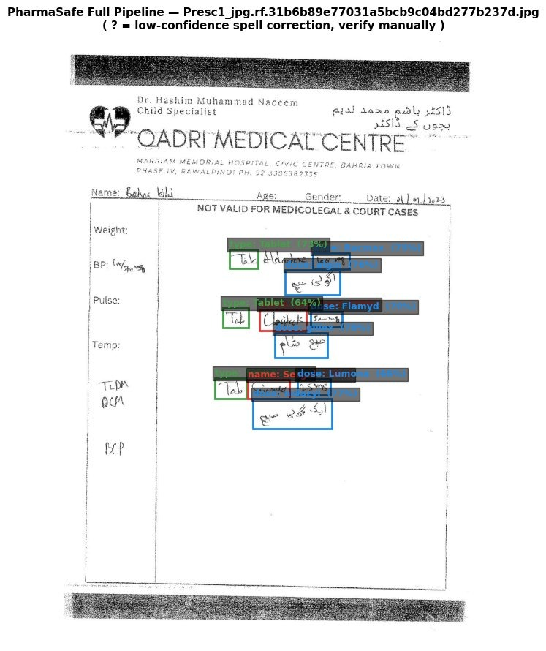
Full pipeline integration
How one prescription image moves through the system
YOLO boxes
conf ≥ 0.25
Crop + 4px padding
resize 384×384
TrOCR beam search
4 beams
Drug correction
name fields only
Full prescription image
FINAL CSV METADATA
dataset, image path, predicted class, bounding box, YOLO confidence, raw OCR output, corrected name, correction score, status flag
Header filter excludes top 35% of the image to avoid clinic letterhead false positives.
Example full-pipeline prediction on one prescription
PharmaSafe OCR
10

Slide 11
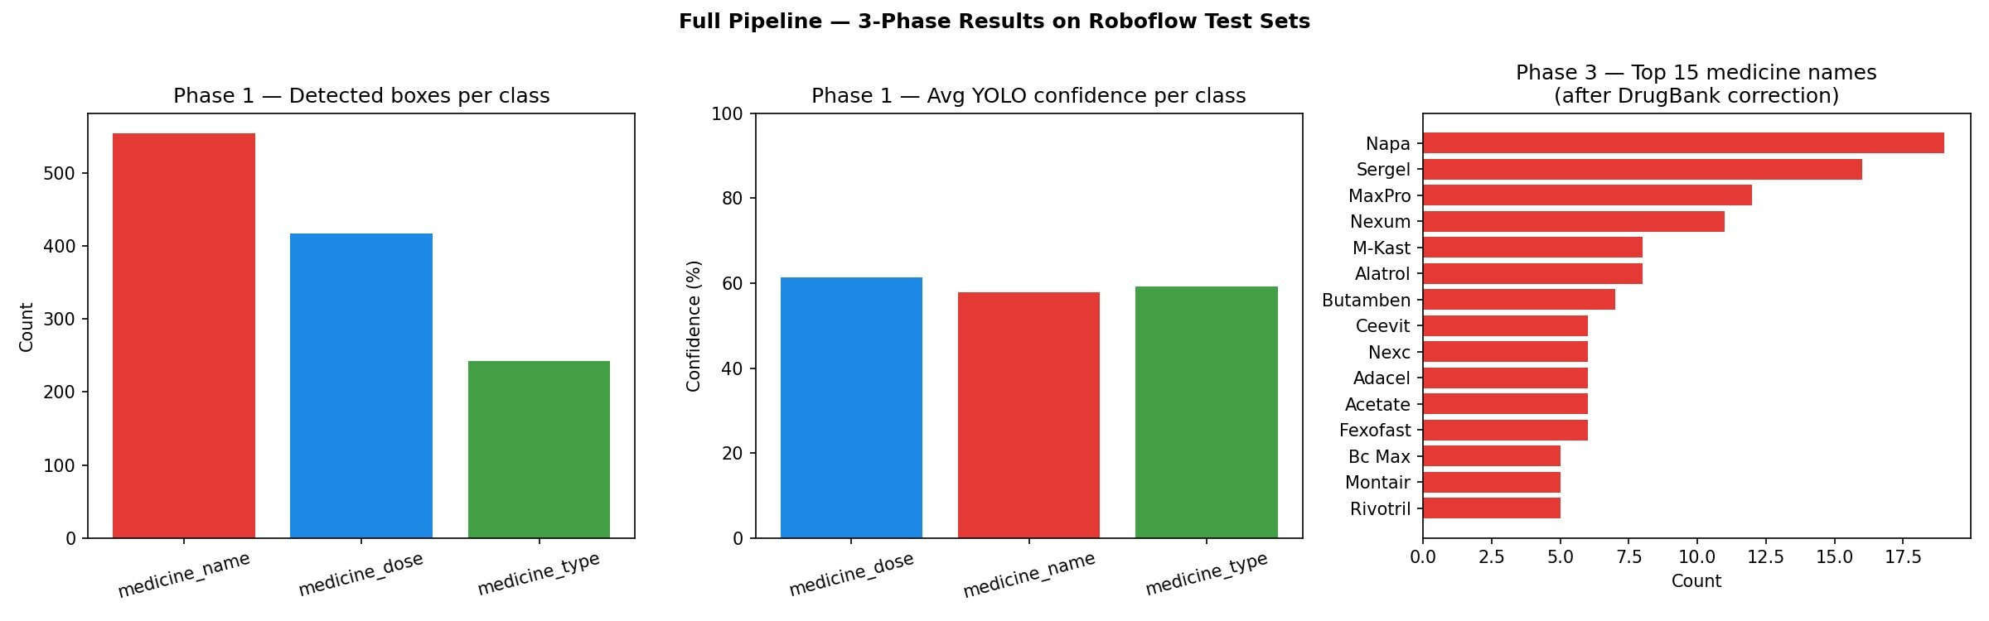
Pipeline test-set results
111 images processed across FAST NUCES and UEM test sets
1,213
554
total detections
medicine_name boxes
417
242
medicine_dose boxes
medicine_type boxes
106 of 111 images produced at least one detection. TrOCR returned non-empty output for all 1,213 crops.
Detected boxes, average confidence and top corrected names
PharmaSafe OCR
11

Slide 12
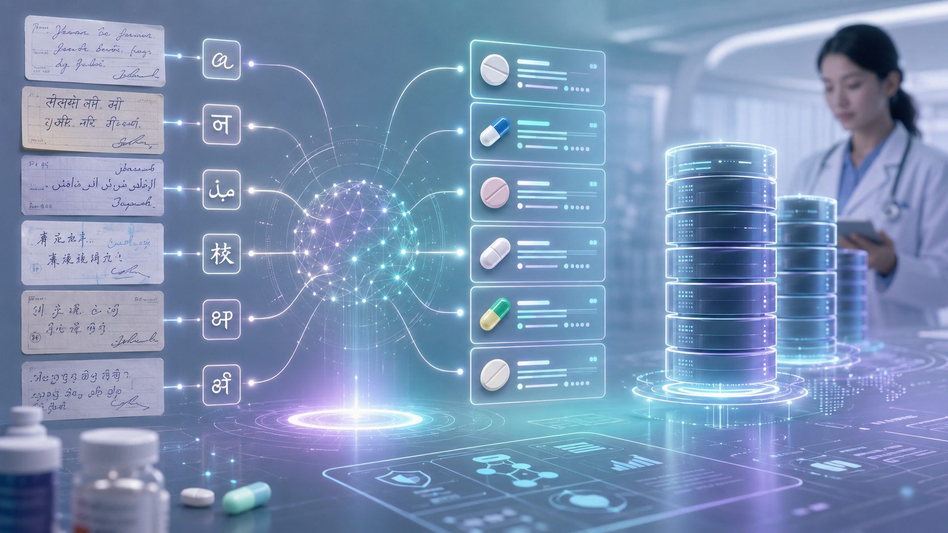
Limitations and future work
The main bottleneck is data fragmentation, not model architecture
CURRENT LIMITATIONS
HIGHEST-IMPACT NEXT STEPS
• No single public dataset covers detection, OCR and standardized names together • Cross-dataset domain gap between YOLO crops and TrOCR word-level training data • Numeric dosage OCR remains difficult • English drug-name coverage only; multilingual text is degraded
• Build a unified prescription dataset with boxes, OCR text and standard mappings • Train larger YOLO variants when more data is available • Add multilingual OCR for Bengali / Urdu scripts • Use active learning with pharmacist verification • Explore pharmacological language models for correction
Future direction: human-in-the-loop validation and wider language coverage
PharmaSafe OCR
12

Slide 13
Key takeaways
A traceable pipeline for prescription information extraction
Detect
Read
Correct
Review
PharmaSafe combines YOLO11n, TrOCR and domain-aware fuzzy correction to transform handwritten prescriptions into structured medication data with inspectable intermediate outputs.
Best current path forward: create a unified dataset and add pharmacist-in-the-loop correction to continuously improve the system.
PharmaSafe OCR
13

