Slide 1
Create Content Review and Publication Processes with Liferay DXP
Liferay DXP Basics
Business
Liferay DXP 7.4

Slide 2
Key Module Takeaways
Custom workflows can be created to define complex review processes that reflect and/or improve existing practices.
Page and Content Auditing can be used to efficiently sort through a page’s content to check for issues with categorization, accessibility, and SEO, thus improving the end quality of the content.
Publications can be created to make and schedule Site changes simultaneously across multiple Users and pages.

Slide 3
Exercise Prerequisites
Unzipped module exercise files in the following folder structure:
Windows: C:\liferay
Unix Systems: [user-home]/liferay
A running instance of Liferay DXP or CE 7.4
The Marvin Robotics Site created
For more information on starting a new instance of Liferay DXP, check out the Liferay Foundations: Introduction to Liferay DXP course

Slide 4
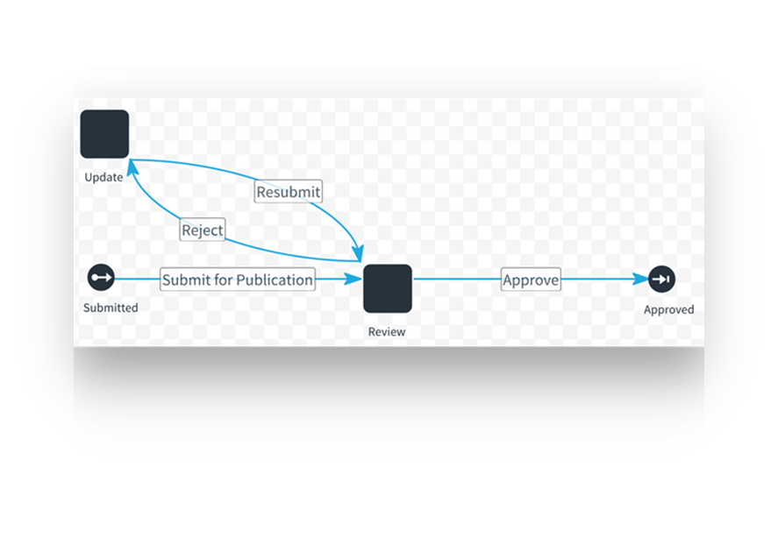
Use Case: Marvin Robotics
Need to address the following issues:
Product-related content that is created needs to be approved by both Tricia McMillan (After Sales Manager) and Ford Dent (Ecommerce Manager)
Marketing content needs to be properly timed to publish alongside ongoing promotions

Slide 5
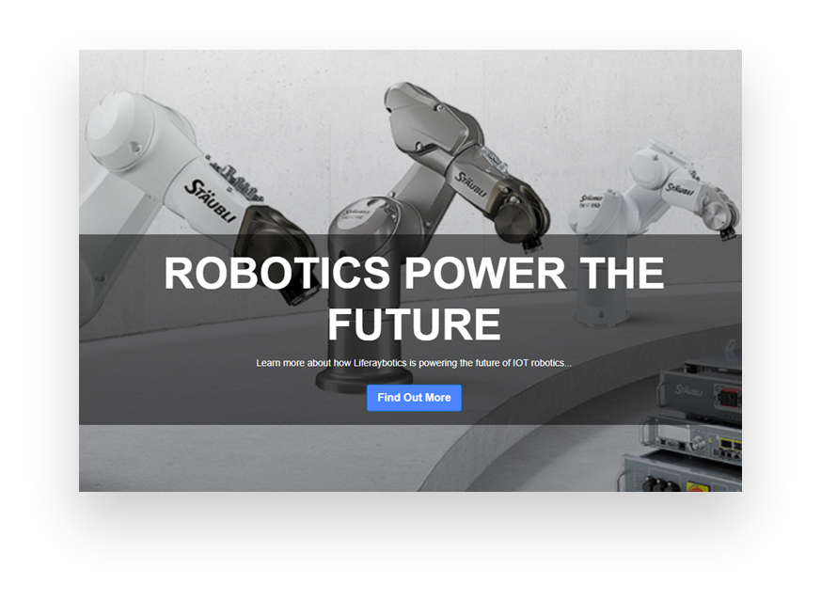
Use Case: Marvin Robotics
Need to address the following issues:
Multiple Users in charge of making edits across Marvin Robotics Sites, occasionally resulting in conflicting changes
Web Team supervisor wants the ability to review and approve multiple changes simultaneously

Slide 6


Relevant KPIs
Increase the number of review options available for created content
Decrease the number of errors in released content
Reduce the amount of time that content spends in review

Slide 7
Creating Custom Workflow Definitions

Slide 8
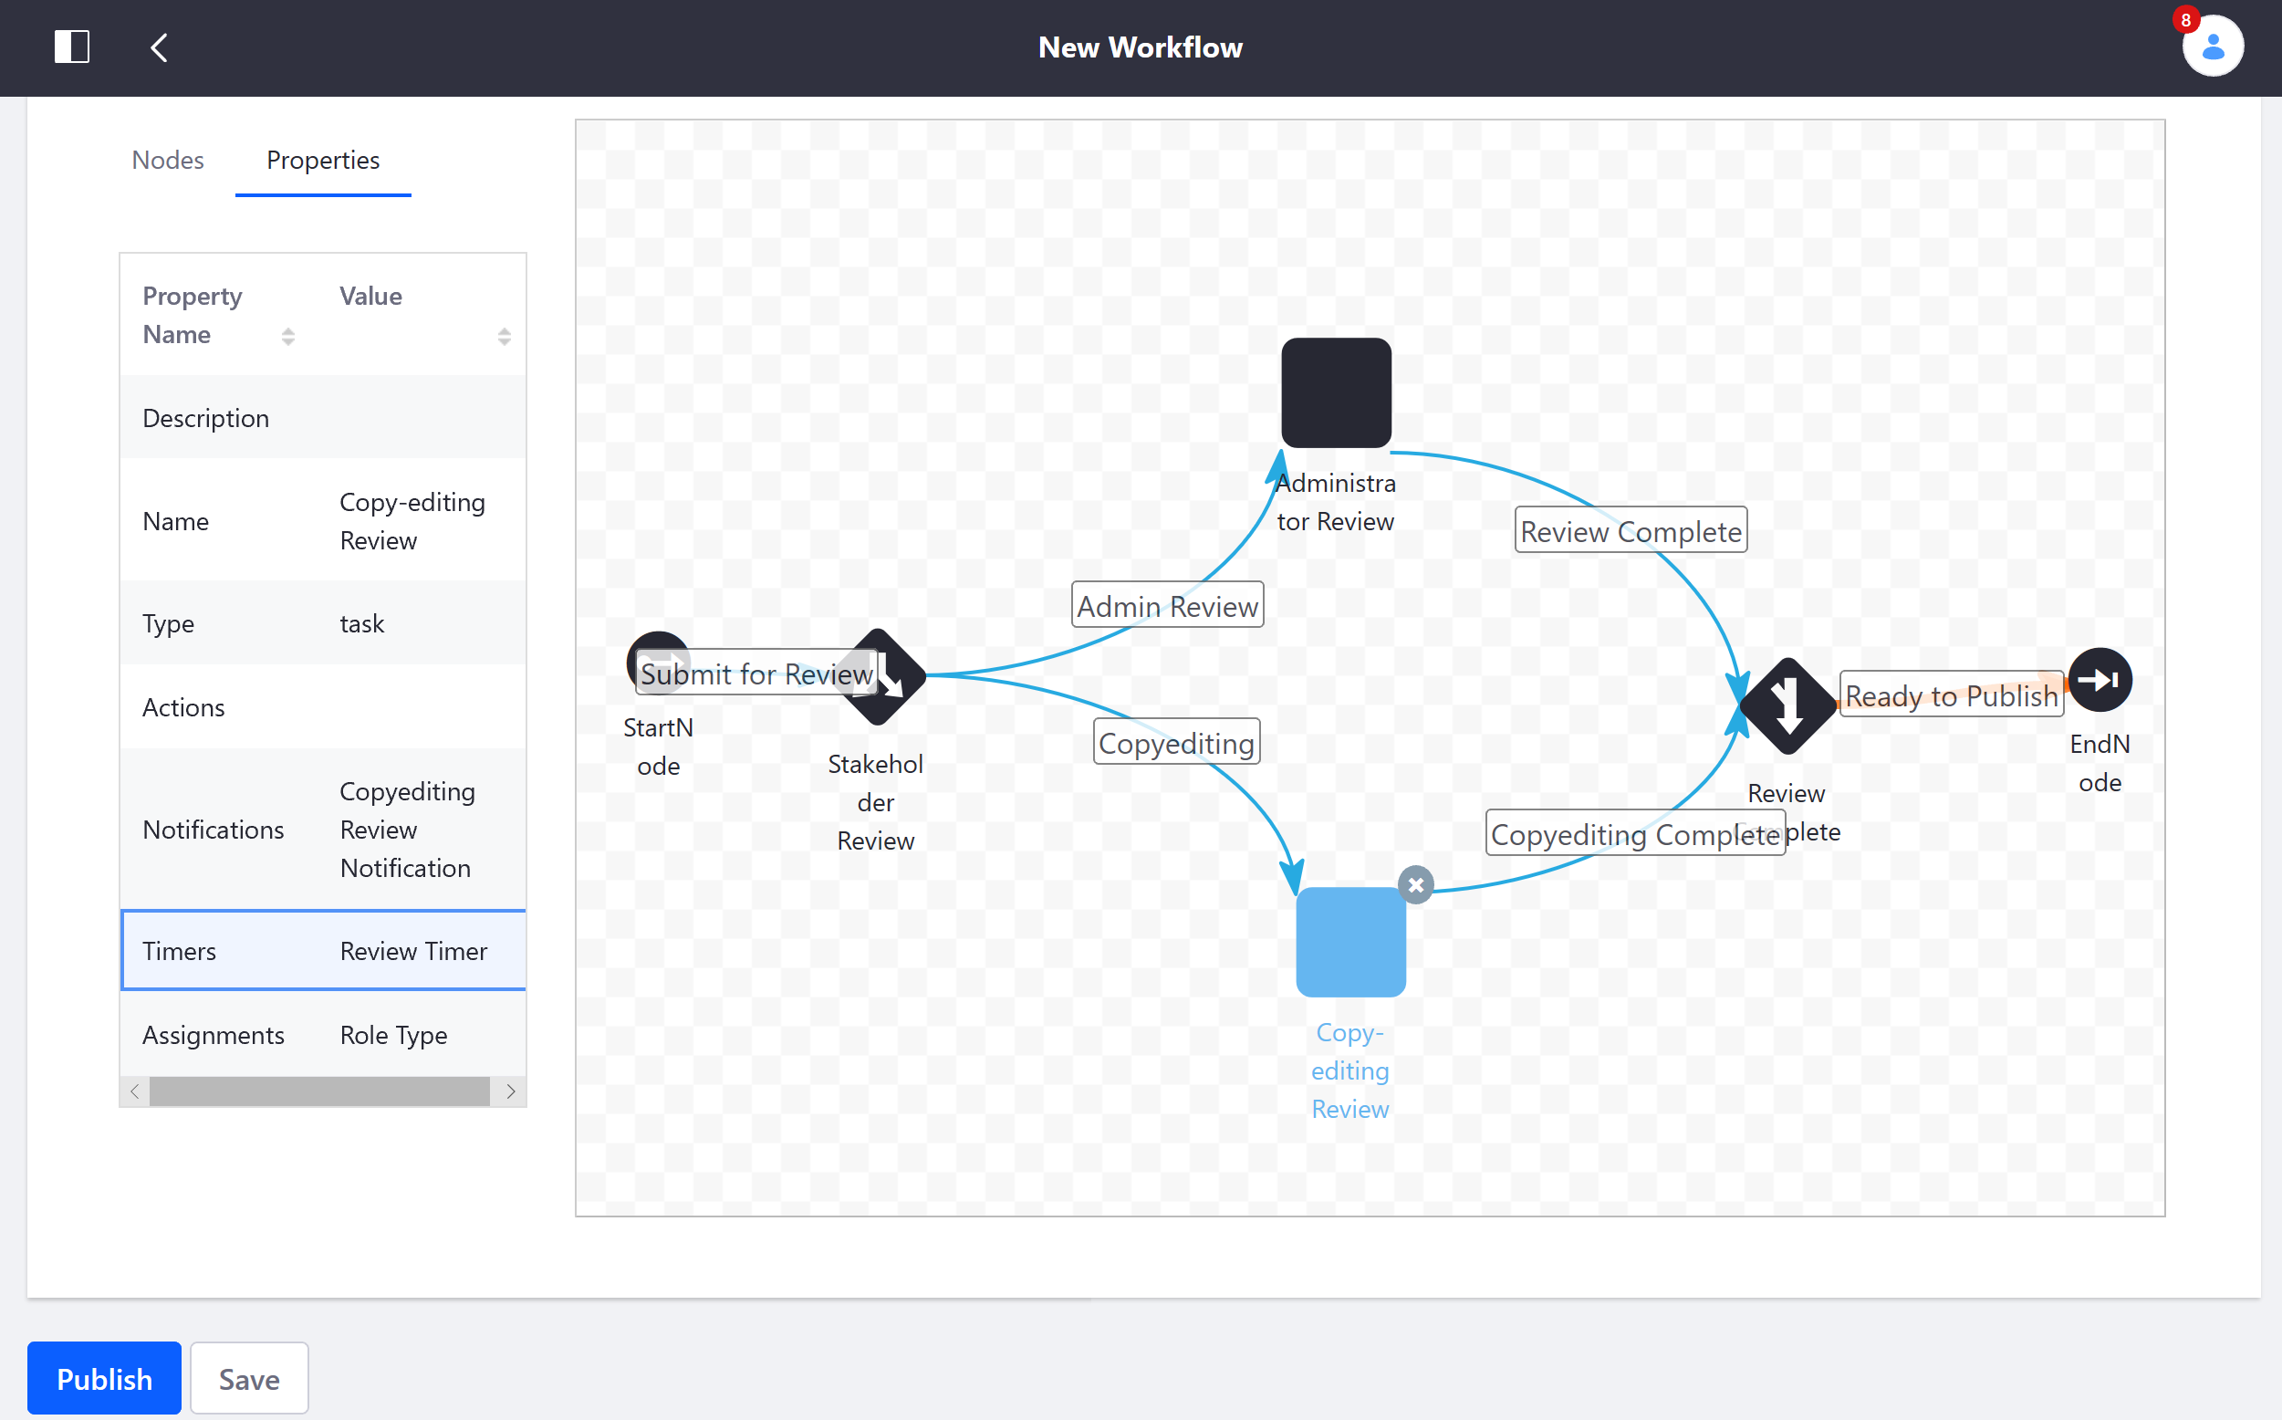
Creating Custom Workflows
To define complex workflows, administrators have two main options:
Write and upload an XML definition
Use the built-in workflow designer
Advantages of using the workflow designer:
Drag and drop interface
Faster than writing a definition in XML
Easily editable in the event of organizational changes
Notes:
Notes:
While Liferay DXP contains the Single Approver workflow out-of-the-box, custom workflows are needed for any review process that involves multiple stages of approval.
Workflows can also be combined with Forms to create processes that require documentation at each stage. This will be explored in more detail in the Gather and Analyze Data with Liferay DXP module.
Use Case:
Marvin Robotics could benefit from a custom workflow involving parallel review for a product highlight article (web content) which needs to be approved by members of both the product and marketing teams.

Slide 9
Workflow Nodes
Workflow Nodes represent specific points in an approval process and typically fulfill one of the following roles:
Begin the review process
Approve or reject an Asset
Reassign a Task
The workflow designer supports the following workflow node types:
Start and End nodes
Fork and Join nodes
Condition Nodes
State nodes
Task nodes
Notes:
Note: A bit more about the types of workflow nodes:
Task: Task nodes indicate the workflow task and its assignee.
Fork and Join: Fork and Join are paired nodes for splitting the review process for multiple reviewers in parallel, and then rejoining when reviews are complete.
Join XOR: The Join XOR node allows the workflow to proceed as long as the transition from one of the parallel reviewers is invoked.
Condition: The Condition node establishes a condition before the review process can proceed.
Start: The Start node begins the workflow.
End: The default End node by default sets the workflow status to Approved.
State: State nodes place the review process in a particular mode, or state. Start and End nodes are special types of state nodes.
Use Case:
As Marvin Robotics plans on utilizing the Process Builder to create custom workflows, they will of course need to be familiar with the available nodes. Certain design processes from the web team will make use of Fork and Join nodes in their workflow processes due to the collaborative nature of their work, whereas Condition nodes will come into play with the Kaleo Forms process that Marvin Robotics will create to mimic their Order Management process.

Slide 10
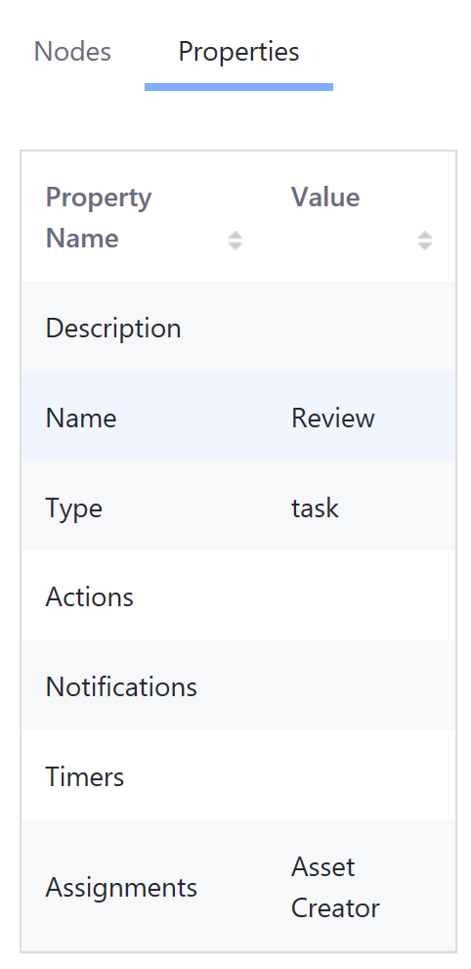
Task Nodes
Task nodes represent actual tasks that need to be fulfilled in the review process
When a Task node is added in the workflow designer, you must configure its Assignment Type
The Task Assignment Type determines how the Task is assigned to the User or Role responsible for completing it
Notes:
Notes:
Tasks have the following properties:
Description: Provides a description of the Task
Name: Defines the database name
Type: Shows the type of node in use
Actions: Different actions can be added to this part of the workflow, like Task Timers or scripts.
Notifications: One or more notifications can be created and sent out to different audiences.
Assignment: This is where you can assign who will be responsible for performing the task.
The available Assignment Types, include the following:
Asset Creator: Assigns the task to the original Content Writer or Content Creator of the asset
Resource Actions: Assigns by permissions
For example, you can assign something to a particular user who has permission to edit a blog post.
Role: Assigns by a single role
Role Type: Assigns by one or more roles
Scripted Assignment: Assigns via script
User: Assigns to one or more specific users
It is also important to note that custom Roles can be created during the creation of a workflow definition by assigning a task to a new, undefined Role. From there, you can add the appropriate permissions and assign the Role to its appropriate User(s).
Use Case:
In general, Task nodes in Marvin Robotics workflows will represent reviews performed by various Users on submitted content, though other actions that Task nodes may represent include updating content and creating Publications for publishing content.

Slide 11
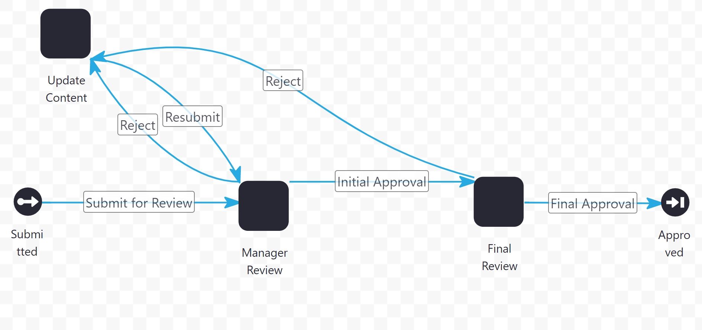
Use Case Example: Marketing Content Workflow
Notes:
Note: The above workflow outlines a workflow for the creation of Marvin Robotics marketing content (e.g., a banner ad for a current promotion). The Content Creator creates the piece of content which is then reviewed by the marketing team lead and then subsequently by the ecommerce manager with steps for revisions and resubmissions along the way.

Slide 12
Knowledge Check
If Marvin Robotics employees do not wish to upload their own custom workflows via XML files, they can still create custom workflow definitions using Liferay DXP’s built-in __________________.
If a Marvin Robotics employee is creating a workflow definition that involves a period of parallel review, they need to include both a __________________ and a __________________ node within the process.
For Assets that do not require custom workflows, Marvin Robotics can simply use the __________________ workflow definition, which is the default, out-of-the-box workflow definition.

Slide 13
Knowledge Check
If Marvin Robotics employees do not wish to upload their own custom workflows via XML files, they can still create custom workflow definitions using Liferay DXP’s built-in workflow designer.
If a Marvin Robotics employee is creating a workflow definition that involves a period of parallel review, they need to include both a Fork and a Join node within the process.
For Assets that do not require custom workflows, Marvin Robotics can simply use the Single Approver workflow definition, which is the default, out-of-the-box workflow definition.

Slide 14
Exercise: Creating Workflow Definitions

Slide 15
Creating Workflow Definitions Exercise Objectives
Create a Workflow definition with the Kaleo Designer
Activate the Workflow and go through a review process

Slide 16

Creating Workflow Definitions Exercise Steps (1/2)
Create a New Workflow with Kaleo Designer
Add the Review and Update Task Nodes
Connect All Nodes with Transitions
Name the New Transitions
Set the Assignments for the Review Tasks
Set Notifications for Tasks
Add Timers to the Tasks

Slide 17
Creating Workflow Definitions Exercise Steps (2/2)
Assign a User to the Review Roles
Activate the Marketing Content Review Workflow
Add a Web Content Article to be Reviewed
Go through the Workflow Process

Slide 18

Bonus Exercises
Add a few more lines to the New Products January 2022 Web Content Article. Resubmit the article and go through the Marketing Content Workflow again, this time Approving it at both the Manager Review and the Final Review.
Create another Workflow. Use Fork and Join nodes to allow two kinds of Review, Copyedit and Content, at the same time.

Slide 19
Preparing Pages and Content for Production

Slide 20
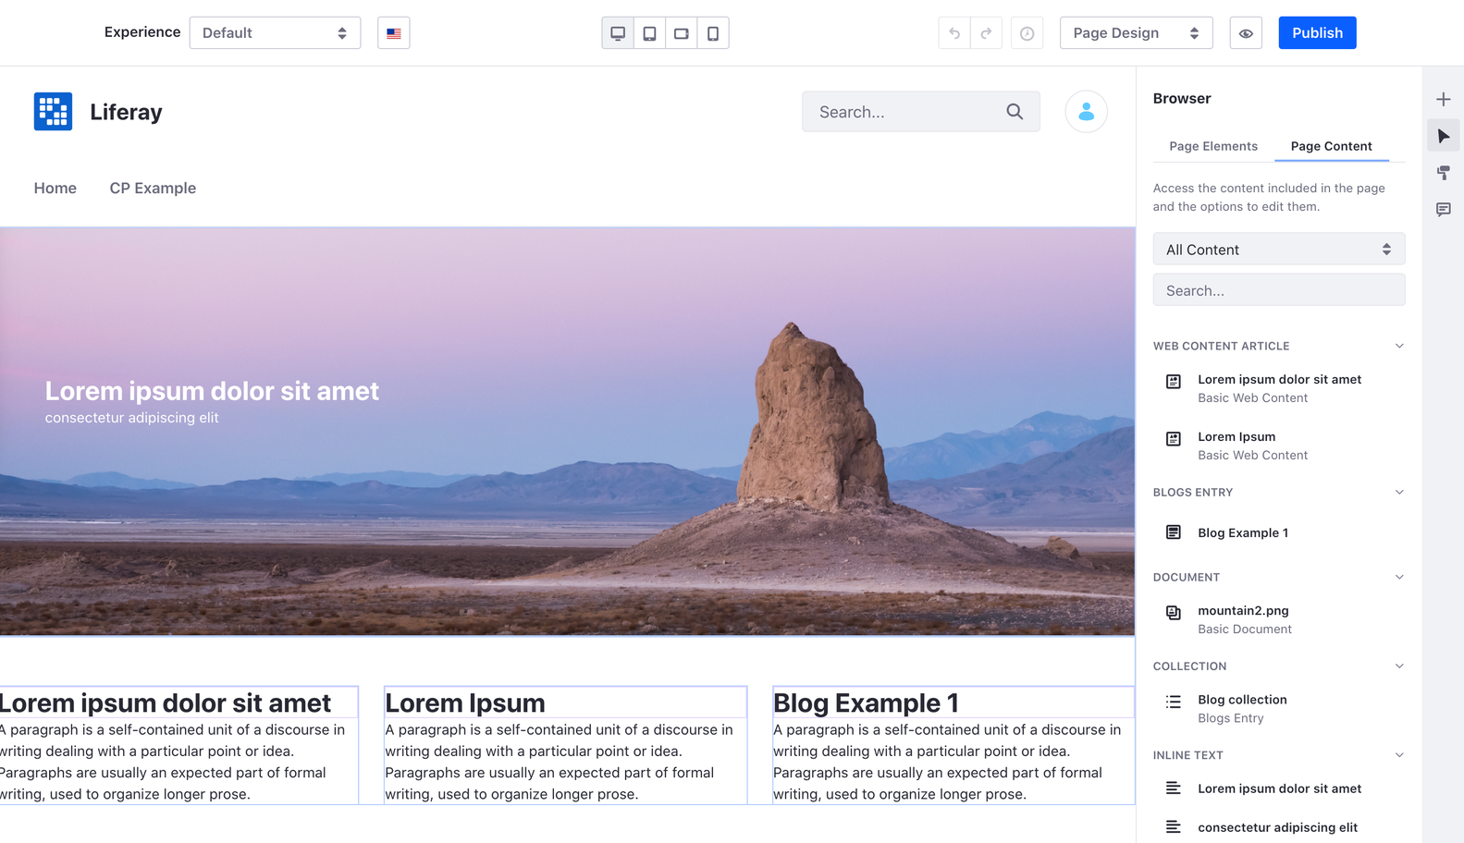
Browsing a Page’s Content
The Browser Panel enables page creators to quickly find and edit the content used on a particular page
Content is distributed by type and can be filtered for quick access and editing, which:
Allows small updates or corrections of errors missed in the review process
Decreases total page creation time, enabling faster turnaround on new content
Notes:
Note: The Browser Panel will be primarily useful for Widget and Content Pages rather than Display Pages as the former page types tend to be mixed in content type and would thus benefit from a method to sort through content effectively.
Use Case:
While not exclusively useful to a manufacturing firm like Marvin Robotics, the Browser Panel assists nearly every use case in the sense that it makes finding, sorting, and editing a page’s content simple and quick. This fast turnaround (especially when used in conjunction with features like Forms and other feedback methods) can be leveraged into a responsive Site that can continue to provide for the needs of its visitors (and by extension, its customers) in a prompt manner.

Slide 21
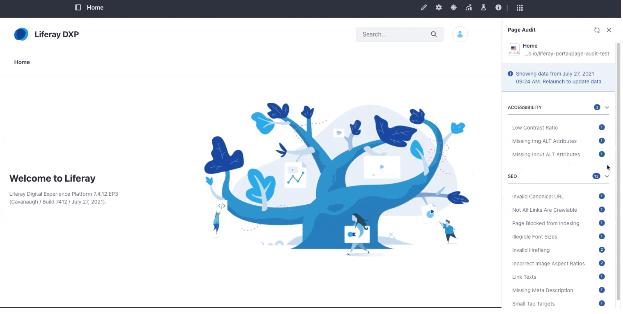
Page Audit
Page Audit performs a series of checks that measure a page’s compliance with best practices for accessibility, search engine metadata, and SEO
Based on Google PageSpeed Insights
Gives warnings and tips to improve content based on the above categories
Notes:
Note: The checkpoints used during the Page Audit encompass Accessibility and SEO issues. These include:
Low contrast ratio
Missing img-alt attributes
Incorrect image aspect ratios
Missing meta-description
Link texts
Page blocked from indexing
Invalid hreflang
Invalid canonical URL
Illegible font sizes
Small tap targets
Missing <title> elements
Uncrawlable links
Use Case:
Accessibility and SEO are increasingly important parts of B2B with both contributing heavily towards a business’s ability to stand out from their competitors. With the Page Audit tool, Liferay software offers teams the ability to optimize their content with respect to these categories, giving a kind of preview for a page’s content performance and offering suggestions to improve any content that is found lacking in these areas.

Slide 22
Launching a Page Audit
In order to set up the Page Audit feature, you will need an API Key from Google PageSpeed Insights, obtained here: https://developers.google.com/speed/docs/insights/v5/get-started
Once configured, a Page Audit can be launched on any public page by opening the associated panel and hitting “Launch Audit”
Will not work for the following page types as they are not crawlable:
Private pages
Local-run sites pages
Under-login pages
Issues have a detail view with description, tips to fix, and even direct links to the places where issues can be fixed
Notes:
Notes:
For businesses that sell internationally, each language version of a page can be audited separately, ensuring content is properly optimized according to its intended audience.
As the exercises for this module will be conducted using a local-run site, a Page Audit will not be performed in the associated exercise for this section. That said, the process for enabling Page Audit will be gone over in order to guide students in that endeavor.
Use Case:
Marvin Robotics will make use of Page Audit on its Main Site in order to maximize SEO.

Slide 23
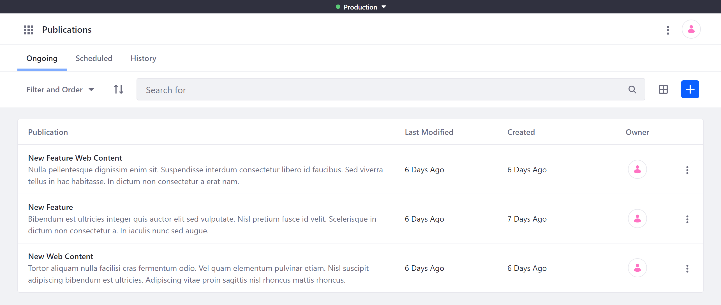
Publications
Publications can be used to develop, track, and publish changes across an instance of DXP
Users can use the tool to create separate publications that group their content into publishable blocks
Minor or major changes can be made by switching between edit and production modes
Edits can be published immediately or scheduled for later publication
Notes:
Note: Publications can be used across the whole DXP instance, allowing Users to group changes across multiple Sites into a single Publication. This, along with its ability for Users to quickly swap between modes, make it ideal for small edits and updates, but it can also be used for larger scale Site changes.
Use Case:
Marvin Robotics can make great use of Publications to handle Site updates across their Main Site and digital storefront.

Slide 24
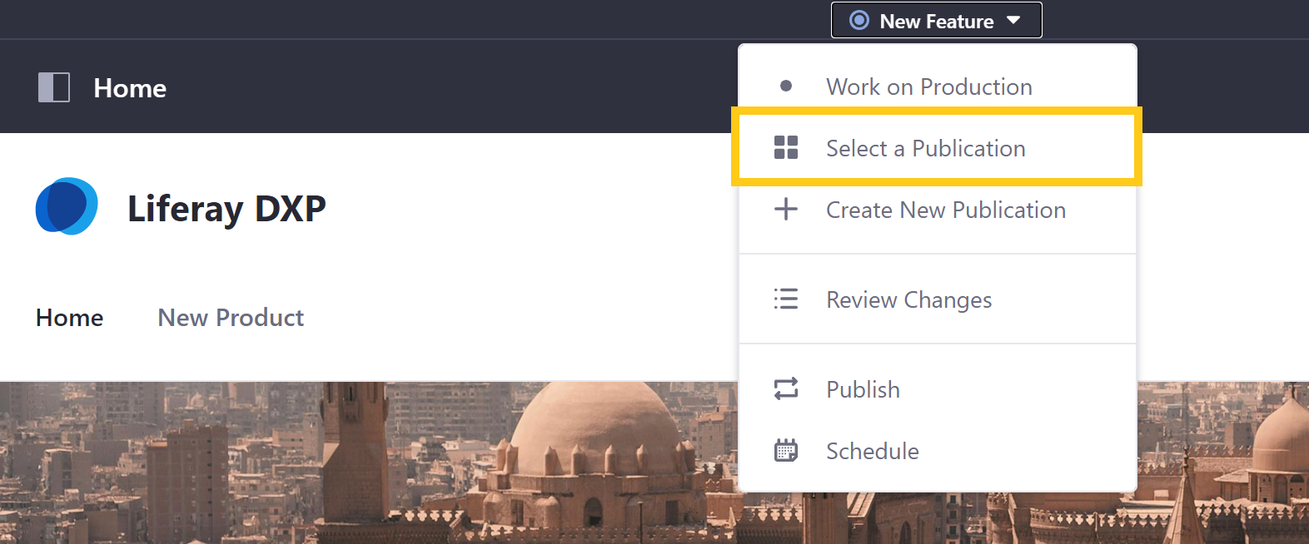
Creating Publications
Publications can be created in Publications in the Applications tab of the Global Menu
Once created, changes can be added to a publication by selecting it in the drop-down next to Production
Making changes on parallel publications can be done without issue, so long as the changes do not conflict with one another
Notes:
Note: Should two parallel publications conflict in their changes, a notification will pop up informing the User of the conflict, which can be manually resolved.
Use Case:
Marvin Robotics will generally not require parallel Publications on their Main Site as Site updates will usually be minor and made at regularly scheduled intervals. That said, the ability to create parallel Publications will prove invaluable in the digital storefront, where several individuals are responsible for maintaining the Site and updates occasionally overlap in content.

Slide 25
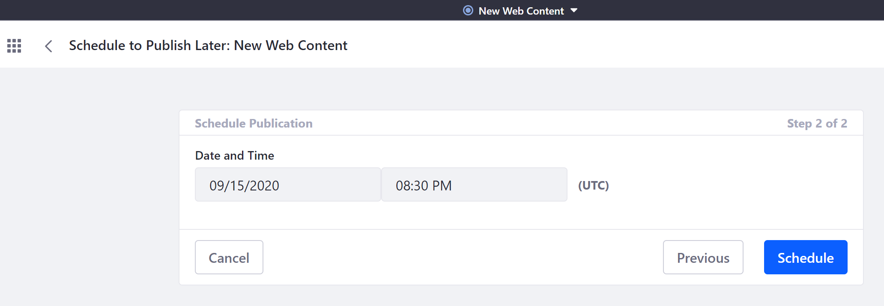
Reviewing and Publishing Changes
Before the changes made in a Publication go live, they can be reviewed in summary from the Publications bar in the drop-down menu
Once approved, a Publication has two methods of being published:
Publish: Immediately publishes the Publication
Schedule: Allows the Publication to be scheduled for a later time
Notes:
Note: The Schedule option for Publications can be particularly useful for timing the release of new content (potentially along with promotional pricing) to coincide with new sales or marketing campaigns.
Use Case:
Marvin Robotics will use scheduled Publications to publish marketing content to coincide with planned marketing campaigns.

Slide 26
Use Case Example: Marvin Robotics Publication Process
Marvin Robotics will take the following steps to prepare their content for production:
Implement a regular Page Audit schedule to ensure that content remains optimized
Create regularly scheduled Publications for Main Site Updates
Create regularly scheduled Publications for Store Updates

Slide 27
Knowledge Check
The __________________ tool is a useful feature that utilizes __________________ to make suggestions for improving a page’s Accessibility and SEO, leading to a better digital experience for Marvin Robotics’ customers.
The Marvin Robotics Web Team can use Publications to swap between __________________ and __________________ modes to make changes without affecting the live Site.
Changes made to the same page on the Marvin Robotics Main Site in parallel publications will all be implemented into the published content, provided they do not __________________.

Slide 28
Knowledge Check
The Page Audit tool is a useful feature that utilizes Google PageSpeed Insights to make suggestions for improving a page’s Accessibility and SEO, leading to a better digital experience for Marvin Robotics’ customers.
The Marvin Robotics Web Team can use Publications to swap between Edit and Production modes to make changes without affecting the live Site.
Changes made to the same page on the Marvin Robotics Main Site in parallel publications will all be implemented into the published content, provided they do not conflict.

Slide 29
Exercise: Publishing Content

Slide 30
Publishing Content Exercise Objectives
- Enable Publications and Create a New Publication
- Invite Users to a Publication
- Schedule a Publication and View the Changes

Slide 31
Publishing Content Exercise Steps (1/2)
Enable Publications and Create a New Publication
Add Pages in the New Publication
Add Fragments to the New Page
Add Two More Public Pages
Review and Publish Changes to the Publication
Create a New User and give them Access to the Marvin Robotic Site
Assign the User Membership, a Role, and a Password

Slide 32
Publishing Content Exercise Steps (2/2)
Create another New Publication
Invite the New User to the Publication
Sign In as the new User and Access the Publication
Make Changes to a Page
Compare the Publication and the Current Site
Schedule the Publication for Release

Slide 33
Bonus Exercises
Create an additional publication. Make changes to the publication and to Production so that there are conflicts (for example, add duplicate folders or move a Web Content article). Resolve any conflicts that you are notified about when you attempt to publish the Publication.

Slide 34
Summary (1/2)
Custom workflows can be created to accommodate complex review processes for various assets.
The workflow designer allows administrators to create workflow definitions in a graphical editor.
The four key components of a workflow each have several properties that work together to clarify and streamline the review process.

Slide 35
Summary (2/2)
The workflow designer contains several options for creating intricate workflows including forks, joins, conditions, and task timers.
Page Audits can be enabled and used to improve a page’s content with regards to accessibility and SEO.
Changes across the entire DXP instance can be made behind the scenes and then published using Publications.

Slide 36
For Further Reading
For more information regarding workflows, consult the documentation here:
https://learn.liferay.com/dxp/latest/en/process-automation/workflow/introduction-to-workflow.html
For more information regarding Publications, consult the documentation here:
https://learn.liferay.com/dxp/latest/en/site-building/publishing-tools/publications/publications-overview.html
For general questions about using Liferay’s products, visit:
https://learn.liferay.com/index.html

