Slide 1
The Safe MedTech Challenge Hackathon
ADHD Check
A digital health solution for children aged 6 to 12 and their parents in Romania and the EU.
PROJECT IDENTITY
We help parents of children aged 6 to 12
decide whether to seek an ADHD assessment
through a short game and a clear next step.
Team: name TODO
Working name: ADHD Check (final name still open)
Status: pilot in development, not CE marked
Orientation, not diagnosis. One population: children aged 6 to 12. One improvement: a clear next step for parents.
Team name TODO | ADHD Check
1 / 8
Notes:
About 20 seconds. We are [team]. Our project is ADHD Check. We help parents of children aged 6 to 12 decide whether to seek an ADHD assessment, through a short game and a clear next step. It orients. It does not diagnose.

Slide 2
The Safe MedTech Challenge Hackathon
The problem and why it matters
Ground the unmet need in a specific population and local context.
CONTEXT + POPULATION
PROBLEM + CONSEQUENCE
EVIDENCE
Romania: 1,452,261 children aged 6 to 12
EU27: 31,711,259 children aged 6 to 12 (Eurostat estimates, 1 Jan 2025)
Priority: access to care. Romania spends the least on health in the EU: EUR 1,800 vs 3,832 per person (PPP, 2023; OECD/EC 2025)
Need: parents cannot tell if their child's attention problems need a professional
When: school age, 6 to 12, before any referral
Why it matters: all ages, ADHD linked to 1.71x higher mortality; with medication 0.75x vs without (observational, 15.9 M people, 2026)
5.29 %: pooled ADHD prevalence, under-18s, worldwide (102 studies)
Romania: about 77,000 children aged 6 to 12 may have ADHD (estimate)
Access: 6 % reported unmet medical care needs, 5th highest in the EU (2024)
England: waits up to 4+ years for children (NHS, 2025); no Romanian data found
In Romania, about 77,000 children aged 6 to 12 may have ADHD, and parents lack a simple, safe first step, which delays assessment and care.
Team name TODO | ADHD Check
2 / 8
Notes:
About 30 seconds. In Romania there are 1.45 million children aged 6 to 12. Applying the worldwide pooled prevalence of 5.29 percent, about 77,000 of them may have ADHD; that is an estimate, no Romanian prevalence study exists. Romania spends the least on health in the EU, and 6 percent of people report unmet care needs. Why it matters: a 2026 meta-analysis of 15.9 million people, all ages, linked ADHD to 1.71 times higher mortality. Parents today have no simple, safe first step.

Slide 3
The Safe MedTech Challenge Hackathon
Your solution and who it serves
Make the digital component, user and value proposition explicit.
WHO IT SERVES
WHAT IT DOES
VALUE PROPOSITION
User: the parent, and the child who plays (no account)
Beneficiary: the child, aged 6 to 12
Decision-maker: the parent first; later insurers, schools and paediatric practices
In one sentence: the child plays a short game, the parent gets one clear answer
Digital: web app, the game runs in the tablet or phone browser
Two features: a game that records attention behaviours; a result card with the next step
Need: know whether to see a professional, and which one
Benefit: result, next step, missions and progress are free; a report is paid
Workflow: the parent brings the report to the family doctor or paediatrician
Our solution enables parents to decide whether to seek a professional assessment through a short game their child plays in the browser.
Team name TODO | ADHD Check
3 / 8
Notes:
About 25 seconds. The parent is our user, the child is the beneficiary. The child plays a short game in the tablet browser, no install. The parent gets one of two answers: a professional assessment is recommended, or no specific follow-up is indicated by this activity. Plus the next step, and a report to bring to the doctor.

Slide 4
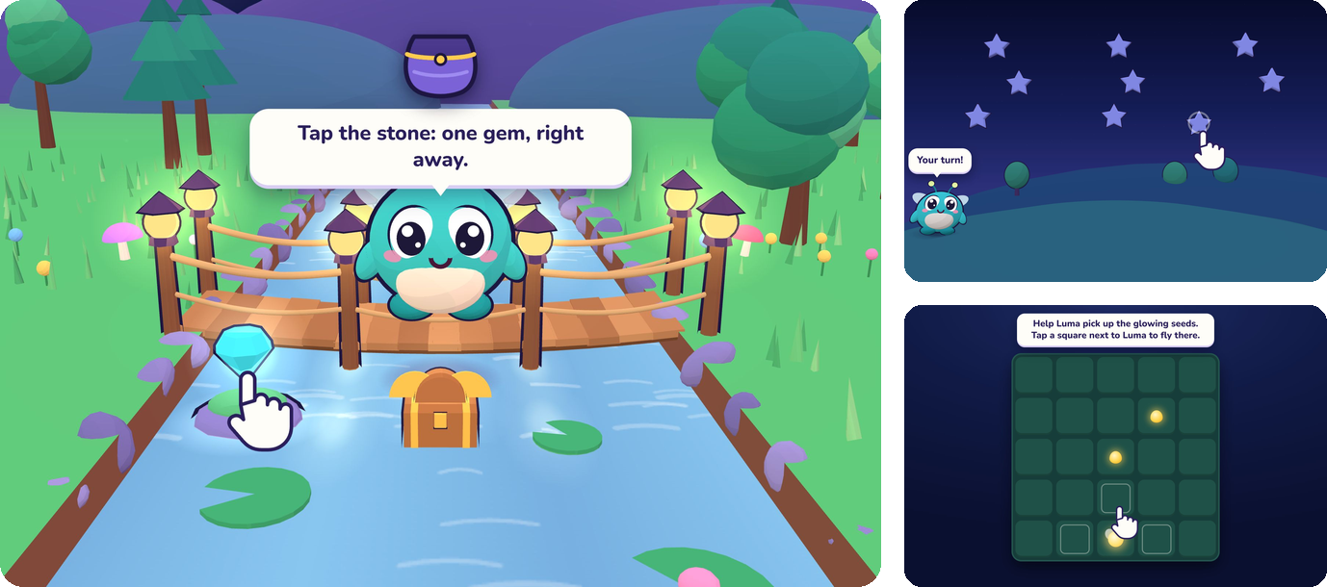
The Safe MedTech Challenge Hackathon
Show how it works
Demonstrate the prototype, mock-up or user journey.
USER JOURNEY
1. The parent creates an account and a child profile: nickname and birth year only.
2. The parent shows a one-use QR code; the child's game opens on the tablet (connection in progress).
3. The parent receives one of two answers, the next step and missions.
Working now: parent app, consent (draft text), QR links, result card, missions, progress, 5 mini-games standalone | Simulated: results | Planned: scored session, scoring rules, camera and mic
Team name TODO | ADHD Check
4 / 8
Notes:
About 25 seconds. Show the screens. One: the parent creates an account and a child profile, nickname and birth year only. Two: a one-use QR code opens the child's game. Three: the parent sees the answer, the next step and missions. Be honest: the parent app and the five mini-games work; results shown are synthetic; connecting the game to scoring is in progress. Do not scan the QR live unless the game is connected.

Slide 5
The Safe MedTech Challenge Hackathon
What makes it different
Explain the improvement over what users rely on today.
CURRENT ALTERNATIVE
OUR IMPROVEMENT
Today: clinician-run tests after referral (QbTest in clinic, QbCheck remotely)
Does well: FDA-cleared; with the QbTest report, 76 % of referred children had a decision at 6 months vs 50 %
Limit: in pooled studies, a CPT score alone missed about 1 in 4 children with ADHD
Difference: for parents, before referral, with a clear next step
Safety: a negative result never rules ADHD out and never replaces a referral
To test: agreement with a full assessment; we found no published study of a game used this way
Compared with clinician-run tests after referral, we offer parents a safe first step before referral, which matters because it aims to bring the right child to the right professional sooner.
Team name TODO | ADHD Check
5 / 8
Notes:
About 25 seconds. Today, tests like QbTest are good: FDA-cleared, and with the QbTest report 76 percent of referred children had a decision at 6 months versus 50. But they come after referral, run by clinicians, and in pooled studies a test score alone missed about 1 in 4 children. So we orient and do not diagnose: a negative result never rules ADHD out. Our difference: a safe first step for parents, before referral.

Slide 6
The Safe MedTech Challenge Hackathon
Expected impact and validation
Connect benefits to beneficiaries and separate evidence from ambition.
EXPECTED OUTCOME
TESTED + LEARNED
STILL UNPROVEN
Benefit: children who need an assessment reach one earlier
Validation metric: agreement with a full assessment (sensitivity, specificity, NPV)
Impact metric: time from parent concern to first visit (later study)
Tested: parent app, API and database: 65 test files
Result: the parent journey runs on seeded synthetic results
Learned: attention tests are not stand-alone tools, so we orient and never diagnose
Assumption: game behaviours match a clinical assessment
Limit: not clinically validated; game not yet connected; scoring rules not written yet
Next test: parent survey, then a validation study with a clinical partner
We expect earlier assessment for children who need it. We observed the parent journey working on synthetic results. We still need to connect the game, write the scoring rules and validate them clinically.
Team name TODO | ADHD Check
6 / 8
Notes:
About 25 seconds. We expect children who need an assessment to reach one earlier. First we must show agreement with a full assessment: sensitivity, specificity, negative predictive value. What works today: the parent journey, with 65 test files, on synthetic results. What is unproven: the game is not yet connected, the scoring rules are not written, nothing is validated. That is our next study.

Slide 7
The Safe MedTech Challenge Hackathon
Delivery, feasibility and next steps
Summarize what implementation needs and the next concrete test.
DELIVERY ESSENTIALS
RISKS + RESPONSE
NEXT MILESTONE
Resources: database in the EU (Frankfurt), game, scoring rules
Partner: child psychiatry or paediatrics team (prospective, none confirmed)
Route: parents online first, then paediatric practices and insurers
Risk: wording that sounds like a diagnosis
Privacy: child profile is a nickname and birth year; camera and mic designed off by default and on-device (not built yet)
Mitigation: no ADHD probability or severity; expected class IIa, Rule 11 (to confirm)
Next: validation pilot
With: a clinical partner; owner TODO
Success: agreement between game result and full assessment
Next, we will run a pilot with a child psychiatry partner to validate that the game result agrees with a full clinical assessment.
Team name TODO | ADHD Check
7 / 8
Notes:
About 20 seconds. Safe by design: the child profile is a nickname and birth year; camera and microphone are designed to stay off by default and be processed on the device, not built yet. No ADHD probability and no severity. Expected EU MDR class IIa under Rule 11, to confirm. Next: a pilot with a child psychiatry partner.

Slide 8
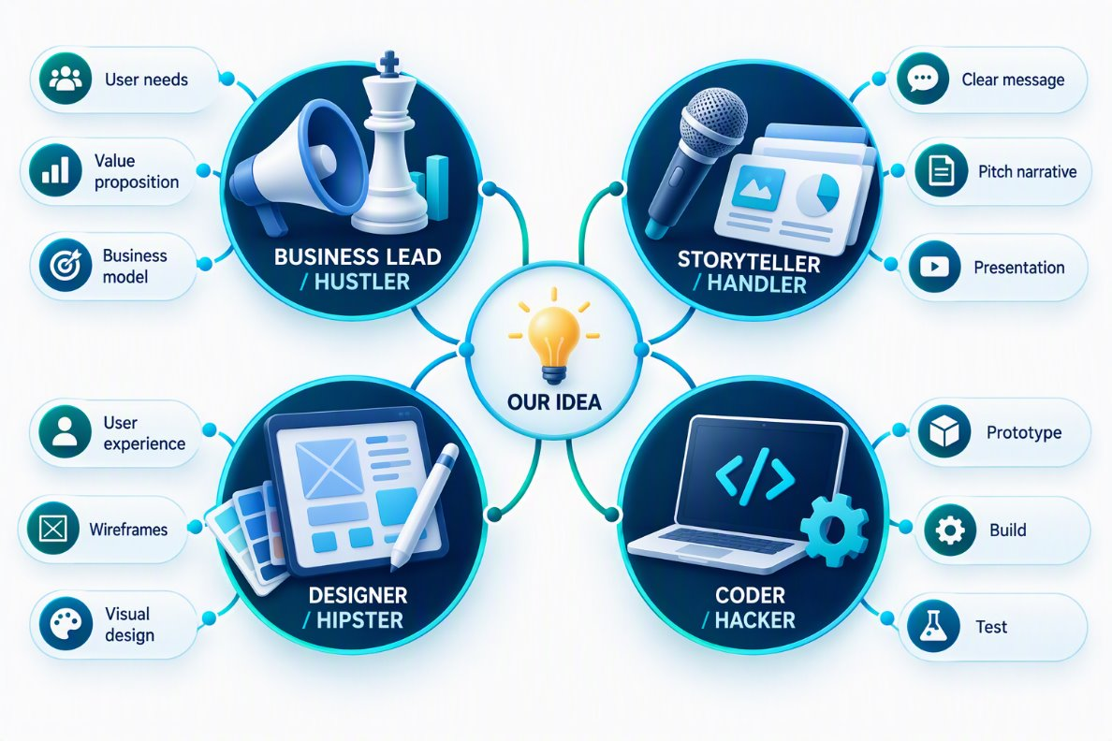
The Safe MedTech Challenge Hackathon
Our team. Our next step.
Close with the people behind the idea and the support needed to continue.
TEAM + CONTRIBUTIONS
OUR ASK
Name TODO: game, mini-games
Name TODO: data, scoring, sensors
Name TODO: backend, security
Name TODO: parent app, payments
Name TODO: claims, regulatory, pitch
A clinical partner
to achieve
a validation pilot in Romania
A short game, a clear next step for parents. Orientation, not diagnosis.
Contact: TODO
Team name TODO | ADHD Check
8 / 8
Notes:
About 15 seconds. This is our team [names and roles]. Our ask: a clinical partner, to run a validation pilot in Romania. Thank you. If asked a question: excellent question, I have a slide for that (appendix A1 stakeholders, A2 costs, A3 sources).

Slide 9
OPTIONAL SUPPORTING MATERIAL
Appendix
All following slides are optional and for support only.
Use them for Q&A, additional detail or project preparation.
They are not part of the eight-slide essential pitch.
Notes:
Appendix starts here. Not part of the 3-minute pitch. Use only for questions.

Slide 10
OPTIONAL APPENDIX / USE ONLY IF NEEDED
Stakeholders in detail
Optional A1: expand user, beneficiary and customer needs.
PRIMARY USER
BENEFICIARY
CUSTOMER + PAYER
Task: notices attention problems at home or at school
Need: know whether to seek help, and from whom
Barrier: stigma; mental health conditions may be under-diagnosed in Romania (OECD/EC 2023)
Who: children aged 6 to 12
Improvement: reach the right professional sooner (to be tested)
Inclusion: free result; runs in any tablet or phone browser
Decision-maker: the parent
Who pays: the parent for the report; later insurers, schools
Reason to adopt: a free first answer and a report for the doctor
The price of the report is not decided yet.
Team name TODO | ADHD Check
A1 / OPTIONAL
Notes:
For questions on who uses, who benefits and who pays.

Slide 11
OPTIONAL APPENDIX / USE ONLY IF NEEDED
Sustainability: costs and funding
Optional A2: explain how delivery could remain viable.
COST STRUCTURE
FUNDING / REVENUE
VIABILITY QUESTIONS
Certification: example notified body: application EUR 1,080; audit EUR 1,495 per auditor-day (excl. VAT)
Operating: cloud hosting, payments, email
Main driver: clinical validation study (cost TODO)
Who pays: parents for the report; later insurers and schools
Revenue: paid report, price to be decided
Assumption: parents pay for a report to bring to the doctor
Affordable: the first answer stays free
Uncertainty: cost of the clinical study
Next test: ask parents what they would pay
Fees from CMI (notified body 1383) price list 26-001, excl. VAT. All other costs are assumptions to validate.
Team name TODO | ADHD Check
A2 / OPTIONAL
Notes:
For questions on cost and money. Only the notified body fees are sourced; say clearly that everything else is an assumption.

Slide 12
OPTIONAL APPENDIX / USE ONLY IF NEEDED
Sources
Every number in this deck, with its source.
PROBLEM
EVIDENCE
MARKET + REGULATION
Eurostat demo_pjan, 1 Jan 2025 (estimated values): children aged 6 to 12
OECD/EC State of Health in the EU, Romania profiles 2025 and 2023
JAMA Netw Open 2026, PMID 42895743: mortality
NHS England ADHD Taskforce, Part 1, April 2025
Am J Psychiatry 2007, PMID 17541055: 5.29 %
J Am Acad Child Adolesc Psychiatry 2023, PMID 37004919: CPT accuracy
J Child Psychol Psychiatry 2023, PMID 37800347: QbTest accuracy
J Child Psychol Psychiatry 2018, PMID 29700813: QbTest trial
Romania estimate: 1,452,261 x 5.29 %, an assumption
MDCG 2019-11 rev.1: Rule 11, expected class IIa
FDA 510(k) K133382: QbTest
CMI (NB 1383) price list 26-001: fees, excl. VAT
Event: 3 min pitch | 2 min Q&A | deck due 21 Oct, 14:45
Team name TODO | ADHD Check
A3 / SOURCES
Notes:
For any question on where a number comes from.

