Slide 1

程序设计实习
C++面向对象程序设计
信息科学技术学院
郭 炜
微博：http://weibo.com/guoweiofpku
学会程序和算法，走遍天下都不怕!
讲义内照片均为郭炜拍摄
微信公众号

Slide 2
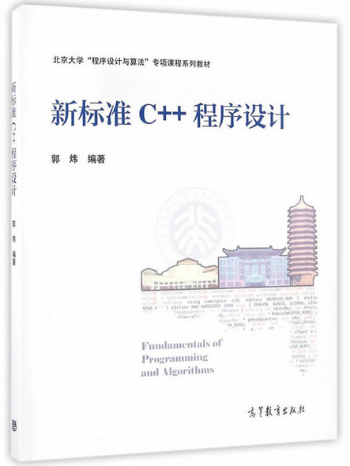
信息科学技术学院
配套教材：
高等教育出版社
《新标准C++程序设计》
郭炜 编著

Slide 3

信息科学技术学院《程序设计实习》 郭炜
探索string对象

Slide 4
  1. 先看看string对象是多大:
  int main()
  {
  string s("12345678");
  cout << "sizeof string = " << sizeof(s) << endl;
  return 0;
  }
  sizeof string = 8
  编译器: dev c++ 5.4.0 , 编译结果是64位程序。64位程序指针为 8 字节。

Slide 5
  2. 看看string对象里放的东西是不是 c_str()返回的指针:

Slide 6
  2. 看看string对象里放的东西是不是 c_str()返回的指针:
  int main()
  {
  string s("12345678");
  cout << "sizeof string = " << sizeof(s) << endl;
  char * * p = (char * * ) & s;
  char * pstr = (char *) s.c_str();
  printf("p=%p,pstr=%p\n",* p,pstr);
  cout << pstr << endl;
  return 0;
  }

Slide 7
  2. 看看string对象里放的东西是不是 c_str()返回的指针:
  int main()
  {
  string s("12345678");
  cout << "sizeof string = " << sizeof(s) << endl;
  char * * p = (char * * ) & s;
  char * pstr = (char *) s.c_str();
  printf("p=%p,pstr=%p\n",* p,pstr);
  cout << pstr << endl;
  return 0;
  }
  sizeof string = 8
  p=00000000003d13d8,pstr=00000000003d13d8
  12345678

Slide 8
  3. 是否每次调用length都要从头找到\0为止？抑或会把字符串长度放在某处？

Slide 9
  3. 是否每次调用length都要从头找到\0为止？抑或会把字符串长度放在某处？
  int main()
  {
  string s("12345678");
  cout << "sizeof string = " << sizeof(s) << endl;
  char * pstr = (char *) s.c_str();
  pstr[3] = 'a';
  pstr[4] = 0;
  cout << pstr << endl;
  cout << s << endl;
  cout << s.length() << endl;
  return 0;
  }

Slide 10
  3. 是否每次调用length都要从头找到\0为止？抑或会把字符串长度放在某处？
  int main()
  {
  string s("12345678");
  cout << "sizeof string = " << sizeof(s) << endl;
  char * pstr = (char *) s.c_str();
  pstr[3] = 'a';
  pstr[4] = 0;
  cout << pstr << endl;
  cout << s << endl;
  cout << s.length() << endl;
  return 0;
  }
sizeof string = 8
123a
123a 678
8

Slide 11
  4. 到底把string的长度放在哪里了呢?

Slide 12
  4. 到底把string的长度放在哪里了呢?
  int main()
  {
  string s("12345678");
  cout << "sizeof string = " << sizeof(s) << endl;
  int * pstr = (int *) s.c_str();
  cout << * ( pstr - 1) << endl;
  return 0;
  }

Slide 13
  4. 到底把string的长度放在哪里了呢?
  int main()
  {
  string s("12345678");
  cout << "sizeof string = " << sizeof(s) << endl;
  int * pstr = (int *) s.c_str();
  cout << * ( pstr - 1) << endl;
  return 0;
  }
  sizeof string = 8
  1230795621

Slide 14
  4. 到底把string的长度放在哪里了呢?
  int main()
  {
  string s("12345678");
  cout << "sizeof string = " << sizeof(s) << endl;
  int * pstr = (int *) s.c_str();
  cout << * ( pstr - 2) << endl;
  return 0;
  }
  sizeof string = 8
  0

Slide 15
  4. 到底把string的长度放在哪里了呢?
  int main()exit
  {
  string s("12345678");
  cout << "siexit
  zeof string = " << sizeof(s) << endl;
  int * pstr = (int *) s.c_str();
  for(int i = 1;i <= 8; ++i )
  cout << * ( pstr - i) << endl;
  return 0;
  }

Slide 16
  4. 到底把string的长度放在哪里了呢?
  int main()
  {
  string s("12345678");
  cout << "sizeof string = " << sizeof(s) << endl;
  int * pstr = (int *) s.c_str();
  for(int i = 1;i <= 8; ++i )
  cout << * ( pstr - i) << endl;
  return 0;
  }
sizeof string = 8
1230795621
0
0
8
0
8
251715415
779278093

Slide 17
  4. 到底把string的长度放在哪里了呢?
  int main()
  {
  string s("1234567890");
  cout << "sizeof string = " << sizeof(s) << endl;
  int * pstr = (int *) s.c_str();
  for(int i = 1;i <= 8; ++i )
  cout << * ( pstr - i) << endl;
  return 0;
  }

Slide 18
  4. 到底把string的长度放在哪里了呢?
  int main()
  {
  string s("1234567890");
  cout << "sizeof string = " << sizeof(s) << endl;
  int * pstr = (int *) s.c_str();
  for(int i = 1;i <= 8; ++i )
  cout << * ( pstr - i) << endl;
  return 0;
  }
sizeof string = 8
1230795621
0
0
10
0
10
218138093
1962932870

Slide 19
  4. 到底把string的长度放在哪里了呢?
  int main()
  {
  string s("1234567890");
  cout << "sizeof string = " << sizeof(s) << endl;
  int * pstr = (int *) s.c_str();
  pstr[-4] = 3;
  cout << s << "," << s.c_str() << endl;
  cout << s.length() << endl;
  return 0;
  }

Slide 20
  4. 到底把string的长度放在哪里了呢?
  int main()
  {
  string s("1234567890");
  cout << "sizeof string = " << sizeof(s) << endl;
  int * pstr = (int *) s.c_str();
  pstr[-4] = 3;
  cout << s << "," << s.c_str() << endl;
  cout << s.length() << endl;
  return 0;
  }
sizeof string = 8
1234567890,1234567890
10

Slide 21
  4. 到底把string的长度放在哪里了呢?
  int main()
  {
  string s("1234567890");
  cout << "sizeof string = " << sizeof(s) << endl;
  int * pstr = (int *) s.c_str();
  pstr[-4] = 3; pstr[-6] = 5;
  cout << s << "," << s.c_str() << endl;
  cout << s.capacity() << "," << s.length() << endl;
  return 0;
  }

Slide 22
  4. 到底把string的长度放在哪里了呢?
  int main()
  {
  string s("1234567890");
  cout << "sizeof string = " << sizeof(s) << endl;
  int * pstr = (int *) s.c_str();
  pstr[-4] = 3; pstr[-6] = 5;
  cout << s << "," << s.c_str() << endl;
  cout << s.capacity() << "," << s.length() << endl;
  return 0;
  }
sizeof string = 8
12345,1234567890
3,5

Slide 23
探索虚函数表
class A {
public: virtual void print() { cout << "A::print" << endl; }
};
class B:public A {
public: virtual void print() { cout << "B::print" << endl; }
};
int main() {
A a; B b;
A * pa = & b;
pa->print();
int * p1 = (int *) pa;
int * p2 = (int *) (& a);
*p1 = * p2;
pa->print(); //输出什么？
return 0;
}

Slide 24
探索虚函数表
class A {
public: virtual void print() { cout << "A::print" << endl; }
};
class B:public A {
public: virtual void print() { cout << "B::print" << endl; }
};
int main() {
A a; B b;
A * pa = & b;
pa->print();
int * p1 = (int *) pa;
int * p2 = (int *) (& a);
*p1 = * p2;
pa->print(); //输出什么？
return 0;
}
B::print
A::print

Slide 25


Slide 26


