Slide 1
Defining a Field, a School and a Curriculum
Walk Around Get to Know Each Other – 5 Minutes
Brian Wright
brianwright@virginia.edu

Slide 2
Brian Wright Associate Professor Director for Undergrad Programs University of Virginia PhD: Higher Education Administration Economics, Public Policy Founded the DS Program at GWU Founded the DSI at GWU Founded UVA’s Undergraduate Programs DS Labs LLC – Founder (DS Consulting) Worked in Defense Consulting for 10 years

Slide 3
Research Interest: Intersection of Data Science and Education generally Data Science Active Learning Lab

Slide 4
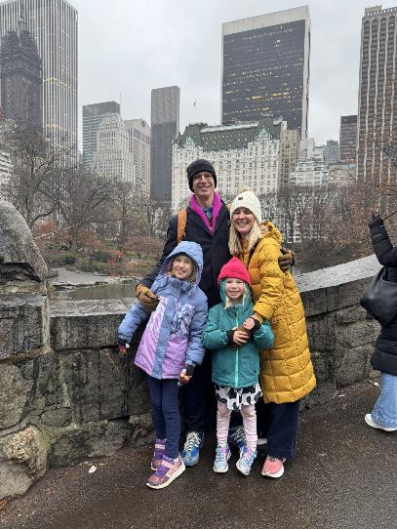
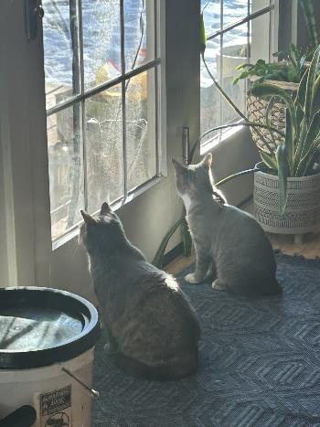
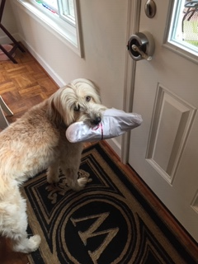

Slide 5
Defining a Field

Slide 6

This Course: a Bit of Everything but Mostly Analytics
Systems: Working environment and version control
Design: Given presentation at the end of the semester, likely will require you to build a standalone website
Value: Going to cover topics related to ethical issues in develop ML solutions

Slide 7
Dream Job Discussion
Find a data science "dream job". Assume for a moment that you are destined to be a Data Scientist! March bravely onto the world wide web and find your data scientist dream job, then let's talk about it. Requirements: must-have "data scientist" in the title Not a requirement - to be a real job, want to create your own...please do, we would all love to hear about it.
Answer these questions
- What do I love about this job (salary, company, mission, area of focus, location...etc.)?
- Which components of the Data Science framework are represented (if you can tell)?
- What do I need to know to do this job (coding, databases, how to build a self-actualizing and empathetic robot..etc)?
- How much of what is required do I already know? (0%....100%)?

