Slide 1
Introduction to Decision Trees, Background and Application….Ensemble Overview Brian Wright

Slide 2
Outline
Decision Trees
Basics
Background
Advantages and Limitations
Mathematical Approaches and Example
Example in Python
Evaluation

Slide 3
Basics: Graph Elements
Tree begins with a Root Node that has no incoming edges and two or more out going edges
Internal Node – Has one incoming edge and two or more outgoing and represent test conditions at every given level
Leaf Node – One incoming edge and no outgoing edges
Edges – Connections between nodes

Slide 4
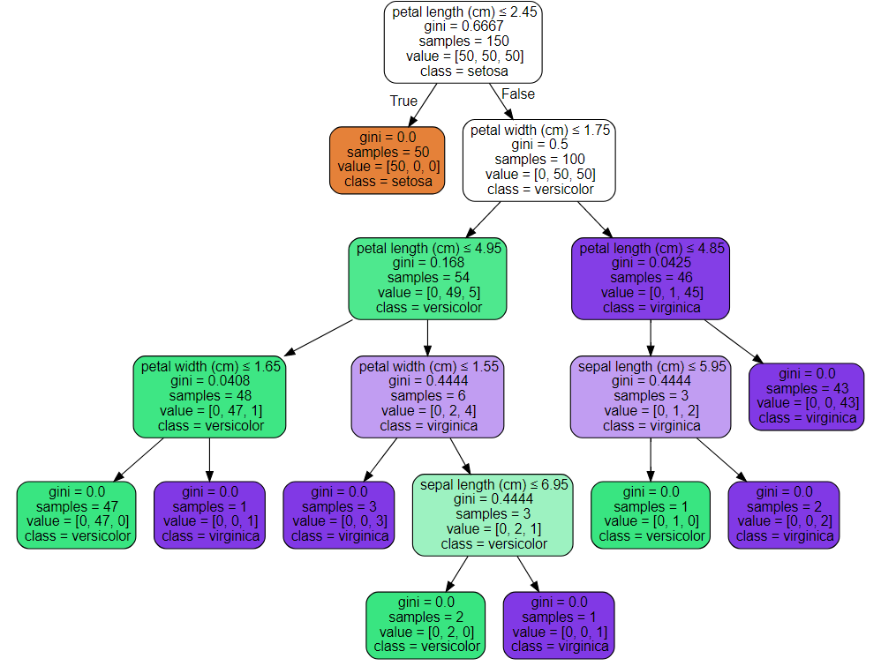
Basics: Graph Example
Root Node
Edges
Internal Nodes
Leaf Nodes

Slide 5


Basics: Intuition
What is the most important question to move on to a second date? The question with the most amount of relevant information.
>
Are you married?
What music do you like?
Notes:
Imagine a real-life situation where you go on a date with someone you met from the internet. What would be the most important question to ask? For example, what do you do for a living? Where did you grow up? These are questions that drive a conversation and provide information about the person you are talking to.

Slide 6
Basics: Intuition
How do you combine questions? Conditional on the first answer - select the next most important question for information gain.
Are you married?
Question 1
Are you married?
YES
NO
YES
NO
>
What music do you like?
Belief in a blue colored sky?
Question 2
Stop!
Stop!
Notes:
To get as much information as possible, people usually ask a series of relevant questions, and conditional on the answers to previous questions, come up with new questions on the fly. A question is relevant when it provides more information; let’s take dating for example, what music do you like is more relevant in terms of relationship than what color is the sky.

Slide 7


Basics: Intuition
When should you stop asking questions? When the answer no longer provides additional relevant information.
50% WILL GO ON
A SECOND DATE
What music do you like?
50% WILL GO ON
A SECOND DATE
Notes:
Eventually you will reach the stopping point where you have had enough information about the person you are meeting with, and asking more questions do not necessarily add valuable addition to the amount of information previously acquired.

Slide 8

Basics: Building a tree in four steps
Step 1: Ask the question with the most amount of information, where “most amount of information” is based on some objective criteria.
Step 2: Conditional on the first answer, select the next most important question.
Step 3: When the answer no longer provides additional information (no information gain), stop growing the branch.
Step 4: Repeat steps 2 and 3 for each question branch.
Notes:
Repeat step 2 and 3 for each question branch.

Slide 9
Basics
Decision trees are a hierarchical technique
Meaning that a series of decisions are made until a predetermined metric is met
Model is built such that a sequence of ordered decisions concerning values of data features results in assigning class labels
Nonparametric
Number of parameters is not pre-determined as is the case with linear models that have pre-determine parameters thus limiting their degrees of freedom
No assumptions need to be met concerning parameters or distributions
Best recognized through graphs produced
Type of Acyclic graph - are used to model probabilities, connectivity, and causality. A “graph” in this sense means a structure made from nodes and edges
Trees consist of nodes and edges defined by decisions rules applied to the data features

Slide 10

Background
Source: https://www.thehindu.com/features/friday-review/where-sanskrit-meets-computer-science/article7061379.ece

Slide 11
Background
Uses recursive binary splitting - Considering every possible partition of space is computationally infeasible, a greedy approach is used to divide the space.
Greedy algorithm because at each step of the tree building process, the best split is made at that particular step, rather than looking ahead and picking a split that will lead to a better tree in the future.
Trees can be regression or classification based, but in both instances will use recursive binary splitting
The difference is that in regression based trees we are predicting the actual class whereas in classification we are generating the probability of class inclusion as the determinate of the splitting
This probability measure that drives the splitting for classification comes in two forms: Gini Index or Entropy

Slide 12
Background: CART Algorithm and C4.5
Classification and Regression Tree (CART) – 1984 Breiman, Friedman, Olshen and Stone – Binary Trees
Can be used on numerical or categorical data
First splits the training data in two subsets using a single feature k and a threshold t_{k}
Searches through all possible pairs (k, t_{k}) to identify the split that produces the purest subsets, based on weighted average of information gain.
Stops once it cannot find a split that reduces impurity or by a pre-determine node size (hyperparameter).
C4.5 – Grew out of ID3 (early version) in the late 1980s early 90s both from J. Ross Quinlan, uses gain ratio, accepts cont. and discrete, introduced pruning and the application of different weights to variables
C5.0 – Next version of C4.5 – performance improvements, computationally more efficient and allows for boosting

Slide 13

Advantages and Limitations
Source: https://socialmediamanager.tweetinggoddess.com/2018/04/20/advantages-and-disadvantages-of-twitter/

Slide 14
Advantages
Simple to understand and to interpret through visualization.
Requires little data preparation. Other techniques often require data normalization, dummy variables need to be created and blank values to be removed.
Able to handle both numerical and categorical data.
Uses a white box model. If a given situation is observable in a model, the explanation for the condition is easily explained by boolean logic. By contrast, in a black box model (some neural network approaches), results may be more difficult to interpret.
Fairly straight forward to evaluate and understand reliability of the model. ROC/Hit Rate/Error Rate/

Slide 15
Limitations
Decision-tree learners can create over-complex trees that do not generalize the data well. This is called overfitting. (helped by cross-validation)
Compare terminal nodes to data points, use the depth of the tree to calculate terminal nodes, for example 6 levels = 2⁶ or 64 terminal nodes, if you have 100 data points that’s a lot of single data terminal nodes. Leaf nodes roughly double with every additional level of the tree.
Mechanisms such setting the minimum number of samples required at a leaf node or setting the maximum depth of the tree can be used to avoid this problem.
Decision trees can be unstable as small variations in the data might result in a completely different tree being generated. This problem is mitigated by using decision trees within an ensemble like Random Forest.

Slide 16
Limitations
Practical decision-tree learning algorithms are based on heuristic algorithms such as the greedy algorithm where locally optimal decisions are made at each node.
Such algorithms cannot guarantee to return the globally optimal decision tree. This can be mitigated by training multiple trees in an ensemble learner, where the features and samples are randomly sampled with replacement.
Decision tree learners create biased trees if some classes dominate. It is therefore recommended to balance the dataset prior to fitting if necessary

Slide 17
Mathematical Approaches and Examples

Slide 18
Mathematical Approaches: Node split criterion
Decision Trees can use several different types of node split criteria depending on the data or data scientist’s preference
Regression/MSE – Continuous data
Entropy – Binary data splits
Gini Coefficient – Most common approach
Let’s take a look at each approach
Both Entropy and Gini Coefficient use Information Gain to determine variable split criteria

Slide 19
Tree Based Methods
Several approaches to tree building
CART – Gini Index – Binary Trees – defaults to 10-fold cross validation
ID3 – Information Gain
C4.5 – Gains Ratio – Introduced pruning (Entropy)
C5.0 – Improvement on C4.5 – Boosting, computationally efficient

Slide 20
Mathematical Approaches: Classification, Entropy (C4.5)
The formula for entropy is below, where Pi is the probability that a random selection would have a state i
Entropy = sum(-P_{i} * log₂P_{i})
= 3
= 2
= 0
= 3
= 4
= 6
(3/6 log₂ 3/6) – (3/6 log₂ 3/6) = 1
(2/6 log₂ 2/6) - (4/6 log₂ 4/6)
= 0.92
(6/6 log₂ 6/6) = 0
Notes:
Before we start building decision trees, there are few key mathematical concepts and notations need to be reviewed. First and foremost, logarithm. The logarithm of a number X is the exponent that you need to take a base number Y to get X. For example, log base 2 of 8 is 3, and log base 2 of 16 is 4. Notice that in R, the default base for the log function is the mathematical constant e, which equals to 2.718282.

Slide 21
Mathematical Approaches: Classification, Entropy
Information gain helps us understand how important an attribute is in the data
We can use it to decide how to order the nodes of the decision tree
Information gain = entropy (parent) – average entropy (children)
entropy (parent)
average entropy (children)
-(3/6 log₂ 3/6) – (3/6 log₂ 3/6) = 1
-(3/4 log₂ 3/4) – (1/4 log₂ 1/4)
= 0.81
-(2/2 log₂ 2/2)
= 0

Slide 22
Mathematical Approaches: Classification, Entropy
In order to calculate the average entropy for the split, we need to weigh the split by the number of data points in each node. So we create a weighted average of the entropy of the children nodes.
Information gain (ratio) = entropy (parent) – average entropy (children)
entropy (parent)
Weighted average entropy (children)
= 1
= (2/6 * 0) + (4/6 * 0.81)
= 0.54

Slide 23
Mathematical Approaches: Information gain + entropy: example
In order to construct the tree, we need to follow three steps:
Choose the attribute with the highest information gain
Construct the child nodes
Repeat steps 1 and 2 recursively until
no more information can be gained
Should you play outside?
Outlook | Temp | Humidity | Play
Sunny | Hot | High | No
Sunny | Hot | Low | No
Cloudy | Cool | High | Yes
Sunny | Cool | Low | Yes

Slide 24
Mathematical Approaches: Information gain + entropy: example
Choose the attribute with the highest information gain
-(2/4 log₂ 2/4) – (2/4 log₂ 2/4) = 1
2 yes 2 no
Sunny
Cloudy
1 yes, 2 no
1 yes
Should you play outside?
-(1/3 log₂ 1/3) – (2/3 log₂ 2/3)
= 0.92
-(1/1 log₂ 1/1) = 0
Outlook | Temp | Humidity | Play
Sunny | Hot | High | No
Sunny | Hot | Low | No
Cloudy | Cool | High | Yes
Sunny | Cool | Low | Yes
weighted average
I.G. = 1 – ((3/4 * 0.92) + (1/4 * 0)) = 0.31
Notes:
As entropy increase information gain decreases

Slide 25
Mathematical Approaches: Information gain + entropy: example
Choose the attribute with the highest information gain
-(2/4 log₂ 2/4) – (2/4 log₂ 2/4) = 1
2 yes 2 no
Hot
Cool
2 no
2 yes
Should you play outside?
-(2/2 log₂ 2/2) = 0
-(2/2 log₂ 2/2) = 0
Outlook | Temp | Humidity | Play
Sunny | Hot | High | No
Sunny | Hot | Low | No
Cloudy | Cool | High | Yes
Sunny | Cool | Low | Yes
weighted average
I.G. = 1 – ((2/4 * 0) + (2/4 * 0)) = 1
I.G.
0.31
Notes:
Want the children nodes to be zero so when subtracted from the parent the result is 1

Slide 26
Mathematical Approaches: Information gain + entropy: example
Choose the attribute with the highest information gain
-(2/4 log₂ 2/4) – (2/4 log₂ 2/4) = 1
2 yes 2 no
High
Low
1 yes 1 no
1 yes 1 no
Should you play outside?
-(1/2 log₂ 1/2) – (1/2 log₂ 1/2)
= 1
-(1/2 log₂ 1/2) – (1/2 log₂ 1/2) = 1
Outlook | Temp | Humidity | Play
Sunny | Hot | High | No
Sunny | Hot | Low | No
Cloudy | Cool | High | Yes
Sunny | Cool | Low | Yes
weighted average
I.G. = 1 – ((2/4 * 1) + (2/4 * 1)) = 0
I.G.
0.31
1

Slide 27
Mathematical Approaches: Information gain + entropy: example
Temp has the highest information gain resulting in an entropy of 1, meaning that this attribute perfectly matches class prediction
Play
Should you play outside?
2 yes 2 no
Outlook | Temp | Humidity | Play
Sunny | Hot | High | No
Sunny | Hot | Low | No
Cloudy | Cool | High | Yes
Sunny | Cool | Low | Yes
Hot
Cool
2 no
2 yes
I.G.
0.31
1
0
Notes:
Let’s look at the toy data set where we need to create a decision trees model to determine, based on outlook, temperature, humidity and wind level, whether to play outside.

Slide 28
C4.5/C5.0 and Gains Ratio
C4.5/C5.0 – Uses Gain Ratio that extends the previous example but dividing the information gain by the overall split ratio for the feature
G_{r}(S,A) = G(S,A)/Split(S,A)
Information Gain
Split Information

Slide 29
Mathematical Approaches: Information gain + entropy + gains ratio (C4.5)
Choose the attribute with the highest info gain ratio
-(2/4 log₂ 2/4) – (2/4 log₂ 2/4) = 1
2 yes 2 no
Sunny
Cloudy
Should you play outside?
1 yes, 2 no
1 yes
Outlook | Temp | Humidity | Play
Sunny | Hot | High | No
Sunny | Hot | Low | No
Cloudy | Cool | High | Yes
Sunny | Cool | Low | Yes
-(1/3 log₂ 1/3) – (2/3 log₂ 2/3)
= 0.92
-(1/1 log₂ 1/1) = 0
weighted average
I.G. = 1 – ((3/4 * 0.92) + (1/4 * 0)) = 0.31
Split = - 3/4log₂3/4 – 1/4log₂1/4 = .811
G Ratio = .31/.811 = .38
Notes:
As entropy increase information gain decreases

Slide 30
Mathematical Approaches: Classification, Gini Impurity (CART)
Gini
Gini Impurity = 1 – sum[(Pi)²]
Pi – Represents the probability that a random selection would have state i (kinda like a target)
Same mathematical process as entropy
Example:
2 yes 2 no
1 – [ (2/4)² – (2/4)² ] = 0.5
1 yes, 2 no
1 yes
1 – [ (1/3)² + (2/3)² ] = 0.44
1 – [ (1/1)² ] = 0
weighted average
Gini Impurity = 0.5 – ((3/4 * 0.44) + (1/4 * 0)) = 0.19
Notes:
Even split for gini is .05 whereas for entropy it’s 1, still want closer to zero.

Slide 31
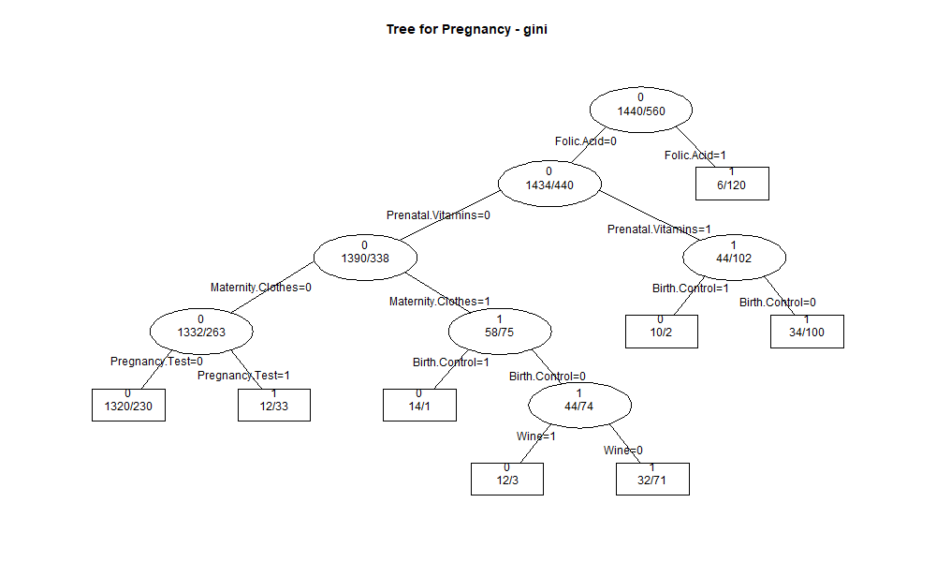
Practice…Poll
https://www.sli.do/
Use # 68881
Or
https://app.sli.do/event/tyl2nmrk

Slide 32
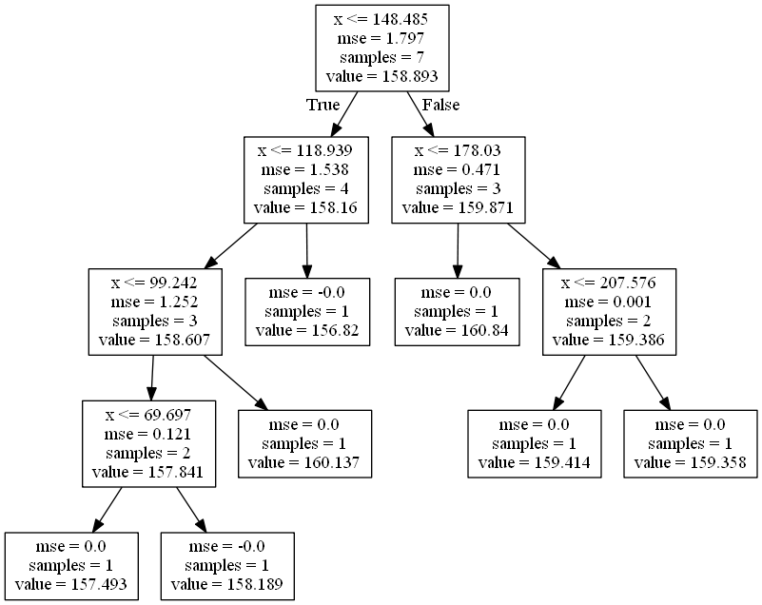
Source: https://botbark.com/2020/01/01/decision-tree-regression-in-python-in-10-lines/

Slide 33








Regression Based Example
Annual Income | Between Averages | Life Expectancy | Below Ave of 6.75 (Prediction) | Above Ave of 6.75 (Prediction) | SE True - Predict
6.5 |  | 75 | 75 75/1 =75 | 85 80 67 85+80+67/3= 77.3 | (75-75)² = 0
7.0 | 6.75 | 85 |  |  | (85-77.3)²= 59.29
8.0 | 7.5 | 80 |  |  | (80-77.3)² = 7.29
8.5 | 8.25 | 67 |  |  | (67-77.3)² = 106.09 SSE=(0+59.29+7.29+106.09) = 172.67
Need to Calculate Sum of Squared Error for every split
First Step is SE –
Then SSE -

Slide 34










Regression Based Example
Annual Income | Between Averages | Life Expectancy | SSE
6.5 |  | 75
7.0 | 6.75 | 85 | 172.67
8.0 | 7.5 | 80 | 134.5
8.5 | 8.25 | 67 | 50
Do this same calculation for every split and pick the lowest score.
MSE = SSE/n
Find the average (80), then do the below:
(75-80) ² + (85-80) ² + (80-80) ²
(25+25+0)/3 = 16.67
What is the MSE for the right side of the equation?

Slide 35
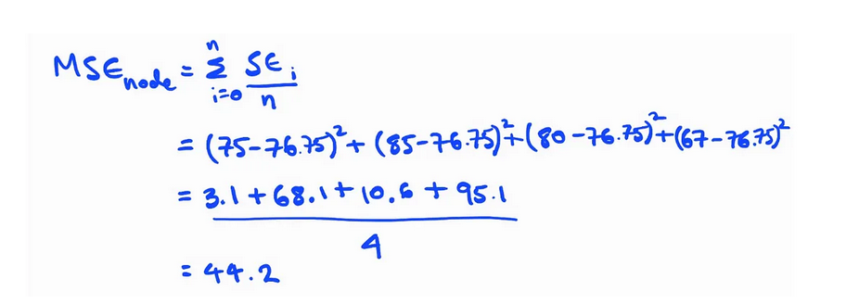

Slide 36
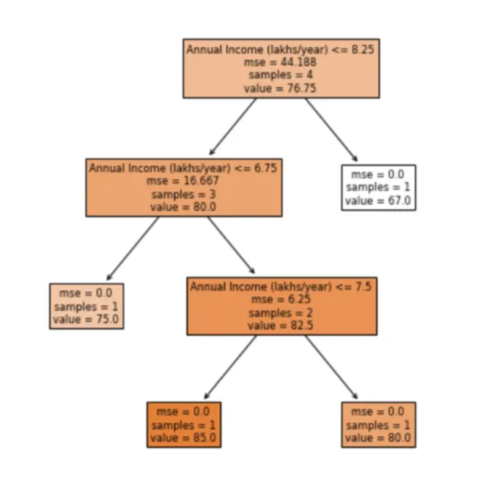

Slide 37
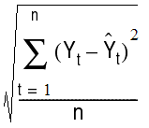
Mathematical Approaches: Regression/MSE
Works to identify the split point in the data set that minimizes sum of squared error (SSE) point
The average of each of the groups is the term that minimizes the mean squared error
MSE – is the average of the difference between the prediction and actual values
The decision tree algorithm searches through all variables and all possible split points to identify the point that minimizes error
Original CART paper: Breiman, Leo, et al. Classification and regression trees. CRC press, 1984.

Slide 38
Decision Trees: Overfitting and Hyper-parameters
Decision trees are often prone to overfitting, one solution is to utilize the hyper-parameters to control how the tree grows
Another option is to use an ensemble method via bagging or what’s known as Random Forest

Slide 39
Decision Trees: Hyper-parameter tuning (Pruning)
Minimum samples for a node split Minimum number of samples (or observations) which are required in a node to be considered for splitting. Higher values prevent a model from learning relations which might be highly specific to the particular sample. It should be tuned using cross validation.
Minimum samples for a terminal node (leaf) The minimum number of samples (or observations) required in a terminal node or leaf. For imbalanced class problems, a lower value should be used since regions dominant with samples belonging to minority class will be much smaller in number.
Maximum depth of tree (vertical depth) The maximum depth of trees, lower values prevent a model from learning relations which might be highly specific to the particular sample. It should be tuned using cross validation.

Slide 40
Decision Trees: Hyper-parameter tuning (Pruning)
Maximum number of terminal nodes Also referred as number of leaves. Since binary trees are created, a depth of n would produce a maximum of 2^n leaves.
Maximum features to consider for split The number of features to consider (selected randomly) while searching for a best split. A typical value is the square root of total number of available features. A higher number typically leads to over-fitting but is dependent on the problem as well.

Slide 41
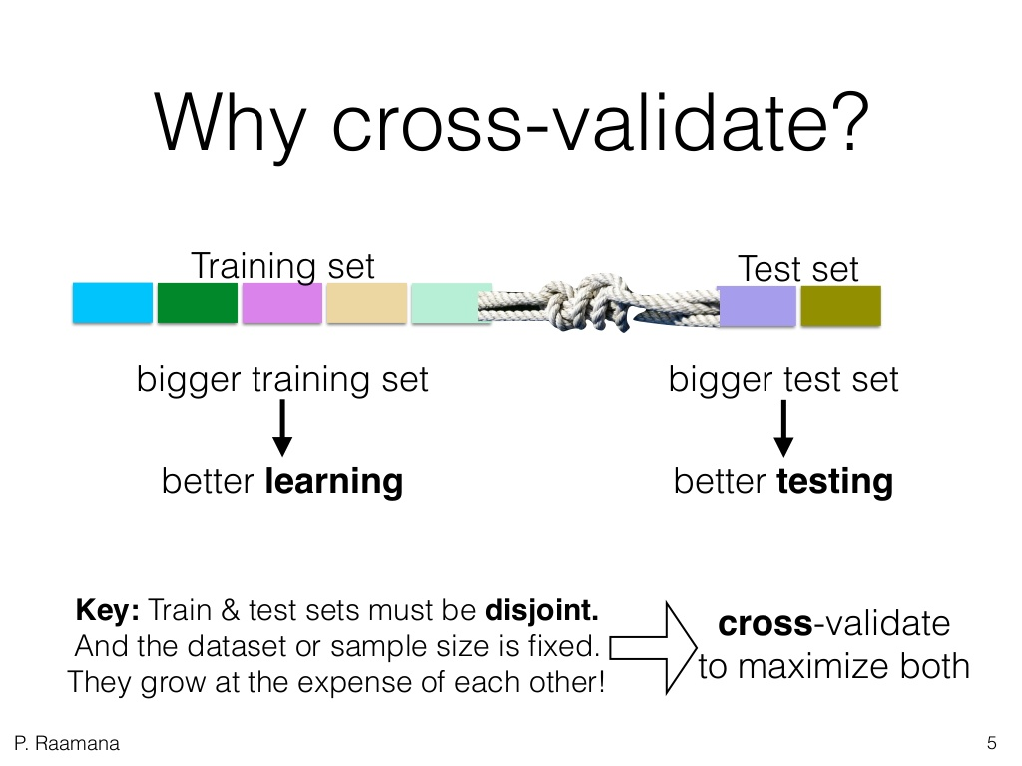
Cross- Validation

Slide 42
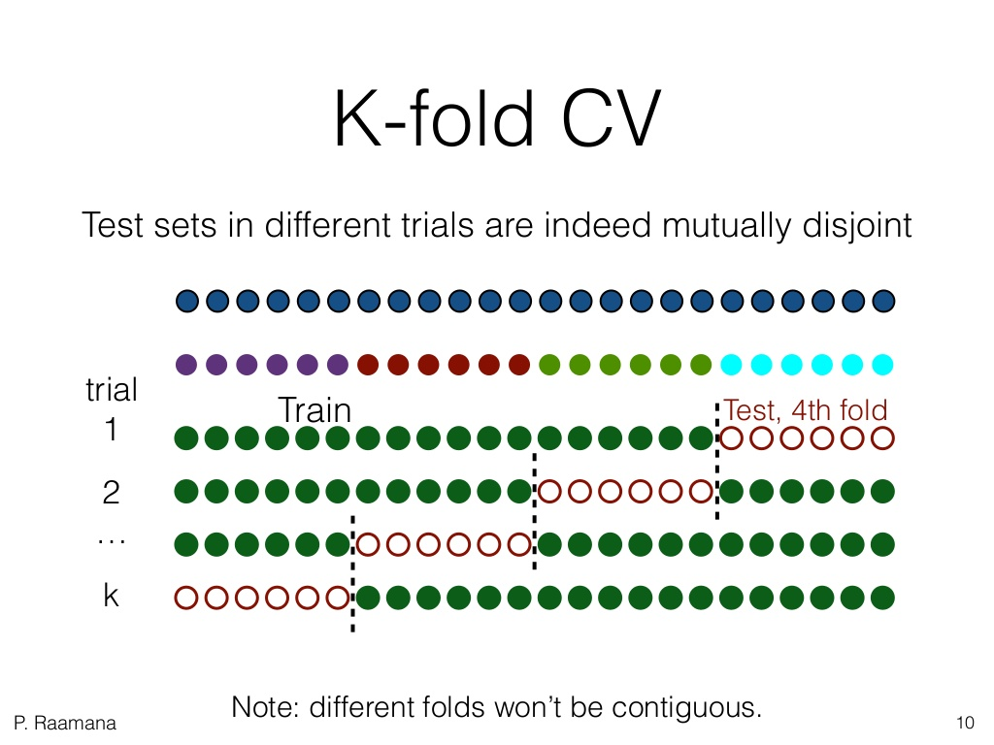
Cross-Validation

Slide 43
Decision Trees: Definitions
Overfitting – model becomes overly complex and as a result is predicting noise or the space between features (random error) instead of the true relationship. It is in theory possible to create a leaf node for every data point.
Ensemble methods – Process of running numerous models and codifying them using a decision rule to choose the optimal model result – example is majority vote on feature inclusion
Heuristic algorithms – approaches designed for operational efficiency generating an approximation to the ideal result but does not guarantee the best model

Slide 44
Ensemble Methods
A standard error is by definition the standard deviation of the sampling distribution of a parameter estimate, generated by repeated sampling.
xerror reflects the mean of the sample means (of the errors) from the ten folds;
xstd reflects the standard deviation of the sample means (of the errors) from the ten folds. Thus, xstd is a standard deviation of sample means, which is also known as the standard error of the mean.

Slide 45
Decision Trees: Balancing Dataset
Imbalanced classes often considers imbalanced to mean a minority class of 10% to 20%. In reality, datasets can get far more imbalanced than this, examples:
About 2% of credit card accounts are defrauded per year¹. (Most fraud detection domains are heavily imbalanced.)
Medical screening for a condition is usually performed on a large population of people without the condition, to detect a small minority with it (e.g., HIV prevalence in the USA is ~0.4%).
The conversion rates of online ads has been estimated to lie between 10⁻³ to 10⁻⁶.
Factory production defect rates typically run about 0.1%.
Intrusion or threat detection, .0001% of network traffic

Slide 46
Decision Trees: Balancing Dataset
Working on real world problems will almost certainly include unbalanced datasets. Making standard algorithms function inefficiently.
Solution is to oversample the minority target or under-sample the majority to create a more balanced training dataset
Oversampling – Most commonly used, can result in a synthetic reduction in the variance associated with the variable but as a positive it essentially duplicates the number of errors, i.e. if there’s a single false positive and it’s included five times you get four additional errors.

Slide 47
Example in Python

