Slide 1

Introduction to Decision Trees, Background and Application Brian Wright

Slide 2
Quick Poll
Use the information below, I’m just trying to get a sense of your experience
https://www.sli.do/
Use #SampleTeach
or
https://app.sli.do/event/deprxouk
Git repository:
https://github.com/NovaVolunteer/UVA_Sample_Teach

Slide 3
Outline
Decision Trees
Basics
Background
Advantages and Limitations
Mathematical Approaches and Example
Example in R
Evaluation
Ensemble
Random Forest
Example

Slide 4
Basics: Graph Elements
Tree begins with a Root Node that has no incoming edges and two or more out going edges
Internal Node – Has one incoming edge and two or more outgoing and represent test conditions at every given level
Leaf Node – One incoming edge and no outgoing edges
Edges – Connections between nodes

Slide 5
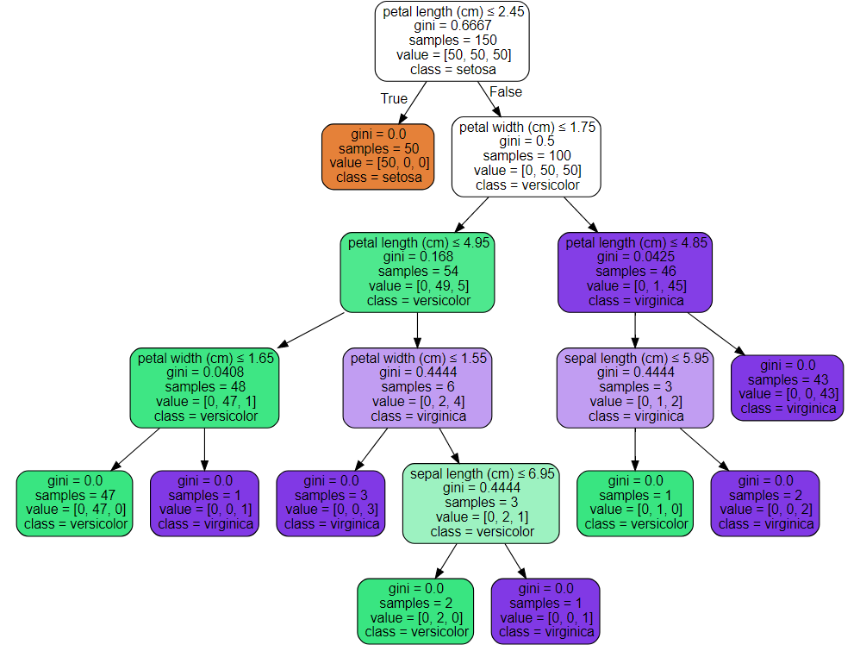
Basics: Graph Example
Root Node
Edges
Internal Nodes
Leaf Nodes

Slide 6


Basics: Intuition
What is the most important question to move on to a second date? The question with the most amount of relevant information.
>
Are you married?
What music do you like?
Notes:
Imagine a real-life situation where you go on a date with someone you met from the internet. What would be the most important question to ask? For example, what do you do for a living? Where did you grow up? These are questions that drive a conversation and provide information about the person you are talking to.

Slide 7
Basics: Intuition
How do you combine questions? Conditional on the first answer - select the next most important question for information gain.
Are you married?
Are you married?
Question 1
YES
NO
YES
NO
>
What music do you like?
Belief in a blue colored sky?
Question 2
Stop!
Stop!
Notes:
To get as much information as possible, people usually ask a series of relevant questions, and conditional on the answers to previous questions, come up with new questions on the fly. A question is relevant when it provides more information; let’s take dating for example, what music do you like is more relevant in terms of relationship than what color is the sky.

Slide 8


Basics: Intuition
When should you stop asking questions? When the answer no longer provides additional relevant information.
50% WILL GO ON
A SECOND DATE
What music do you like?
50% WILL GO ON
A SECOND DATE
Notes:
Eventually you will reach the stopping point where you have had enough information about the person you are meeting with, and asking more questions do not necessarily add valuable addition to the amount of information previously acquired.

Slide 9

Basics: Building a tree in four steps
Step 1: Ask the question with the most amount of information, where “most amount of information” is based on some objective criteria.
Step 2: Conditional on the first answer, select the next most important question.
Step 3: When the answer no longer provides additional information (no information gain), stop growing the branch.
Step 4: Repeat steps 2 and 3 for each question branch.
Notes:
Repeat step 2 and 3 for each question branch.

Slide 10
Basics
Decision trees are a hierarchical technique
Meaning that a series of decisions are made until a predetermined metric is met
Model is built such that a sequence of ordered decisions concerning values of data features results in assigning class labels
Nonparametric
Number of parameters is not pre-determined as is the case with linear models that have pre-determine parameters thus limiting their degrees of freedom
No assumptions need to be met concerning parameters or distributions
Best recognized through graphs produced
Type of Acyclic graph - are used to model probabilities, connectivity, and causality. A “graph” in this sense means a structure made from nodes and edges
Trees consist of nodes and edges defined by decisions rules applied to the data features

Slide 11
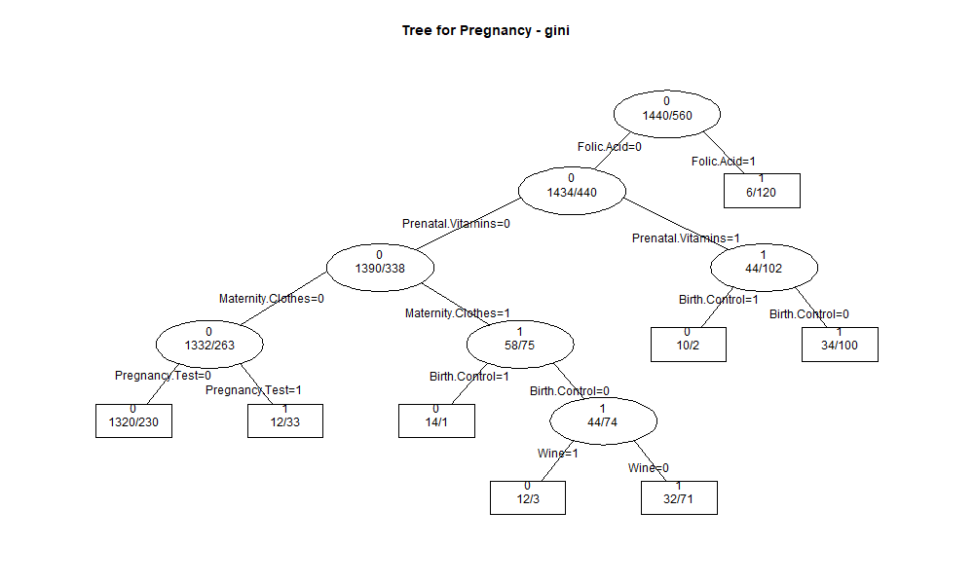
Practice…Poll
https://www.sli.do/
Use #SampleTeach
or
https://app.sli.do/event/deprxouk

Slide 12

Background
Source: https://www.thehindu.com/features/friday-review/where-sanskrit-meets-computer-science/article7061379.ece

Slide 13
Background
Uses recursive binary splitting - Considering every possible partition of space is computationally infeasible, a greedy approach is used to divide the space.
Greedy algorithm because at each step of the tree building process, the best split is made at that particular step, rather than looking ahead and picking a split that will lead to a better tree in the future.
Trees can be regression or classification based, but in both instances will use recursive binary splitting
The difference is that in regression based trees we are predicting the actual class whereas in classification we are generating the probability of class inclusion as the determinate of the splitting
This probability measure that drives the splitting for classification comes in two forms: Gini Index or Entropy

Slide 14
Background: CART Algorithm (and C4.5)
Classification and Regression Tree (CART) – 1984 Breiman, Friedman, Olshen and Stone
Can be used on numerical or categorical data
First splits the training data in two subsets using a single feature k and a threshold t_{k}
Searches through all possible pairs (k, t_{k}) to identify the split that produces the purest subsets, based on weighted average of information gain.
Stops once it cannot find a split that reduces impurity or by a pre-determine node size (hyperparameter).
C4.5 – Grew out of a earlier version ID3 in the late 1980s early 90s both from J. Ross Quinlan, uses entropy and information gain.

Slide 15

Advantages and Limitations
Source: https://socialmediamanager.tweetinggoddess.com/2018/04/20/advantages-and-disadvantages-of-twitter/

Slide 16
Advantages
Simple to understand and to interpret through visualization.
Requires little data preparation. Other techniques often require data normalization, dummy variables need to be created and blank values to be removed.
Able to handle both numerical and categorical data.
Uses a white box model. If a given situation is observable in a model, the explanation for the condition is easily explained by boolean logic. By contrast, in a black box model (some neural network approaches), results may be more difficult to interpret.
Fairly straight forward to evaluate and understand reliability of the model. ROC/Hit Rate/Error Rate/

Slide 17
Limitations
Decision-tree learners can create over-complex trees that do not generalize the data well. This is called overfitting.
Compare terminal nodes to data points, use the depth of the tree to calculate terminal nodes, for example 6 levels = 2⁶ or 64 terminal nodes, if you have 100 data points that’s a lot of single data terminal nodes. Leaf nodes roughly double with every additional level of the tree.
Mechanisms such setting the minimum number of samples required at a leaf node or setting the maximum depth of the tree can be used to avoid this problem.
Decision trees can be unstable as small variations in the data might result in a completely different tree being generated. This problem is mitigated by using decision trees within an ensemble like Random Forest.

Slide 18
Limitations
Practical decision-tree learning algorithms are based on heuristic algorithms such as the greedy algorithm where locally optimal decisions are made at each node.
Such algorithms cannot guarantee to return the globally optimal decision tree. This can be mitigated by training multiple trees in an ensemble learner, where the features and samples are randomly sampled with replacement.
Decision tree learners create biased trees if some classes dominate. It is therefore recommended to balance the dataset prior to fitting if necessary

Slide 19
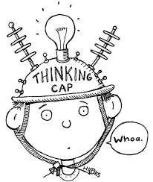
Quiz time!!!
Which one of the following is a limitation of DTs?......Use same link below:
https://www.sli.do/
Use #SampleTeach
or
https://app.sli.do/event/deprxouk
Source : http://www.sclance.com/clipart/student-thinking-clipart-black-and-white/view-page-2.htm

Slide 20
Mathematical Approaches and Example

Slide 21
Mathematical Approaches: Node split criterion
Decision Trees can use several different types of node split criteria depending on the data or data scientist’s preference
Regression/MSE – Continuous data
Entropy – Binary data splits
Gini Coefficient – Most common approach
Let’s take a look at each approach
Both Entropy and Gini Coefficient use Information Gain to determine variable split criteria

Slide 22
Mathematical Approaches: Classification, Entropy (C4.5)
The formula for entropy is below, where Pi is the probability that a random selection would have a state i
Entropy = sum(-P_{i} * log₂P_{i})
= 3
= 2
= 0
= 3
= 4
= 6
(3/6 log₂ 3/6) – (3/6 log₂ 3/6) = 1
(2/6 log₂ 2/6) - (4/6 log₂ 4/6)
= 0.92
(6/6 log₂ 6/6) = 0
Notes:
Before we start building decision trees, there are few key mathematical concepts and notations need to be reviewed. First and foremost, logarithm. The logarithm of a number X is the exponent that you need to take a base number Y to get X. For example, log base 2 of 8 is 3, and log base 2 of 16 is 4. Notice that in R, the default base for the log function is the mathematical constant e, which equals to 2.718282.

Slide 23
Mathematical Approaches: Classification, Entropy
Information gain helps us understand how important an attribute is in the data
We can use it to decide how to order the nodes of the decision tree
Information gain = entropy (parent) – average entropy (children)
entropy (parent)
average entropy (children)
-(3/6 log₂ 3/6) – (3/6 log₂ 3/6) = 1
-(3/4 log₂ 3/4) – (1/4 log₂ 1/4)
= 0.81
-(2/2 log₂ 2/2)
= 0
Notes:
Before we start building decision trees, there are few key mathematical concepts and notations need to be reviewed. First and foremost, logarithm. The logarithm of a number X is the exponent that you need to take a base number Y to get X. For example, log base 2 of 8 is 3, and log base 2 of 16 is 4. Notice that in R, the default base for the log function is the mathematical constant e, which equals to 2.718282.

Slide 24
Mathematical Approaches: Classification, Entropy
In order to calculate the average entropy for the split, we need to weigh the split by the number of data points in each node. So we create a weighted average of the entropy of the children nodes.
Information gain = entropy (parent) – average entropy (children)
entropy (parent)
Weighted average entropy (children)
= 1
= (2/6 * 0) + (4/6 * 0.81)
= 0.54
Notes:
Before we start building decision trees, there are few key mathematical concepts and notations need to be reviewed. First and foremost, logarithm. The logarithm of a number X is the exponent that you need to take a base number Y to get X. For example, log base 2 of 8 is 3, and log base 2 of 16 is 4. Notice that in R, the default base for the log function is the mathematical constant e, which equals to 2.718282.

Slide 25
Mathematical Approaches: Information gain + entropy: example
In order to construct the tree, we need to follow three steps:
Choose the attribute with the highest information gain
Construct the child nodes
Repeat steps 1 and 2 recursively until
no more information can be gained
Should you play outside?
Outlook | Temp | Humidity | Play
Sunny | Hot | High | No
Sunny | Hot | Low | No
Cloudy | Cool | High | Yes
Sunny | Cool | Low | Yes

Slide 26
Mathematical Approaches: Information gain + entropy: example
Choose the attribute with the highest information gain
-(2/4 log₂ 2/4) – (2/4 log₂ 2/4) = 1
2 yes 2 no
Sunny
Cloudy
1 yes, 2 no
1 yes
Should you play outside?
-(1/3 log₂ 1/3) – (2/3 log₂ 2/3)
= 0.92
-(1/1 log₂ 1/1) = 0
Outlook | Temp | Humidity | Play
Sunny | Hot | High | No
Sunny | Hot | Low | No
Cloudy | Cool | High | Yes
Sunny | Cool | Low | Yes
weighted average
I.G. = 1 – ((3/4 * 0.92) + (1/4 * 0)) = 0.31
Notes:
As entropy increase information gain decreases

Slide 27
Mathematical Approaches: Information gain + entropy: example
Choose the attribute with the highest information gain
-(2/4 log₂ 2/4) – (2/4 log₂ 2/4) = 1
2 yes 2 no
Hot
Cool
2 no
2 yes
Should you play outside?
-(2/2 log₂ 2/2) = 0
-(2/2 log₂ 2/2) = 0
Outlook | Temp | Humidity | Play
Sunny | Hot | High | No
Sunny | Hot | Low | No
Cloudy | Cool | High | Yes
Sunny | Cool | Low | Yes
weighted average
I.G. = 1 – ((2/4 * 0) + (2/4 * 0)) = 1
I.G.
0.31
Notes:
Want the children nodes to be zero so when subtracted from the parent the result is 1

Slide 28
Mathematical Approaches: Information gain + entropy: example
Choose the attribute with the highest information gain
-(2/4 log₂ 2/4) – (2/4 log₂ 2/4) = 1
2 yes 2 no
High
Low
1 yes 1 no
1 yes 1 no
Should you play outside?
-(1/2 log₂ 1/2) – (1/2 log₂ 1/2)
= 1
-(1/2 log₂ 1/2) – (1/2 log₂ 1/2) = 1
Outlook | Temp | Humidity | Play
Sunny | Hot | High | No
Sunny | Hot | Low | No
Cloudy | Cool | High | Yes
Sunny | Cool | Low | Yes
weighted average
I.G. = 1 – ((2/4 * 1) + (2/4 * 1)) = 0
I.G.
0.31
1

Slide 29
Mathematical Approaches: Information gain + entropy: example
Temp has the highest information gain resulting in an entropy of 1, meaning that this attribute perfectly matches class prediction
Play
Should you play outside?
2 yes 2 no
Outlook | Temp | Humidity | Play
Sunny | Hot | High | No
Sunny | Hot | Low | No
Cloudy | Cool | High | Yes
Sunny | Cool | Low | Yes
Hot
Cool
2 no
2 yes
I.G.
0.31
1
0
Notes:
Let’s look at the toy data set where we need to create a decision trees model to determine, based on outlook, temperature, humidity and wind level, whether to play outside.

Slide 30
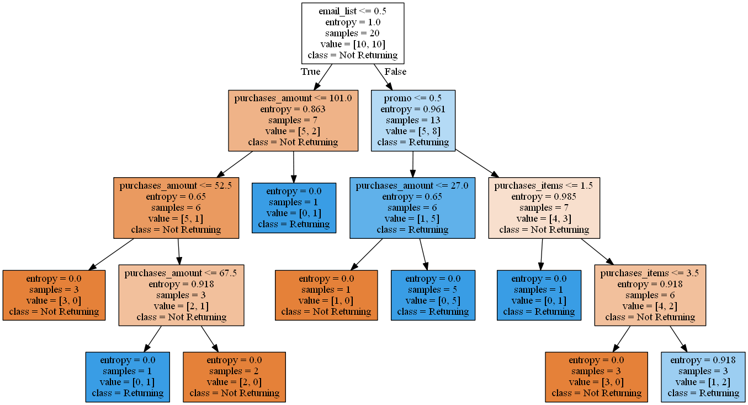
Mathematical Approaches: Returning Customer Example

Slide 31
Mathematical Approaches: Classification, Gini Coefficient (CART)
Gini
Gini Impurity = 1 – sum[(Pi)²]
Pi – Represents the probability that a random selection would have state i (kinda like a target)
Same mathematical process as entropy
Example:
2 yes 2 no
1 – [ (2/4)² – (2/4)² ] = 0.5
1 yes, 2 no
1 yes
1 – [ (1/3)² + (2/3)² ] = 0.44
1 – [ (1/1)² ] = 0
weighted average
Gain = 0.5 – ((3/4 * 0.44) + (1/4 * 0)) = 0.19
Notes:
Even split for gini is .05 whereas for entropy it’s 1, still want closer to zero.

Slide 32
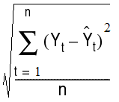
Mathematical Approaches: Regression/MSE
Works to identify the split point in the data set that minimizes mean squared error (MSE) point
The average of each of the groups is the term that minimizes the mean squared error
MSE – is the average of the difference between the prediction and actual values
The decision tree algorithm searches through all variables and all possible split points to identify the point that minimizes error

Slide 33
Example in R

Slide 34
Decision Trees: Overfitting and Hyper-parameters
Decision trees are often prone to overfitting, one solution is utilize the hyper-parameters to control the depth of the tree or limit the expansion of leaf nodes
Another option is to use a ensemble method via bagging or what’s known as Random Forest

Slide 35
Decision Trees: Hyper-parameter tuning (Pruning)
Minimum samples for a node split Minimum number of samples (or observations) which are required in a node to be considered for splitting. Higher values prevent a model from learning relations which might be highly specific to the particular sample. It should be tuned using cross validation.
Minimum samples for a terminal node (leaf) The minimum number of samples (or observations) required in a terminal node or leaf. For imbalanced class problems, a lower value should be used since regions dominant with samples belonging to minority class will be much smaller in number.
Maximum depth of tree (vertical depth) The maximum depth of trees, lower values prevent a model from learning relations which might be highly specific to the particular sample. It should be tuned using cross validation.

Slide 36
Decision Trees: Hyper-parameter tuning (Pruning)
Maximum number of terminal nodes Also referred as number of leaves. Since binary trees are created, a depth of n would produce a maximum of 2^n leaves.
Maximum features to consider for split The number of features to consider (selected randomly) while searching for a best split. A typical value is the square root of total number of available features. A higher number typically leads to over-fitting but is dependent on the problem as well.
There’s actually many more, the documentation is here:
http://scikit-learn.org/stable/modules/generated/sklearn.tree.DecisionTreeClassifier.html

Slide 37

Evaluation
Source: https://life.solventuregroup.com/2017/09/25/improve-forecast-accuracy/

Slide 38
Decision Trees: Evaluation: Receiver Operating Curve or Area Under the Curve
ROC and AUC are two very common approaches for measuring the performance of classification models
Essentially both these measure the misclassification error rate associated with your model
A Confusion Matrix is a good tool for understanding how accurate you model is classifying and can be used to build ROC

Slide 39
Decision Trees: Evaluation: Confusion Matrix and threshold
Let‘s use intruder detection as a example
Say we have 135 emails entering our system and we are trying to detect whether they are fraudulent or not
We use lots of criteria – source, subject, if they came from a prince…
Generate probability measures as a result of our tree algorithm to determine the likelihood that any one of these emails fraudulent
The cutoff point that is predetermined in the tree at 50% but can be modified as a input the confusion_matrix() function by adjusting the sample_weight parameter
 | Predictive Class
Actual Class |  | Positive Fraud | Negative Not Fraud
 | Positive Fraud | True Positive 10 | False Negative 7
 | Negative Not Fraud | False Positive 22 | True Negative 96

Slide 40
Decision Trees: Evaluation: Confusion Matrix and threshold
Let’s consider the extremes: what if we set the threshold to 0?
Means that everything is captured as Fraud and no ever gets a email again!
 | Predictive Class
Actual Class |  | Positive Fraud | Negative Not Fraud
 | Positive Fraud | True Positive 17 | False Negative 0
 | Negative Not Fraud | False Positive 118 | True Negative 0
Let’s consider the extremes: what if we set the threshold to 100?
Means nothing is fraud and now everyone is getting rich off of Arabian princes

Slide 41
Decision Trees: Evaluation: Confusion Matrix and threshold
Let’s consider the extremes: what if we set the threshold to 100?
Means nothing is fraud and now everyone is getting rich off of Arabian princes
 | Predictive Class
Actual Class |  | Positive Fraud | Negative Not Fraud
 | Positive Fraud | True Positive 0 | False Negative 17
 | Negative Not Fraud | False Positive 0 | True Negative 118

Slide 42
Decision Trees: Evaluation: Confusion Matrix and threshold
We can also predict the accuracy of our model using this information:
True Positive Rate (TPR) = 10/(10+22) = .45
False Positive Rate (FDR) = 7/(7+96) = .06
 | Predictive Class
Actual Class |  | Positive Fraud | Negative Not Fraud
 | Positive Fraud | True Positive 10 | False Negative 7
 | Negative Not Fraud | False Positive 22 | True Negative 96
These two data points can then be used to begin to develop a Receiver Operating Characteristic Curve or ROC curve
True Positive Rate (TPR) = 10/(10+22) = .45 = y-axis
False Positive Rate (FDR) = 7/(7+96) = .06 = x-axis

Slide 43
Outline
Decision Trees
Basics
Theoretical Background
Advantages
Limitations
Mathematical Approaches
Pruning
Evaluation
Case Study
Ensemble
Random Forest
Example
Practice

Slide 44
Ensemble Methods

Slide 45
Ensemble Methods
Ensemble methods are more or less aggregated predictions of many different algorithms in order to increase predictive accuracy.
Often in solving a machine learning problem building a ensemble model comes at the end of the process after trying several different approaches you can combine them into one all knowing predictor!
We will focus on Random Forrest, a ensemble of decision tress but also discuss bagging and boosting

Slide 46
Ensemble Methods
Example: suppose we have developed several different classifiers a KNN model, Logistic Regression, an SVM and a Decision Tree.
We could use the majority vote process to build the final classification of our data points, based on below what would be the outcome for this single data point?
This is called hard voting, another approach is soft voting (discuss later)
This process often works better than using single weak learners – or algorithms that predict only slightly better than random guessing
Model | KNN | Logistic Regression | Support Vector Machine | Decision Tree
Prediction | 1 | 0 | 1 | 1

Slide 47
Ensemble Methods
Why do the models work better together?
Essentially scale increases the probability of finding a majority vote.
As an example if we have a bias coin flip the gives us 51% chance of heads and 49% chance of tails the more we toss the coin the higher the probability of getting a majority vote for heads.
1,000 = 75% chance
10,000 = 97% chance
Works the same way for model building, the reliability of the results simple increase with scale.
Works best if the models are perfectly independent, meaning the error terms don’t correlation which is hard when using one approach on a single dataset, that’s why combining approaches can sometimes result in better outcomes

Slide 48
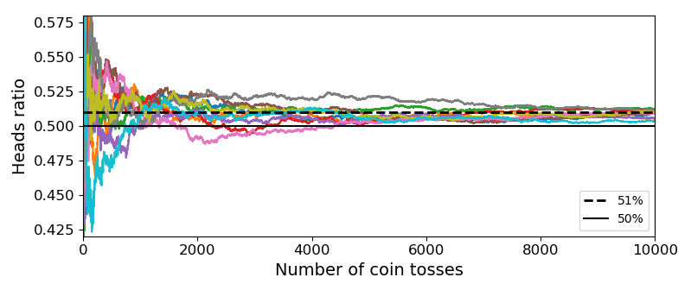
Ensemble Methods: Probabilities Converge (Code Available)

Slide 49
Ensemble Methods: Ensemble
Soft voting is used for algorithms that produce probabilistic outputs or those that have a hyperparameter that can be modified to support probability outputs (such as SVM, probability hyperparameter to TRUE).
The class is generated using the highest class probability as the metric
Replacing voting = hard to voting = soft in the VotingClassifier() function

Slide 50
Decision Trees: Balancing Dataset
Imbalanced classes often considers imbalanced to mean a minority class of 10% to 20%. In reality, datasets can get far more imbalanced than this, examples:
About 2% of credit card accounts are defrauded per year¹. (Most fraud detection domains are heavily imbalanced.)
Medical screening for a condition is usually performed on a large population of people without the condition, to detect a small minority with it (e.g., HIV prevalence in the USA is ~0.4%).
The conversion rates of online ads has been estimated to lie between 10⁻³ to 10⁻⁶.
Factory production defect rates typically run about 0.1%.
Intrusion or threat detection, .0001% of network traffic

Slide 51
Decision Trees: Balancing Dataset
Working on real world problems will almost certainly include unbalanced datasets. Making standard algorithms function inefficiently.
Solution is to oversample the minority target or under-sample the majority to create a more balanced training dataset
Oversampling – Most commonly used, can result in a synthetic reduction in the variance associated with the variable but as a positive it essentially duplicates the number of errors, i.e. if there’s a single false positive and it’s included five times you get four additional errors.

Slide 52
Ensemble Methods: Random Forest – power in numbers
Ensemble methods – Essentially instead of building a single tree we are going to build a whole bunch
We can limit the growth of the trees but don’t have to use any of the hyper-parameters
Set the number of trees grown and track the error classification rate of our algorithm
Can be used for again for both Regression or Classification
Random Forest uses bagging
Bagging – Bootstrap Aggregation – selecting subsets of the data with replacement to generate unique trees
Boosting – Another form of dataset selection that is commonly used in ensemble methods

Slide 53

Ensemble Methods: Bagging
As discussed on method is to use several methods and combine them to produce a more powerful outcome
You can also you the same technic but re-sample the data numerous times to produce different results, one such method is Bagging
Bagging – is sampling with replacement, meaning that the entire dataset is available for every sub-sample. (without replacement is often called pasting)
3) Predictors
2) Training
1) Random Samples

Slide 54
Ensemble Methods: Random Forest
Sampling with replacement
Sampling without replacement
Obs | X1 | X2 | Y1 | Y2
1 | 2.5 | 3.6 | 4.8 | 3.7
2 | 2.8 | 4.7 | -2.8 | 7.1
3 | 5.8 | 9.7 | 9.1 | 13
Obs | X1 | X2 | Y1 | Y2
1 | 2.5 | 3.6 | 4.8 | 3.7
2 | 2.8 | 4.7 | -2.8 | 7.1
1 | 2.5 | 3.6 | 4.8 | 3.7
Obs | X1 | X2 | Y1 | Y2
2 | 2.8 | 4.7 | -2.8 | 7.1
1 | 2.5 | 3.6 | 4.8 | 3.7
3 | 5.8 | 9.7 | 9.1 | 13
Notes:
Unlike restaurant reviews submitted by different individual, how can we ensure the randomness of decision trees model from an existing training set? Bagging, short for “Bootstrap aggregation”, is a resampling method. It generates a new training set from existing training set by sampling with replacement.

Slide 55

Ensemble Methods: Random Forest
If we keep building decision trees on the same dataset, we would essentially get the same decision trees every time
Obs | X1 | X2 | Y1 | Y2
1 | 2.5 | 3.6 | 4.8 | 3.7
2 | 2.8 | 4.7 | -2.8 | 7.1
3 | 5.8 | 9.7 | 9.1 | 13
Obs | X1 | X2 | Y1 | Y2
2 | 2.8 | 4.7 | -2.8 | 7.1
1 | 2.5 | 3.6 | 4.8 | 3.7
3 | 5.8 | 9.7 | 9.1 | 13
Obs | X1 | X2 | Y1 | Y2
3 | 5.8 | 9.7 | 9.1 | 13
1 | 2.5 | 3.6 | 4.8 | 3.7
2 | 2.8 | 4.7 | -2.8 | 7.1
Notes:
Bagging is used to generate multiple training sets from existing training set to which decision trees model is fitted. Each resulting decision trees would not necessary be different because even sampling with replacement would generate identical sample, however, it does add randomness to the outcome.

Slide 56


Ensemble Methods: Random Forest
Use a subset of attributes generated by bagging to build original data sets to make decision trees
Obs | X1 | X2 | Y1 | Y2
1 | 2.5 | 3.6 | 4.8 | 3.7
1 | 2.5 | 3.6 | 4.8 | 3.7
3 | 5.8 | 9.7 | 9.1 | 13
Obs | X1 | X2 | Y1 | Y2
2 | 2.8 | 4.7 | -2.8 | 7.1
1 | 2.5 | 3.6 | 4.8 | 3.7
2 | 2.8 | 4.7 | -2.8 | 7.1
Obs | X1 | X2 | Y1 | Y2
3 | 5.8 | 9.7 | 9.1 | 13
3 | 5.8 | 9.7 | 9.1 | 13
2 | 2.8 | 4.7 | -2.8 | 7.1
Notes:
In addition to “Bagging”, random forest algorithm only uses a subset of attributes as compared to the full set of attributes in decision trees. Given two randomly selected attributes and training set, each decision trees model will produce different results which ensures the randomness of random forest model.

Slide 57
Ensemble Methods: Bagging
Typically once the sub-samples have been gathered the new classes are generated through hard voting for classification or the average for regression
However if the algorithm produces a probabilistic output, like decision trees, soft voting is used.

Slide 58
Ensemble Methods: Random Forest
Instead of building the ensemble from the ground up using the bagging method we can also just use the Random Forrest classifier
Typically all the hyperparameter are the same as the DecisionTreeClassifier and the hyperparameters of the baggingclassifier
Extra Randomness is also included as the Random Forest classifier as it searches for the best node split among all the random subsets of features
This creates greater tree diversity but trades higher variance for lower bias, which is often the case when increasing the complexity of the method
Bias – is underfitting a model, meaning you’re missing important relationships between variables.
Variance – is overfitting the model, meaning the model is measuring the spaces between data points or the noise versus

Slide 59
Ensemble Methods: Random Forest: Variable Importance
One of the really nice features associated with Random Forrest is it’s ability to select variables that are most “important” to training the model.
This is done by determining which variables are closest to the root of the tree and then moving outward
Random Forrest does this at scale and the output is generated as a part of the training process
Sklearn calculates the average depth at which each feature is utilized and ranks them accordingly

Slide 60
Decision Trees: Definitions
Overfitting – model becomes overly complex and as a result is predicting noise or the space between features (random error) instead of the true relationship. It is in theory possible to create a leaf node for every data point.
Ensemble methods – Process of running numerous models and codifying them using a decision rule to choose the optimal model result – example is majority vote on feature inclusion
Heuristic algorithms – approaches designed for operational efficiency generating a approximation to the ideal result but does not guarantee the best model

Slide 61
Main Sources
Hands-on Machine Learning with Scikit-Learn & Tensor Flow – Aurelien Geron
Data Science and Analytics with Python – Jesus Rogel-Salazar
Machine Learning in Python – Michael Bowles
Python Machine Learning – Sepastian Raschka & Vahid Mirjalili

