Slide 1

ML 2023 Project – Type A Team Name: All' ultimo momentum
Andriani Paolo
Velardita Michele
Department of Computer Science,
University of Pisa
A/A 23-24

Slide 2
Abstract
In this project, a flexible neural network was implemented in Python, allowing the selection of the number of layers, activation functions, and the use of L2 regularization. Gradient descent, stochastic gradient descent (SGD), classical moment (CM), and accelerated Nesterov gradient (NAG) methods were implemented. Additionally, we developed grid search and k-fold cross validation for parameter tuning and model validation. Our experiments and hypotheses, as will be better explained later, were based on the results of previous studies [1] [2] [3].

Slide 3
Introduction - reviewed papers
[1] The importance of weight initialization together with an increasing momentum schedule greatly influences the performance of the model. The authors show how in the transient phase of NN training, momentum-based methods (applied to the stochastic case) maintain better performances than simple SGD.
[2] [3] Although SGD, CM and NAG with mini-batch show the same order of convergence in expectance, momentum helps to generalize better. The empirical results in [2] & [3] demonstrates that NAG (in stochastic setting) achieves a good tradeoff between speed of convergence in TR error and robustness of convergence in Test.

Slide 4
Introduction - hardware specification
All the most time consuming experiments were conducted on a PC with 32 GB RAM Ryzen 7 5800x 8 core/16 thread processor
To expedite the parameter search, we utilized the Joblib[4] library to parallelize the grid search process. This approach significantly reduced the model validation times

Slide 5
Introduction - objectives
Aim
Explore in depth momentum-based methods in neural network training.
Rationale
Studying these methods early saves validation time to find good parameters and provides valuable insights.
Approach
Conduct experiments to verify characteristics from literature.
Develop and validate models for MONK tasks and the CUP dataset.

Slide 6
Introduction – preliminary experiments
We delved into momentum-based optimization methods by studying and replicating experiments from key research papers. This provided us with several insights:
Nesterov Accelerated Gradient (NAG) demonstrates higher tolerance at elevated momentum μ values, especially with larger step sizes α .
Implementing a momentum schedule reduces the need for parameter tuning and enhances stability in the learning process.
Overall, momentum-based methods offer superior generalization and stability compared to standard Stochastic Gradient Descent (SGD).
{ Appendix 1 }
{ Appendix 1.1 }
{ Appendix 2 }

Slide 7
Introduction - method
In-depth analysis of the method
Having conducted an in-depth study of momentum-based methods, we strategically avoided combining certain parameters values and were able to anticipate the behavior of specific models.
Nested GridSearch
We performed an initial grid search with order of magnitude for some parameters and then restricted the search in a smaller interval.
Parallelizing the Cross-Validation
CV with 5 folds and 3 repeats
We took advantage of the joblib library[4] to speed up the trials.

Slide 8
MONK - Preprocessing
A correlation analysis was performed in each MONK dataset. This helped us understand how the features relate to the target y and to what extent (Appendix 3).
Furthermore, for MONK3, misclassified records were identified in the training set, which affected the generalization performance of the models (Appendix 3.1).
One-hot encoding has been performed on features for all MONK tasks.

Slide 9
MONK - Validation
#Grid = 324
Initial Grid
 | Batch Size | Momentum μ | Learning Rate α | Activation Function | λ regularizer | Topology (hidden)
Grid | [4, 8, 16] | 0.9, 0.95, 0.98 schedule | 0.1, 0.01, 0.001 | Sigmoid, tanh, relu | 0, 0.01, 0.001 | [6] [6, 4] [6, 4, 4]

Slide 10
MONK result: Summary
Task | Hyperparameters | MSE (TR / TS) | Accuracy (TR / TS)
MONK 1 | μ: 0.95, α: 0.05, λ: 0.001 Topology: [n, 6, 4, 1], f: tanh Init: he, batch_size: 8, epochs: 128 | 0.0003±0.001 0.002±0.003 | 100% / 100%
MONK 2 | μ: 0.9, α: 0.05, λ: 0 Topology: [n, 6, 4, 1], f: tanh Init: he, batch_size: 4, epochs: 128 | 0.0001±0.0001 0.0002±0.0001 | 100% / 100%
MONK 3 | μ: 0.95, α: 0.05, λ: 0 Topology: [n, 6, 4, 1], f: sigmoid Init: he, batch_size: 8, epochs: 128 | 0.0500±0.005 0.0237±0.005 | 94% / 98%±1%

Slide 11
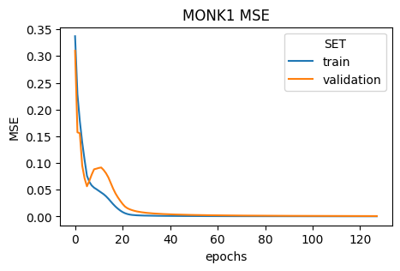
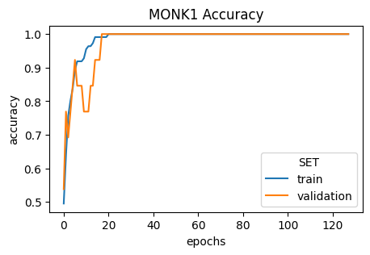
MONK result: Plot

Slide 12
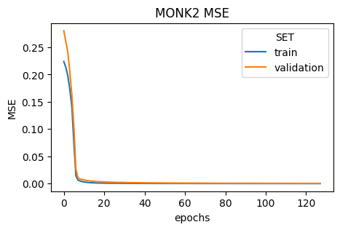
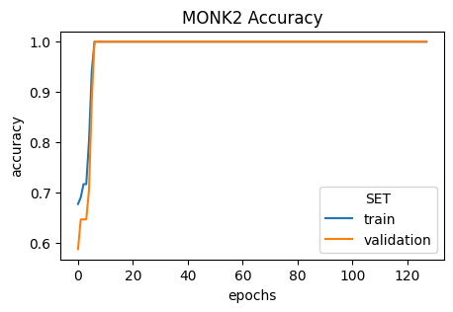
MONK result: Plot

Slide 13
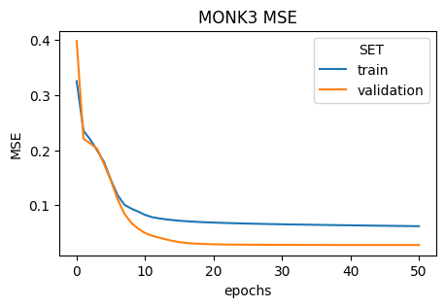
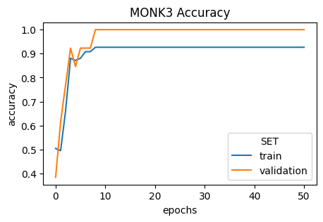
MONK result: Plot

Slide 14
CUP: Validation Schema
0.
1.
2.
3.
Train Set / Holdout Test Set Split (80%/20%)
Repeated K-Fold CV*
(Split 80%/20%, n_fold=5, n_repeat=3)
Best
Hyperparameters
Retrain NN with the best hyperprameters on TR Set with early stopping
Trained NN
Performance measure
(MSE/MEE)
Assessment on Holdout Test Set
* Parallelized with joblib [4]

Slide 15
CUP: Grid Search strategy
 | Batch Size | Momentum μ | Learning Rate α | Activation Function | λ regularizer | Topology (hidden)
Grid 1 | 16, 32, 64 | 0.90, 0.95, 0.98 schedule | 0.1, 0.01, 0.001 | Sigmoid, tanh, relu | 0, 0.001, 0.0001 | [10, 20, 10] [32, 64, 32]
Grid 2 | 32, 64 | 0.95, schedule | 0.001, 0.002, 0.005 | Sigmoid, tanh | 0, 0.001 | [32, 64, 32]
#Grid 1: 648
#Grid 2: 48

Slide 16
CUP: Final NN model
Optimizer: Nesterov
Topology: [10, 32, 64, 32, 3]
Hidden function: sigmoid
Output function: linear
λ regularizer: 0.001
Init method: he
Max Epochs: 512
Batchs Size: 64
Learning Rate: 0.005
Momentum: scheduled
Momentum schedule
a = ( 1 + sqrt(4a_prev**2+1) ) / 2
μ = (a_prev - 1) / (a)
He initialization
Gaussian distribution with
Mean: 0
Std: sqrt(2/N_prev)

Slide 17
CUP: result
Result of 20 trials on the same model. We calculate the MSE and MEE,
take the mean and the standard deviation.
 | MSE | MEE
Train | 0.055 ± 0.023 | 0.320 ± 0.062
Holdout Test | 0.285 ± 0.063 | 0.633 ± 0.058

Slide 18
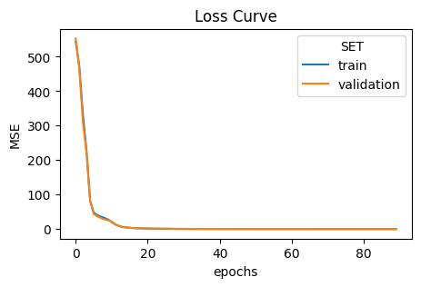
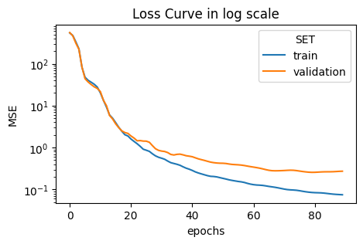
CUP: Plot

Slide 19
Conclusion
We discovered that although Nesterov Accelerated Gradient (NAG) does not yield significant improvements over classical momentum, it is more robust and stable.
Additionally, NAG allows us to experiment with much higher parameters.
Initialization is crucial: a random initialization, tested across multiple trials, results in highly variable outcomes.
Regarding generalization ability, we observed that on more complex datasets (such as CUP), NAG outperforms classical momentum.
In conclusion, our theoretical study of these models enabled us to explore hyperparameters more effectively and anticipate the expected results for certain models

Slide 20
Bibliography
[1] Sutskever, I., Martens, J., Dahl, G. & Hinton, G. (2013). On the importance of initialization and momentum in deep learning. Proceedings of the 30th International Conference on Machine Learning, 28(3):1139-1147. Available from: https://proceedings.mlr.press/v28/sutskever13.html.
[2] Yang, T., Lin, Q., & Li, Z. (2016). Unified Convergence analysis of stochastic momentum methods for convex and non-convex optimization. Available from: https://arxiv.org/abs/1604.03257
[3] Yan, Y., Yang, T., Li, Z., Lin, Q., & Yang, Y. (2018). A unified analysis of stochastic momentum Methods for Deep learning. Available from: https://arxiv.org/abs/1808.10396 [4] Joblib: running Python functions as pipeline jobs — joblib 1.4.2 documentation. (n.d.). Available from: https://joblib.readthedocs.io/en/stable/

Slide 21
Thanks!
Do you have any question?

Slide 22
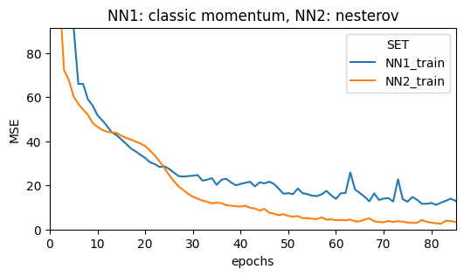
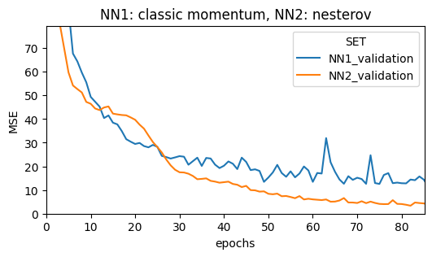
Appendix 1
Based on the results obtained in [1], we conducted experiments on the CUP dataset.
(Experiments–Initialization&momentum.ipynb)
Nesterov Momentum is much more effective at deceleration, thus making NAG more tolerant to large values of momentum term.
It exihibits less oscillations than classical momentum, making the method more robust especially in a stochastic setting.

Slide 23
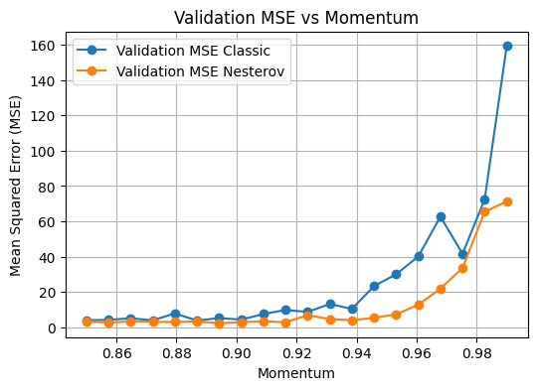
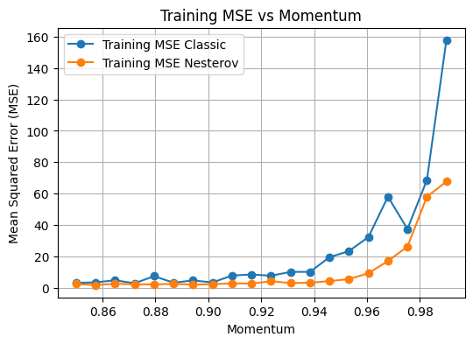
Appendix 1
Using a relatively high stepsize (0.02), the difference between CM and NAG is much more visible

Slide 24
Appendix 1.1
We analyzed the effect of the schedule and compared it with different fixed momentum values μ
μ | MSE (TR) | MSE (TS) | Std(TR) | Std(TS)
0.9 | 0.180 | 0.320 | 0.042 | 0.063
0.95 | 0.129 | 0.263 | 0.019 | 0.039
0.98 | 17.410 | 18.220 | 33.649 | 33.043
schedule | 0.063 | 0.180 | 0.025 | 0.034

Slide 25
Appendix 2
The convergence results in [2, Theorem 3] indicate that stochastic GD, classic momentum (CM), and Nesterov Accelerated Gradient (NAG) have similar convergence rate.
However, NAG achieves the best training error and testing error robustness among the three methods.
Method | MSE (TR) | MSE (TS) | Std(TR) | Std(TS)
GD | 6.919 | 8.275 | 1.4299 | 1.598
CM | 0.500 | 0.748 | 0.294 | 0.339
NAG | 0.306 | 0.510 | 0.036 | 0.047

Slide 26
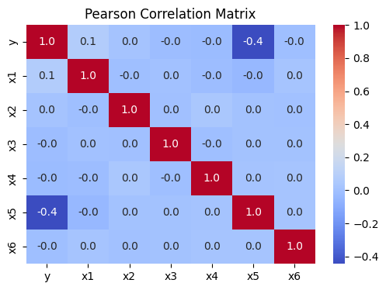
Appendix 3 – data exploration
MONK 1 – linear correlation
The outcome of y in MONK 1 depends on only 3 variables, thus making the remaining features useless for the model.
In the case of MONK 2, each variable appears to influence the prediction

Slide 27
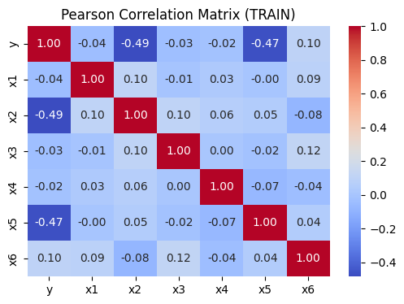
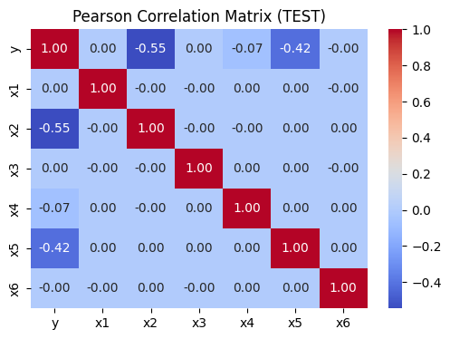
Appendix 3.1 – data exploration
In MONK3 we notice a discrepancy between training and testing.
We hypothesized that there was some misclassified records in the TR set.
Only x2, x4, x5 contribute to the outcome of y.

