Slide 1
Coursera Capstone Project
Correlation between Number of crimes, Hardship Index and Surrounding features for Chicago
Gabriel Novais

Slide 2
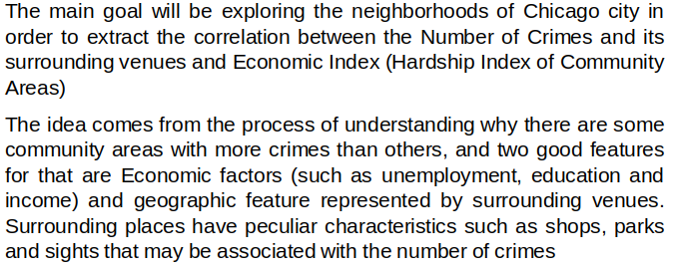
Introduction

Slide 3
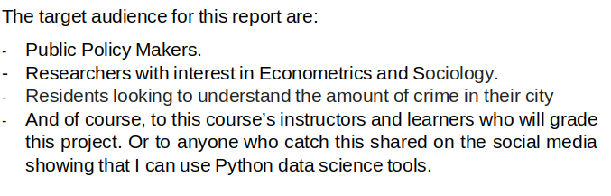
Introduction

Slide 4
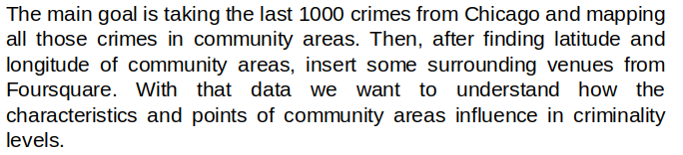
Data Description

Slide 5
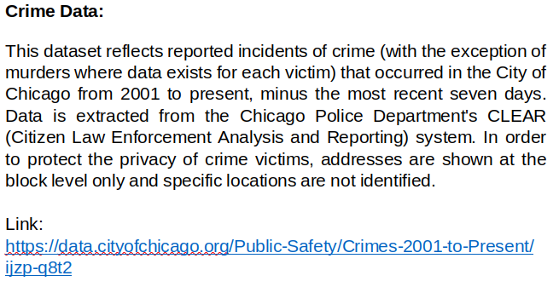
Data Description

Slide 6
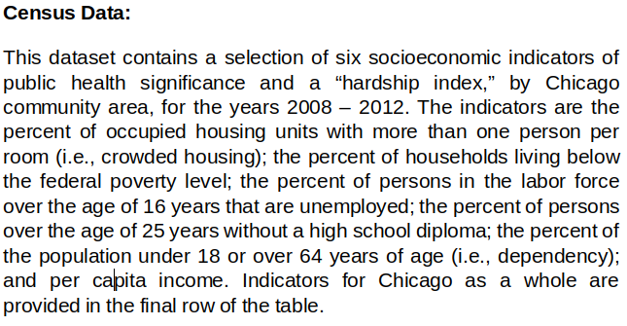
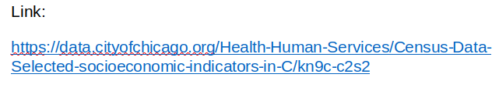
Data Description

Slide 7
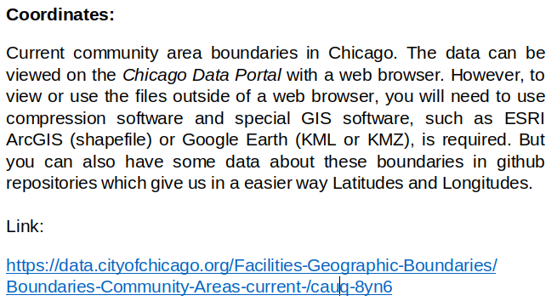
Data Description

Slide 8
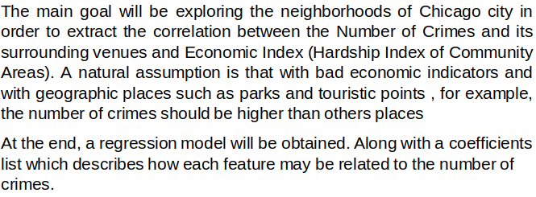
Methodology

Slide 9
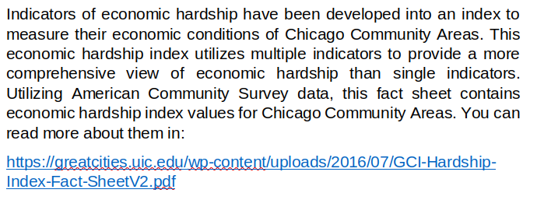
Methodology

Slide 10
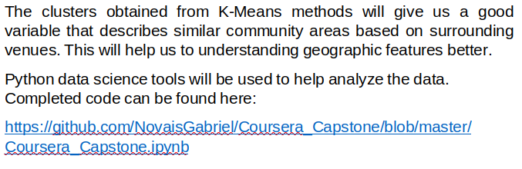
Methodology

Slide 11
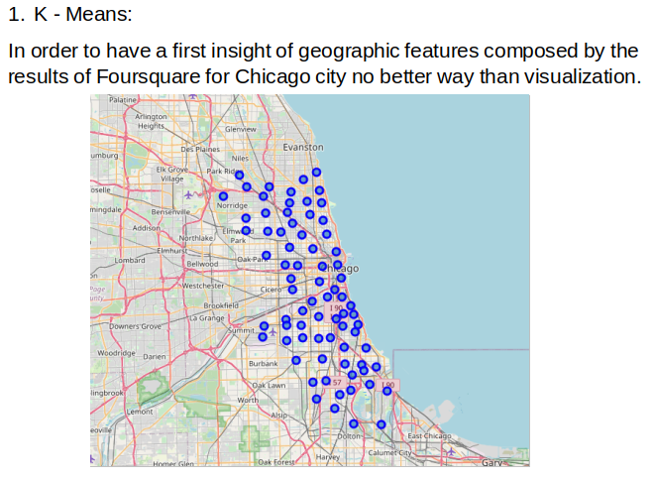
Methodology

Slide 12
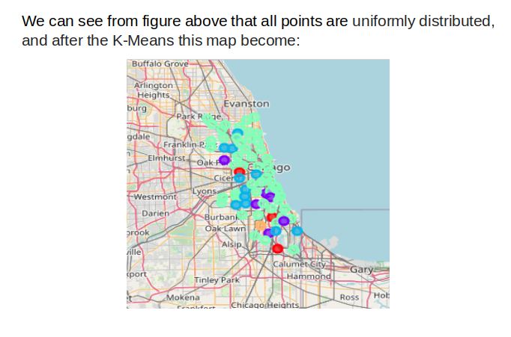
Methodology

Slide 13
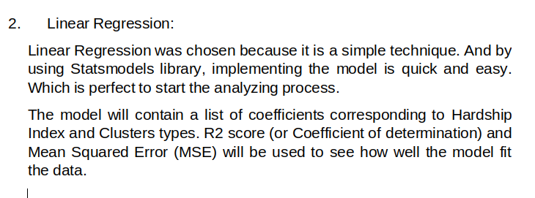
Methodology

Slide 14
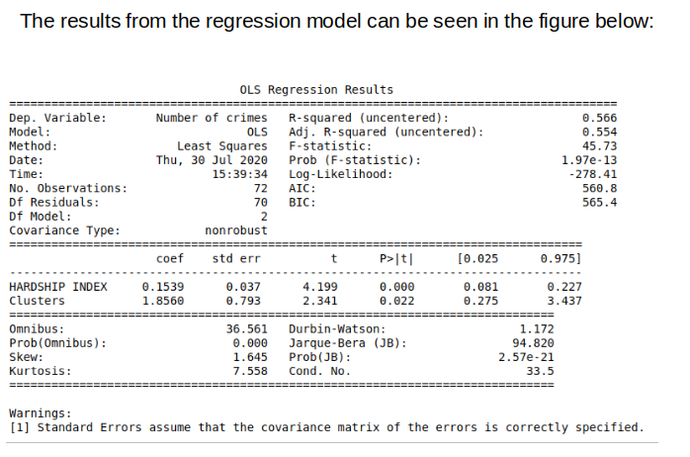
Results

Slide 15
The End
Thanks! :)

