Slide 1

2024-12-30 13:46:18

Slide 2
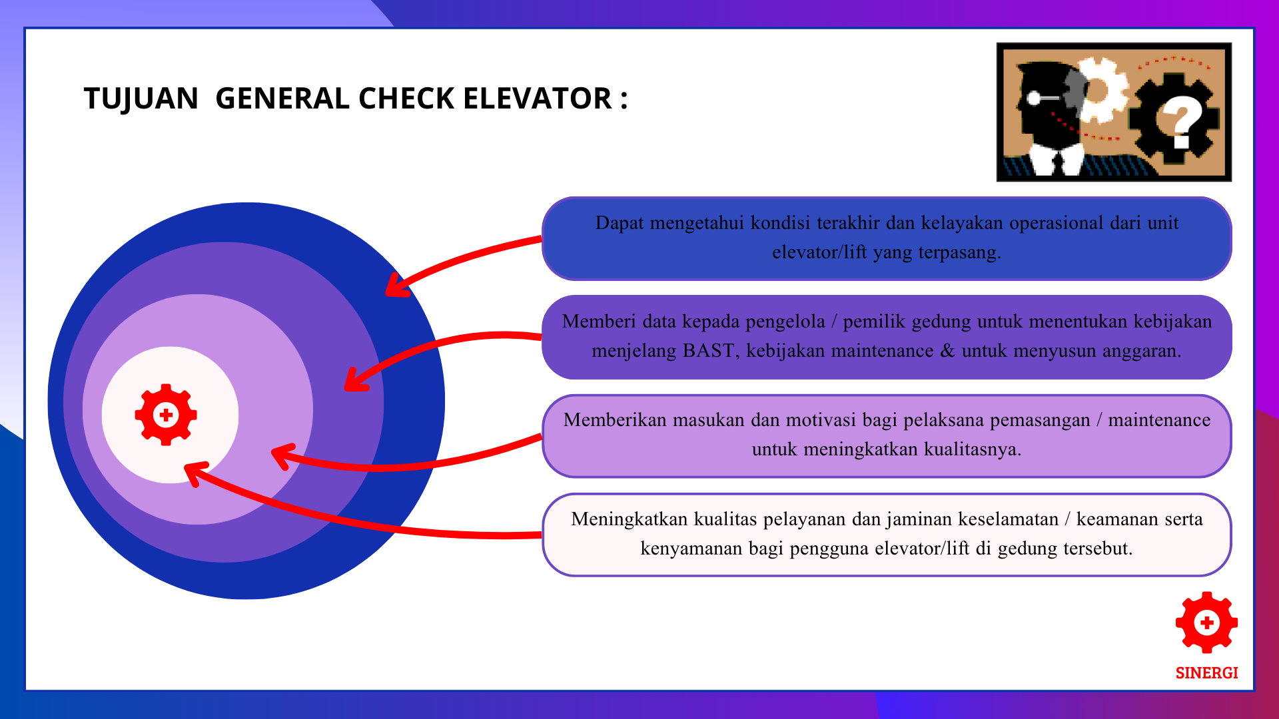

Slide 3

UNIT LIFT TERPASANG
Korek Api Gas
Hp Oppo
Stik eskrim
Tangan

Slide 4
UNIT LIFT TERPASANG
Korek Api Gas
Hp Oppo
Stik eskrim
Tangan

Slide 5
UNIT LIFT TERPASANG
Korek Api Gas
Hp Oppo
Stik eskrim
Tangan

Slide 6
UNIT LIFT TERPASANG
Korek Api Gas
Hp Oppo
Stik eskrim
Tangan

