Slide 1

2024-12-30 13:46:18

Slide 2
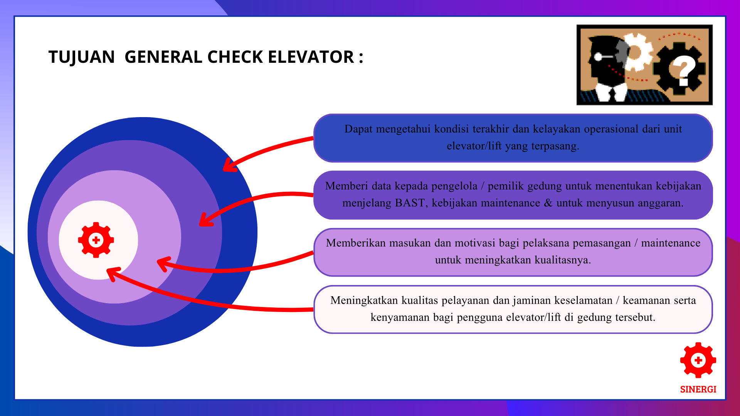

Slide 3

UNIT LIFT TERPASANGKorek Api GasHp OppoStik eskrimTangan

Slide 5
UNIT LIFT TERPASANGKorek Api GasHp OppoStik eskrimTangan

Slide 7
UNIT LIFT TERPASANGKorek Api GasHp OppoStik eskrimTangan

Slide 9
UNIT LIFT TERPASANGKorek Api GasHp OppoStik eskrimTangan

