Slide 1
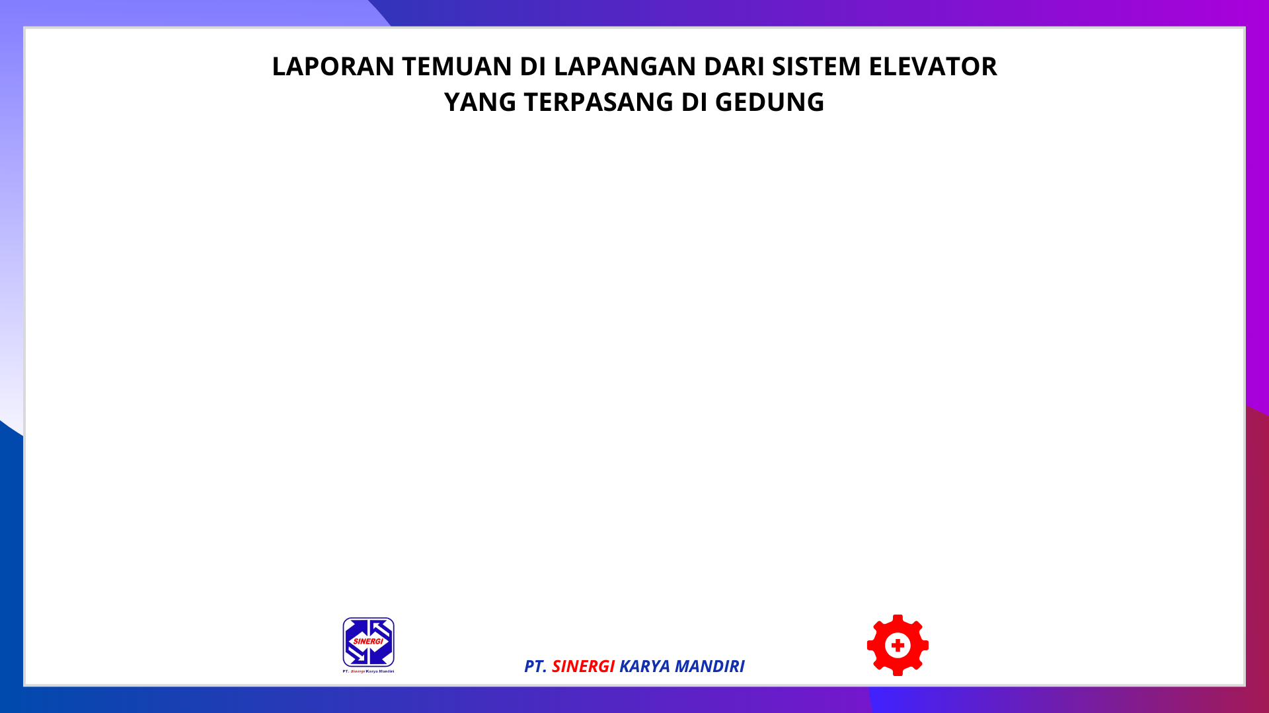
2024-12-30 13:46:18

Slide 2
