Slide 1
SWOP – Iteratie 3
Groep 21
Kenny Op De Beeck
Jonathan Langens
Andrey Kirillin
Wonne Joosen

Slide 2
Rollenverdeling
Lead Designer = Kenny
Lead Tester = Wonne
Lead Domain Modeller = Jonathan

Slide 3
Index
1. CMCSystem
2. User
3. Orderbuilder
4. Tasks
5. Parts
6. Scheduler
7. Assembly line
8. Controllers

Slide 4
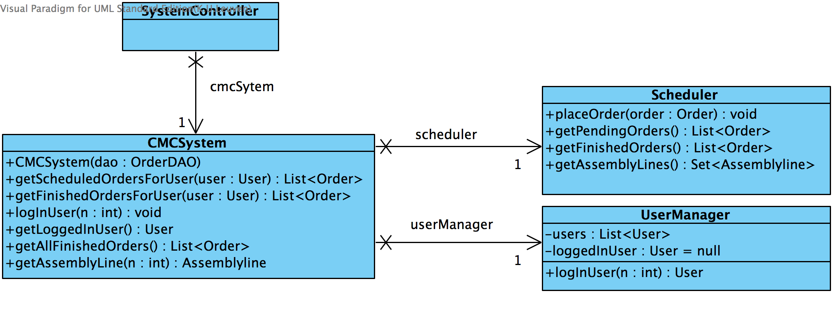
CMCSystem - implementatie

Slide 5
CMCSystem – Implementatie/Design
Responsabilities:
Provide an entry point for the system
Manage the system
Design
Pure fabrication

