Slide 1
SWOP
Groep 21
Kenny Op de Beeck
Jonathan Langens
Wonne Joosen
Andrey Kirillin

Slide 2
Inhoud
Klasse diagrammen
Taakverdeling
Testen

Slide 3
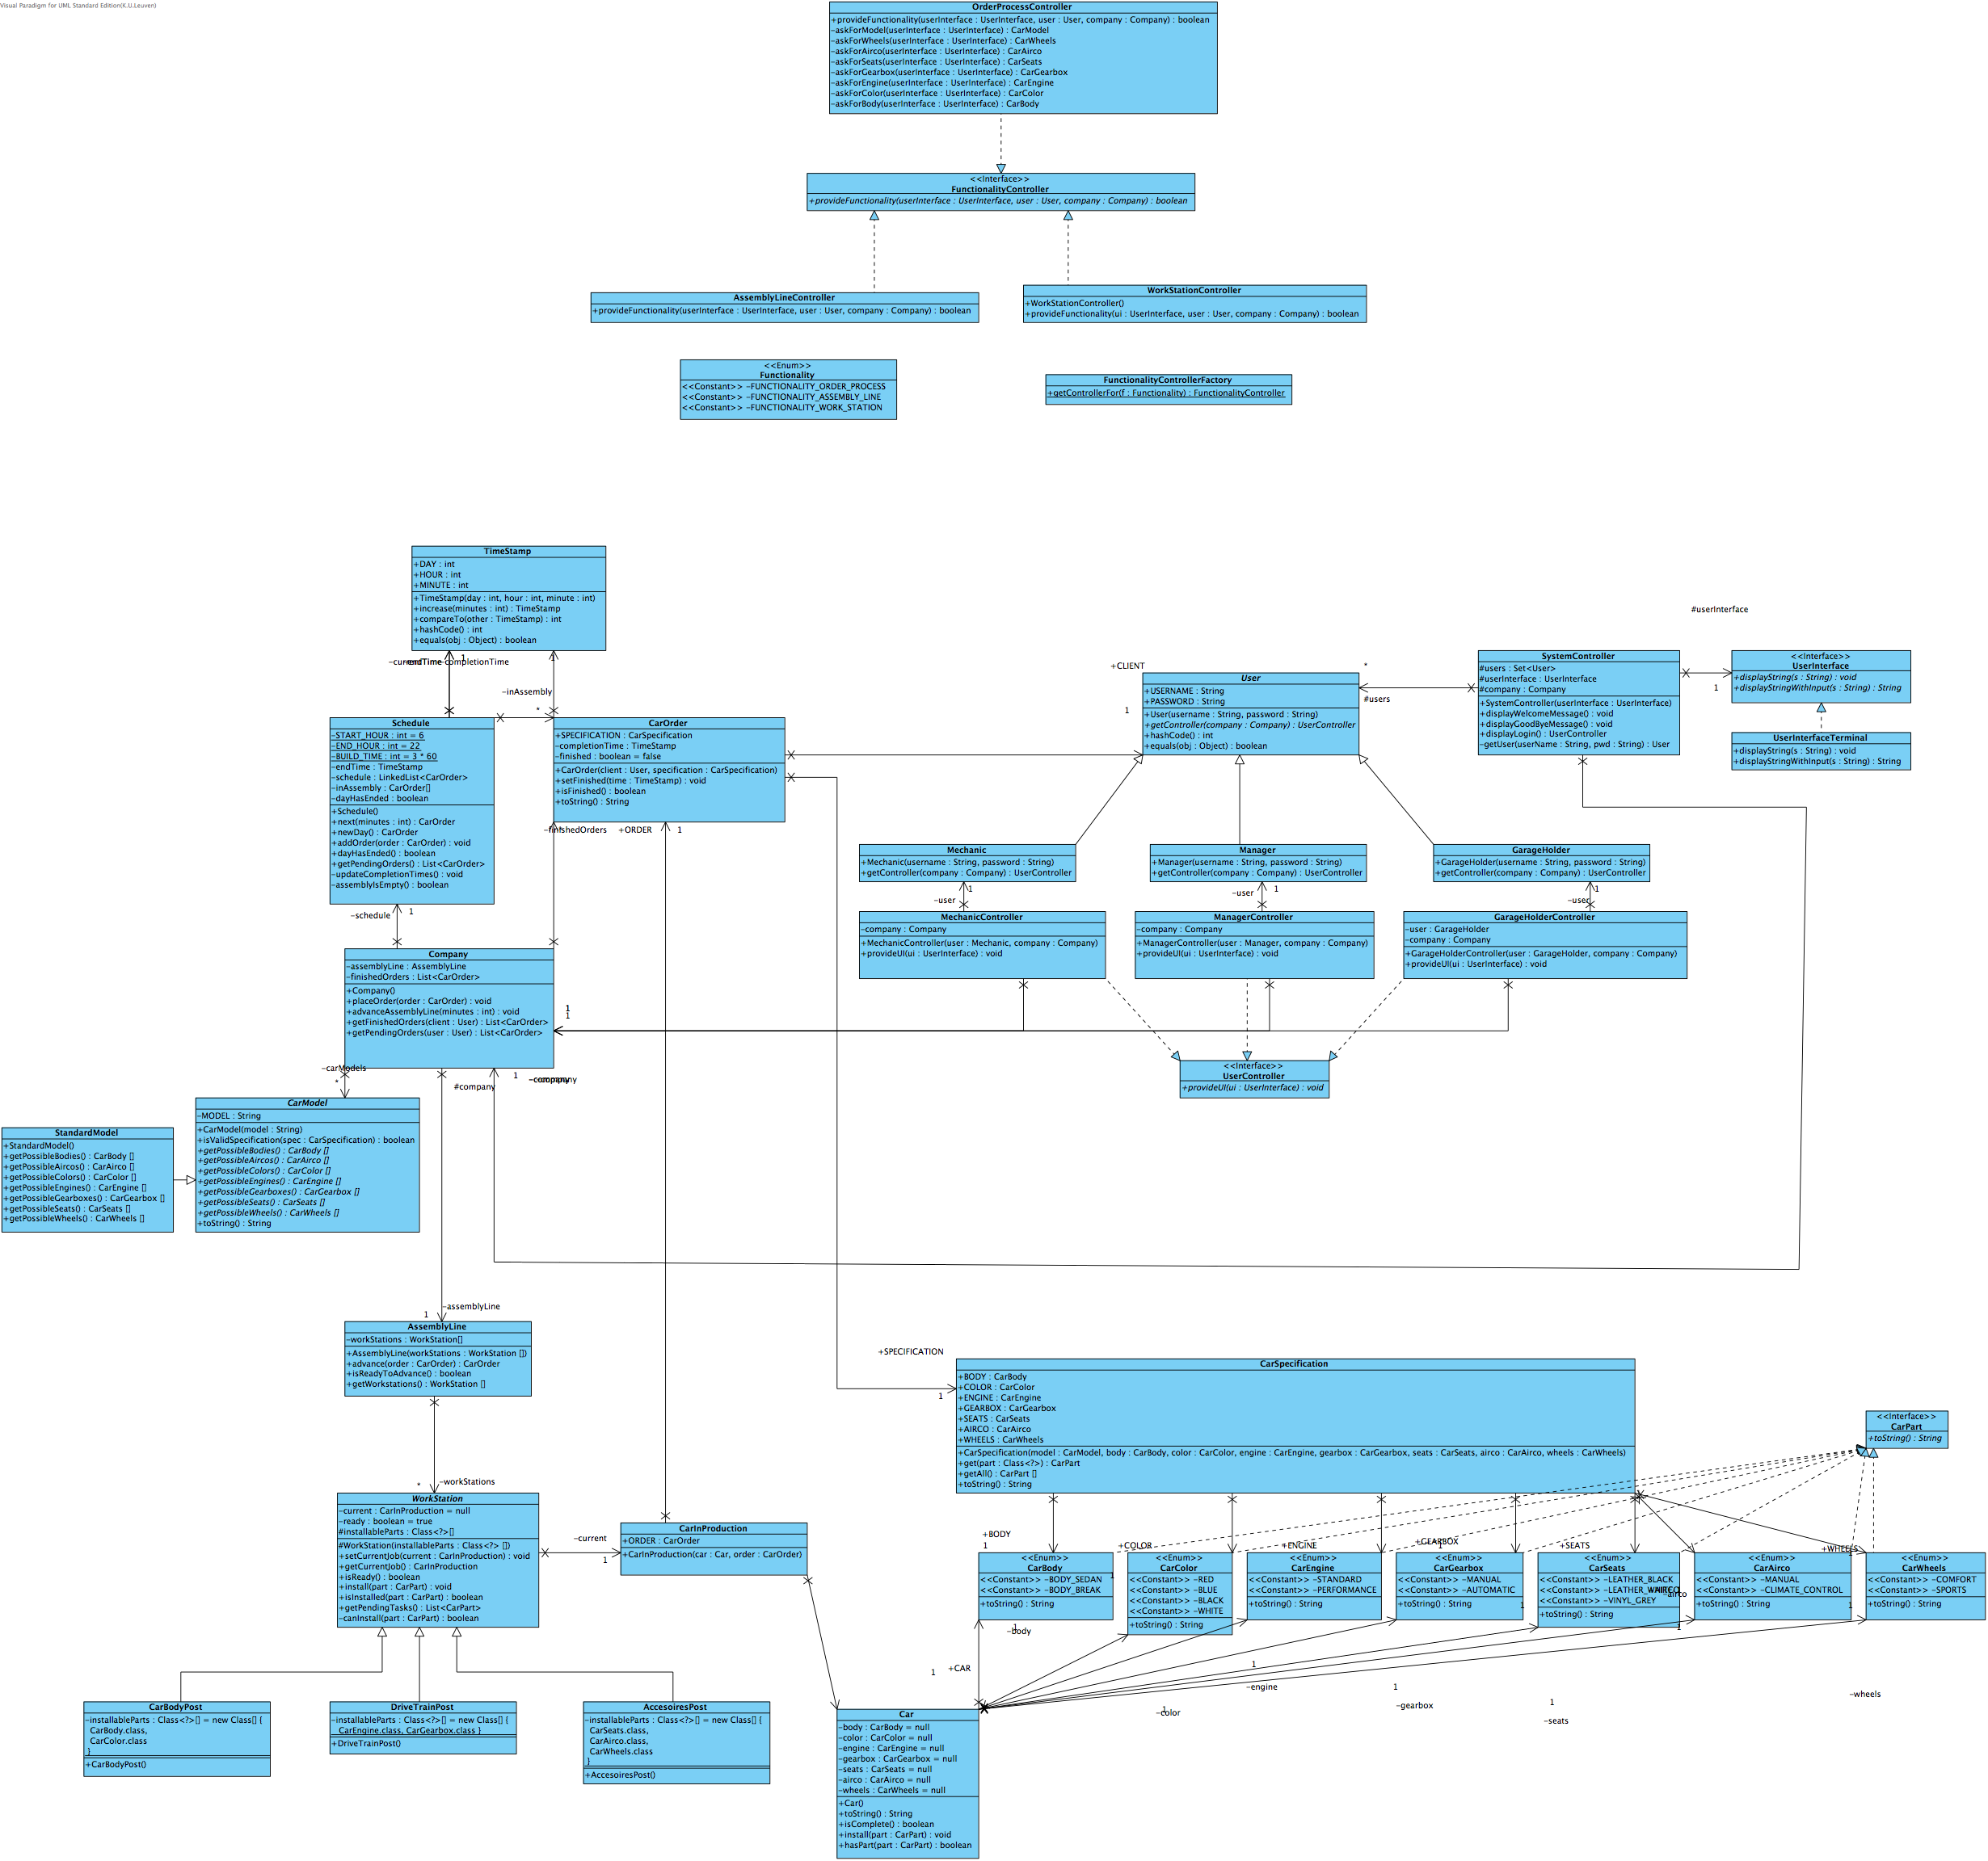
Class diagram

Slide 4
Cars
Interface: carPart
Klasse: Car
Abstracte klasse: CarModel
Klasse: CarSpecification
Klasse: CarOrder
Klasse: CarInProduction

Slide 5
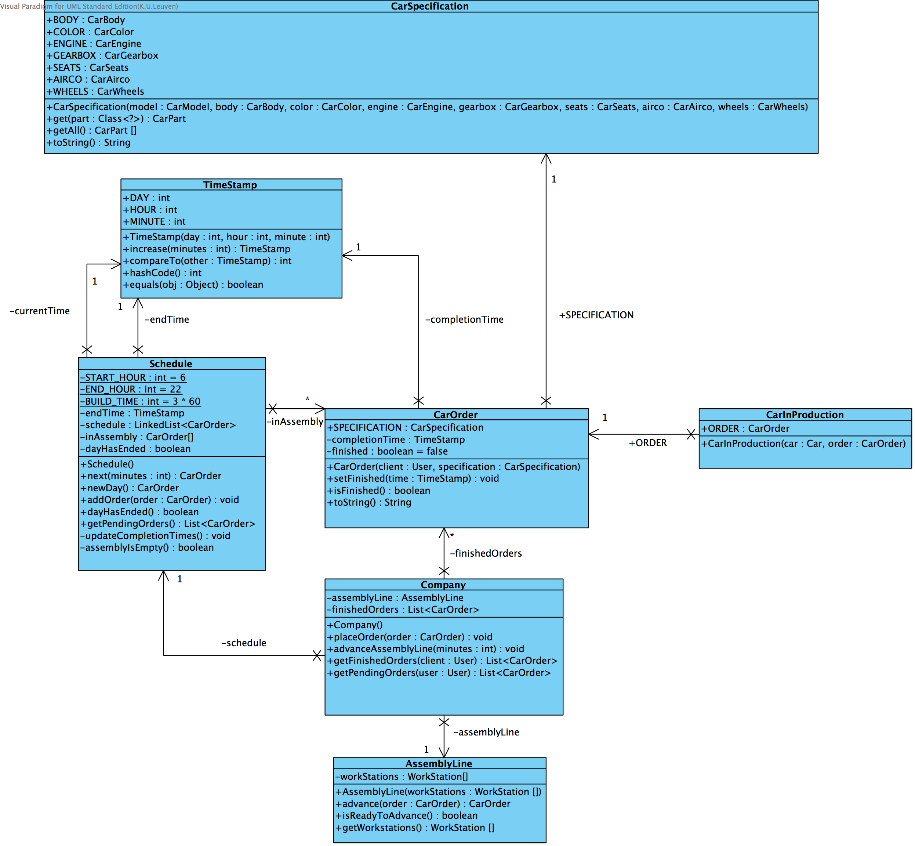

Slide 6
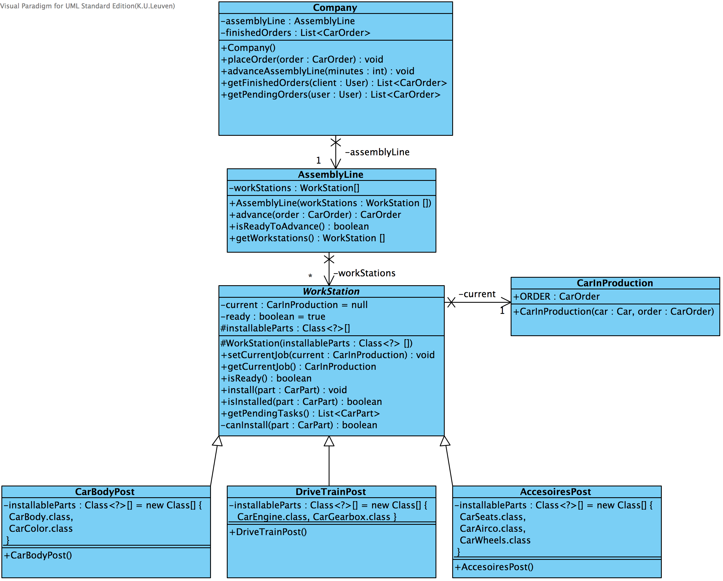

Slide 7
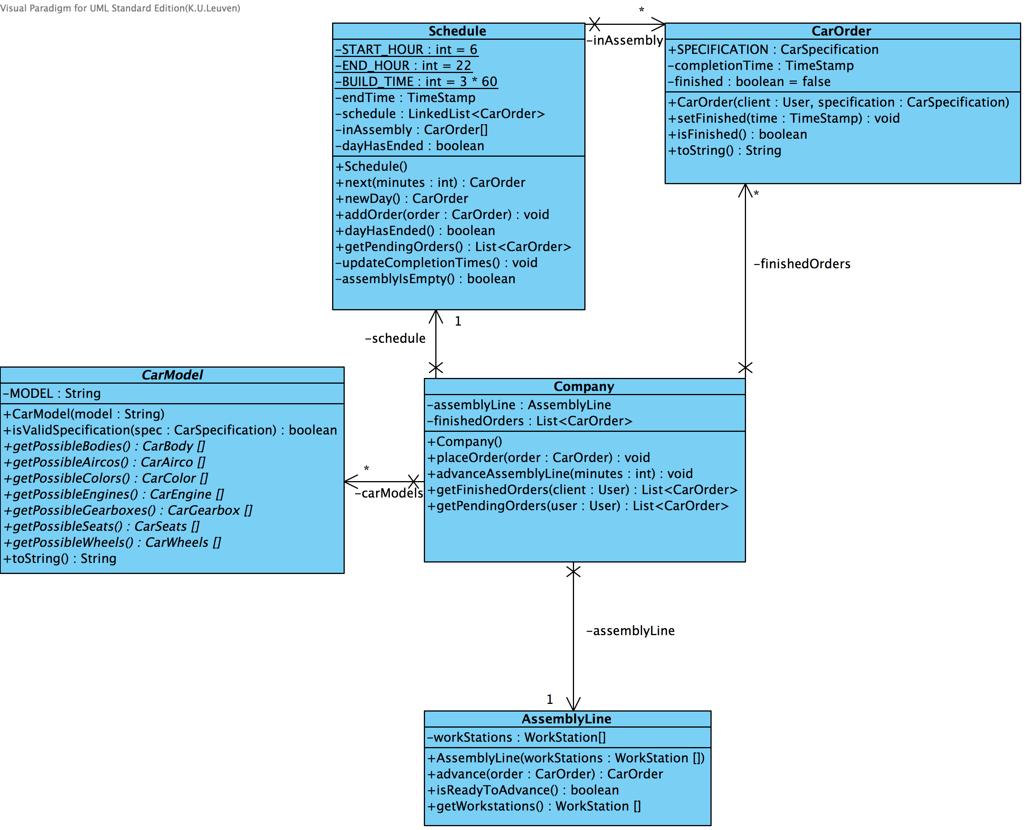

Slide 8
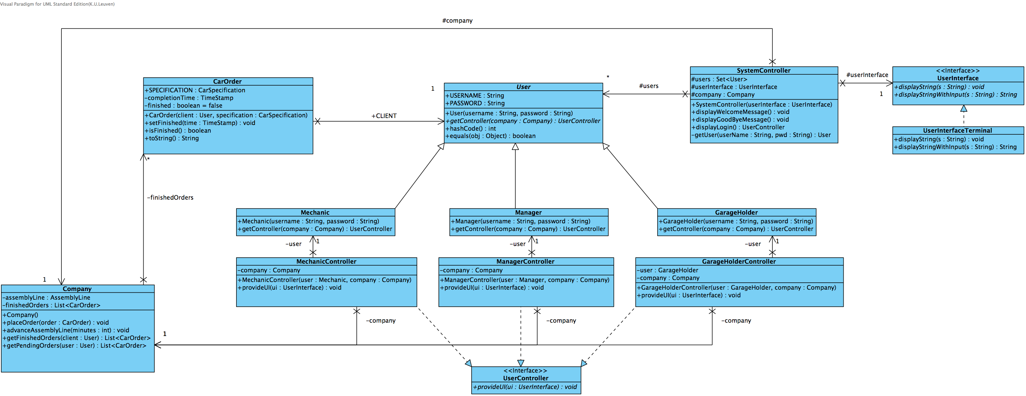
Controller

Slide 9
Taakverdeling
Design coordinator: Wonne Joosen
Testing coordinator: Jonathan Langens
Domain coordinator: Kenny Op de Beeck

Slide 10
Testen

