Slide 1
AssemAssist
SWOP 2013-14
Andrey Kirillin
Wonne Joosen
Jonathan Langens
Kenny Op de Beeck

Slide 2
Cars
Interface: carPart
Klasse: Car
Abstracte klasse: CarModel
Klasse: CarSpecification
Klasse: CarOrder
Klasse: CarInProduction

Slide 3
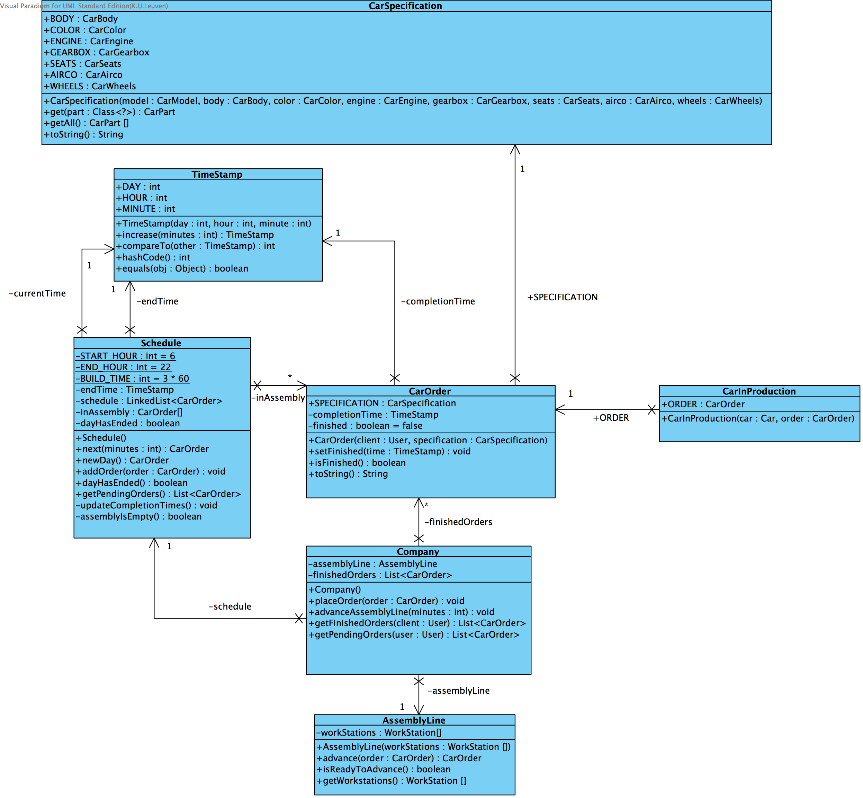

Slide 4
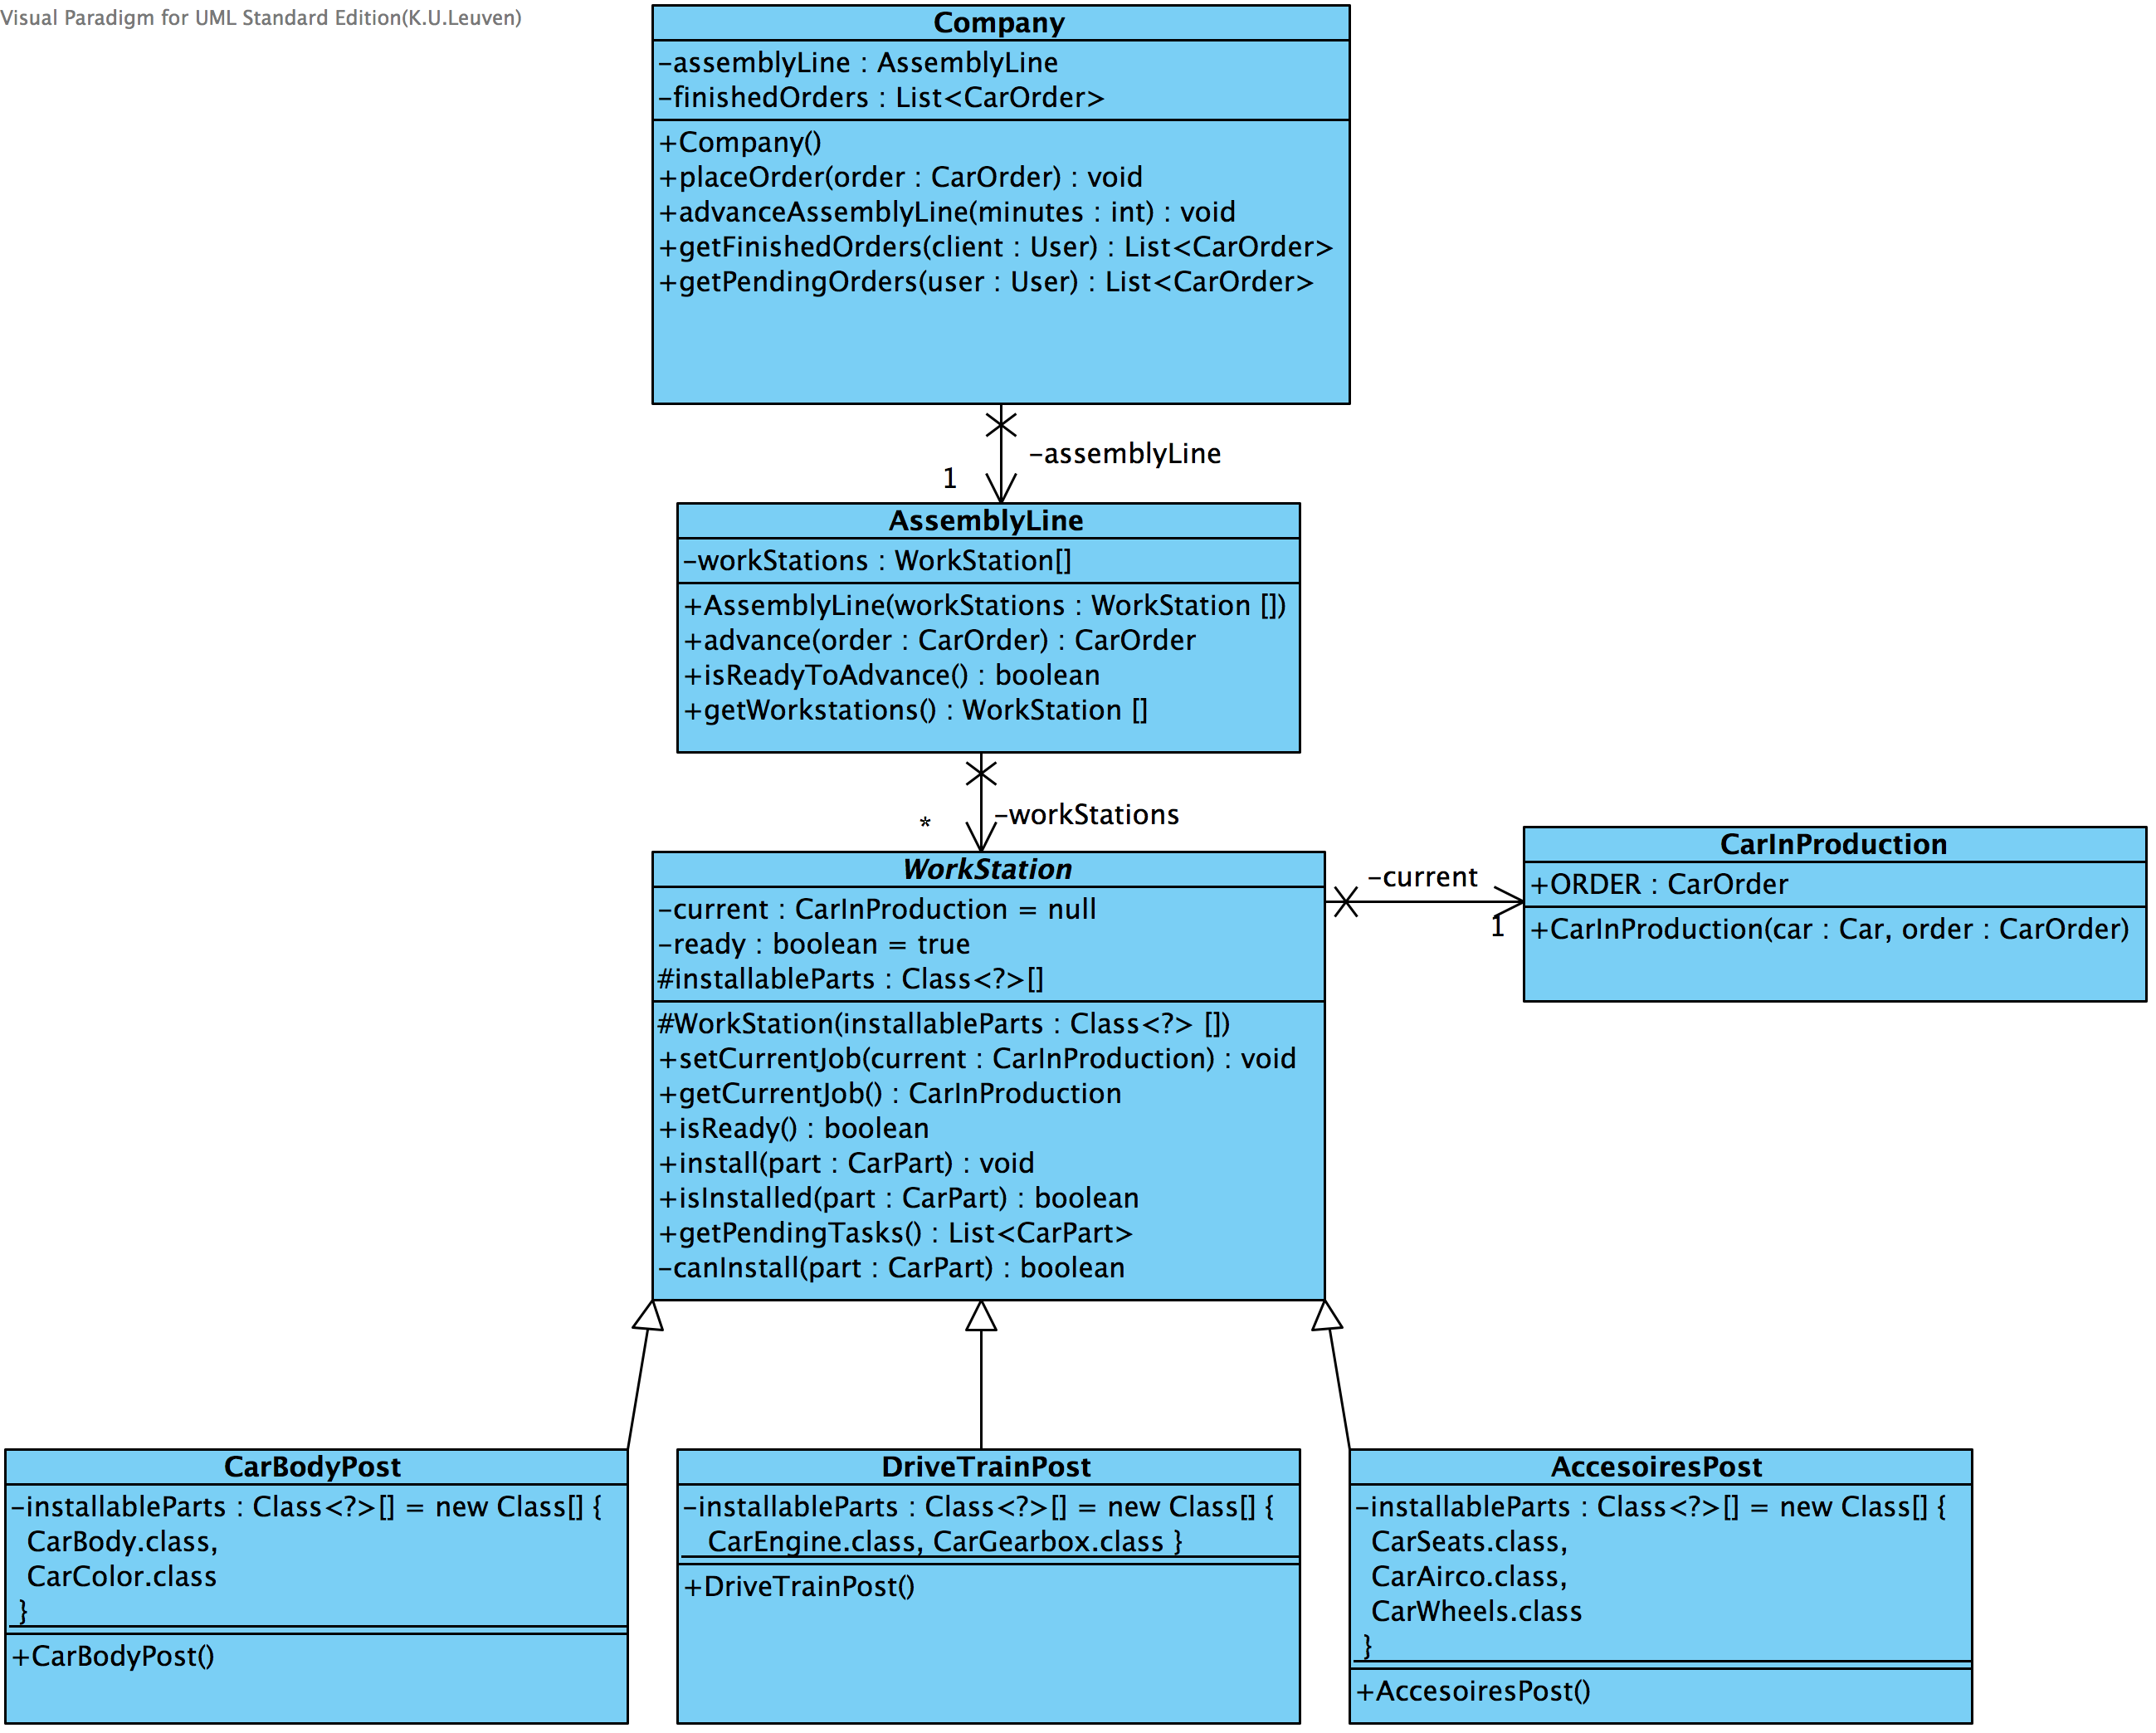
Company

Slide 5
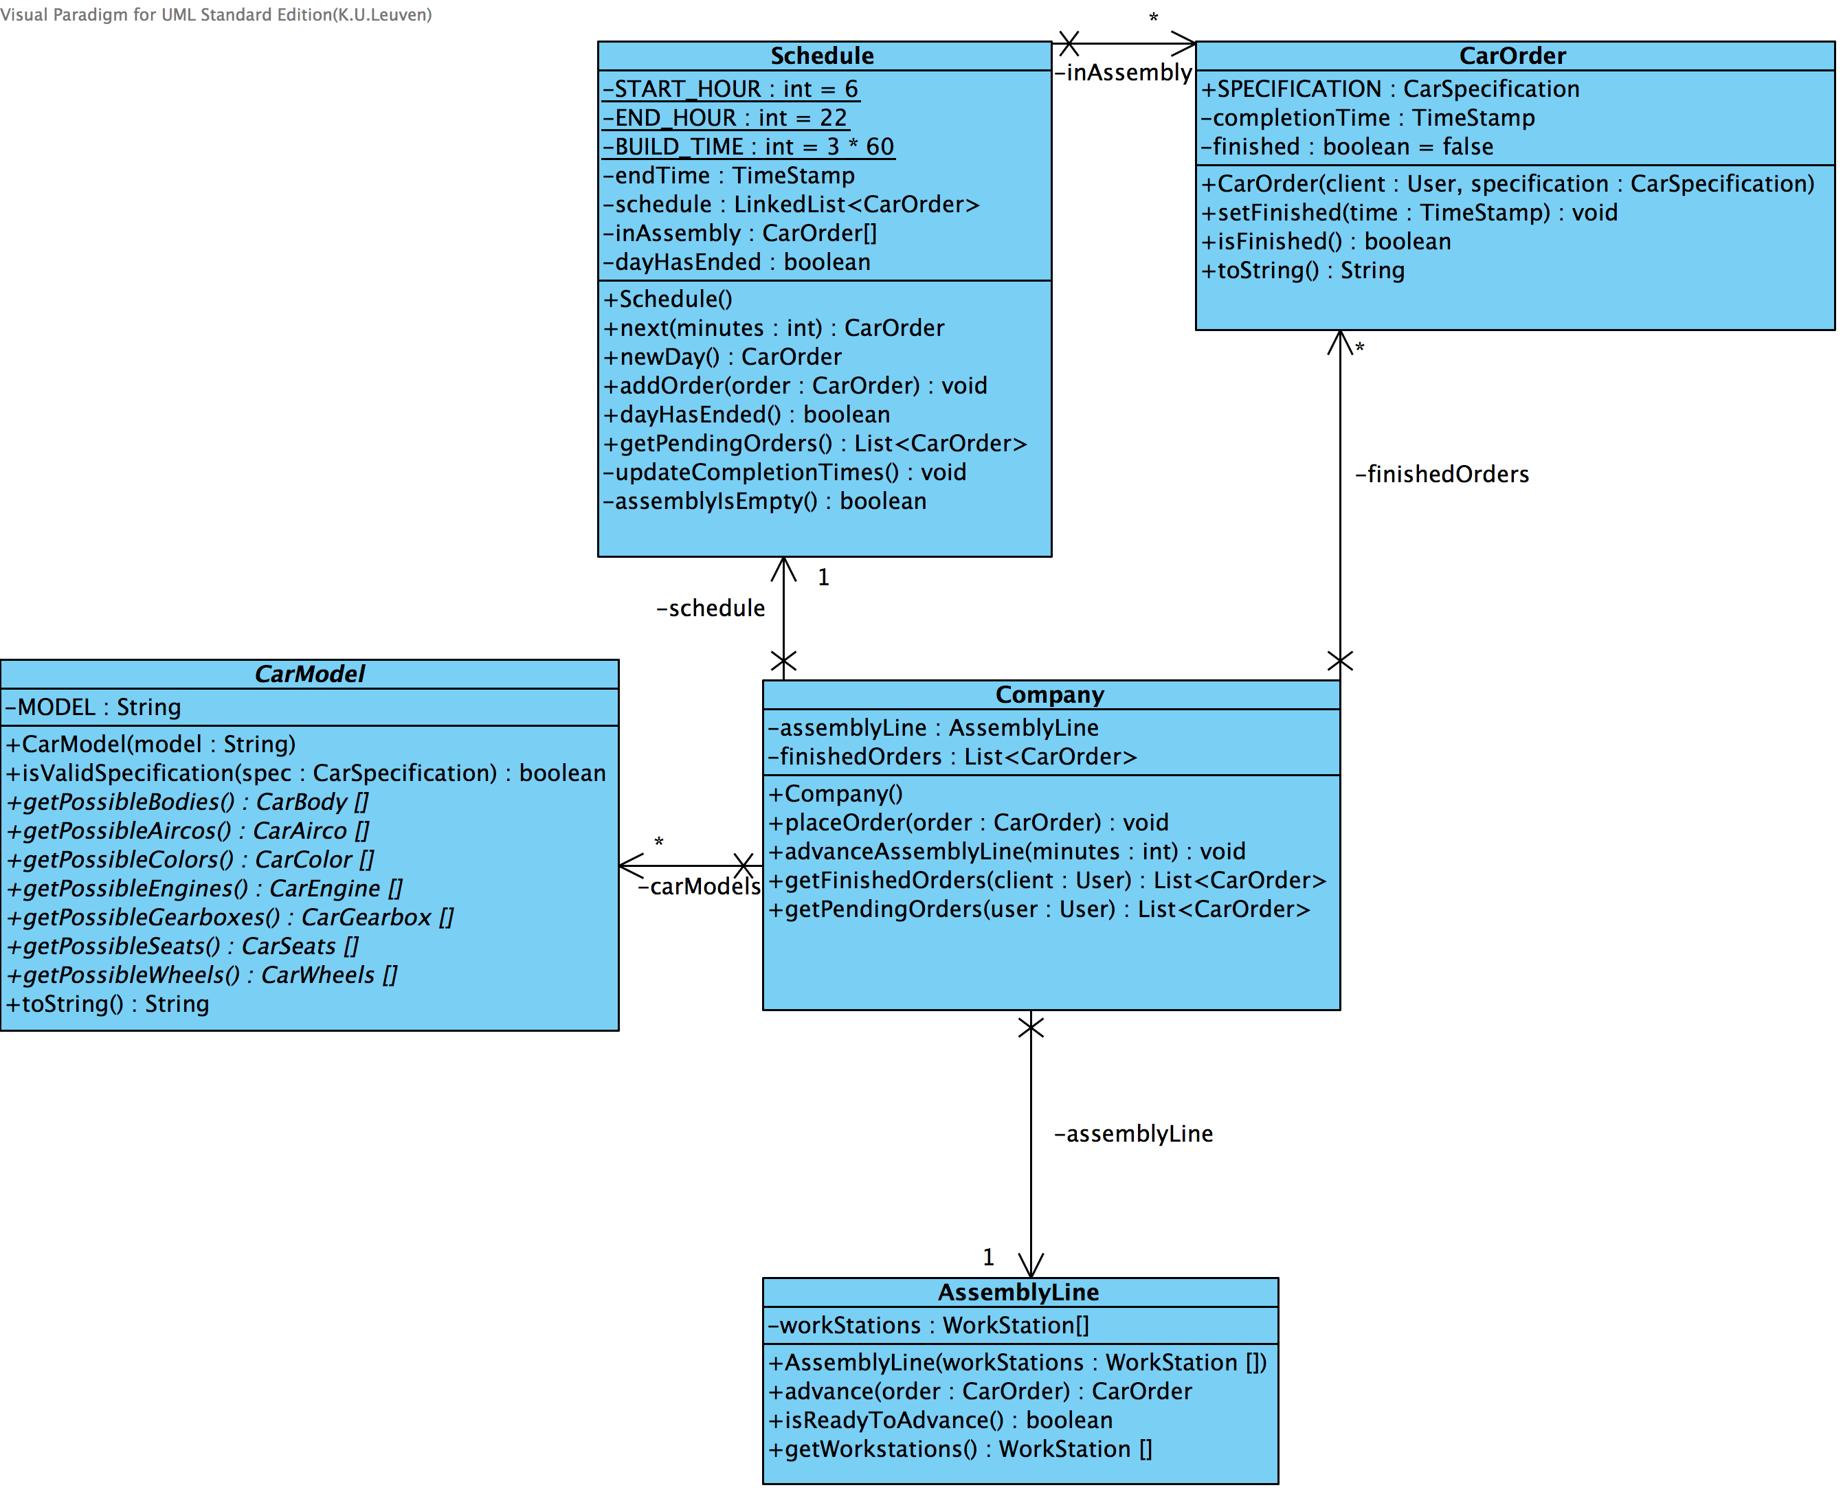
Schedule

Slide 6
User Interface
SystemController
UserController
Manager
Mechanic
GarageHolder
FunctionalityController
AssemblyLine
WorkPost
OrderProcess

Slide 7
Testing
…

