Slide 1



Post-Quantum Blockchain
Mickaël TEAUDORS, Yoann VALERI
Supervised by Ludovic PERRET and Jean-Charles FAUGERE

Slide 2
Challenges
1
2
3

Slide 3
Challenges
1
2
3
Incorporate post-quantum signature algorithms in an open-source Blockchain manipulation tool : Hyperledger

Slide 4
Challenges
1
2
3
Incorporate post-quantum signature algorithms in an open-source Blockchain manipulation tool : Hyperledger
Understand the basis of the signature scheme we modified and implemented

Slide 5
Challenges
1
2
3
Incorporate post-quantum signature algorithms in an open-source Blockchain manipulation tool : Hyperledger
Understand the basis of the signature scheme we modified and implemented
Ensure compatibility between GO and C programs

Slide 6
Challenges
1
2
3
Incorporate post-quantum signature algorithms in an open-source Blockchain manipulation tool : Hyperledger
Understand the basis of the signature scheme we modified and implemented
Ensure compatibility between GO and C programs
Modular integration : Ease the change of the algorithm used

Slide 7
Challenges
1
2
3
Incorporate post-quantum signature algorithms in an open-source Blockchain manipulation tool : Hyperledger
Understand the basis of the signature scheme we modified and implemented
Ensure compatibility between GO and C programs
Modular integration : Ease the change of the algorithm used
Evaluate the impact of these algorithms on the performances

Slide 8



Hyperledger : an open-source Blockchain manipulation tool
1
2
3

Slide 9
Hyperledger : an open-source Blockchain manipulation tool
1
2
3
Open source framework for developing Blockchain-based applications

Slide 10
Hyperledger : an open-source Blockchain manipulation tool
1
2
3
Open source framework for developing Blockchain-based applications
Source code is written in GO

Slide 11
Hyperledger : an open-source Blockchain manipulation tool
1
2
3
Open source framework for developing Blockchain-based applications
Source code is written in GO
Signature algorithm implemented is Schnorr [C. P. Schnorr. Efficient Identification and Signatures for Smart Cards] combined with Elliptic curves [Neal Koblitz, Alfred Menezes, and Scott Vanstone. The State of Elliptic Curve Cryptography]

Slide 12
Quantum security threat
1
2
3

Slide 13
Quantum security threat
1
2
3
Two schemes in the Blockchain :
Proof-Of-Work, based on the pre-image resistance of hash functions
Signature, used to authenticate transactions in Blockchains

Slide 14
Quantum security threat
1
2
3
Two schemes in the Blockchain :
Proof-Of-Work, based on the pre-image resistance of hash functions
Signature, used to authenticate transactions in Blockchains
Quantum computers allow the deployment of already-existing algorithms
Grover’s algorithm [Lov K. Grover. A fast quantum mechanical algorithm for database search]
Minimal impact on the Proof Of Work process in Blockchains
Size of keys has to be doubled to keep the same level of security

Slide 15
Quantum security threat
1
2
3
Two schemes in the Blockchain :
Proof-Of-Work, based on the pre-image resistance of hash functions
Signature, used to authenticate transactions in Blockchains
Quantum computers allow the deployment of already-existing algorithms
Grover’s algorithm [Lov K. Grover. A fast quantum mechanical algorithm for database search]
Minimal impact on the Proof Of Work process in Blockchains
Size of keys has to be doubled to keep the same level of security
Shor’s algorithms [Peter W. Shor. Polynomial-Time Algorithms for Prime Factorization and Discrete Logarithms on a Quantum Computer]
Huge impact on the signature process
Polynomial algorithm to solve the discrete logarithm problem

Slide 16

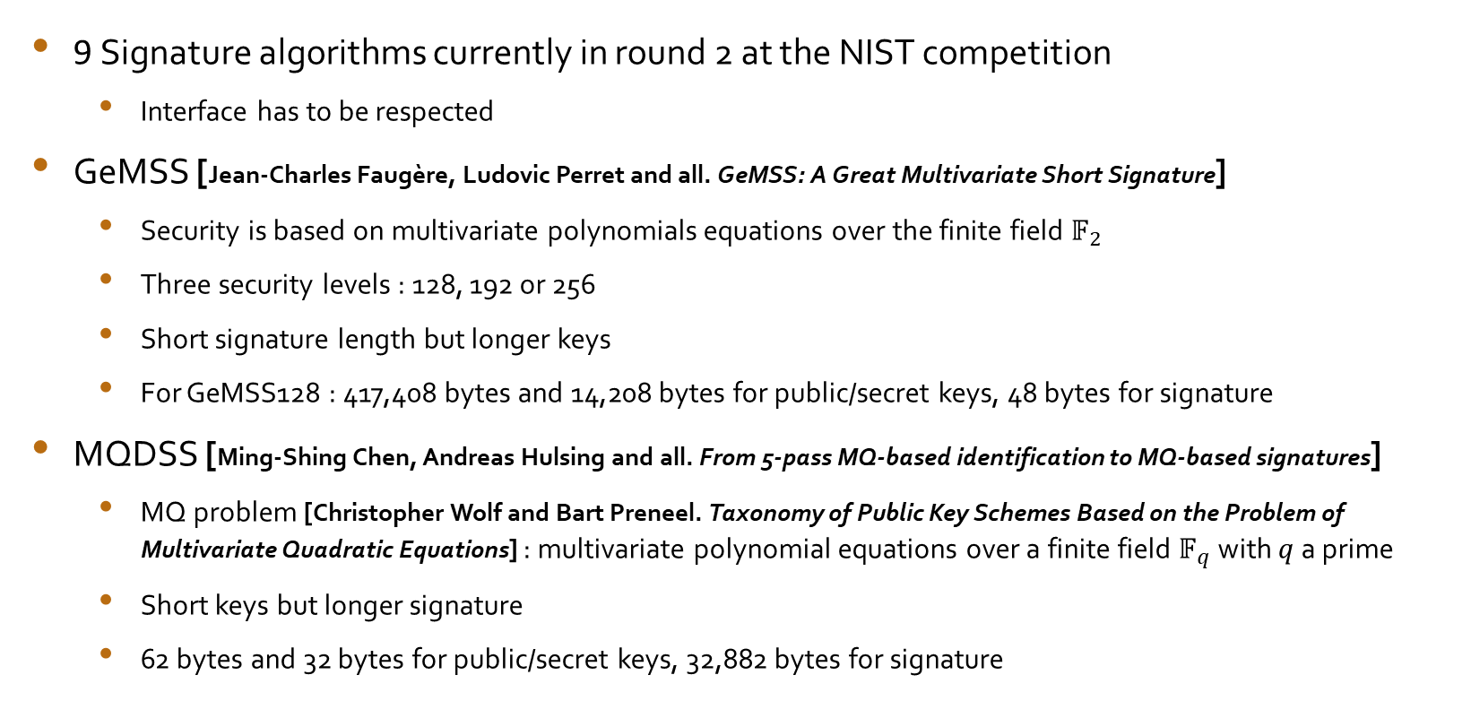
Post-quantum signature solutions
1
2
3
9 Signature algorithms currently in round 2 at the NIST competition
Interface has to be respected
GeMSS [Jean-Charles Faugère, Ludovic Perret and all. GeMSS: A Great Multivariate Short Signature]
Security is based on multivariate polynomials equations over the finite field ${\text{𝔽}}_{2}$
Three security levels : 128, 192 or 256
Short signature length but longer keys
For GeMSS128 : 417,408 bytes and 14,208 bytes for public/secret keys, 48 bytes for signature
MQDSS [Ming-Shing Chen, Andreas Hulsing and all. From 5-pass MQ-based identification to MQ-based signatures]
MQ problem [Christopher Wolf and Bart Preneel. Taxonomy of Public Key Schemes Based on the Problem of Multivariate Quadratic Equations] : multivariate polynomial equations over a finite field ${\text{𝔽}}_{q}$ with $q$ a prime
Short keys but longer signature
62 bytes and 32 bytes for public/secret keys, 32,882 bytes for signature

Slide 17
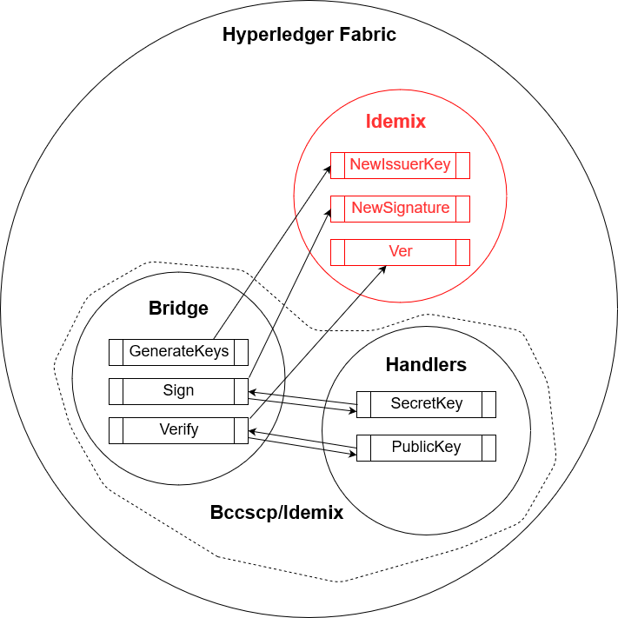
Hyperledger organisation
1
2
3
Idemix : Implementation of the cryptographic functions
Handlers : functions used to make the conversion between types
Bridge : Converts parameters before a cryptographic function call

Slide 18
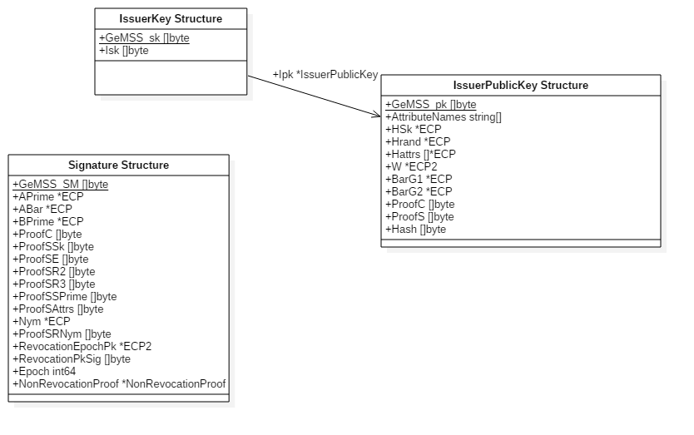
Integration : Structures
1
2
3

Slide 19
Integration : Functions
1
2
3
Use of a static library to give access to GeMSS functions
Memory was the main problem
Memory allocation is done in GO before calling C functions
CGO gives access to standard C functions such as malloc, free …
Prototypes of C functions must be declared in a header file
Definition of a macro to choose the algorithm
GeMSS 128, 192 or 256
MQDSS
Wrapper functions to perform correct-sized malloc and appropriate function calls
Swap between post-quantum signature algorithms by changing one macro

Slide 20
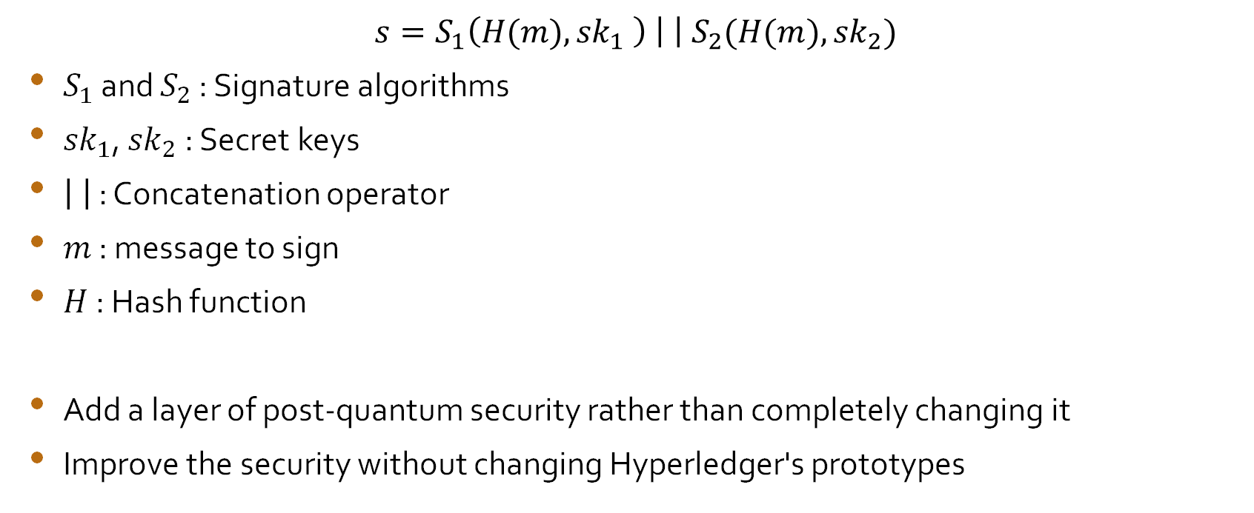
Hybrid-cryptography model
1
2
3
$$s=S_{1}\left(H(m),{sk}_{1} \right) \left| \right| S_{2}(H(m),{sk}_{2})$$
$S_{1}$ and $S_{2}$ : Signature algorithms
${sk}_{1}$, ${sk}_{2}$ : Secret keys
: Concatenation operator
$m$ : message to sign
$H$ : Hash function
Add a layer of post-quantum security rather than completely changing it
Improve the security without changing Hyperledger's prototypes

Slide 21
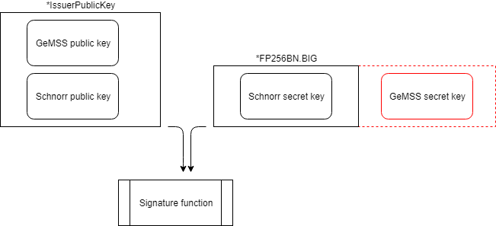
1
2
3
Signature uses a big integer FP256BN.BIG instead of the secret key
Format memory to add GeMSS’s secret key after the FP256BN.BIG

Slide 22
Performances tests
1
2
3
 | Hyperledger | GeMSS (128) | MQDSS (120) | GeMSS (192) | GeMSS (256)
Keys generation | 0.002 ms | 13 ms | 1 ms | 60 ms | 191 ms
Signature | 31 ms | 220 ms | 33 ms* | 560 ms | 905 ms
Signature verification | 60 ms | 0.05 ms | 22 ms | 0.2 ms | 0.5 ms
 | Hyperledger + GeMSS 128 | Hyperledger + MQDSS | Hyperledger + GeMSS 192 | Hyperledger + GeMSS 256
Keys generation | 14 ms | 1.1 ms | 66 ms | 207 ms
Signature | 227 ms | 61 ms* | 619 ms | 1180 ms
Signature verification | 60 ms | 85 ms | 62 ms | 62 ms
Measures on Intel(R) Core(TM) i5-7600K CPU @ 3.80GHz * Time taken over a few runs

Slide 23
1
2
3
 | GeMSS 128 | MQDSS | GeMSS 192 | GeMSS 256
Keys generation | 434 KB | 0.288 KB | 1351 KB | 3137 KB
Signature | 0.232 KB | 49.288 KB | 0.264 KB | 0.288 KB
Signature verification | 96 B | 96 B | 96 B | 96 B
Memory consumption for one function call with a 40 bytes message
MQDSS is post-quantum resilient and faster than Hyperledger
Signatures are stored in blocks so their sizes have to be taken into account
GeMSS adapted for Blockchains : Large quantity of verifications
Memory allocation for the verification is the same and depends on the message’s size

Slide 24
Remaining tasks
1
2
3
Finalize the implementation
Adapt the hybrid-cryptography model to the application
Test a real use case
Test over a broad network
Perform multiple transactions
Incorporate other post-quantum signature algorithms

Slide 25
Conclusion
1
2
3
Understand how CGO works
Implement our functions to call GeMSS functions
Modify structures to take into account those new functions and fields
The drawbacks on performances are small
Changing to post-quantum signature algorithm is already possible and usable even in current applications

Slide 26
References
[1] Christopher Wolf and Bart Preneel. Taxonomy of Public Key Schemes Based on the Problem of Multivariate Quadratic Equations. 2005.
[2] Lov K. Grover. A fast quantum mechanical algorithm for database search. May 29, 1996.
[3] Peter W. Shor. Polynomial-Time Algorithms for Prime Factorization and Discrete Logarithms on a Quantum Computer. Oct. 1997
[4] C. P. Schnorr. Efficient Identification and Signatures for Smart Cards. 1990
[5] Antoine Casanova, Jean-Charles Faugère, Gilles Macario-Rat, Jacques Patarin, Ludovic Perret, and Jocelyn Ryckeghem. GeMSS: A Great Multivariate Short Signature. 2017
[6] Ming-Shing Chen, Andreas Hulsing, Joost Rijneveld, Simona Samardjiska, and Peter Schwabe. From 5-pass MQ-based identification to MQ-based signatures. 2016
[7] Neal Koblitz, Alfred Menezes, and Scott Vanstone. The State of Elliptic Curve Cryptography

