Slide 2
0
Overview
1
Permission Control
2
contents
Message Digest & Public key encryption
3
Exchange files with Digital Certificate
4
Secure Sockets Layer/Transport Layer Security

Slide 3
0
Java Security Overview

Slide 4
0
Java Security Overview
The security features provided by the Java Development Kit (JDK™) are intended for a variety of audiences:
Users running programs:
Built-in security functionality protects you from malevolent programs (including viruses), maintains the privacy of your files and information about you, and authenticates the identity of each code provider. You can subject applications and applets to security controls when you need to.
Developers:
You can use API methods to incorporate security functionality into your programs, including cryptography services and security checks. The API framework enables you to define and integrate your own permissions (controlling access to specific resources), cryptography service implementations, security manager implementations, and policy implementations. In addition, classes are provided for management of your public/private key pairs and public key certificates from people you trust.
Systems administrators, developers, and users:
JDK tools manage your keystore (database of keys and certificates); generate digital signatures for JAR files, and verify the authenticity of such signatures and the integrity of the signed contents; and create and modify the policy files that define your installation's security policy.

Slide 5
1
Permission Control

Slide 6
Java Security Model
local or remote code（signed or not）
security policy
class loader
local code
local code
remote code
remote code
trusted
SandBox
SandBox
SandBox
JVM
JVM
JVM
valuable resources
valuable resources
valuable resources
JDk 1.0 SecurityModel
JDk 1.1 SecurityModel
JDk 1.2 SecurityModel

Slide 7
Security Manager
What is it
A class in charge of checking whether a specific operation is allowed to excute or not.
security manager
operation
check permission
throw exception if no permission

Slide 8
Operations overseen by security manager
Access local file system
Exit virtual machine
Open socket connection
Start print job
Create a new class loader
access the system clipboard.
...........

Slide 9
Policy File
policy File
Permission Set 1
Code Base 1
Permission
# 1a
code location
certificates
Permission
# 1b
policy File
Permission Set 1
Code Base 2
Permission
# 1a
code location
certificates
Permission
# 1b

Slide 10
Permission
Permission class in library
AWTPermission
NetPermission
AudioPermission
SQLPermission
..........
Implement your own Permission
class MyPermission extends Permission
{
.........
}

Slide 11
How to write policy File
Structure
grant codeBase A(code source) { B(permission) };
permission Structure:
permission className targetName, actionList
Example
grant codeBase “http://www.see.tongji.edu.cn/classes”
{ permission java.io.FilePermission “C:/JavaEE/-”,”read,write”}
grant codeBase “file:/C:/JavaEE/”
{ permission java.io.FilePermission “C:/JavaEE/-”,”read,write”}

Slide 12
Have a try
have your own policy file’s policy entries considered by the java interpreter
System.setProperty("java.security.policy", "MyPolicy.policy")
java -Djava.security.policy=C:/MyPolicy.policy ...
Install sercurity manager
System.setSecurityManager(new SecurityManager());
java -Djava.security.manager .....

Slide 13
Demo

Slide 14
Message Digest & Public key encryption
2
Notes:
Next, we will examine what is Message Digest & Public/Private key encryption

Slide 15
2.1
Message Digest
Notes:
In this section, we will talk about message digests, which take the data in a message and generate a block of bits designed to represent the "fingerprint" of the message.

Slide 16
What is a message digest?
A message digest is a one-way hash function that ensures the integrity of a message. Message digests take a message as input and generate a block of bits, usually several hundred bits long, that represents the fingerprint of the message. A small change in the message creates a noticeable change in the fingerprint. It is a simple matter to generate the fingerprint from the message, but quite difficult to generate a message that matches a given fingerprint.
Notes:
- ### What is a message digest?
A message digest is a one-way hash function that ensures the integrity of a message. Message digests take a message as input and generate a block of bits, usually several hundred bits long, that represents the fingerprint of the message. A small change in the message creates a noticeable change in the fingerprint. It is a simple matter to generate the fingerprint from the message, but quite difficult to generate a message that matches a given fingerprint.

Slide 17
Algorithms, classes, and methods
JDK supports the following message-digest algorithms:
-MD2 and MD5 , which are 128-bit algorithms
-SHA-1, which is a 160-bit algorithm
-SHA-256,SHA-383, and SHA-512, which offer longer fingerprint sizes of 256, 383, and 512 bits, respectively MD5 and SHA-1 are the most used algorithms.
Notes:
The algorithms we use here is mainly MD5 and SHA-1 algorithm

Slide 18
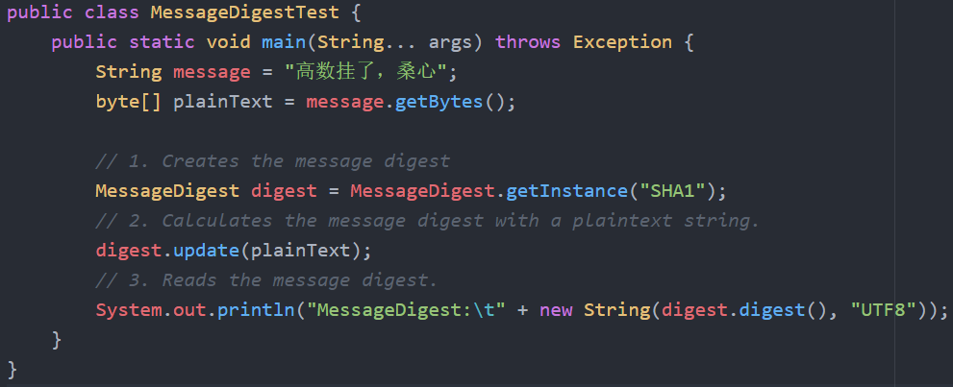
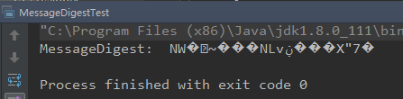
Example
Notes:
Let’s take a look at our example. The MessageDigest class manipulates message digests. The following methods are used in the Message digest code example:

Slide 19
2.2
Public key cryptography
Notes:
In this section, we'll look at public key cryptography, a feature that solves the problem of encrypting messages between parties without prior arrangement on the keys. I will illustrate this with some pictures to make it easier to understand.

Slide 20
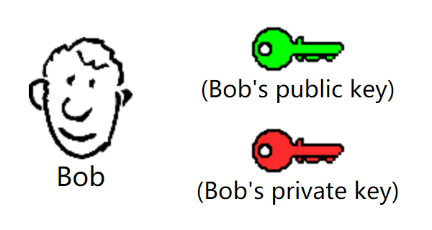
Notes:
Bob has been given two keys. One of Bob's keys is called a Public Key, the other is called a Private Key.

Slide 21
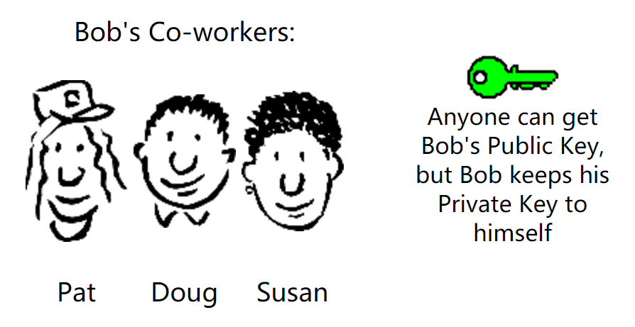
Notes:
Bob's Public key is available to anyone who needs it, so he sent his public key to Pat, Doug and Susan, but he keeps his Private Key to himself. Keys are used to encrypt and decrypt information.

Slide 22
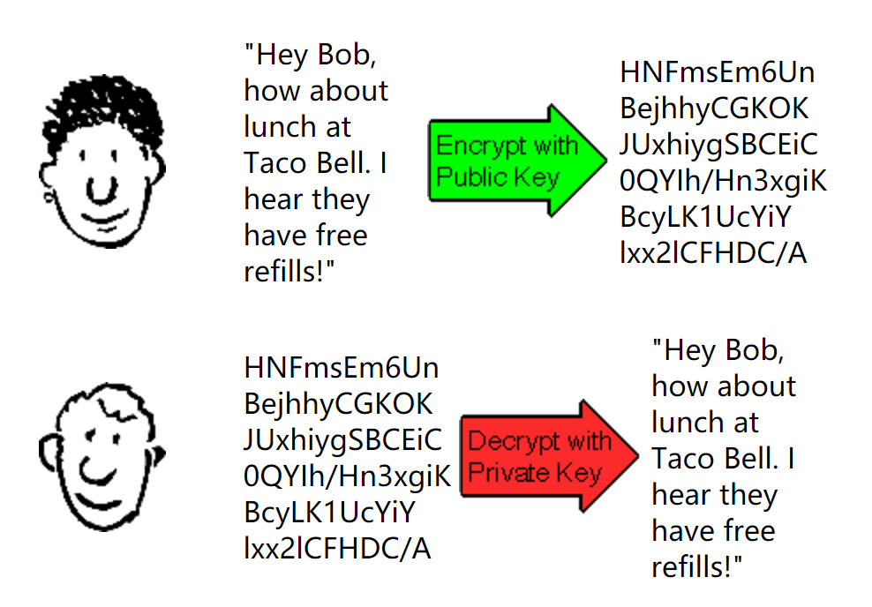
Notes:
Susan (shown above) can encrypt a message using Bob's Public Key. After encryption, she sends the encrypted data to Bob. Bob uses his Private Key to decrypt the message received from Susan. Any of Bob's coworkers might have access to the message Susan encrypted, but without Bob's Private Key, the data is worthless.

Slide 23
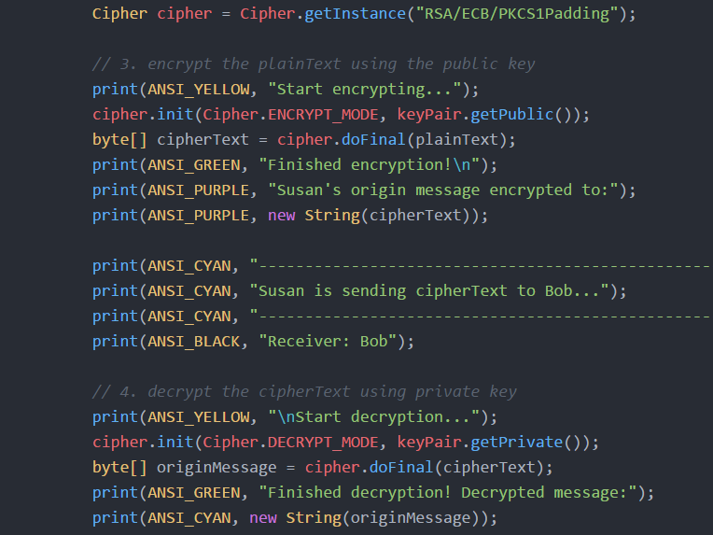
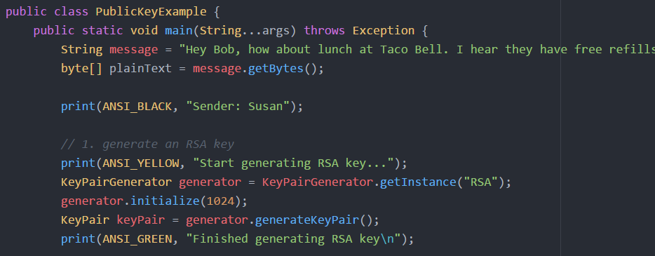
Example

Slide 24
2.3
Digital Signatures
Notes:
Did you notice the flaw in the public key message exchange described above? How can Bob prove that the message really came from Susan but not from others? Because anyone who has Bob's public key will be able to encrypt his own message and send the message to Bob, in that Bob will have no way to confirm the message is from Susan. This is known as a Man-in-the-Middle attack. But we can solve this problem by using a digital signature.

Slide 25
In real world, the message digest is signed by the private key. So, if Bob wants to send Susan a signed message, he generates the message digest of the message and signs it with his private key. He sends the message and the signed message digest to Susan. Susan decrypts the signed message digest with Bob's public key and computes the message digest from the cleartext message and checks that the two digests match. If they do, Susan can be sure the message came from Bob.
Notes:
In real world, the message digest is signed by the private key. So, if Bob wants to send Susan a signed message, he generates the message digest of the message and signs it with his private key. He sends the message and the signed message digest to Susan. Susan decrypts the signed message digest with Bob's public key and computes the message digest from the cleartext message and checks that the two digests match. If they do, Susan can be sure the message came from Bob.

Slide 26
Note:
Digital signatures do not provide encryption of the message, so encryption techniques must be used in conjunction with signatures if you also need confidentiality.
Notes:
Note that digital signatures do not provide encryption of the message, so encryption techniques must be used in conjunction with signatures if you also need confidentiality.
We'll illustrate an easy way to implement this, by uses the Java language's direct support for signatures.

Slide 27
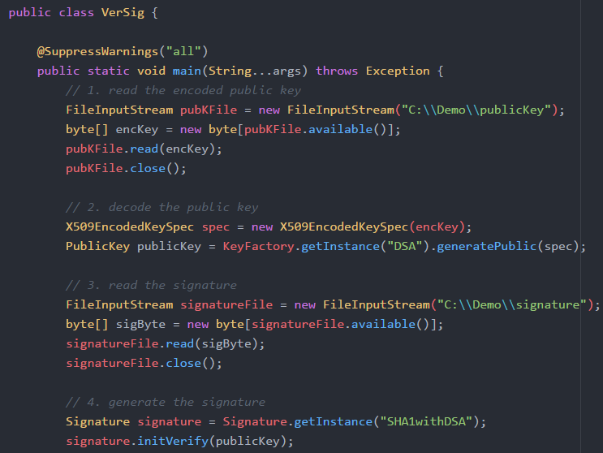
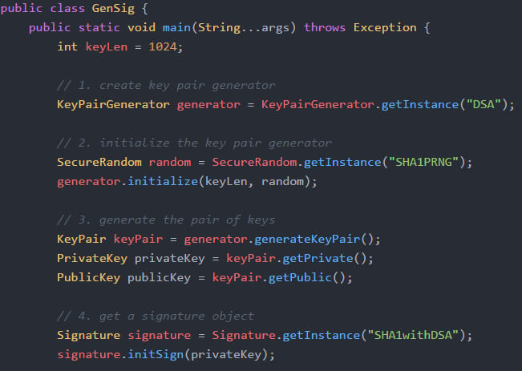
Example

Slide 28
03
Exchange files with Digital Certificate

Slide 29
03
Exchange files with Digital Certificate
Sender
Receiver
Notes:
Let me show some points abort exchanging files. If you want to electronically send an important document, (like a Contract) to someone else, it is a good idea to digitally "sign" the document, so your recipient can check that the document indeed came from you and was not altered in transmission. I will tell you how to do as two roles, sender and recipient. Later I will show a demo in printscreen.

Slide 30
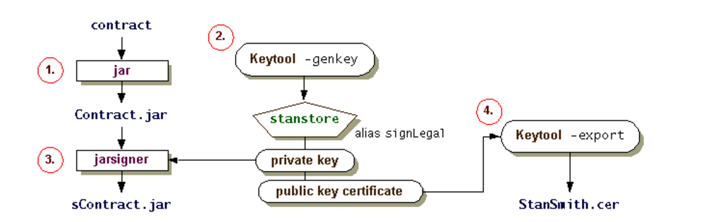
Sender
Create a JAR File Containing the Contract
Generate Keys
Sign the JAR File
Export the Public Key Certificate
Notes:
Pretending that you are the contract sender, Amm.
First you should create a jar file containing the contract
Second You are going to create a keystore and create an entry with a newly generated public and private key pair .
Then you using the private key in the keystore to name the resulting signed JAR file
Last you export the public key certificate, which means that you supply your public key by sending them a copy of the certificate that contains your public key
And this picture can help you understand the process better.

Slide 31
Receiver
Import the Certificate as a Trusted Certificate
Verify the JAR File Signature
Notes:
Now supposing you are the recipient, Bob. You have received the signed file and the certificate which contains the public key.
First you need to import certificate into your keystore. So you can see the fingerprints of certificate, you can phone Amm and ask her what the fingerprints should be. If you are the same, you can assume that the certificate has not been modified in transimision.
second use the jarsigner tool to verify the authenticity of the JAR file signature

Slide 32
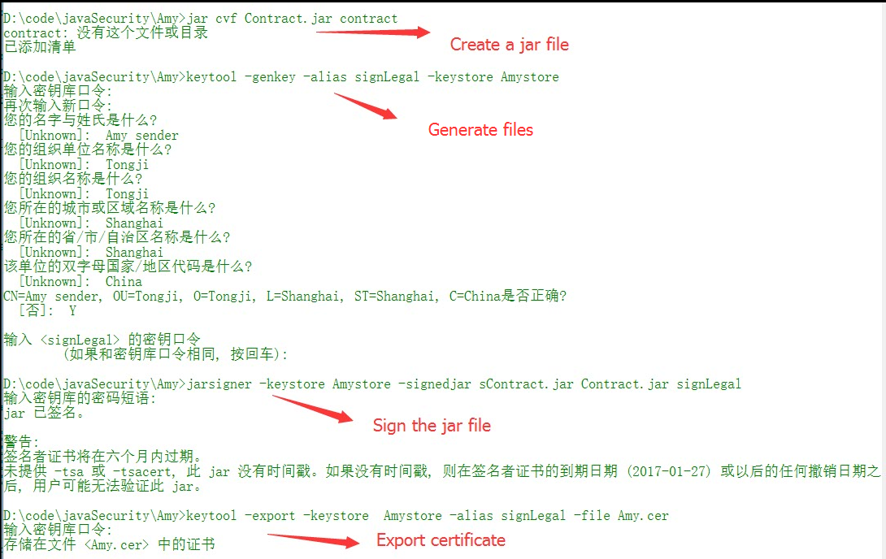
Notes:
This is what sender to do

Slide 33
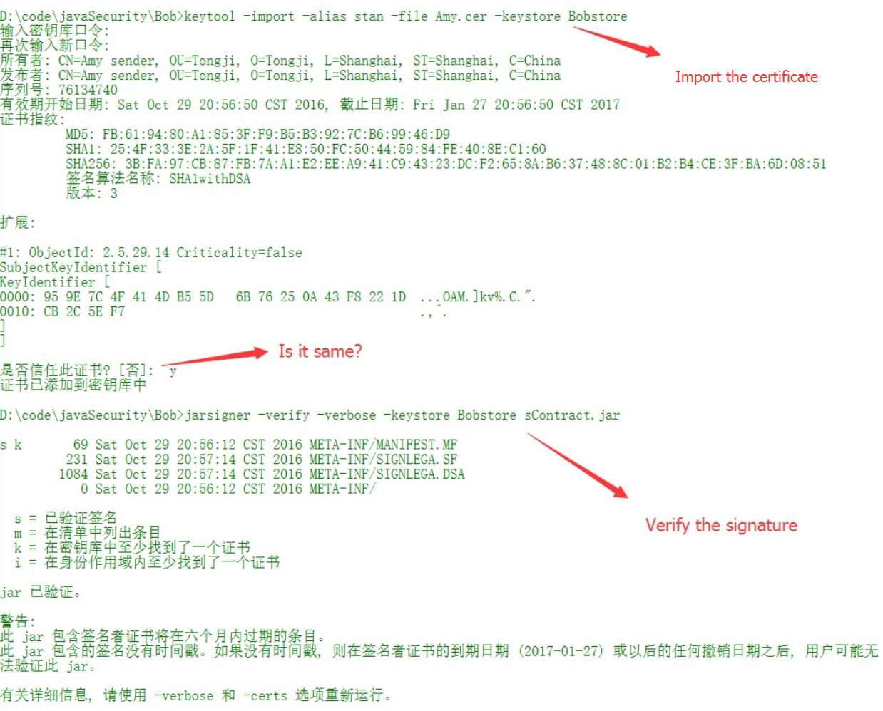
Notes:
This is what recepient to do

Slide 34
04
SSL/TLS: Securing C/S communication

Slide 35
04
SSL/TLS: Securing C/S communication
What is Secure Sockets Layer/Transport Layer Security?
·Secure Sockets Layer (SSL) and its replacement, Transport Layer Security (TLS)
·protocol
·to establish a secure communications channel between a client and a server

Slide 36
04
SSL/TLS: Securing C/S communication
Three steps: No.1
· When a request is made to a site using SSL/TLS (usually with an https:// URL), a certificate is sent from the server to the client. The client verifies the identify of the server from this certificate using the installed public CA certificates, then checks that the IP name (machine name) matches the machine that the client is connected to.

Slide 37
04
SSL/TLS: Securing C/S communication
Three steps: No.2
·The client generates some random info that can be used to generate a private key for the conversation, known as a session key, and encrypts it with the server's public key and sends it to the server. The server decrypts the message with its private key and uses the random info to derive the same private session key as the client. The RSA public key algorithm is usually used for this phase.

Slide 38
04
SSL/TLS: Securing C/S communication
Three steps: No.3
·The client and server then communicate using the private session key and a private key algorithm, usually RC4. A message-authentication code, using yet another key, is used to ensure the integrity of the message.

Slide 39
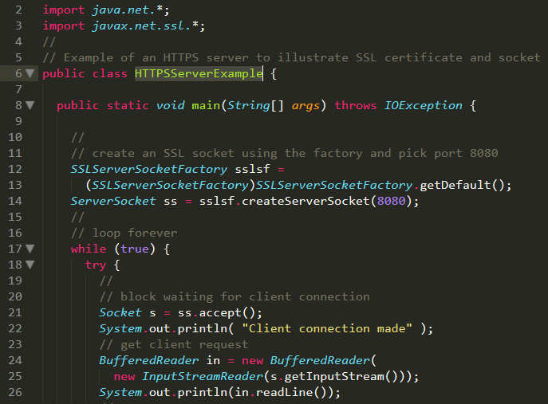
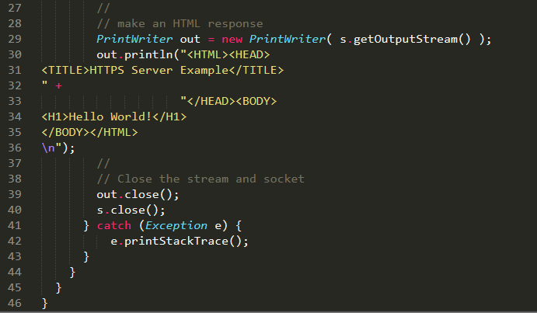
04
SSL/TLS: Securing C/S communication
Example

Slide 40
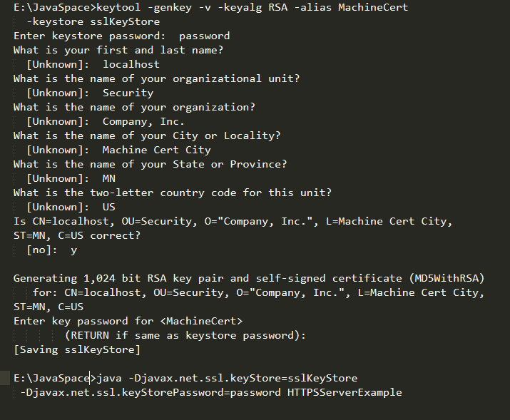
04
SSL/TLS: Securing C/S communication
Example

Slide 41
Thank You
Q&A

