Slide 1
Cloud Computing : Virtualization
클라우드 컴퓨팅 실습
2018.10.08
DNCLAB

Slide 2
Table of Contents
1일차 Introduction
2일차 Xentool
3일차 credit scheduler

Slide 3
Introduction

Slide 4

1. Introduction - corporation

Slide 5
1. Introduction - corporation
1960s John McCarthy, Douglas Parkhill, and others explored the idea of computing
as a public utility.
1960s, IBM developed first hypervisors which provide full virtualization by allowing
multiple OS to run concurrently.
1999, Vmware introduced the first x86 virtualization product
2003, Xen first opensource x86 hypervisor was released to the public.
2006, AMAZON launched Cloud service which is new market for cloud computing

Slide 6
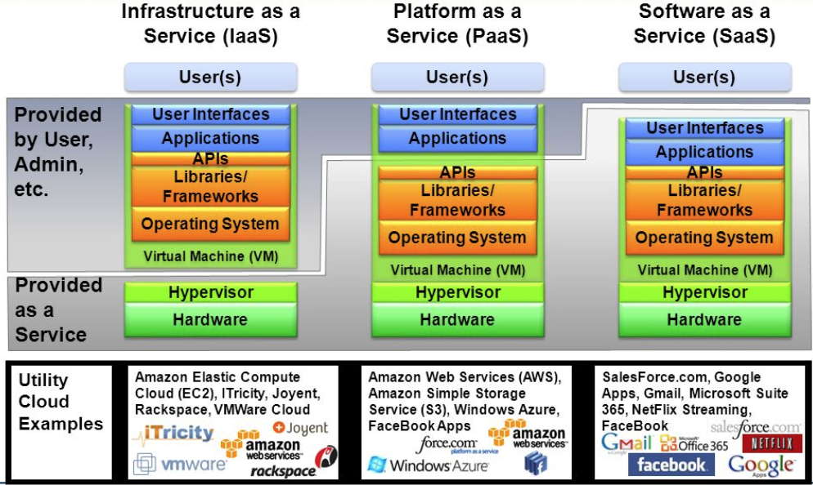
1. Introduction - corporation

Slide 7
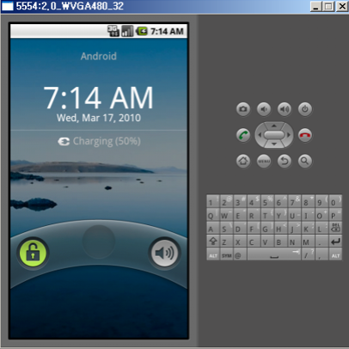
1. Introduction – Emulator and Virtualization
So, what is the virtualization? Let’s look around Emulator on android in java.
Android – ARM Architecture, PC – x86 Architecture
Emulator ordering(implementation ARM on x86 pc)
Android ARM binary image
reverse assembling
translation ARM command to x86 command
implementation on Virtual Machine

Slide 8
1. Introduction – Emulator and Virtualization
But, there is a critical overhead on translation(too long path).
To overcome the overhead, we need to Direct Execution which means hardware directly implements the binary code without translation.
ANDROID EMULATION
VIRTUALIZATION
RING-3
Target app
Target app
Target app
Target app
TRANSLATAION
emulator
OS
OS
OS
OS
DIRECT EXECUTION
Hypervisor
RING-0
Hardware
Hardware

Slide 9
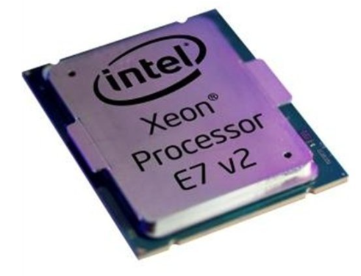
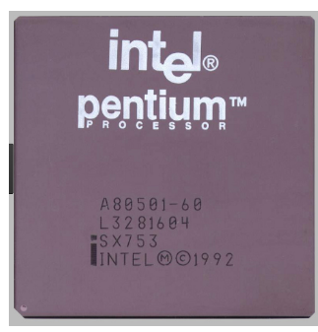
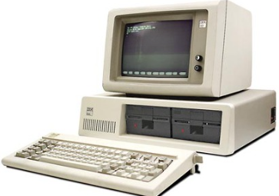

1. Introduction
In 1960, concecpt of virtualization is revealed but not concentrated cause the poor
Hardware specification.
Recently, the hardware has a powerful processing capability than previous.
So, there is a capable to implement the concept of virtualization to commercialization.

Slide 10
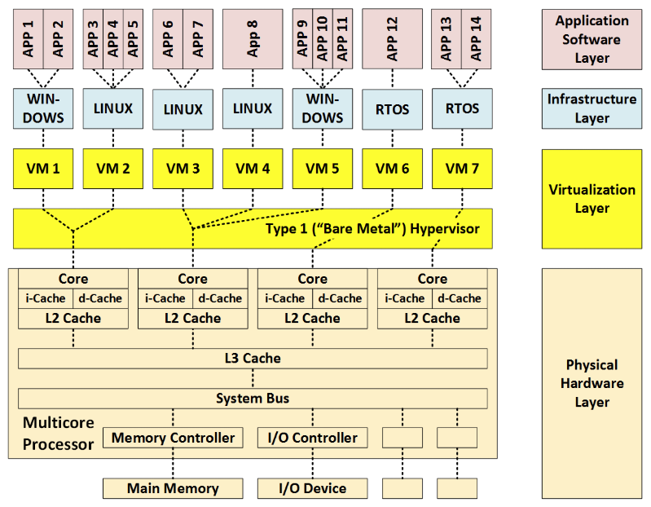
1. Introduction – Base Virtualization Structure

Slide 11
1. Introduction – Definition
Domain or guest
Task
Guest Os
Hyperviosr
Host

Slide 12
1. Introduction – Virtualization System Ring-Layer Based on x86 Architecture
RING-3…? RING-0…?
LET’S SEE THE LAYER OF VIRTUALIZATION OVER NON-VIRTULIAZATION LAYER
kernel
kernel
Ring 3
Ring 3
kernel
kernel
kernel
kernel
kernel
hypervisor
Ring 0
Ring 0
Domain
user
application
application
Typical system
Virtualization system
Entering Ring-0
Typical system : Trap, systemcall, interrupt
Virtualization system : hypercall

Slide 13
1. Introduction – Syscall in Virtualization System
Typical system
Register
OS
syscall
kernel
Interrupt handler
Interrupt processing
Retrun
Virtualization system
If guestOS
hypercall
Hypercall processing
routine
Register
guestOS
syscall
hypervisor
VMI
Retrun
If guestApp
Give controll to guestOS

Slide 14
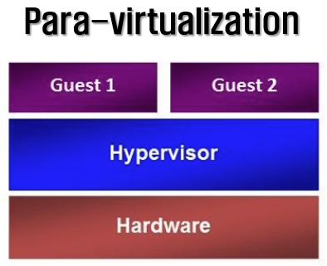
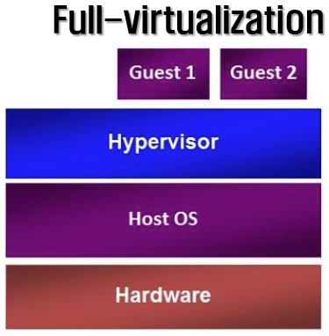
1. Introduction – Virtualization Type
Boot order
Boot order
Need modify the geustOS kernel.
GuestOSs use the hypercall.
GuestOSs must be reconfigured with
the corresponding hypervisor.
Low performance.
Ex) Xen, KVM, Vmware ESX
Dont Need to modify the geustOS kernel.
Fully virtualized hardware.
Need to CPU – VT tech.
Low performance.
Ex)Vmware, VirtualBox

Slide 15
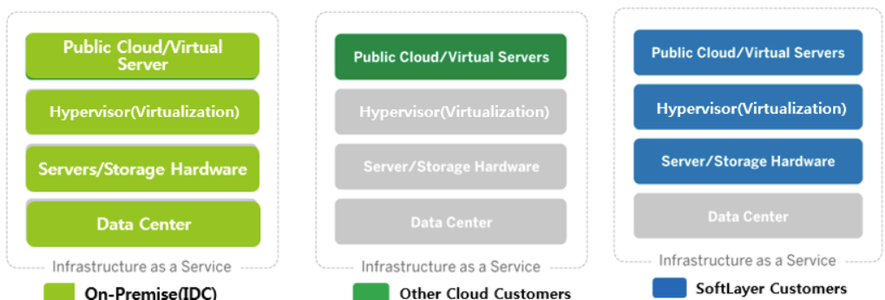
2. XEN
Xen Project is a hypervisor using a microkernel design, providing services that allow
multiple computer operating systems to execute on the same computer hardware concurrently.
It was developed by the University of Cambridge and is now being developed by the Linux Foundation
with support from Intel.

Slide 16
2. XEN
Scalability : The hypervisor can scale up to 4,095 host CPUs with 16Tb of RAM.
Using Para Virtualization (PV), the hypervisor supports a maximum of 512 VCPUs
with 512Gb RAM per guest. Using Hardware Virtualization (HVM), it supports a maximum
of 128 VCPUs with 1Tb RAM per guest.
VM Migration : The software supports Virtual Machine Migration.
This allows you to react to changing loads on your servers, protecting your workloads.
Open Source : Alibaba / Aliyun, AWS, AMD, ARM, Bromium,
Cavium, Citrix, Google, Intel, NetApp, Oracle, Rackspace, and Verizon.
Supports multiple Cloud platforms : CloudStack, OpenStack
Supports multiple guest operating systems : Linux, Windows, NetBSD, FreeBSD

Slide 17
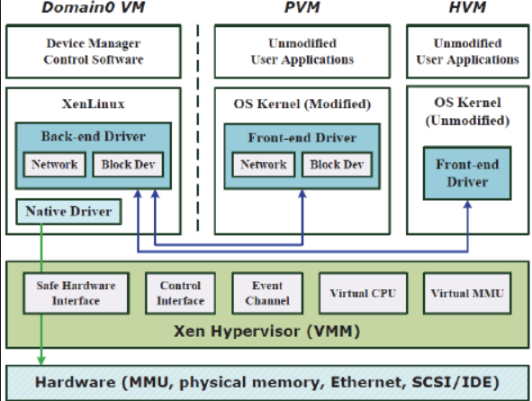
2. XEN - Structure

Slide 18
2. XEN - Domain-0 and Domain-U
Dom0 in Xen is a privileged domain that can function as a driver domain
(if it hosts the device drivers) to perform the I/O operations on behalf of the unprivileged
guest domains (i.e., DomUs) on the same host. In order to transit and receive the data packets,
the DomUs cooperate with the Dom0 via ring

Slide 19
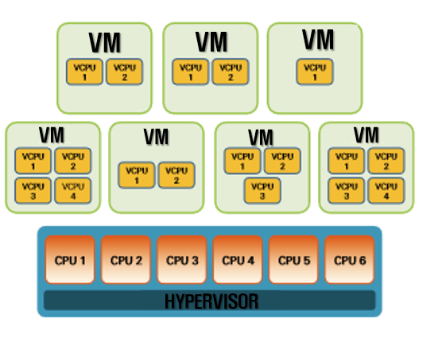
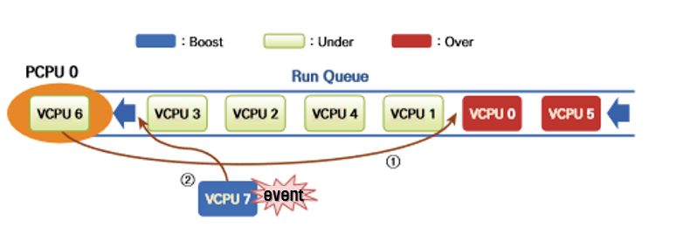
1. XEN Vcpu
2. XEN - VCPU
A physical central processing unit (CPU) which is assigned to a virtual machine (VM).
A virtual processor is more likely amount of processing time spent on the CPU
Virtual processors are mapped to available logical processors in the physical computer and are scheduled by the Hypervisor software to allow you to have more virtual processors than you have logical processors.

Slide 20
2. XEN – I/O
Split Driver model (Backend Driver and Frontend Driver)
To allow unprivileged DomUs to share hardware, Dom0 must give them an interface by which to
make requests for access to the hardware. This is accomplished by using a Backend-Driver.
The Backend-Driver runs in Dom0 and communicates with Domain-U’s frontend-Driver
It queues requests from DomUs and relays them to the real hardware driver.
Event Channel : Asynchronous notification mechanism.
Interdomain Events(Domain ←→ Domain)
Physical IRQ (hardware ←→ Domain)
Virtual IRQ (virtual hardware ←→ Domain)
Ring-IO : used for data transfer between Xen and the guest OSes.
Grant-Table : The grant table is a mechanism to share or transfer memory pages between
domains. With grant table, one domain can inform the hypervisor of granting another
domain to access its own memory pages

Slide 21
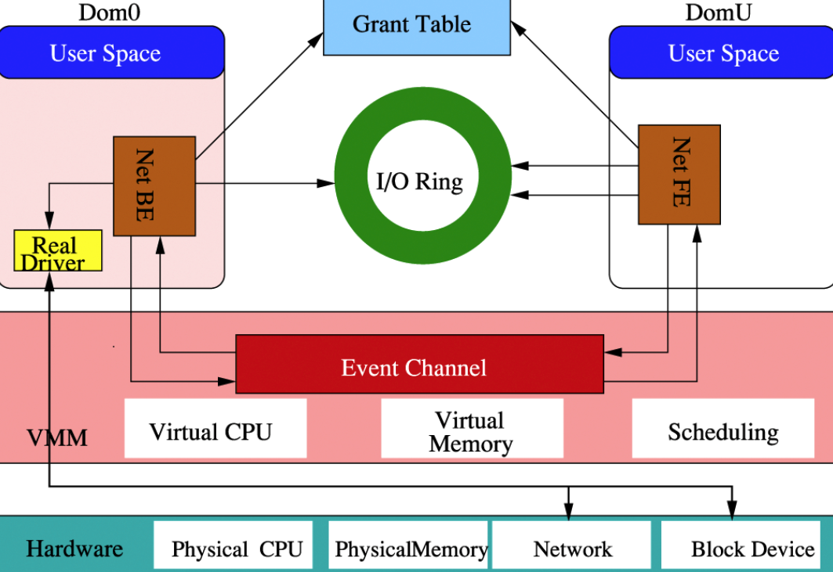
2. XEN – I/O ring

Slide 22
2. XEN – I/O ring
Dom-3 write the Grant reference(ID, Page frame number…) to Grant Table.
Dom-3 write the Request information(ID, request type…) to I/O-Ring.
Dom-0 reads the Request information in I/O-Ring written from Dom-3.
Dom-0 notices to Xen-Hypervisor to mapping the Grant reference at Xen’s Active Grant Table
Dom-0’s backend driver request(Dom-3’s request Type) to Physical Device Driver

Slide 23
2. XEN – I/O ring
(6) When device driver complete the task, Xen-hypervisor initialize the Active Grant Table.
(7) Dom-0’s backend driver write the respond to I/O-Ring
(8) When one of the Dom-3’s vCPU is implemented, it checks the event channels and then reads the
Respond which is from Dom-0 via I/O-ring

Slide 24
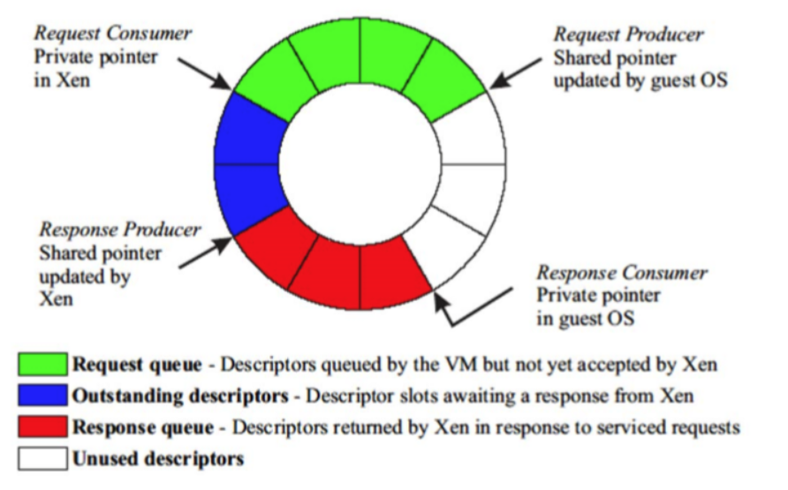
2. XEN – I/O ring

Slide 25
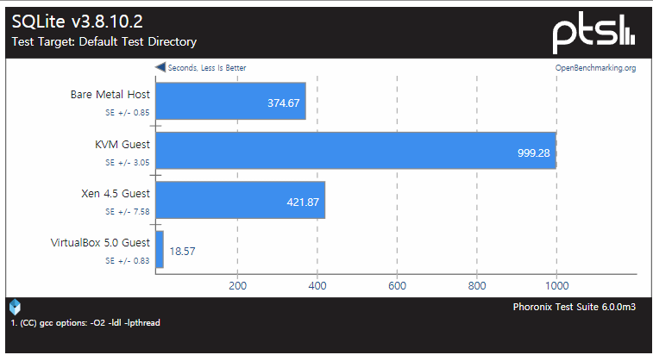
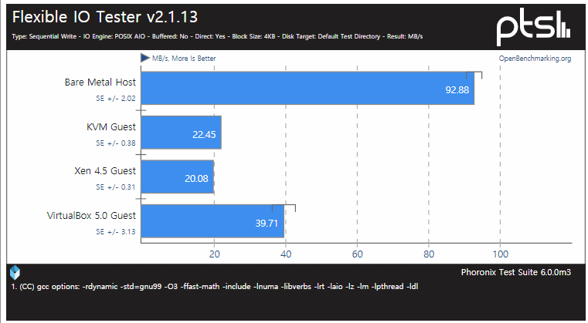
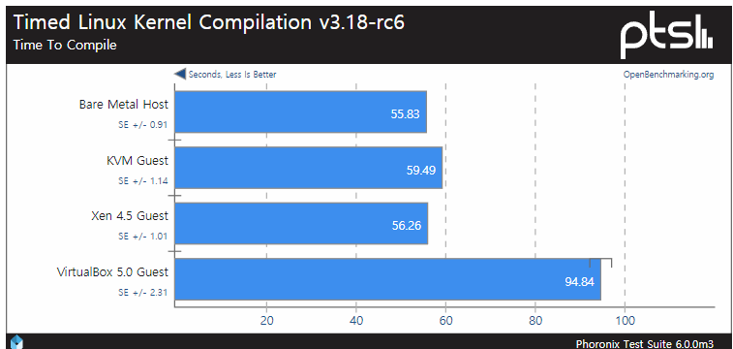
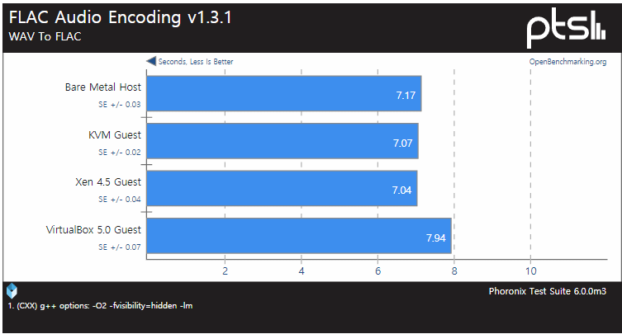
2. XEN – PERFORMANCE

Slide 26
2. XEN - Installation
[XEN INSTALLATION]
$sudo –s
#apt-get install xen-hypervisor-4.6-amd64
#reboot
#apt-get install virt-manager
#reboot
[work directory]
/etc/xen/
[check]
#xl info
#xentop

Slide 27
2. XEN – Para Virtual Machine(PVM)
Para-Virtualization needs to modify the guestOS.
We need 4 file below.
Linux kernel binary file 2. RAM disk file 3. VM configuration file 4. VM storage file
[Para-Virtual Machine set up]
1. Make the directory which is store the linux kernel, RAM disk file.
# sudo mkdir -p /var/lib/xen/images/ubuntu-netboot/trusty14LTS
# cd /var/lib/xen/images/ubuntu-netboot/trusty14LTS
2. Use Linux kernel, RAM disk file which are offered by Ubuntu mirror server(we use neowiz ubuntu-mirror server).
# wget http://ftp.neowiz.com/ubuntu/ubuntu/dists/trusty/main/installer-amd64/current/images/netboot/xen/vmlinuz
# wget http://ftp.neowiz.com/ubuntu/ubuntu/dists/trusty/main/installer-amd64/current/images/netboot/xen/initrd.gz

Slide 28
2. XEN – Para Virtual Machine(PVM)
3. Make the block device which is used by PVM at /etc/xen
# sudo dd if=/dev/zero of=pvm1.img bs=1024k seek=20000 count=0
(make 100GB block disk)
4. Make VM configuration file at /etc/xen
#gedit pvm1.cfg

Slide 29
2. XEN –VM config file
[XEN PV config file example]
# Guest name name =‘pvm1’ # 128-bit UUID for the domain as a hexadecimal number. # Use "uuidgen" to generate one if required. # The default behavior is to generate a new UUID each time the guest is started. #uuid = "XXXXXXXX-XXXX-XXXX-XXXX-XXXXXXXXXXXX" #bootloader = "/usr/lib/xen-4.4/bin/pygrub" on_reboot="restart" on_crash="restart" # Kernel image to boot kernel = "/var/lib/xen/images/ubuntu-netboot/trusty14LTS/vmlinuz" # Ramdisk (optional) ramdisk = "/var/lib/xen/images/ubuntu-netboot/trusty14LTS/initrd.gz" # Kernel command line options extra = "root=/dev/xvda1" # Initial memory allocation (MB) memory = 256
maxmem = 512 # Number of VCPUS vcpus=2
maxvcpus = 4 # Network devices vif = [ ‘mac=00:16:3e:68:e1:01,bridge=virbr0,modell=e1000’ ] # Disk Devices disk = [ ‘/etc/xen/pvm1.img,raw,xvda,rw’ ]

Slide 30
2. XEN – VM instruction
Virtual machine(VM)’s resource is configured through the configure file.
#xl create –c <example.cfg>
#xl console <VM name or ID>
#xl destroy <VM name or ID>
#xl shutdown <VM name or ID>
#xl pause <VM name or ID>
#xl unpause <VM name or ID>
“xl list” will help you to know about Domain information.

Slide 31
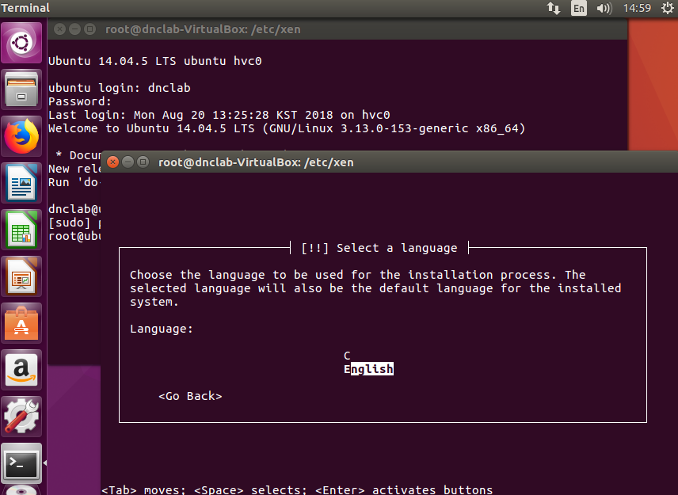
2. XEN – Para Virtual Machine(PVM)
After make config file, do command #xl create –c <example.cfg>

Slide 32
2. XEN – Para Virtual Machine(PVM)
5. When finish the guestOS installation, modify the configuration file like below
kernel = "/var/lib/xen/images/ubuntu-netboot/trusty14LTS/vmlinuz"
→#kernel = "/var/lib/xen/images/ubuntu-netboot/trusty14LTS/vmlinuz“
ramdisk = "/var/lib/xen/images/ubuntu-netboot/trusty14LTS/initrd.gz"
→#ramdisk = "/var/lib/xen/images/ubuntu-netboot/trusty14LTS/initrd.gz“
#bootloader = "/usr/lib/xen-4.4/bin/pygrub"
→bootloader = "/usr/lib/xen-4.4/bin/pygrub“
6. Reboot the VM
#xl shutdown <VM name or ID>
#xl create -c <example.cfg>
#xl console <VM name or ID>

Slide 33
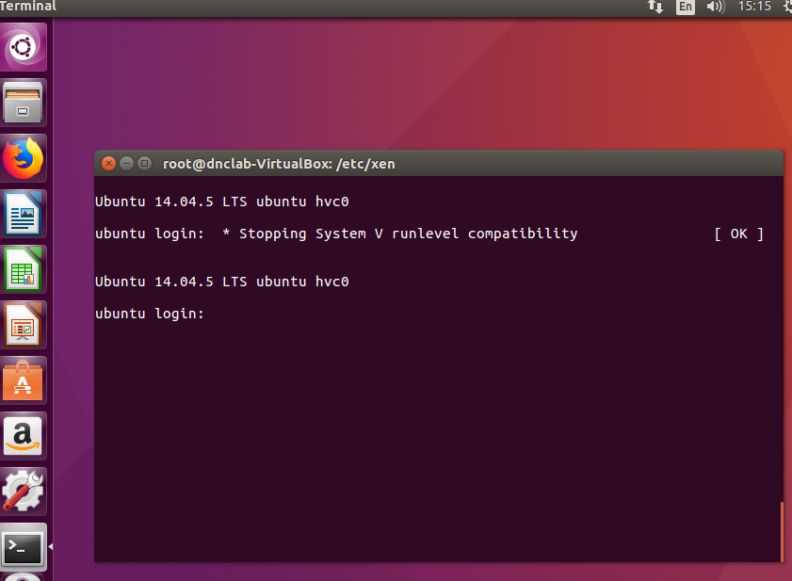
2. XEN – Para Virtual Machine(PVM)
Complete!

Slide 34
2. XEN – Para Virtual Machine(PVM)
Let’s command again below,
#xl list
#xentop

