Slide 1
Cloud Computing : Virtualization
클라우드 컴퓨팅 실습
2018.05.04
DNCLAB

Slide 2
Table of Contents
1일차 Introduction
2일차 Xentool
3일차 credit scheduler

Slide 3
XL tool

Slide 4
2. XL - xentool
Xl is based on the xen-light library(libxl).
Basic guest lifecycle operations → create, shutdown, reboot, pause, unpaues, list etc
Control of CPU scheduler parameters
#xl destroy pvm1
#xl create –c pvm1.cfg
#xl reboot –c pvm1
#xl console pvm1

Slide 5
2. XL – make VM
Make pvm2, pvm3 using pvm1.cfg, pvm1.img
At /etc/xen,
#cp pvm1.cfg pvm2.cfg
#cp pvm1.img pvm2.img
And then, modify the pvm2.cfg

Slide 6
2. XL – pvm configuration file
# Guest name name =‘pvm1’ →need to change, VM id → ‘pvm2’ # 128-bit UUID for the domain as a hexadecimal number. # Use "uuidgen" to generate one if required. # The default behavior is to generate a new UUID each time the guest is started. #uuid = "XXXXXXXX-XXXX-XXXX-XXXX-XXXXXXXXXXXX" bootloader = "/usr/lib/xen-4.6/bin/pygrub" on_reboot="restart" on_crash="restart" # Kernel image to boot #kernel = "/var/lib/xen/images/ubuntu-netboot/trusty14LTS/vmlinuz" # Ramdisk (optional) #ramdisk = "/var/lib/xen/images/ubuntu-netboot/trusty14LTS/initrd.gz" # Kernel command line options extra = "root=/dev/xvda1" # Initial memory allocation (MB) memory = 256
maxmem = 512 // the maximum memory that assigned # Number of VCPUS vcpus=2
maxvcpus = 4 // the maximum vCPU that assigned # Network devices vif = [ ‘mac=00:16:3e:68:e1:01,bridge=virbr0,modell=e1000’ ] →need to change, mac addr → mac=00:16:3e:68:e1:02 # Disk Devices disk = [ ‘/etc/xen/pvm1.img,raw,xvda,rw’ ] → need to change, path → ‘/etc/xen/pvm2.img

Slide 7
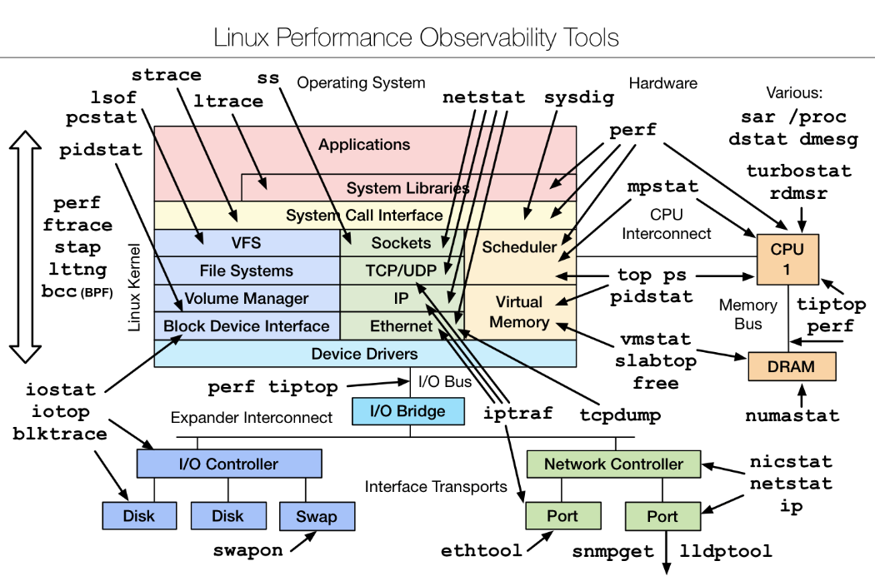
2. Performance Measurement Tool - Sysbench
Sysbench, CPU performance
Iperf , Network-IO performance

Slide 8
2. Performance Measurement Tool - Sysbench
#apt-get install sysbnech
#sysbench –test=<name> help
#sysbench --num-threads=2 --test=cpu --cpu-max-prime=40000 run
Run the sysbench on your VM, and then command xentop on your host, Dom-0.

Slide 9
2. Performance Measurement Tool - iperf
#apt-get install iperf
#iperf --help
In service side,
Check the your host ip, and then open the TCP.
#iperf -s
in client side,
#iperf -w 1000000k –c <your host ip> -i 1 –t 120

Slide 10
2. Performance Measurement Tool - iperf
Pvm1
#iperf -w 1000000k –c <your host ip> -i 1 –t 120
Pvm2
#iperf -s

Slide 11
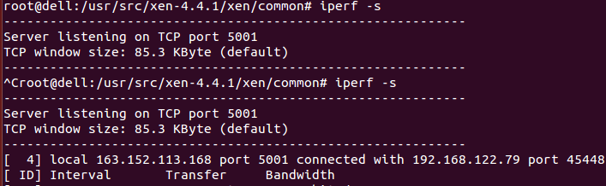
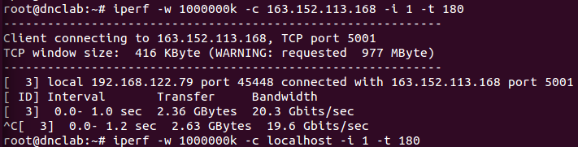
2. Performance Measurement Tool - iperf
Host
Client

Slide 12
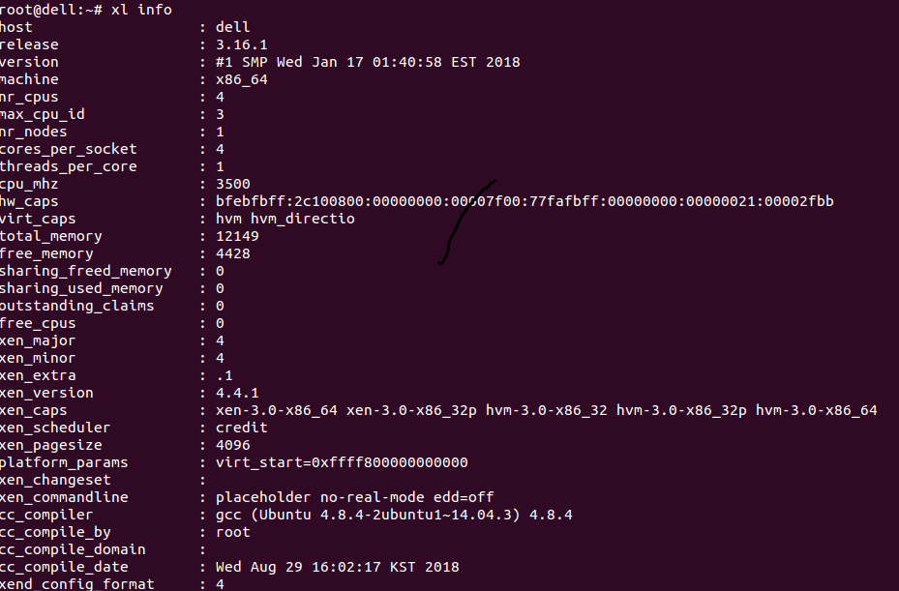
2. xl info

Slide 13
2. xl list
#Xl list <option>
-l, --long
The output for xl list is not the table view shown below, but instead presents
the data as a JSON data structure.
-Z, --context
Also displays the security labels.
-v, --verbose
Also displays the domain UUIDs, the shutdown reason and security labels.
-c, --cpupool
Also displays the cpupool the domain belongs to.
-n, --numa
Also displays the domain NUMA node affinity.

Slide 14
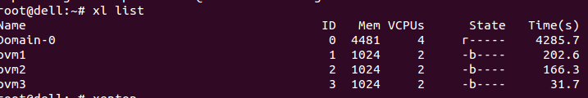
2. xl list

Slide 15
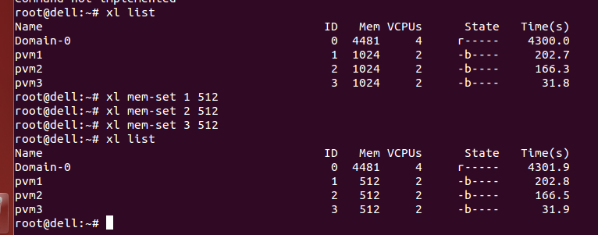
2. xl mem
#Xl mem-set <domain-id> <size>

Slide 16
2. xl vcpu
#Xl vcpu-list
#Xl vcpu-pin <domid> <vcpu number> <pcpu number>
#Xl vcpu-set <domid> <vcpu quantity>

Slide 17
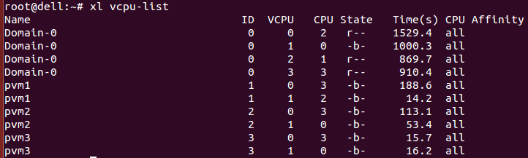
2. xl vcpu

Slide 18
2. xl vcpu
On Dom-0, command
#xl vcpu-set pvm1 4
#xl vcpu-set pvm2 2
#xl vcpu-set pvm3 1

Slide 19
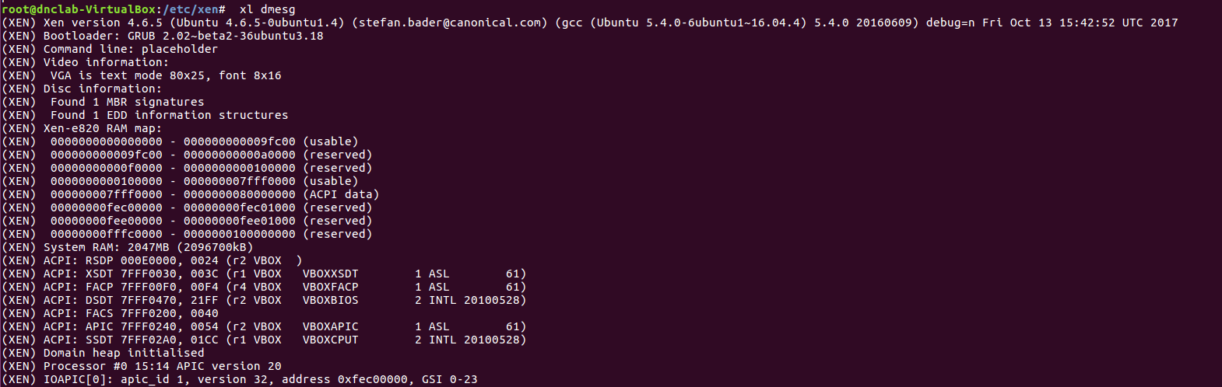
2. XL - dmesg
#xl dmesg
show xen’s kernel log

