Slide 1
Cloud Computing : Virtualization
클라우드 컴퓨팅 실습
2018.05.04
DNCLAB

Slide 2
Table of Contents
1일차 Introduction
2일차 Xentool
3일차 credit scheduler

Slide 3
CREDIT SCHEDULER

Slide 4
3. XEN – Credit Scheduler
Proportional fair share, based on Round-Robin
Credits are assigned to each domain(according to weight)
Weight : proportion of CPU allocated , cap : max limit on CPU time.
Credit scheduler’s basic algorithm
Per 30ms, Credit is assigned to VM according to the weight(high weight, more credit)
When VCPU running, credit is decremented up to execution time(per 10ms)
Each PCPUs have a one run-queue.
*run-queue is arranged with priority.
OVER : run out of credit(lowest).
UNDER : have a bit of credit(middle).
BOOST : when get a event(highest).
4. When there is a no more UNDER-VCPU in run-queue, PCPU find VCPU in another VCPU. When It find, bring it present run-queue and execute(Load balancing).

Slide 5
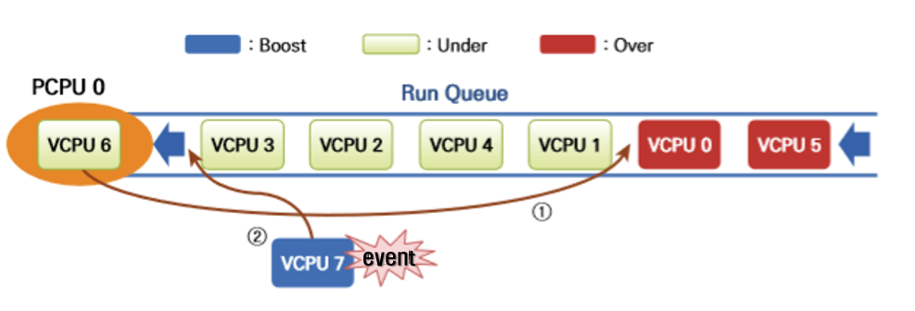
3. XEN – Credit Scheduler
5. When VCPU is blocked or yields the execution turn to wait for exterior event, it get rid of it self in the run queue.
event
present PCPU0 execute the VCPU6. When VCPU spends all of time-slice, it stops the execution and inserted after the same priority VCPU. When VCPU has a exterior event, It is inserted at the front.
OVER VCPU is not scheduled until UNDER VCPU is exhausted.

Slide 6
3. XEN – credit scheduler xl
#sched-credit <option>
-d domain, --domain=DOMAIN
-w weight, --weight = WEIGHT
-c cap, --cap=CAP // 100 is 1cpu, 50 is half cpu(slow down the cpu clockspeed)
-t TSLICE, --tslice_ms=TSLICE
-r RLIMIT, --ratelimit_us=RLIMIT
EX)
#Xl sched-credit <-option> <nothing>
#xl sched-credit <-d> <domain>
#xl sched-credit <-w> <weight size> <-d> <domain>
#xl sched-credit <-c> <cap size> <-d> <domain>

Slide 7
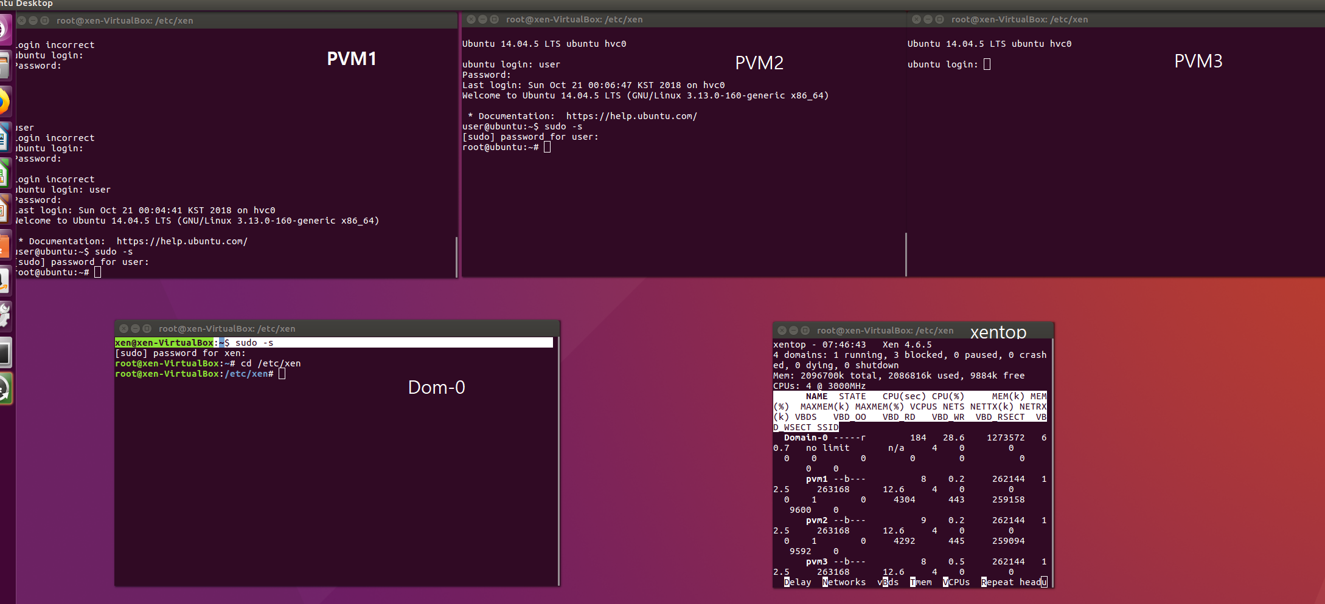
3. XEN – setting
Project

Slide 8
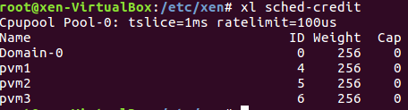
3. XEN – Credit Scheduler information
[command]

Slide 9


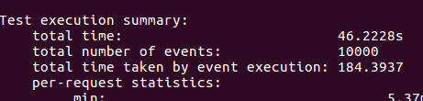

3. XEN – Credit Scheduler, weight
[command]
On pvm1, pvm2, pvm3
#sysbench --test=cpu --num-threads=4 --cpu-max-prime=40000 run
[result]
pvm1
pvm2
pvm3

Slide 10

3. XEN – Credit Scheduler, weight
Again,

Slide 11

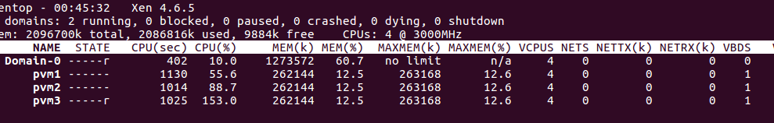
3. XEN – Credit Scheduler, cap
[command]
On pvm1, pvm2, pvm3
#sysbench --test=cpu --num-threads=2 --cpu-max-prime=40000 run
[result]

Slide 12

3. XEN – Credit Scheduler, weight
Again,

Slide 13
3. XEN – Credit Scheduler, timeslice
On Dom-0
#xl sched-credit –s –t 1
And then, change the VM scheduler’s time-slices.
On Dom-0
#xl sched-credit –s –t 30

Slide 14
3. XEN – Scheduler change
On /boot/grub/grub.cfg
### BEGIN /etc/grub.d/20_linux_xen ###
menuentry 'Ubuntu GNU/Linux, with Xen hypervisor' --class ubuntu --class gnu-linux --class gnu --class os --class xen $menuentry_id_option 'xen-gnulinux-simple-2dcbcf05-9a5e-4e73-bc4b-199b524cac7d' {
insmod part_msdos
insmod ext2
set root='hd0,msdos1'
if [ x$feature_platform_search_hint = xy ]; then
search --no-floppy --fs-uuid --set=root --hint-bios=hd0,msdos1 --hint-efi=hd0,msdos1 --hint-baremetal=ahci0,msdos1 2dcbcf05-9a5e-4e73-bc4b-199b524cac7d
else
search --no-floppy --fs-uuid --set=root 2dcbcf05-9a5e-4e73-bc4b-199b524cac7d
fi
echo 'Loading Xen 4.6-amd64 ...'
if [ "$grub_platform" = "pc" -o "$grub_platform" = "" ]; then
xen_rm_opts=
else
xen_rm_opts="no-real-mode edd=off"
fi
multiboot /boot/xen-4.6-amd64.gz placeholder sched=credit2 ###${xen_rm_opts}
echo 'Loading Linux 4.15.0-29-generic ...'
module /boot/vmlinuz-4.15.0-29-generic placeholder root=UUID=2dcbcf05-9a5e-4e73-bc4b-199b524cac7d ro dom0_max_vcpus=4
echo 'Loading initial ramdisk ...'
module --nounzip /boot/initrd.img-4.15.0-29-generic
}

Slide 15
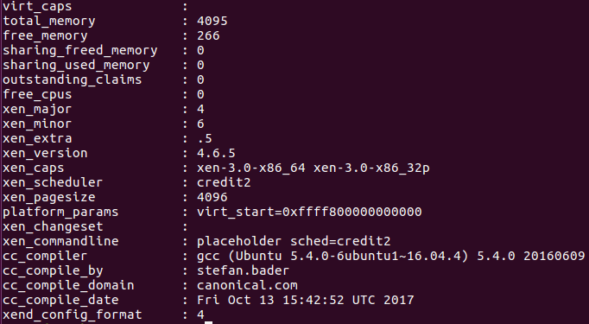
xl info
Back to credit scheduler
multiboot /boot/xen-4.6-amd64.gz placeholder ${xen_rm_opts}

