Slide 1
⚽
TRACK 1 | GenAI Hackathon
World Cup Match Predictor
& Analyst Chatbot
LangChain · FAISS · GPT-4o · RAG
GROUP 5
Novia Dsilva
Sushmitha Sudharsan
Tanmayi Shurpali
Spring 2026
Notes:
PERSON 1 (0:00–0:40): Hi, we're Group 6. Our project is a LangChain-powered World Cup Match Predictor and Analyst Chatbot — Track 1. We built a conversational AI that answers historical World Cup questions using RAG, and can predict match outcomes using a 5-factor statistical model. Our data comes from Kaggle — 49,000+ match records. Let me hand off to [Person 2] to walk through the architecture.

Slide 2
The Problem We are Solving
The Challenge
Our Solution
Football fans need quick, data-backed answers about World Cup history
Comparing teams requires searching scattered sources
No single tool combines historical Q&A with transparent prediction
Conversational AI answers any World Cup question via RAG
Data-driven predictions with computed statistical factors
All numbers from code -- LLM never invents statistics
Confidence and limitations stated with every response

Slide 3
Our Data
Link: https://www.kaggle.com/datasets/martj42/international-football-results-from-1872-to-2017
File | Rows | Description
results.csv | 49,071 | International match results (1872-2026)
goalscorers.csv | 47,555 | Individual goal records with minute and type
shootouts.csv | 665 | Penalty shootout outcomes
former_names.csv | 36 | Historical team name mappings
Preprocessing
Zero nulls, zero duplicates
Date parsing, 36 team name mappings
Result and TotalGoals derived
964 World Cup matches filtered
Key Advantage
Covers ALL international matches.
Enables meaningful recent form
from actual recent matches.

Slide 4
Data Pipeline
6-Stage Data Pipeline
1
dataset_discovery_tool
Catalogs & validates all CSV files
↓
Rows
What it contains
2
data_ingestion_tool
Loads all 4 CSVs into DataFrames
↓
3
data_validation_tool
Zero nulls, zero duplicates confirmed
↓
4
preprocessing_tool
Date parse, name normalization, WC filter
↓
5
eda_visualization_tool
10+ EDA charts generated
↓
6
vector_store_builder
FAISS index with OpenAI embeddings
Notes:
PERSON 2 (0:40–1:30): We used Tier 1 — offline Kaggle CSV datasets. No API keys, no scraping. Four files: 49,071 match results from 1872 to 2026, 47,555 goal records, 597 penalty shootout outcomes, and 74 team name mappings. Our 6-stage pipeline ingests, validates — zero nulls confirmed — preprocesses, runs EDA, and builds a FAISS vector store. Fully reproducible on any machine.

Slide 5
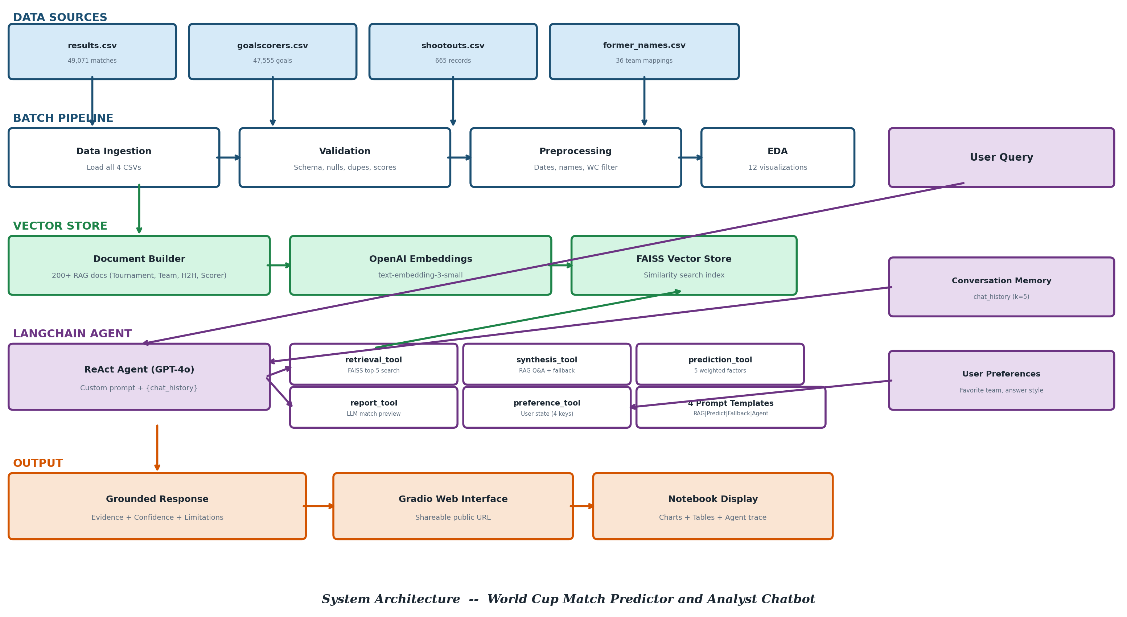
System Architecture
Notes:
PERSON 2 (0:40–1:30): We used Tier 1 — offline Kaggle CSV datasets. No API keys, no scraping. Four files: 49,071 match results from 1872 to 2026, 47,555 goal records, 597 penalty shootout outcomes, and 74 team name mappings. Our 6-stage pipeline ingests, validates — zero nulls confirmed — preprocesses, runs EDA, and builds a FAISS vector store. Fully reproducible on any machine.

Slide 6
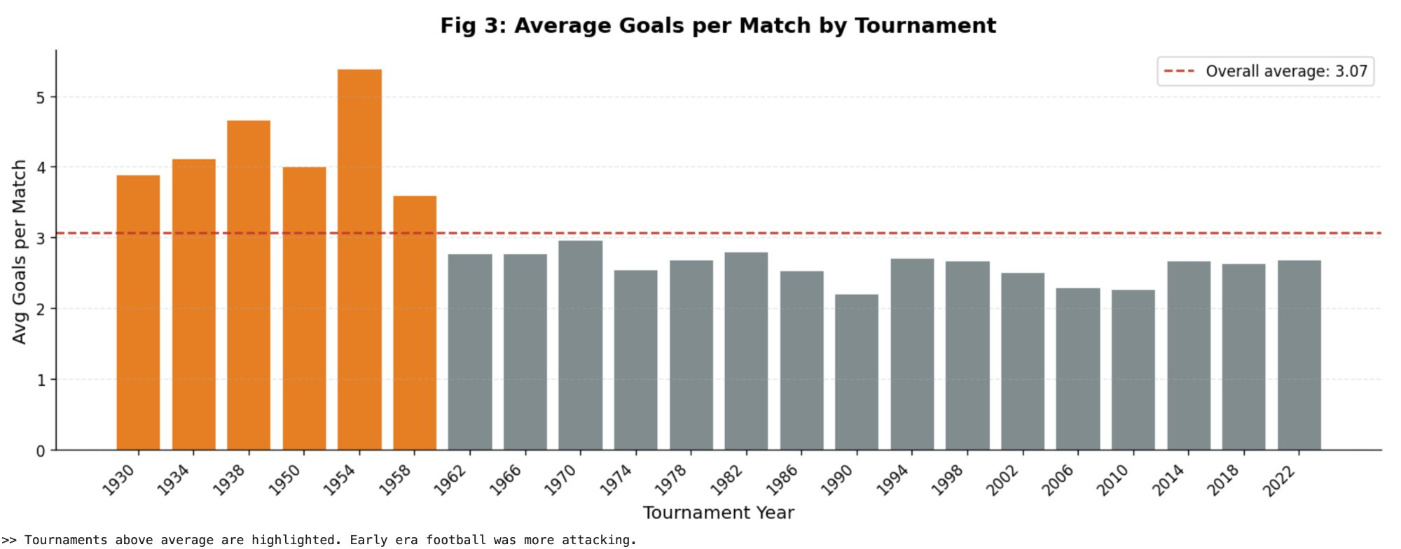
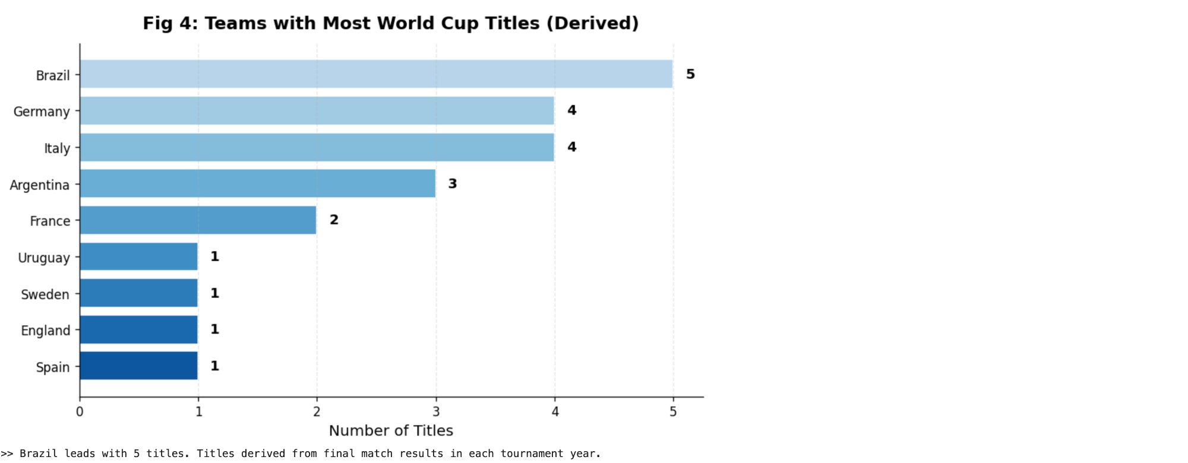
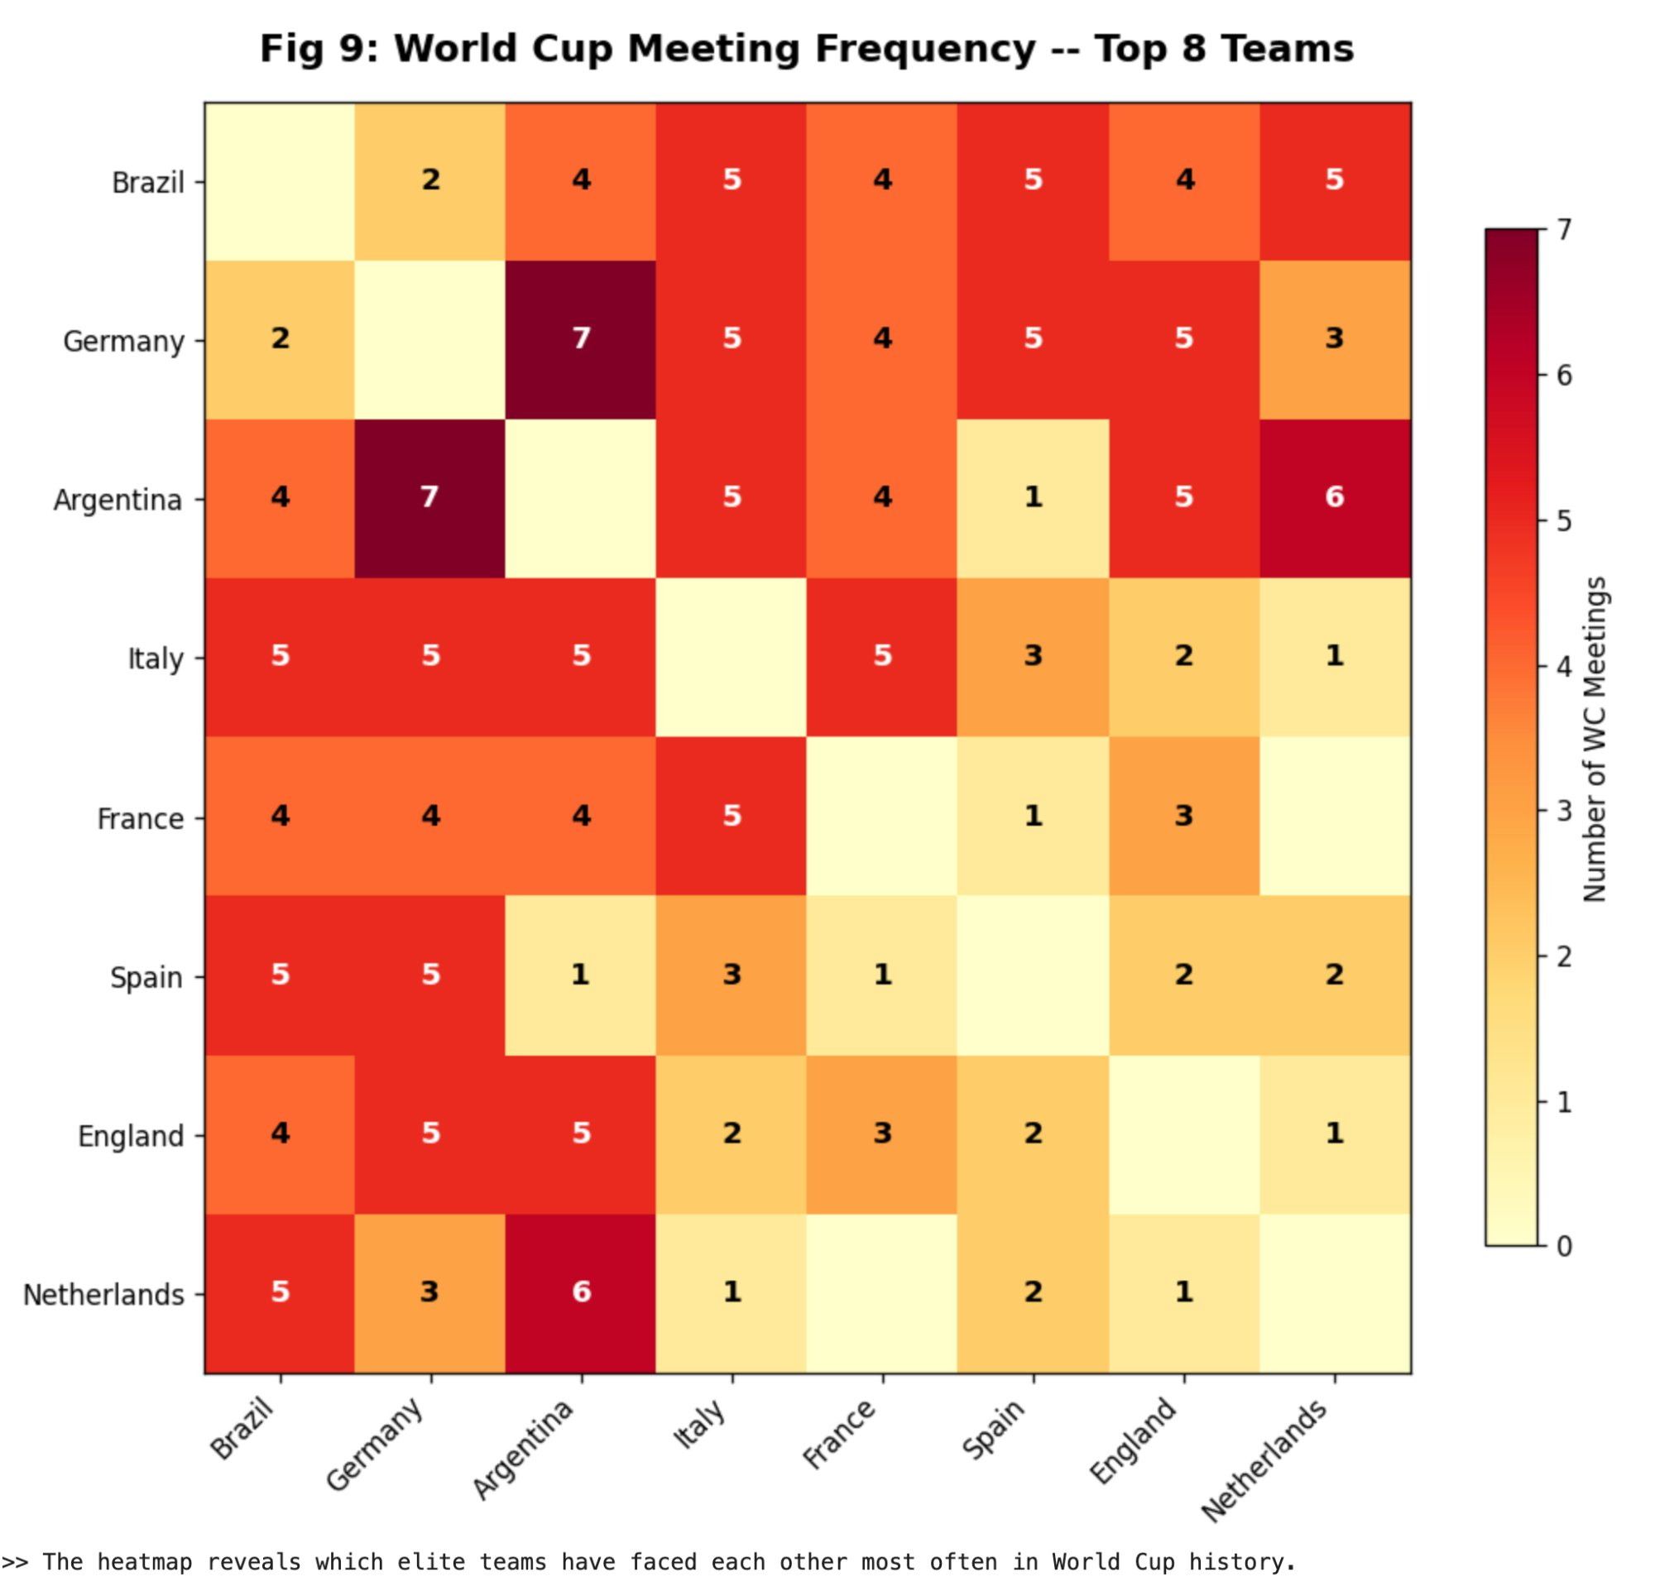
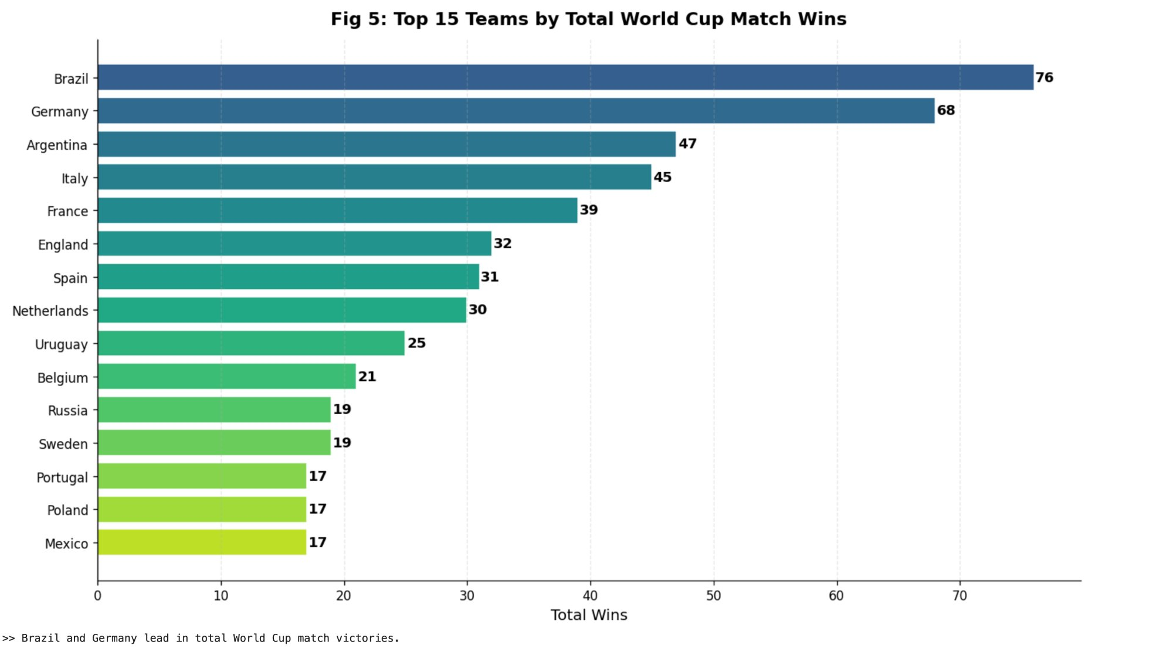
EDA Highlights — What the Data Tells Us
Notes:
PERSON 1 (demo intro, ~3:10): Before we show the live demo, here are four key insights from our EDA. First — World Cup match count grew 2.8x since 1930, with clear jumps at expansion years. Second — home teams win 45% of matches vs 29% away. Third — Brazil leads all-time WC wins with 76. Fourth — modern tournaments average 2.6 goals per match, down from 4.7 in 1954. All of these patterns are embedded in our FAISS vector store, so the chatbot can answer questions about them directly.

Slide 7
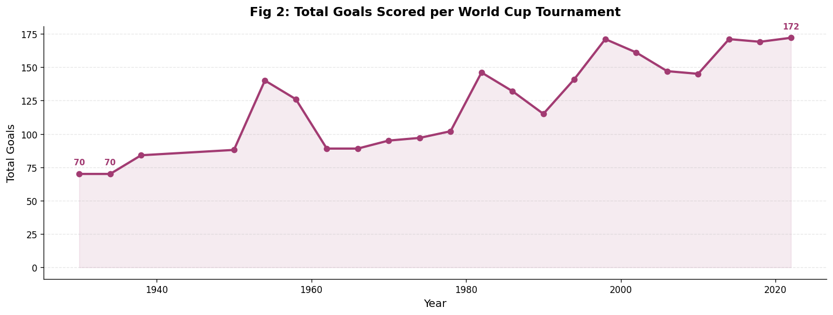
EDA Highlights — What the Data Tells Us
Notes:
PERSON 1 (demo intro, ~3:10): Before we show the live demo, here are four key insights from our EDA. First — World Cup match count grew 2.8x since 1930, with clear jumps at expansion years. Second — home teams win 45% of matches vs 29% away. Third — Brazil leads all-time WC wins with 76. Fourth — modern tournaments average 2.6 goals per match, down from 4.7 in 1954. All of these patterns are embedded in our FAISS vector store, so the chatbot can answer questions about them directly.

Slide 8
Match Prediction Engine
Recent Form Score
25%
Head-to-Head Record
20%
Overall WC Win Rate
25%
Last 10 international matches (all competitions)
All international meetings between the two teams
Complete World Cup match history
H2H Goal Average
15%
Recent Goal Difference
15%
Goals per game in head-to-head meetings
Goal difference in last 10 international matches
Notes:
PERSON 1 (demo intro, ~3:10): Before we show the live demo, here are four key insights from our EDA. First — World Cup match count grew 2.8x since 1930, with clear jumps at expansion years. Second — home teams win 45% of matches vs 29% away. Third — Brazil leads all-time WC wins with 76. Fourth — modern tournaments average 2.6 goals per match, down from 4.7 in 1954. All of these patterns are embedded in our FAISS vector store, so the chatbot can answer questions about them directly.

Slide 9
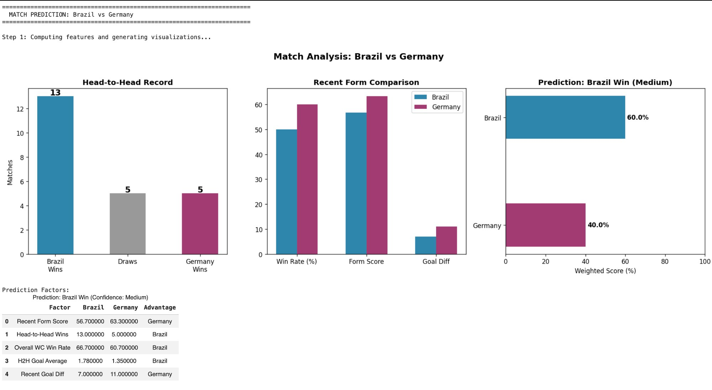
Prediction: Brazil vs Germany
Notes:
PERSON 1 (demo intro, ~3:10): Before we show the live demo, here are four key insights from our EDA. First — World Cup match count grew 2.8x since 1930, with clear jumps at expansion years. Second — home teams win 45% of matches vs 29% away. Third — Brazil leads all-time WC wins with 76. Fourth — modern tournaments average 2.6 goals per match, down from 4.7 in 1954. All of these patterns are embedded in our FAISS vector store, so the chatbot can answer questions about them directly.

Slide 10
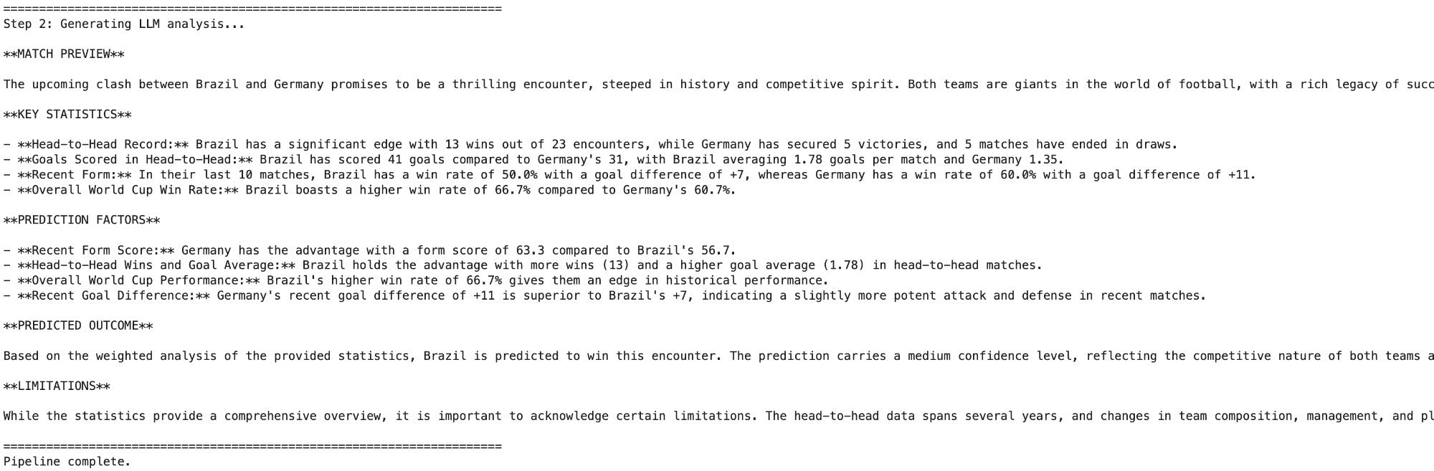
LLM Match Preview
Notes:
PERSON 1 (demo intro, ~3:10): Before we show the live demo, here are four key insights from our EDA. First — World Cup match count grew 2.8x since 1930, with clear jumps at expansion years. Second — home teams win 45% of matches vs 29% away. Third — Brazil leads all-time WC wins with 76. Fourth — modern tournaments average 2.6 goals per match, down from 4.7 in 1954. All of these patterns are embedded in our FAISS vector store, so the chatbot can answer questions about them directly.

Slide 11
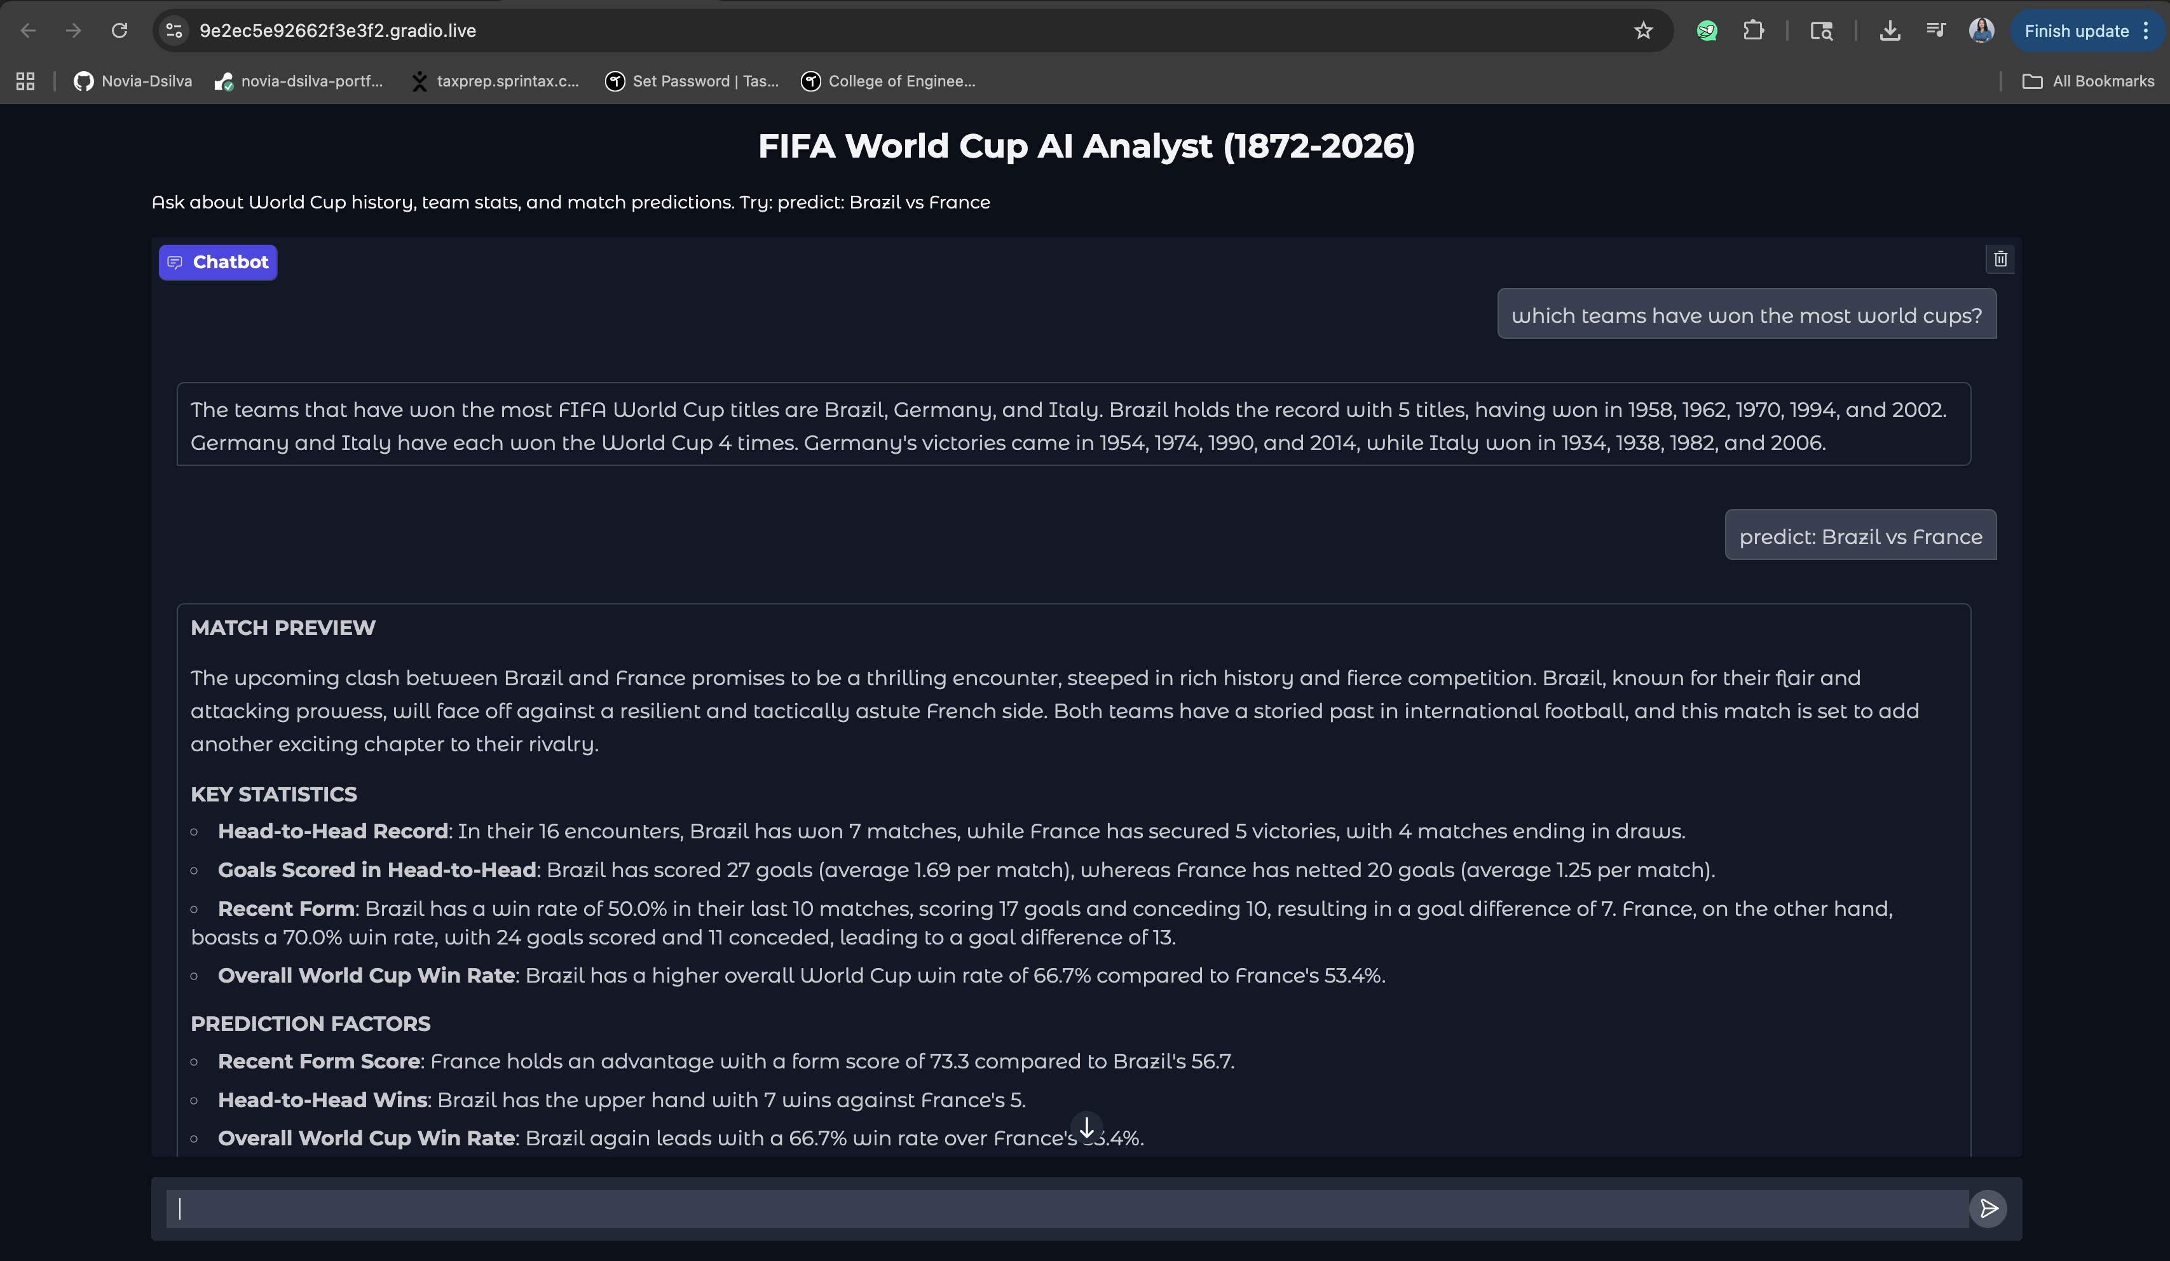
Live Demo — Gradio Web Interface
Notes:
DEMO (2:20–4:00): Switch to the Gradio interface now. Person 1 sets preferences. Person 2 asks the history question and the follow-up to show memory. Person 3 runs the Argentina vs France prediction — point out the auto-generated bar chart and radar chart. Then show the Atlantis edge case — the fallback prompt fires and says 'I don't have data for this team.' Finally switch answer_style to brief and ask about Germany.

Slide 12
KEY FEATURES & DEMO
What the chatbot can do
🔍
Natural Language Q&A
SAMPLE QUERIES
Ask anything about World Cup history — winners, top scorers, records
1
"Who has scored the most goals in World Cup history?"
🎯
Match Prediction
Prefix query with "predict:" to get evidence-based match outcome analysis
"Which country has won the most World Cups?"
2
🧠
Conversation Memory
Retains chat_history for multi-turn context with persistent user preferences
3
"predict: Brazil vs Germany"
🌐
Gradio Interface
"How many times has Argentina reached the final?"
4
Live shareable web UI for interactive demo during presentations
5
"What was the biggest upset in World Cup history?"
⚠️
Responsible AI
Grounded outputs with limitations stated — not gambling advice
Notes:
PERSON 1 (4:00–5:00): Here's how we map to each grading criterion. 40% architecture — 5 tools, 4 prompt templates, memory. 20% data — Tier 1 Kaggle, fully reproducible. 20% grounded outputs — no hallucination, fallback prompts. 10% innovation — Gradio UI, prediction charts. 10% presentation — this deck and the demo. On the right, each of us owned specific components.

Slide 13
⚽
Limitations, Responsible AI & Future Work
Group 6 · World Cup GenAI Hackathon · Spring 2026
Known Limitations
Responsible AI
Data coverage
The dataset covers international matches through early 2026 including all World Cups through 2022. As with any historical dataset, the most recent matches may not yet be reflected.
All statistics are computed from verifiable, publicly available source data.
The LLM is instructed to avoid hallucinating statistics in all 4 prompt templates.
Confidence levels and limitations are stated with every prediction.
A dedicated fallback prompt prevents guessing when evidence is insufficient.
Prompts explicitly discourage use as betting advice.
Data sources are cited with URLs and licensing information
Recent form scope
Recent form is computed from the last 10 international matches across all competitions, which provides a broad signal but may weigh friendlies equally with competitive fixtures.
Historical comparisons
Comparing teams across different football eras naturally involves some approximation, as rules, team composition, and competition standards evolve over time.
Prediction scope
Predictions are based on historical statistical patterns and do not incorporate real-time factors such as current squad fitness, managerial tactics, or match-day conditions.
Model behavior
The LLM synthesizes text based on retrieved and computed evidence, and is explicitly prompted to avoid speculation, though no language model is perfectly constrained.
Future Enhancements
▸ Elo rating integration
▸ Tournament bracket simulation
▸ Player-level squad stats
Thank you! Happy to take questions. ⚽
Notes:
PERSON 3 (5:00–6:00): To wrap up — our limitations: data goes through early 2026, no real-time squad info, and outputs are educational only. We explicitly state these in every prediction response — that's part of our responsible AI design. Future work: Elo ratings, live API data, tournament simulation. What we delivered: a fully grounded, reproducible LangChain system — every stat from data, every answer citable, no hallucination. Thank you!

