Slide 1
Switch
Status Meeting #3
Members:
Xin Zhao (Scrum Master)
Yinuo Huang (Product Manager)
Jin Feng Lin
Yueming Tang
David Huang

Slide 2
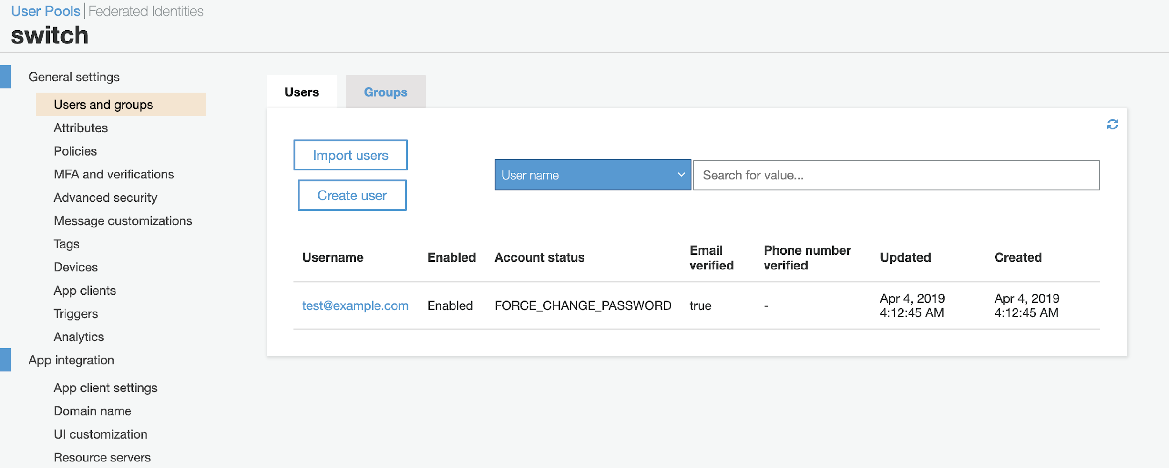
Cognito user pool

Slide 3
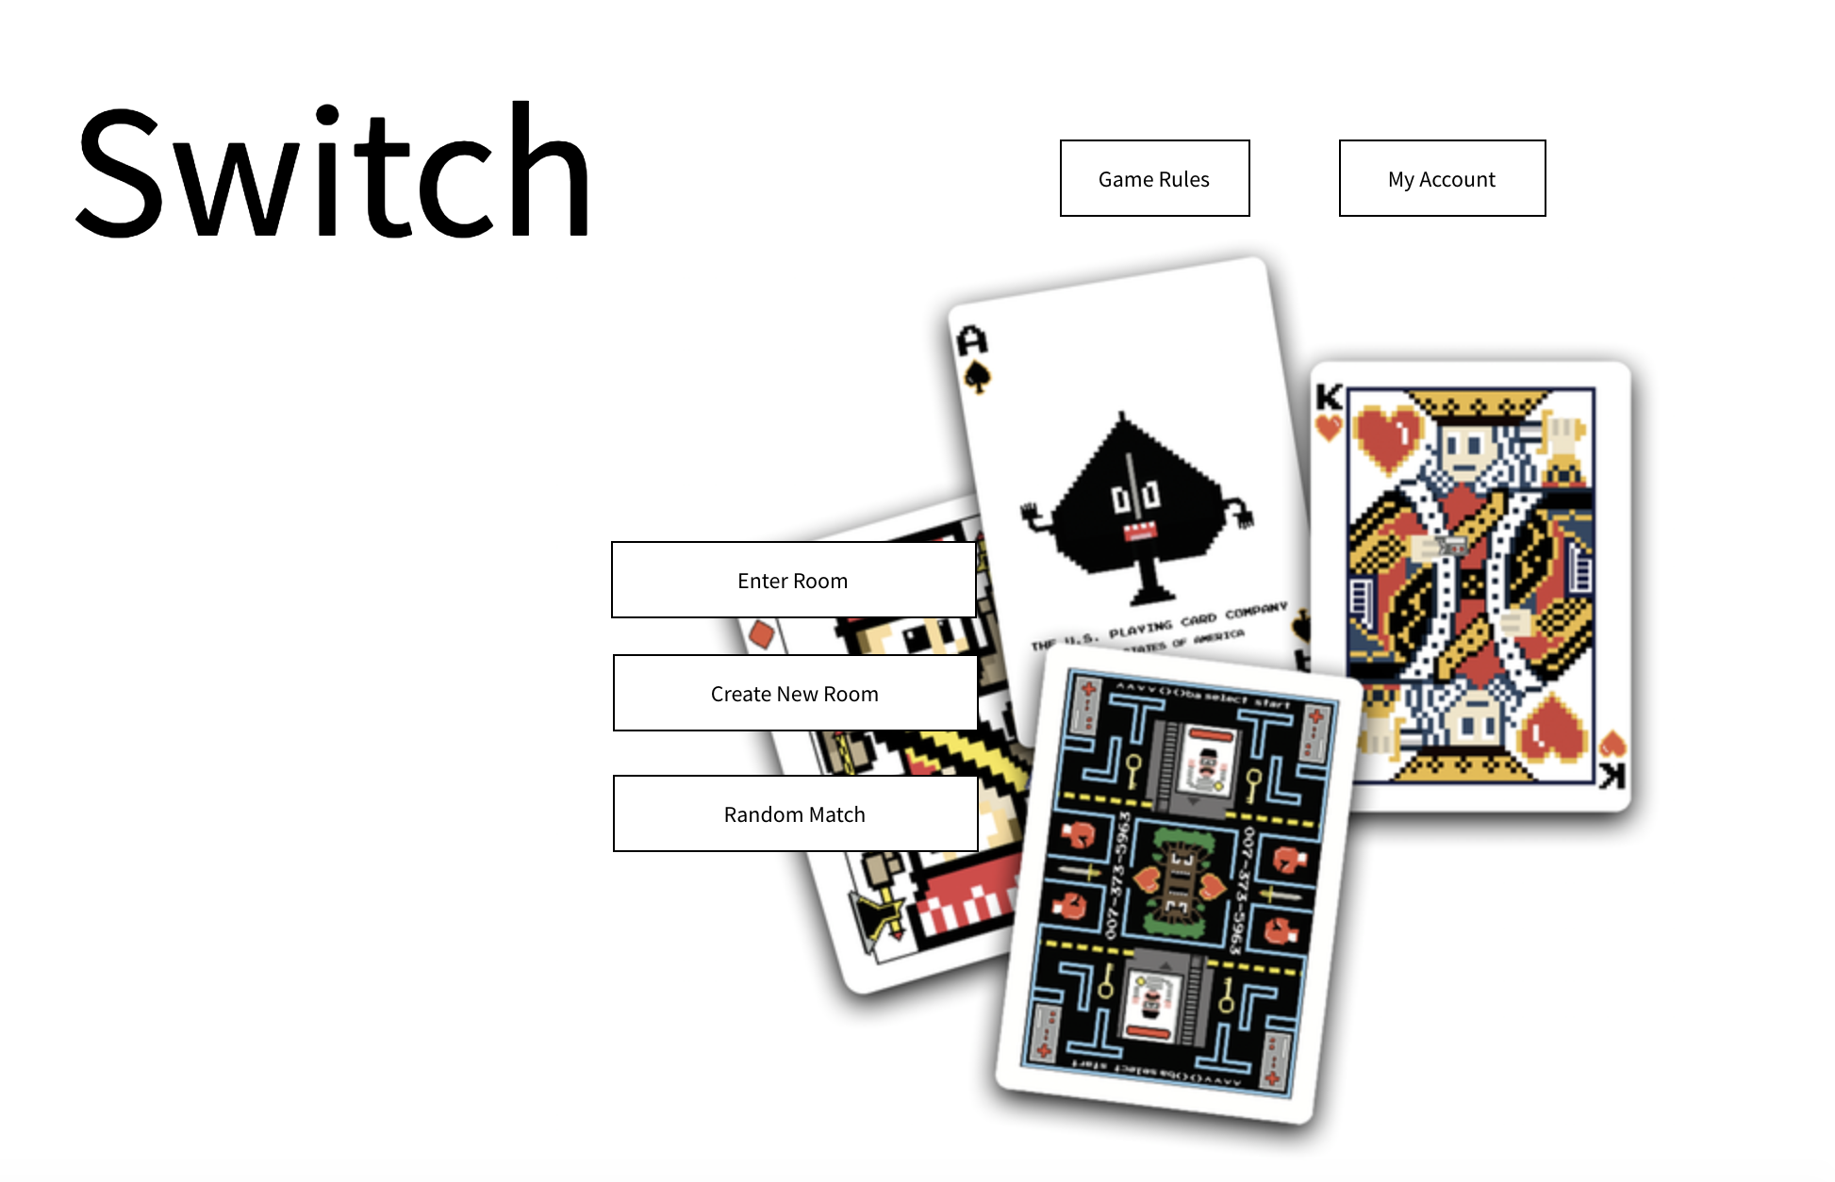
Room Page Wireframe

Slide 4
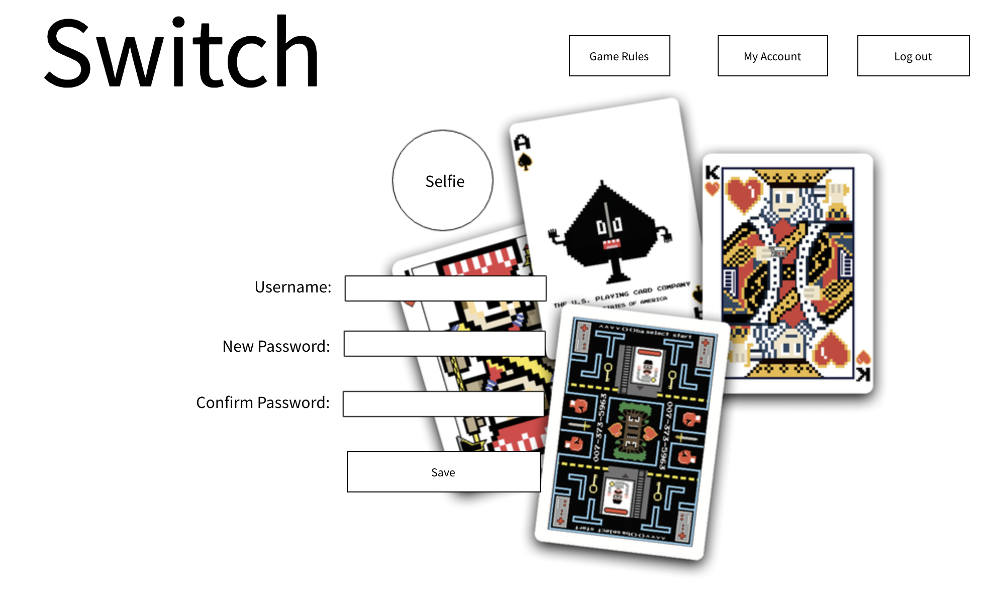
Account Page Wireframe

Slide 5
Current Progress
Fixed gameboard bugs
Amplify & AppSync
Pages after login
Enter room number
Create a new room
Random match

Slide 6
New Issues
Implement gameboard for multi-user
Maybe moving to React-Phaser
Backend database

