Slide 1








Slide 2
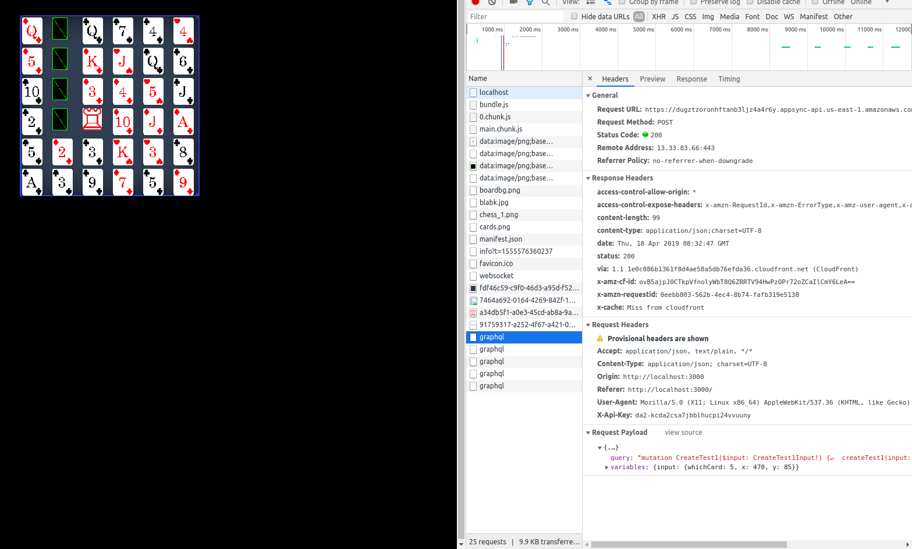
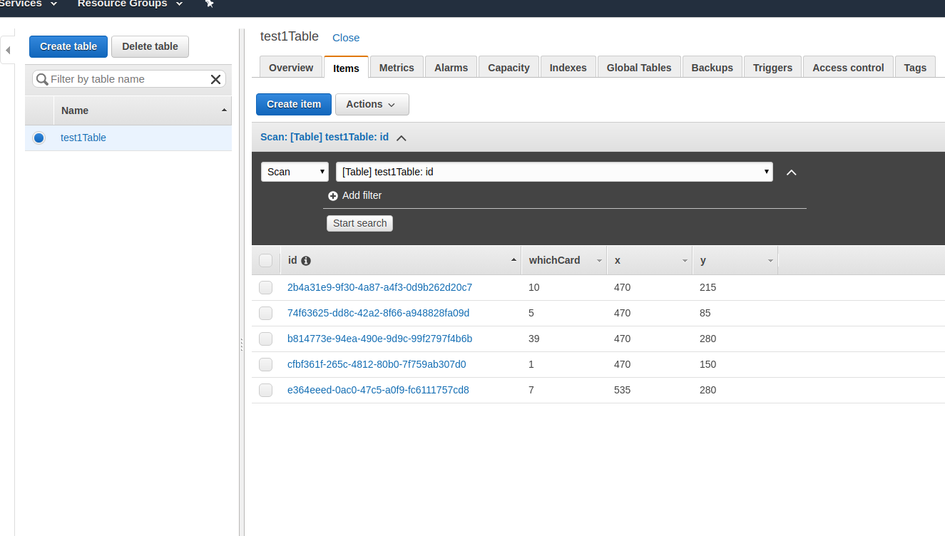
APPSYNC WORKS ,
BUT ONLY BASED ON THE GAMEBOARD

Slide 3
Current Progress
Half-completed Room List page
Need to retrieve data from database
Figured out to render Phaser in React
MULTIPLAYER MODE ~
Started working on profile page and game rule page

Slide 4
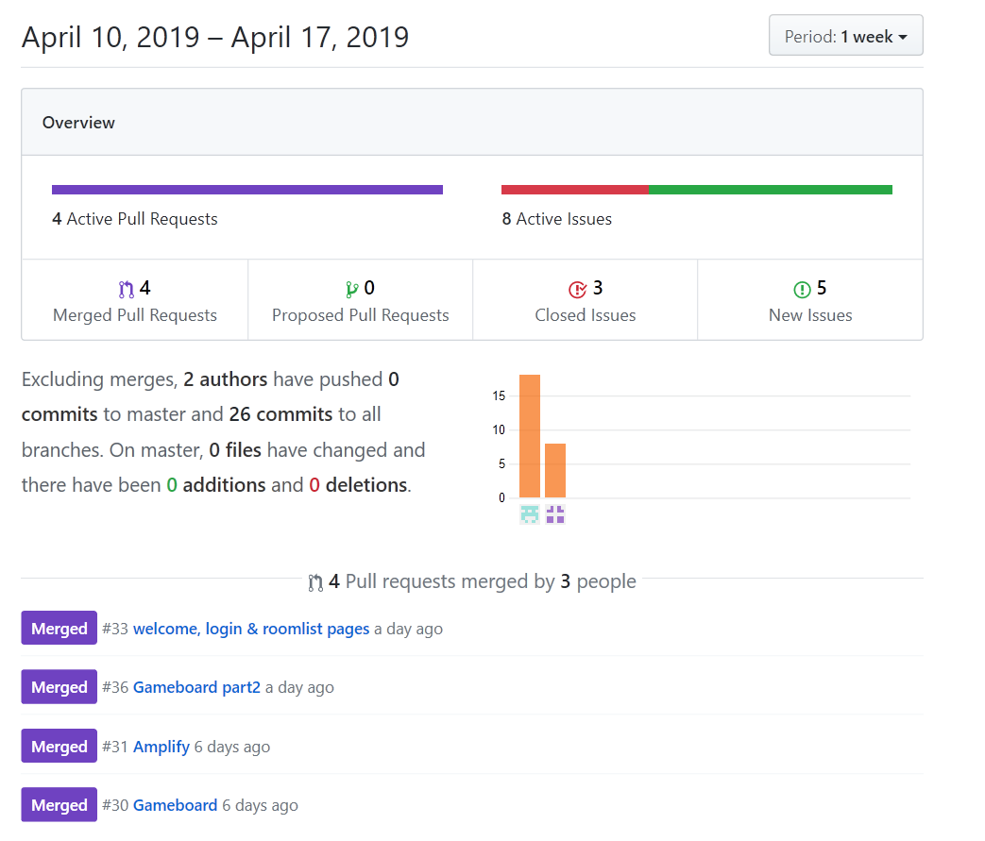
Commits

Slide 5
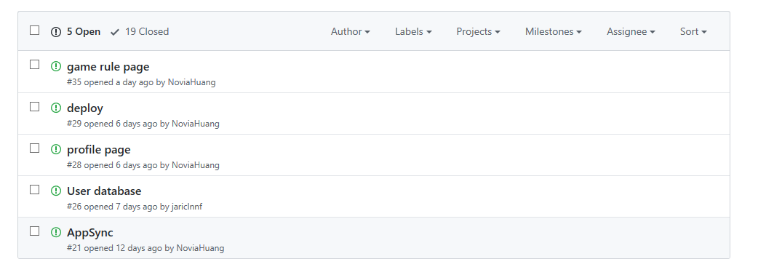
Issues

