Slide 1
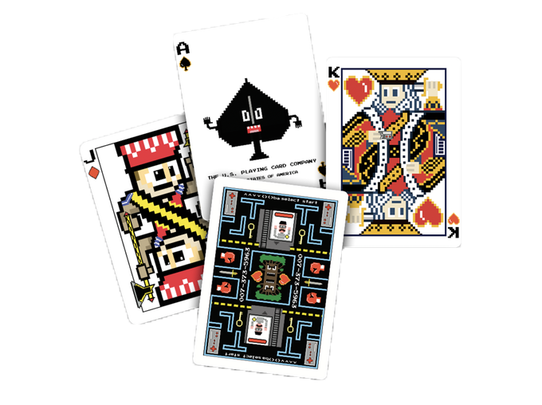







Slide 2
Current Progress
Switched from using controlled component to React-Router
Updated game-rule page and profile page
Retrieved room id using appsync
Finished with create new room feature using appsync
Testing Pages and Game functions

Slide 3
Next Steps
Complete random match feature
Complete retrieve status and player number using appsync
Complete profile page with change password and email feature
Fix multiplayer
Documentation

Slide 4
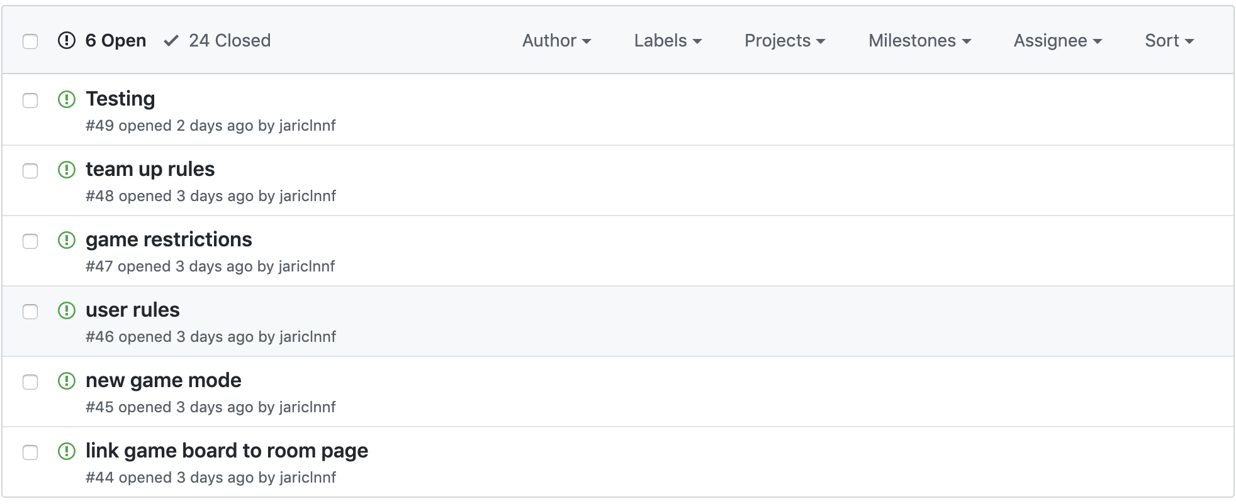
· Issues

Slide 5
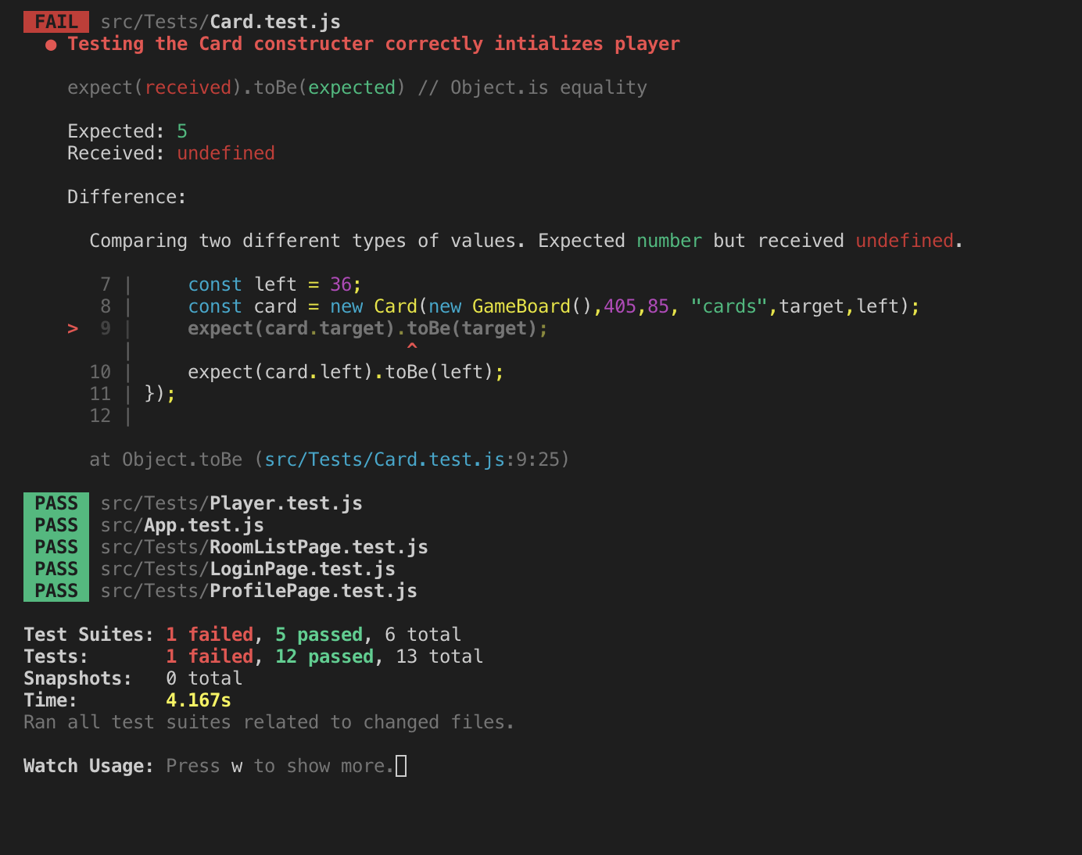
· Test

Slide 6
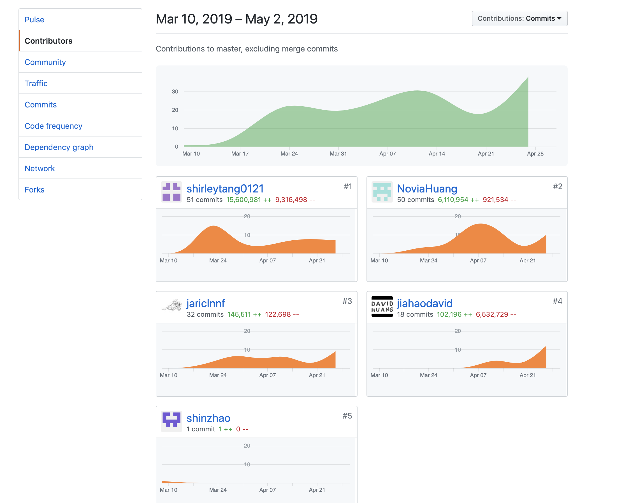
· Contributes

Slide 7
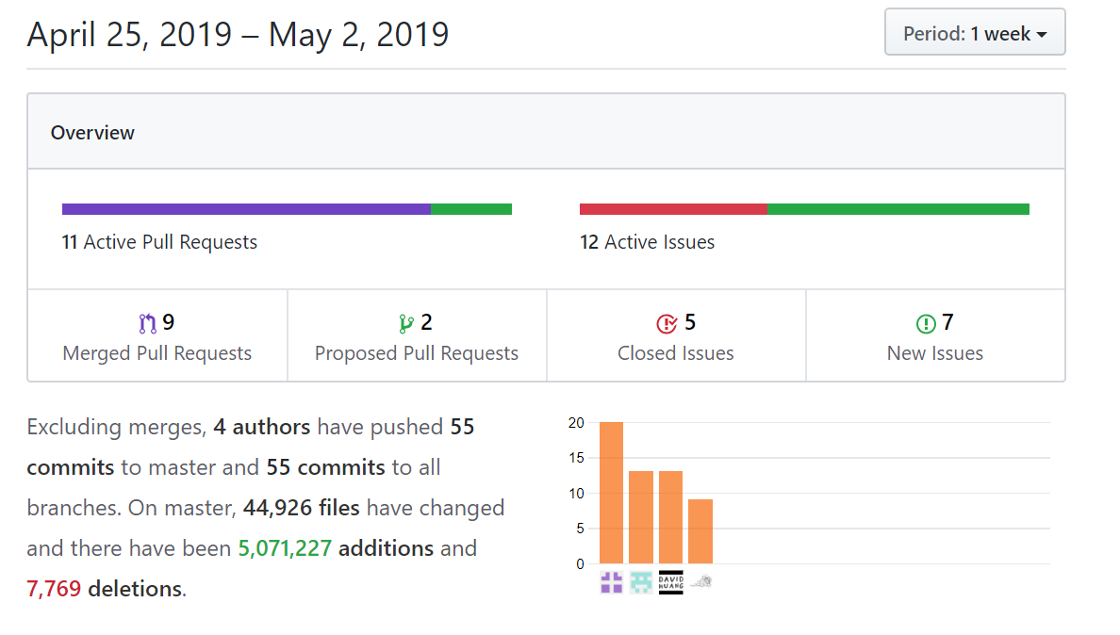
Recent Commits

