Slide 1

Switch - Status Meeting #4
·Xin Zhao ·Yinuo Huang ·Jin Feng Lin ·Yueming Tang ·David Huang

Slide 2
An Issue
Phaser and React…?

Slide 3
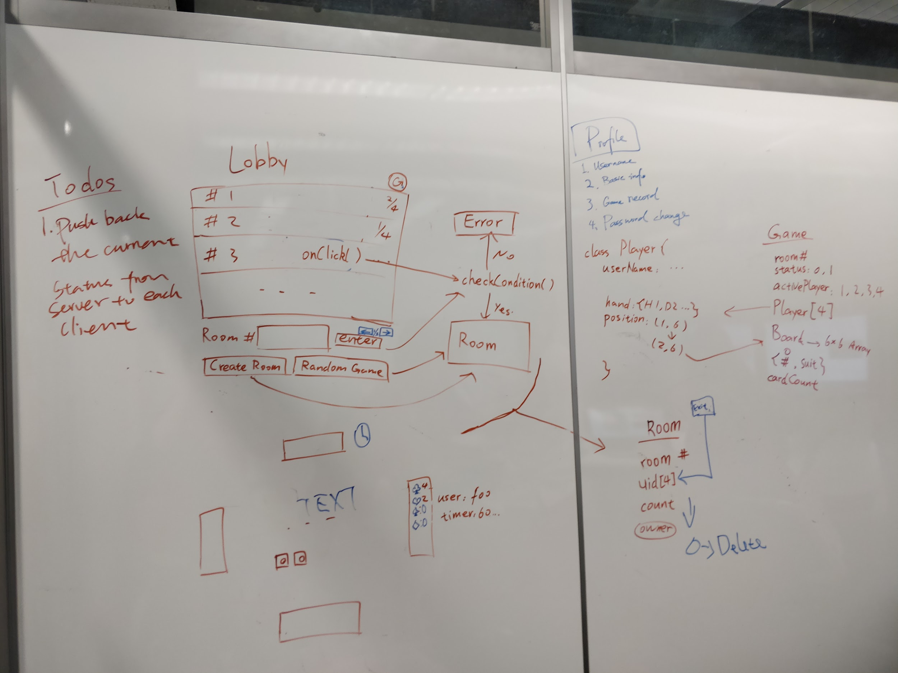
Current Progress

Slide 4
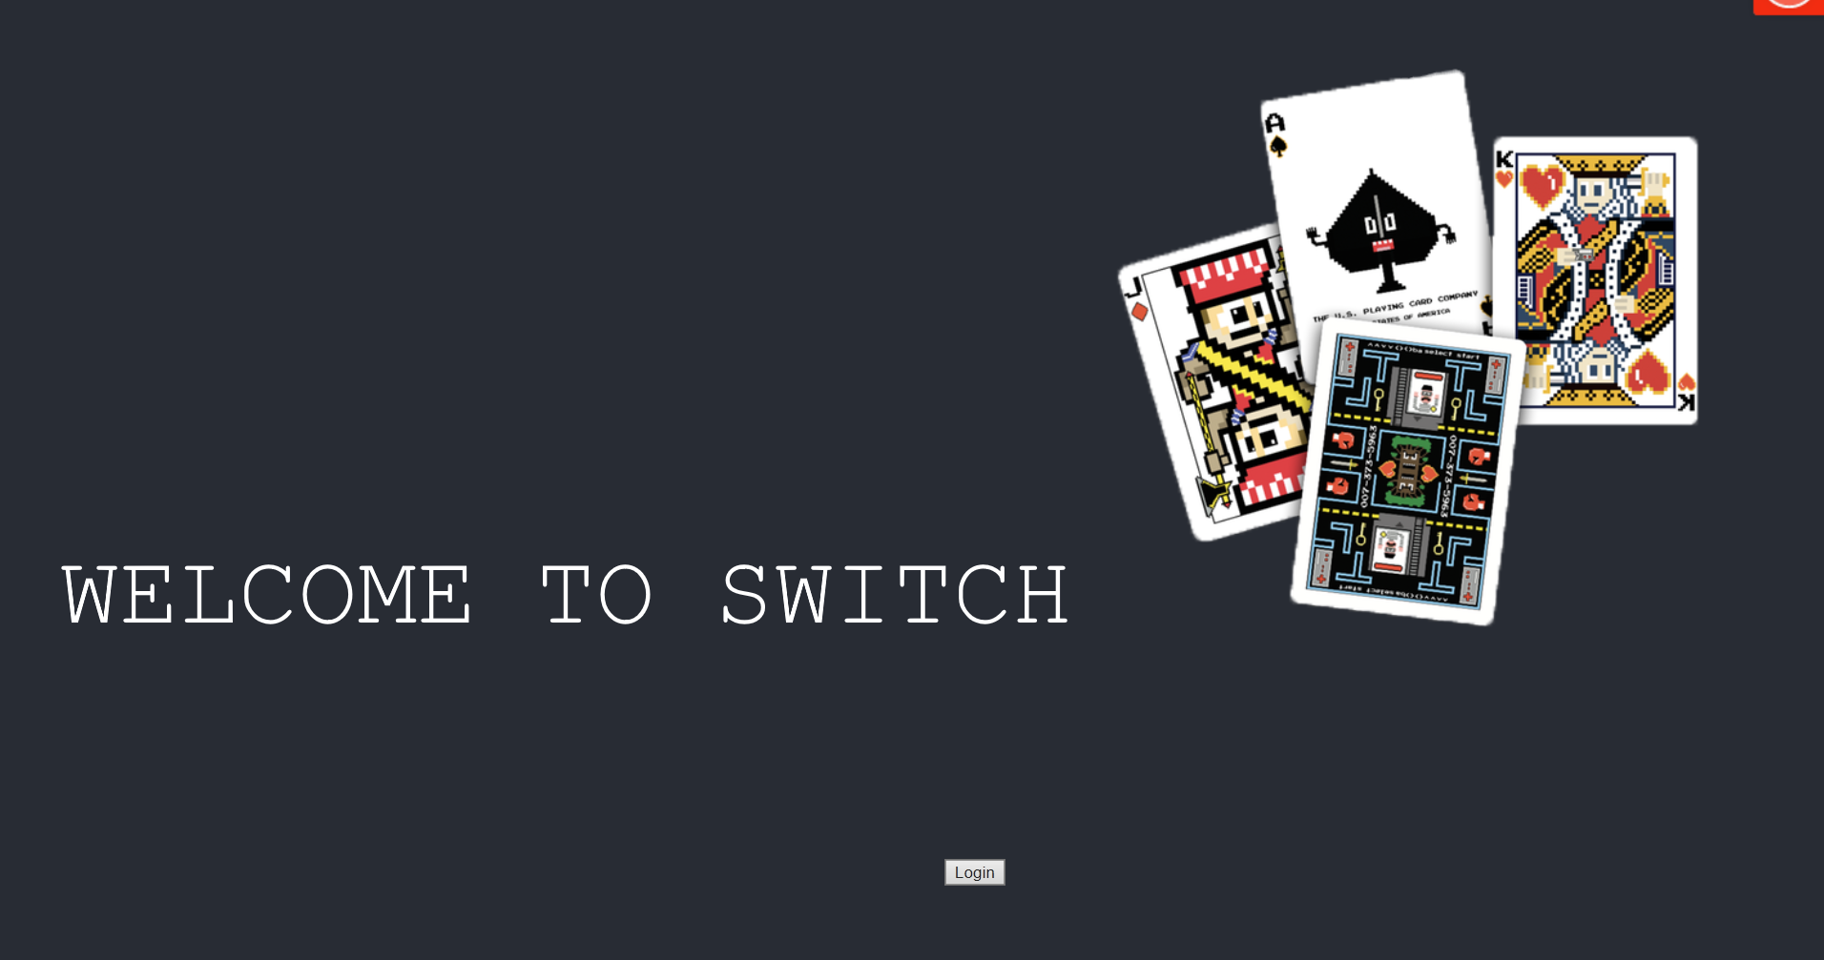

Slide 5
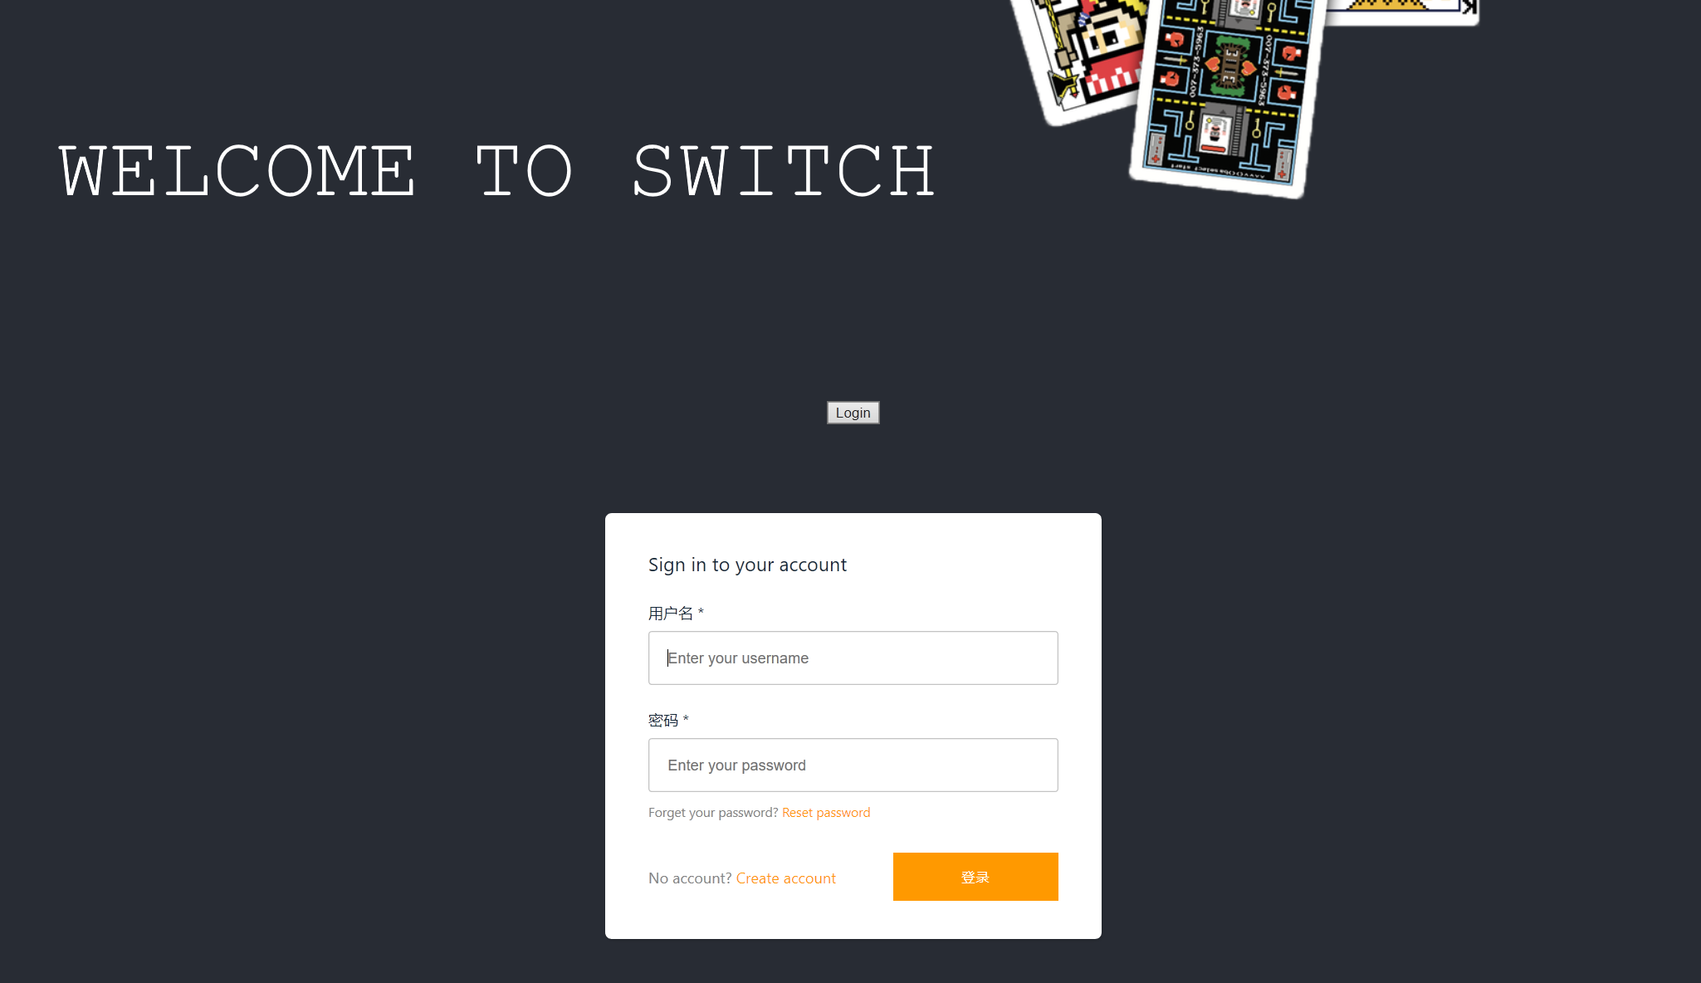

Slide 6
Lobby

Slide 7
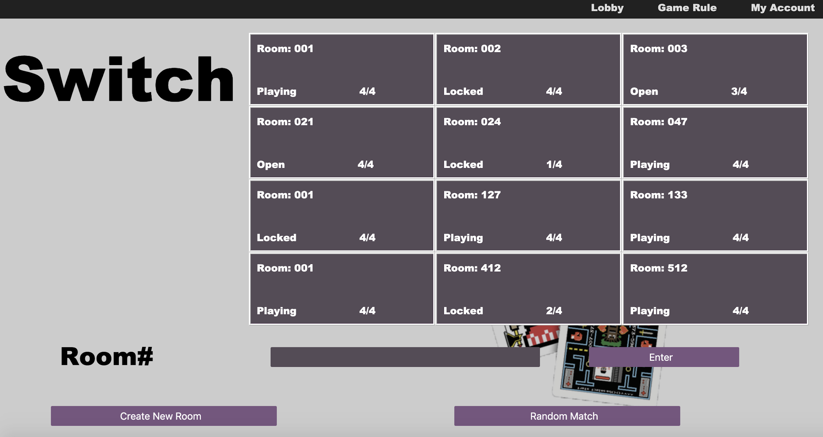

Slide 8
Game status

Slide 9
Players in
each room

Slide 10
Find a specific by room #

Slide 11
Create Room
Or
Random match players

Slide 12
Game

Slide 13
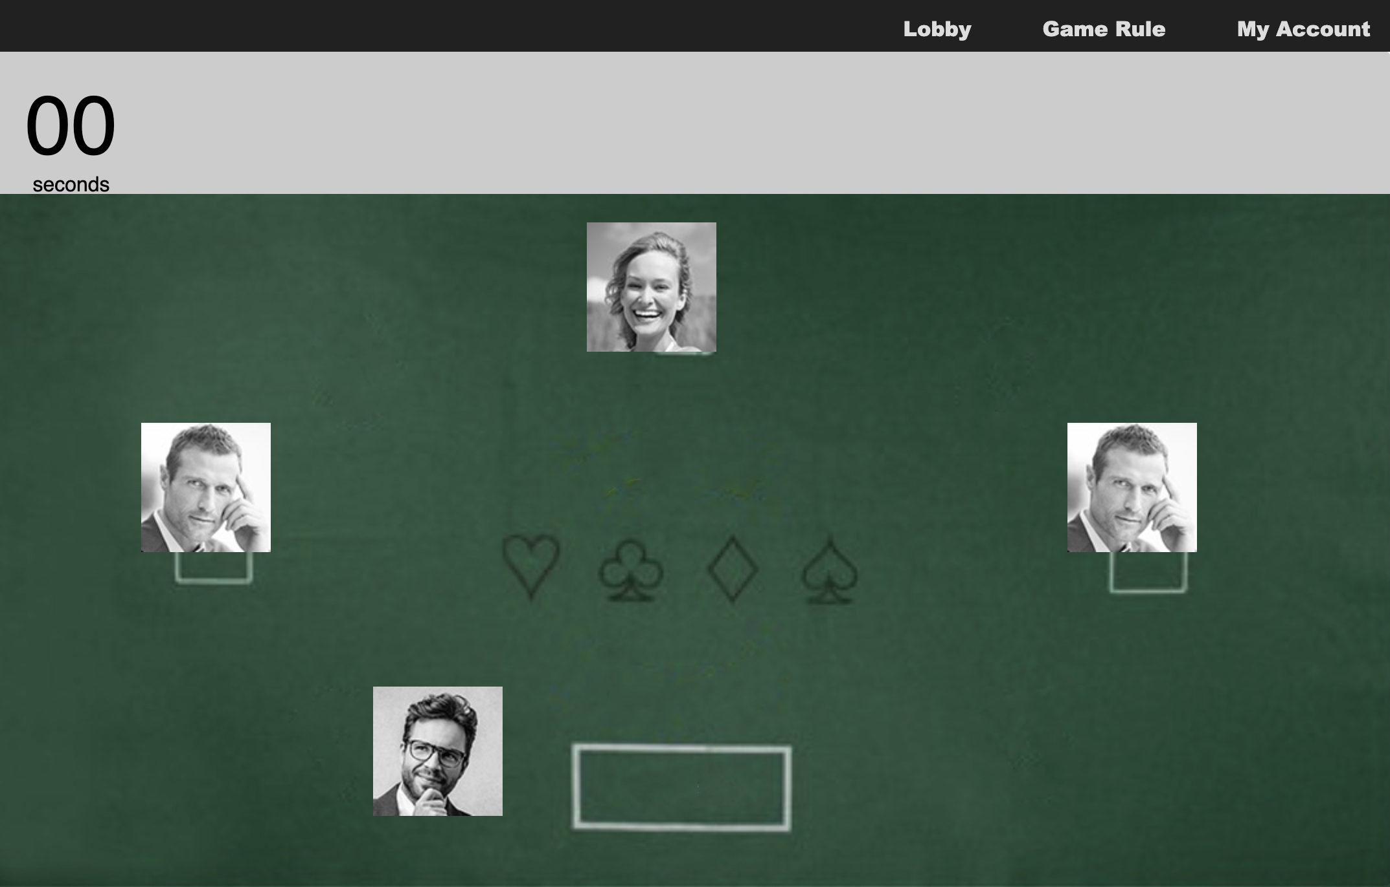

Slide 14
Schemas
Room
roomID -- Room ID
ownerID -- Room owner
uid[4] -- Identify users
count -- # of players in room
status -- In game or not
Game
roomID -- Room ID
activePlayer -- Who’s turn
cardCount -- # of cards left
Board[6][6] -- 6 x 6 array
Player[4] -- Array of Player object
Objects
class Board {
rank: 1 - 13, suit: H, D, S, C
}
class Player {
userName: testname,
uid: 12349876,
playerID: 1 - 4,
hand[ ]: [ (H, 3), (C, 12), (D, 8) … ],
position: (4, 3),
allyID: 1 - 4,
...
}

Slide 15
Next Step...
Jinfeng Lin: Database, AppSync Backend
Jiahao Huang: Database, AppSync Backend
Xin Zhao: Front-end, Testing
Yinuo Huang: Front-end, Deployment
Yueming Tang: Front-end

