Slide 2
How does Node.js work
Notes:
Async?

Slide 3
Node.js
Node.js is a JavaScript runtime built on Chrome’s V8 JavaScript engine © nodejs.org
JavaScript is a language
Node.js is a runtime
Runtime is - ?
Engine is - ?
Notes:
https://medium.com/@chaudharypulkit93/how-does-nodejs-work-beginner-to-advanced-event-loop-v8-engine-libuv-threadpool-bbe9b41b5bdd
https://www.youtube.com/watch?v=PNa9OMajw9w

Slide 4
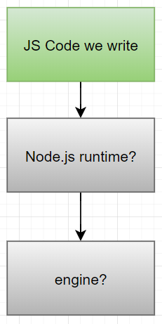

Slide 5
Runtime
Runtime is any code which is executed to make your code work
The code that we write is not “runtime” code. It is just some code which will be executed by the “runtime”
Notes:
NodeJS is called a "runtime“ because it consists of a V8 engine, libuv threadpool and OS Async Helpers. All of these combined give you the power to write the JavaScript code on the server that you are used to writing

Slide 6
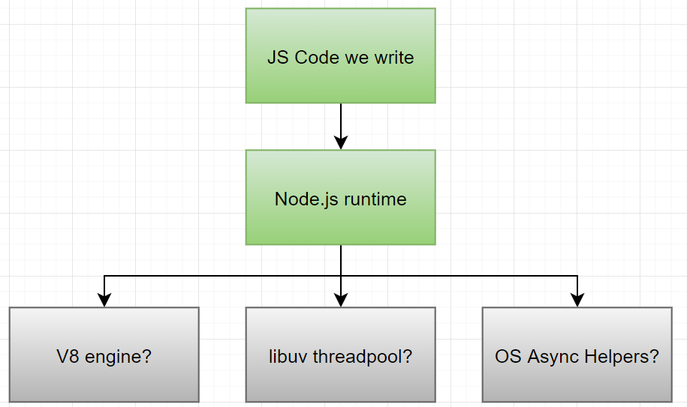

Slide 7
Engine
An “engine” is the actual code responsible to execute your code
Depending on the runtime/language, an engine could consist of a compiler, interpreter, garbage collector, call stack, heap

Slide 8

Notes:
You can think of your code as a train's coach. Without an "engine“ there is no way a train's coach could run. Engine is the component responsible for running the train's coach(your code)
but the engine alone cannot run the coach. It would need train's tracks, railway stations, signals, fuel, etc. All of these combined create a runtime which runs your train's coach(your code) effectively and gives a seamless experience

Slide 9
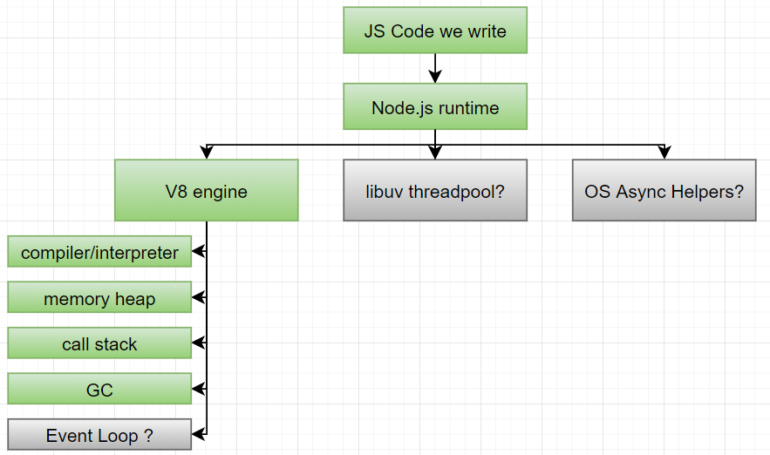
Notes:
As V8 is an engine it is responsible to provide the features required to execute the JavaScript code that we write:
Compile and execute JavaScript code
Provide memory heap to allocate and store your variables
Provide a call stack to run the functions in order
Garbage collector to garbage collect the object and memory references not in use anymore
Provide data types, operators, object and functions to write the code in JavaScript language
Provide an event loop to run asynchronous code. (Side note: This is not always true. In some cases, like in the browser, browser's APIs tend to provide the event loop too)

Slide 10
Event loop
“Event loop” is just a loop like a for loop or a while loop.
“Event Loop” is not responsible for executing your code. The V8 engine is. “Event Loop” is just a loop. V8 is the one which actually compiles and executes the code
An “Event Loop” is some piece of code in a loop which picks up tasks from “Job/Task Queue” and sends them to V8 to be executed.
Notes:
When you start your node process by running node index.js, the following sequence of steps take place:
V8 engine reads through and processes your index.js file. This includes requiring modules and executing any code in it
V8 engine then immediately starts up an Event Loop

Slide 11
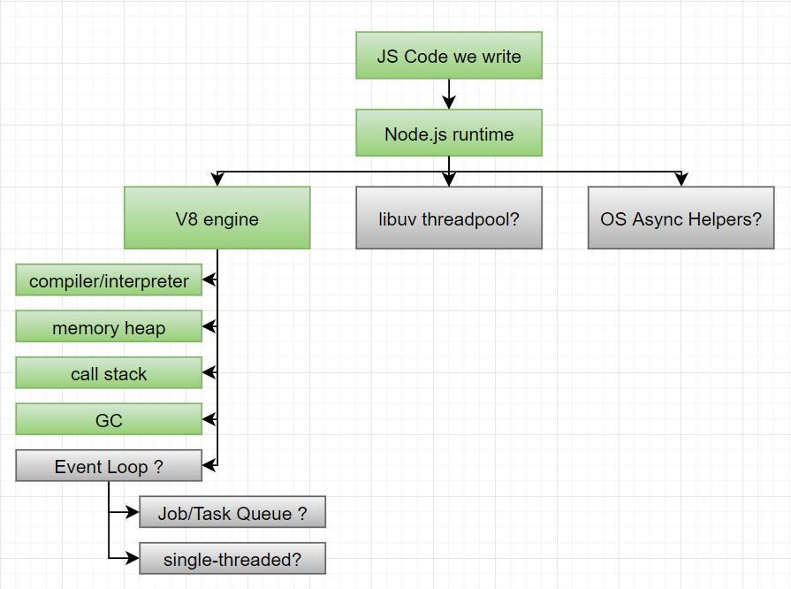

Slide 12
Job/Task Queue
A “Job Queue” is a FIFO (first-in-first-out) data structure which is just used to store some data (or “tasks”). You can think of it as an array(s) of tasks
A “task” is some code inside a function that needs to be executed
A “task” enters the queue when a callback function is called after an I/O operation, setTimeout, setInterval, setImmediate, or an OS task complete.
Notes:
The "tasks“ keep getting pushed to the end of the array and they keep getting picked up by the Event Loop from the start of the array

Slide 13
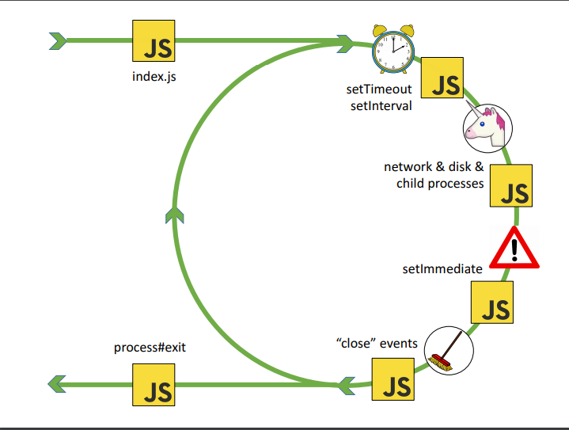

Slide 14
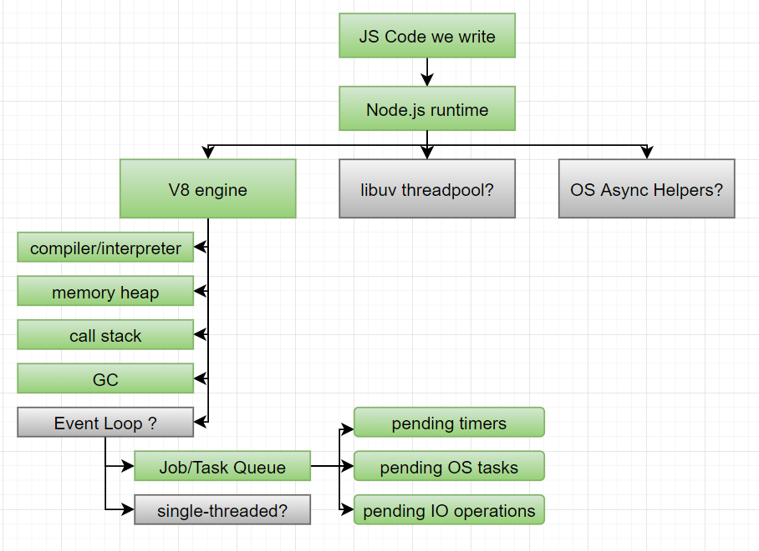

Slide 15
Single thread
NodeJS process is not “single-threaded”. “Event loop” is single-threaded
NodeJS, in fact, uses a threadpool provided by libuv
JavaScript is “single-threaded” because JavaScript works on “Event Loop”. NodeJS is NOT “single-threaded” as it has a libuv threadpool in its runtime
Notes:
Browsers also have their own “runtime”. Browsers also are multi-threaded and those features are provided by tools like Web APIs

Slide 16
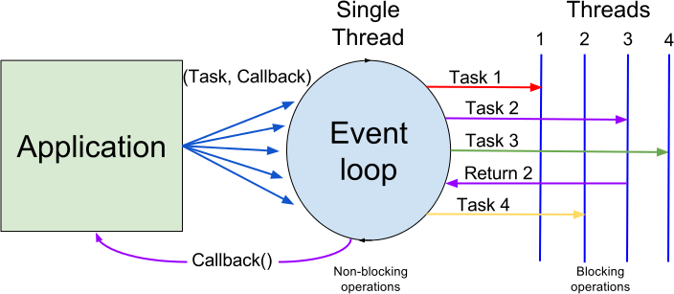
Threadpool for single thread?
“libuv” is a library which provides a set of threads(threadpool) to NodeJS runtime to execute long-running tasks, like fs module-based tasks
Notes:
https://medium.com/preezma/node-js-event-loop-architecture-go-deeper-node-core-c96b4cec7aa4

Slide 17
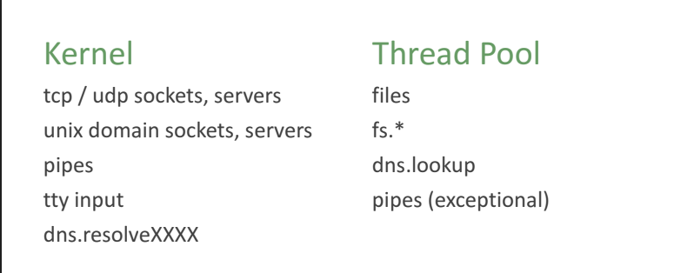
Threadpool for single thread?
Notes:
“OS Async Helpers” are used when any low-level OS operations take place. For example, a REST API call using http or https module or creation of a web server using http.createServer(). These operations bypass the threadpool completely and are executed immediately as soon as a CPU core is available for operation
Once “libuv” or “OS Async Helpers” are done with their tasks, they put the callbacks into the “Job Queue” for the “Event Loop” to pick them up and then send them to “V8 Engine” to be executed

Slide 18
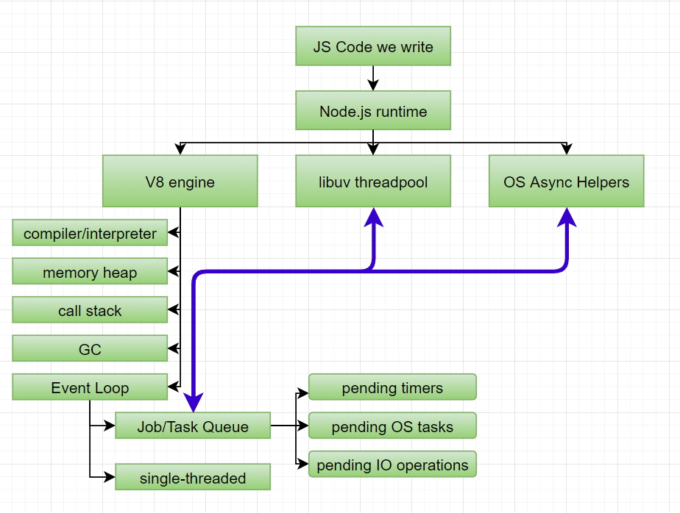

Slide 19
Example
Imagine you are at a restaurant. Below are the actors:
  The restaurant is the NodeJS runtime.
  The JavaScript code you want to be executed is the food you and other people want to have at the restaurant.
  The waiter is the V8 engine and the Event Loop.
  The chefs are the libuv threadpool and OS Async Helpers.

Slide 20
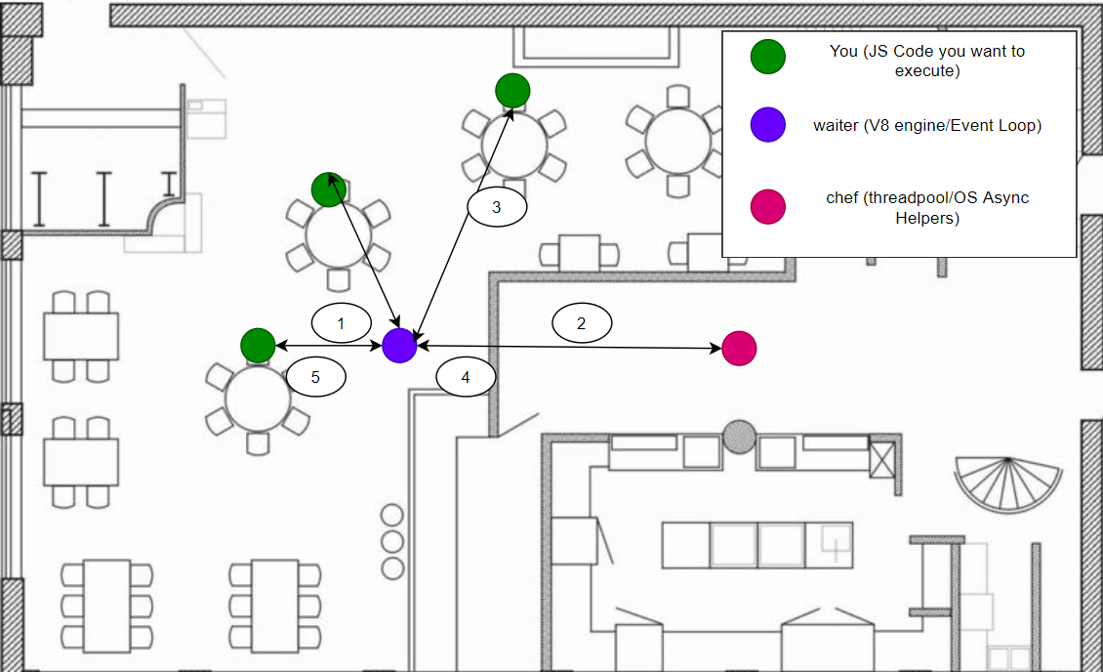
Notes:
Let’s say you want to eat something(execute some code), you ask the waiter(V8 Engine) to take your order(execute the code). The waiter does not, though, wait for you to decide on the order. If he sees that he is not doing any task, he goes to other people to take their order or to serve their order or to do any other task. Once you are ready to order, only then the waiter comes over to you to take your order. This is Event Loop. The waiter is intelligent and is able to serve more customers in the same amount of time.
Let’s say you gave your order to the waiter. The cooking of the food is a long-running process(I/O operation). The waiter doesn’t cook the order himself. He forwards it to the chefs(threadpool) and they end up cooking the order(performing I/O). Once the order is ready, they inform the waiter(Event Loop). The waiter then picks up the order and serves to you.
Eventually, all the customers end up being satisfied at the NodeJS runtime restaurant.

Slide 21
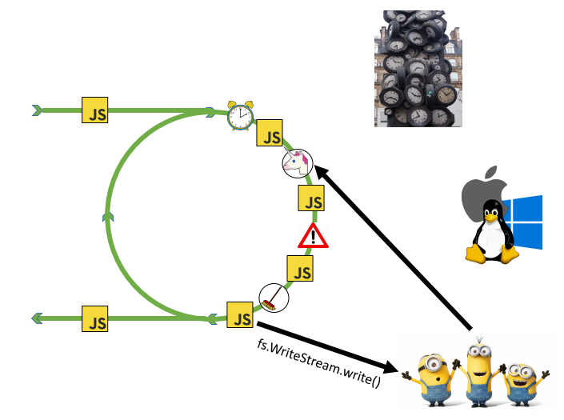

Slide 22
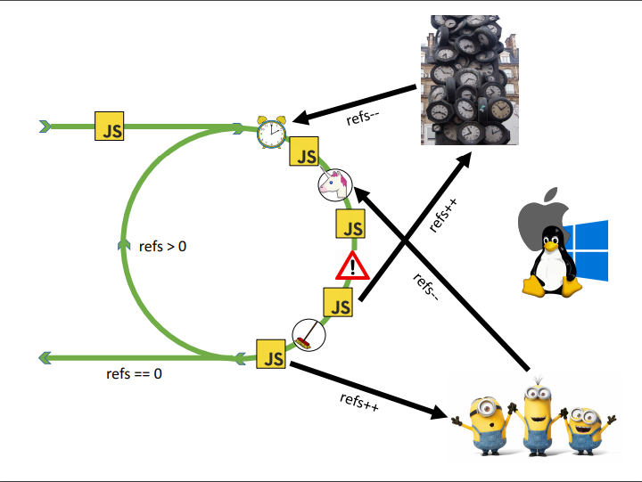

Slide 23
setTimeout/setInterval
setImmediate
process.nextTick – node.js & IE only

Slide 25
