Slide 2
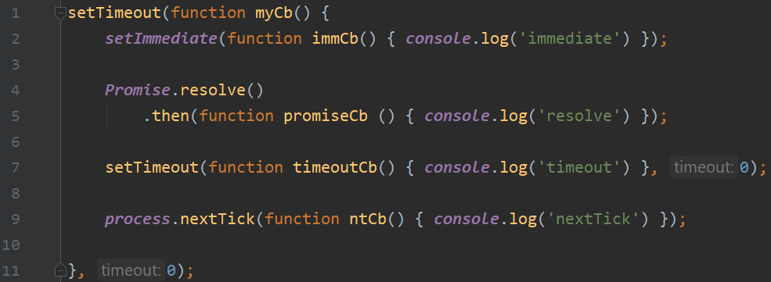

Slide 3
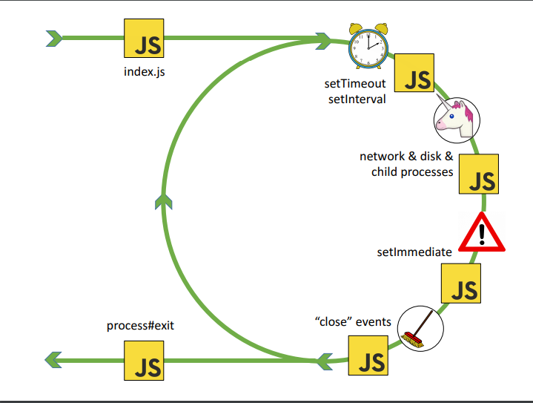
Setting setTimeout here ↑,
myCb function is only created and just added to alarm heap

Slide 4
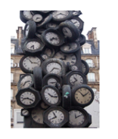
Iteration 1
Timeout COULD not finished yet, so myCb is still in the heap, not even in the queue

Slide 5
Iteration 2
Call myCb()

Slide 6
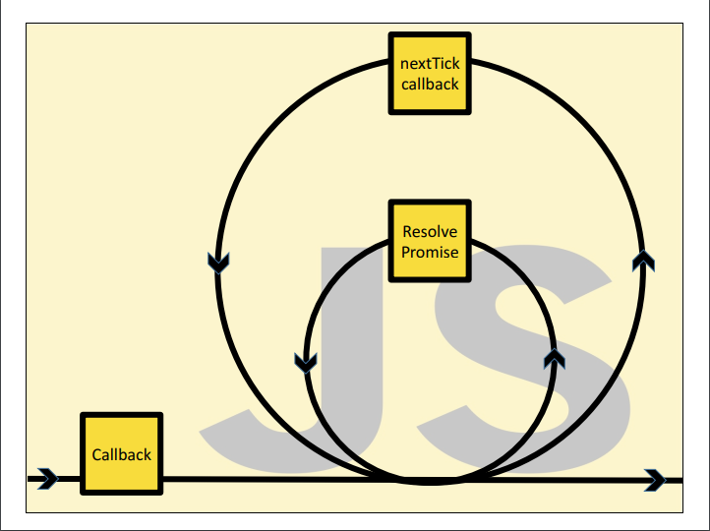

Slide 7
Callstack in “myCb” (still iteration 2, phase timeouts)
nextTick queue
Microtask queue
alarmHeap
Cb queue
myCb

Slide 8
Callstack in “myCb” (still iteration 2, phase timeouts)
nextTick queue
Microtask queue
alarmHeap
Cb queue | immCb
 | setImmediate
myCb | myCb

Slide 9
Callstack in “myCb”
nextTick queue
Microtask queue | promiseCb
alarmHeap
Cb queue | immCb
 |  | Promise.resolve()
myCb | myCb | myCb

Slide 10
Callstack in “myCb”
nextTick queue
Microtask queue | promiseCb
alarmHeap | timeoutCb
Cb queue | immCb
 |  |  | setTimeout
myCb | myCb | myCb | myCb

Slide 11
Callstack in “myCb”
nextTick queue | ntCb
Microtask queue | promiseCb
alarmHeap | timeoutCb
Cb queue | immCb
 |  |  |  | Process.nextTick
myCb | myCb | myCb | myCb | myCb

Slide 12
Callstack in “myCb”
nextTick queue | ntCb
Microtask queue | promiseCb
alarmHeap | timeoutCb
Cb queue | immCb
 |  |  |  | myCb

Slide 13
Callstack after myCb (still iteration 2, phase timeouts – (after timeouts)
nextTick queue
Microtask queue | promiseCb
alarmHeap | timeoutCb
Cb queue | immCb
 | Console.log
ntCb | ntCb | ntCb | [next tick queue is empty – go next]

Slide 14
Callstack after myCb (still iteration 2, phase timeouts – (after timeouts)
nextTick queue
Microtask queue
alarmHeap | timeoutCb
Cb queue | immCb
 | Console.log
promiseCb | promiseCb | promiseCb | [micro task queue is empty]

Slide 15
Immediate phase of event loop – still iteration 2
nextTick queue
Microtask queue
alarmHeap | timeoutCb
Cb queue
 | Console.log
immCb | immCb | immCb

Slide 16
Iteration3! Timeouts phase
nextTick queue
Microtask queue
alarmHeap
Cb queue
 | Console.log
timeoutCb | timeoutCb | timeoutCb

Slide 17
Finish

