Slide 1

Ecommerce Customer Churn Analysis and Prediction
Mid-Bootcamp project by Julia Novikova

Slide 2
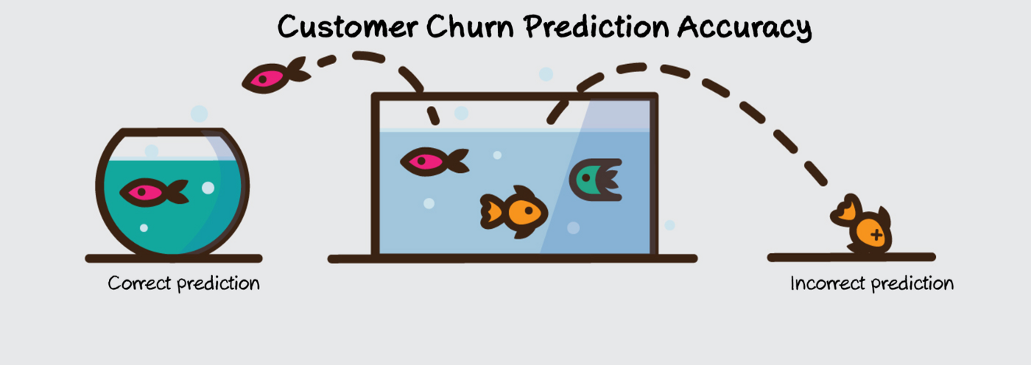
Objective
The data set belongs to a leading online E-Commerce company.
Main objectives:
1. Explore which business insights we can get from the data.
2. The company wants to know the customers who are going to churn, so accordingly they can approach customer to offer some promos.
Origin of the dataset: https://www.kaggle.com/datasets/ankitverma2010/ecommerce-customer-churn-analysis-and-prediction

Slide 3
Data exploration and cleaning

Slide 4
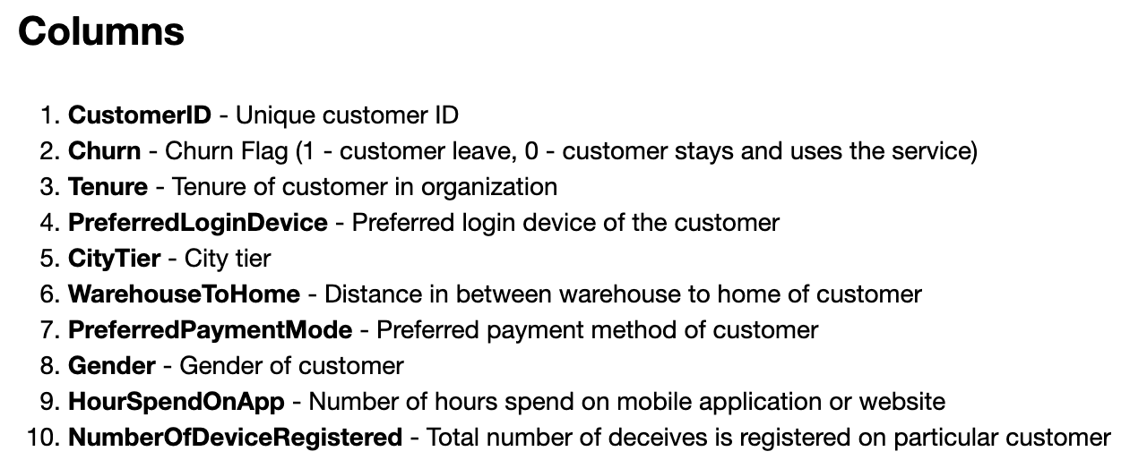
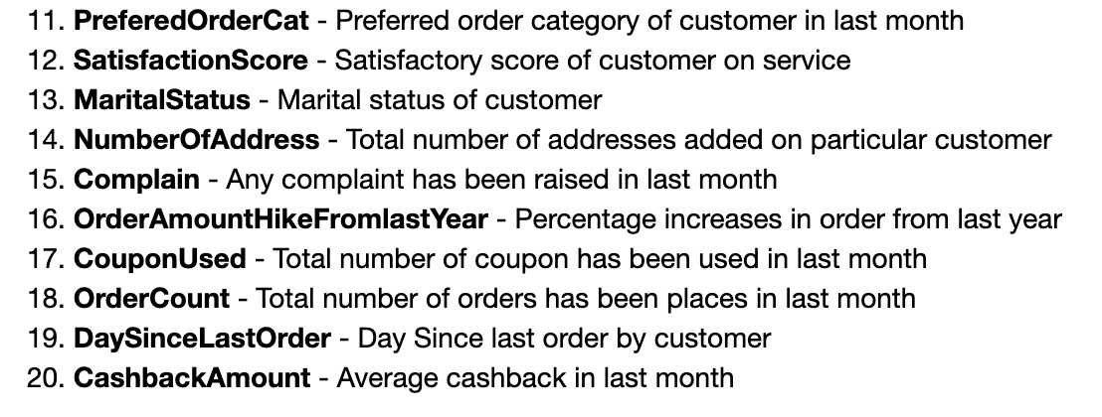
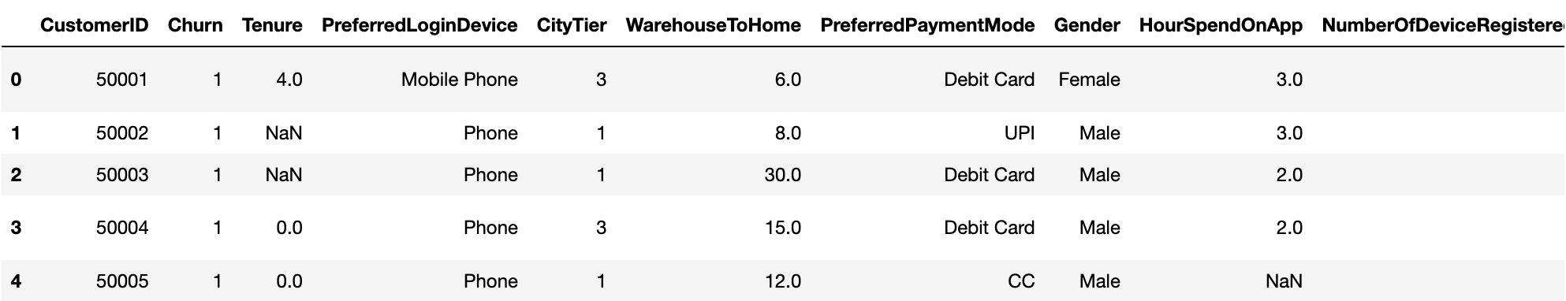
Columns

Slide 5
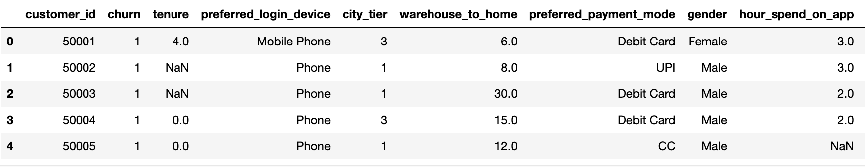
Making dataset easier to read
To make it easier to work with this dataset I used function, which is:
Standardizing header names:
Converting column names to lowercase
Replacing spaces by underscores
Dropping duplicates
Renaming columns

Slide 6
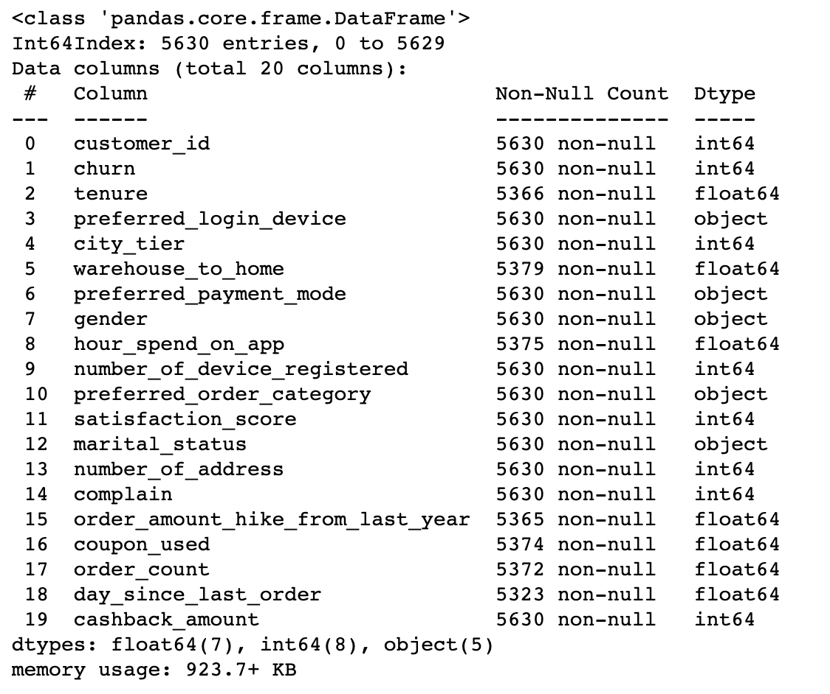
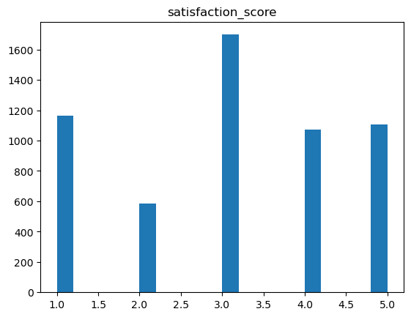
Data exploration
Using function explore_data, I’ve checked information about this dataset, explored numerical and categorical columns and histogram of the target column (‘churn’).
From this exploration, I found that:
1) A few columns contain NaN - values, so we need to replace / remove them.
2) Also, we can change the data type in some of the columns.

Slide 7
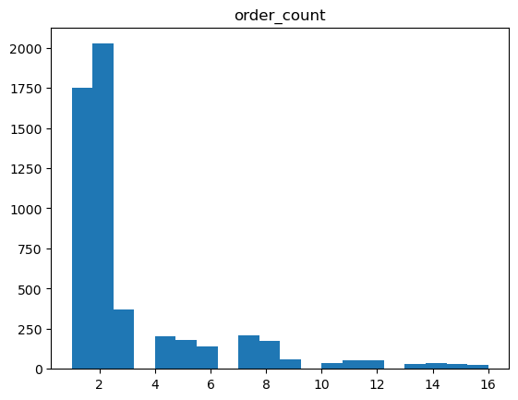
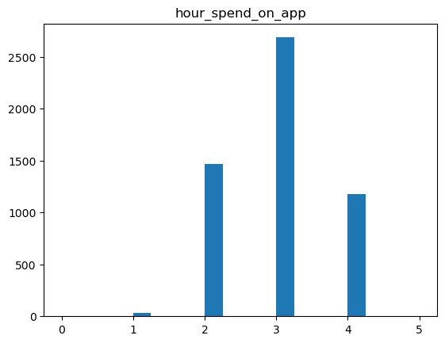
Numerical columns
All NaN values in this dataset are in numerical columns. We can replace all NaN values in these columns with the mean values, but we need to round them to the nearest whole number for it to make sense.

Slide 8
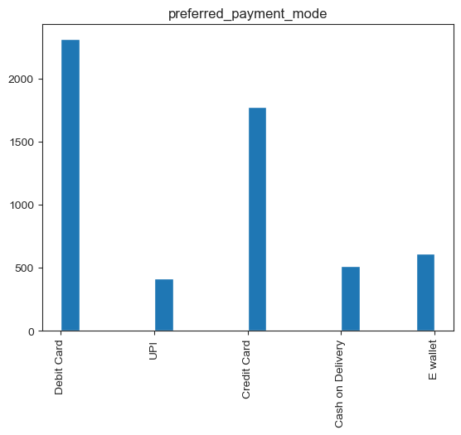
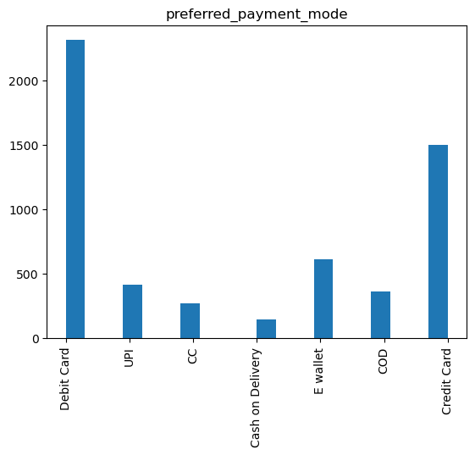
Categorical columns
Some of the columns have duplicated values – so I merged them.

Slide 9
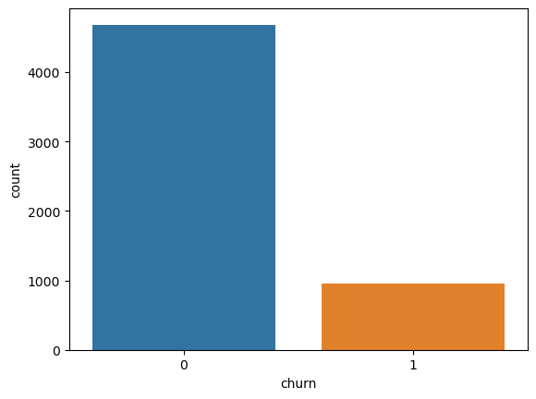
Target value
We have a noticeable data imbalance in our target value (column 'churn'), so we will try to deal with it when we will train our model.

Slide 10
Insights we can get from this dataset

Slide 11
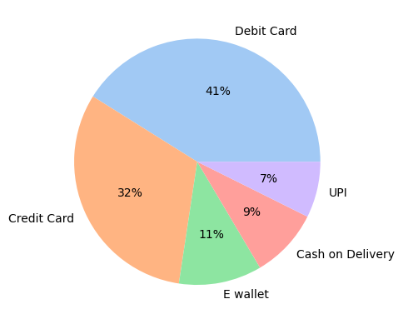
The ratio of use of the different payment modes
Debit Card is the most popular payment option (41%), after that goes Credit Card (32%) and another three options are having almost the same ratio.

Slide 12
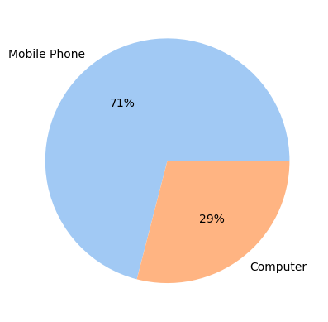
The ratio of use of the different login devices
As we can see - more than 2/3 (71%) of the customers use mobile phone to login into the service.

Slide 13
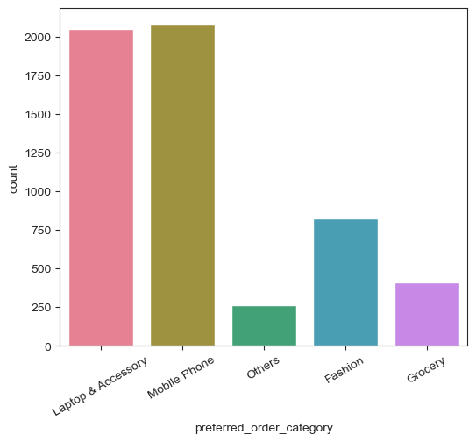
From which category do customers order the most?
The most popular category is 'Mobile Phone', right after it - 'Laptop & Accessory', then 'Fashion' and the rest two - 'Grocery' and 'Others'.

Slide 14
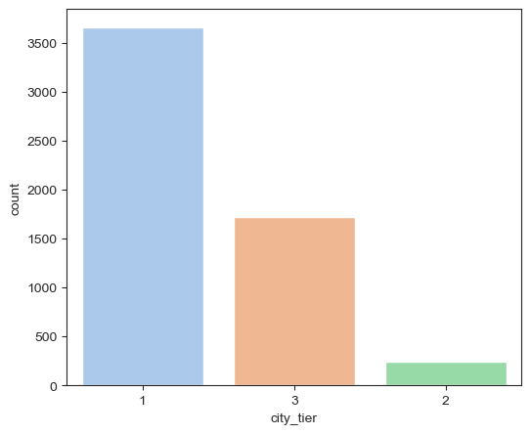
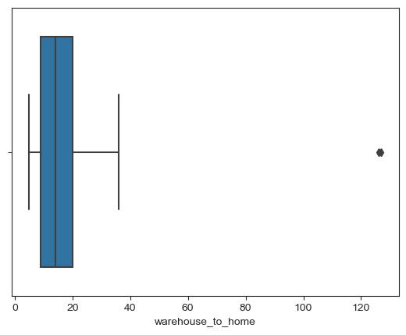
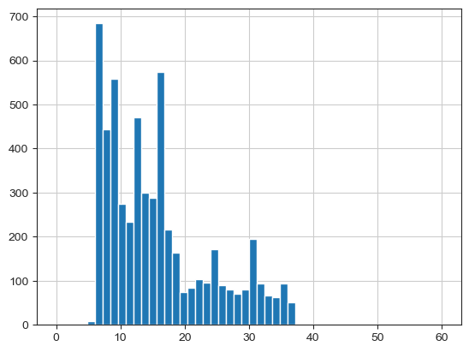
Size of the city customers live in, typical distance from warehouse to home
Most of the customers live in the big cities, but at the same time about a quarter of all the customers live in tier 3 cities.
Distance between warehouse and home of customer is usually around 6-16km, average distance - 15.6km. Some of the customers live in the area 16-40km and we can see a few outliers somewhere over 120km - we deleted these rows.

Slide 15
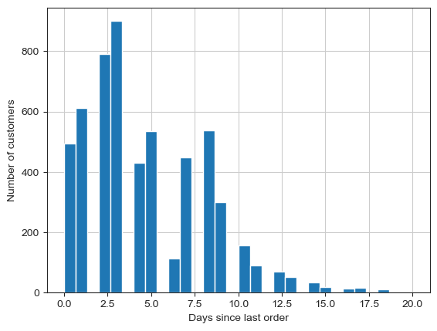
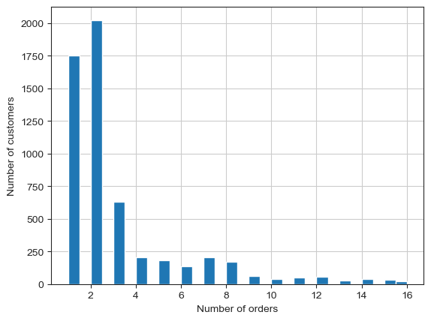
How often people make orders? How many orders on average each customer make?
Most of the customers buy products again every 1-8 days. Some of them buy products once per 2 weeks. The most popular frequency is 3-4 days.
Most of the customers have only 1-2 orders in total, but this service definitely has regular customers as well (some people placed orders 4-8-15 times).

Slide 16
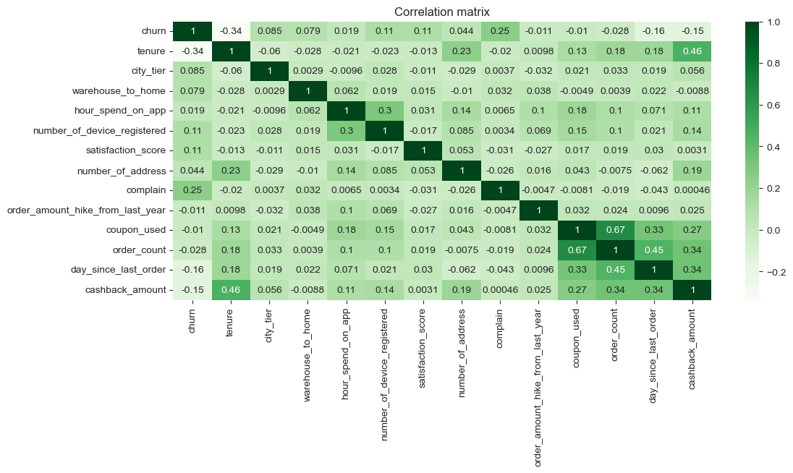
Correlation matrix
Numerical columns 'tenure', 'complain' are showing the highest correlation with the target column ('churn'), but their correlation is still very low.
Column 'order count' is showing pretty high correlation with the column 'coupon_used', so we may want to drop 'coupon_used' (as it has lower correlation with the target variable).

Slide 17
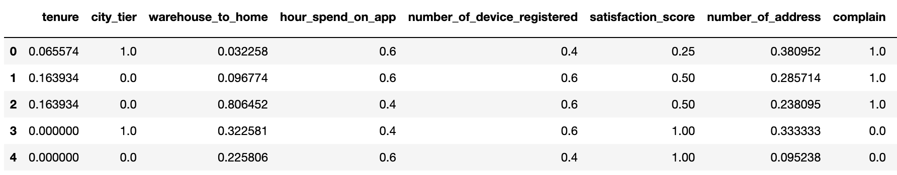
Scaling numerical features and encoding categorical features
As given numerical columns have very different values (some of them high, some of them low) and we don't want it to influence on our target variable ('churn') - we will use scaler (in this case MinMaxScaler).
Also, in order to use values from categorical columns in our prediction model, we need to convert them into numerical ones (we will use One Hot Encoder for it).
Then we will merge scaled numerical features and encoded categorical features together again.

Slide 18
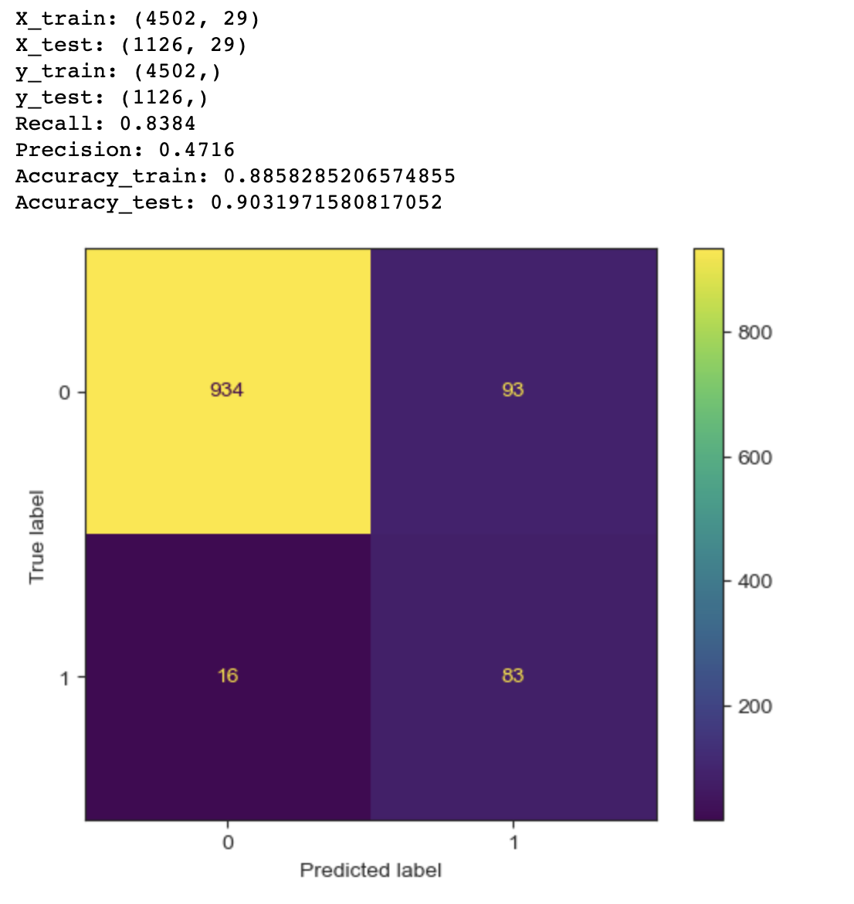
Model building and validation
Splitting X, y into train and test data
Applying logistic regression, train/fit the model
Predicting training set
Predicting test set
Showing all the metrics: recall, precision, accuracy and confusion matrix.

Slide 19
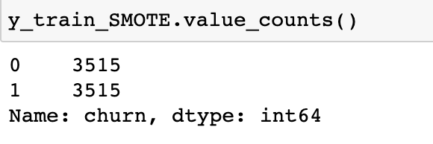
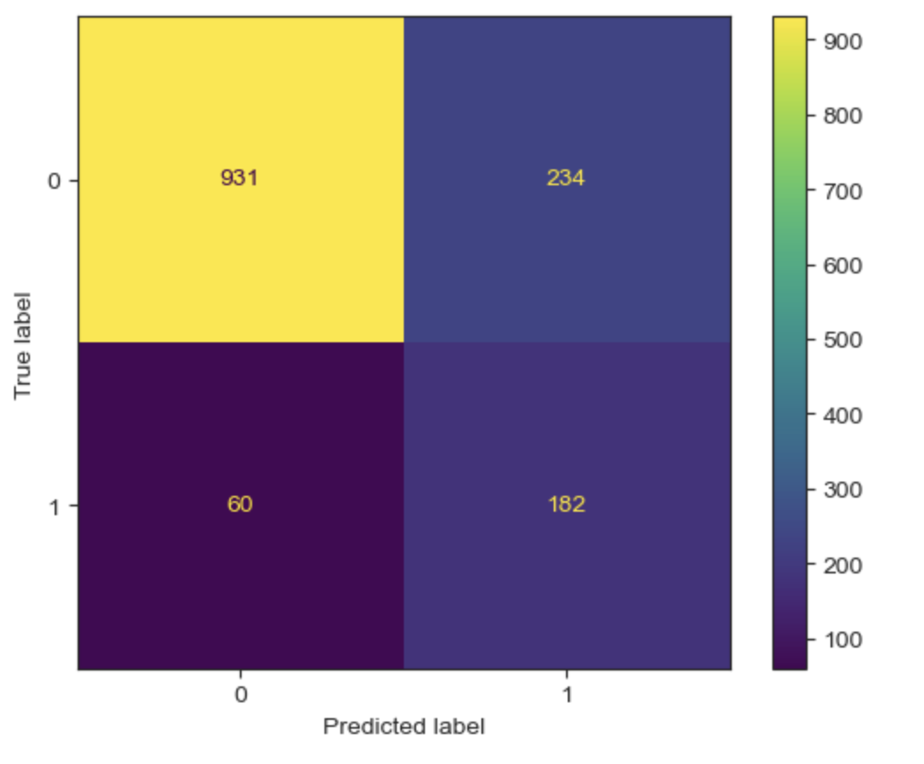
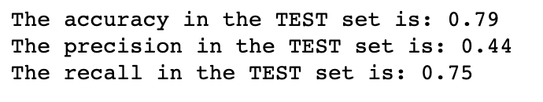
Data imbalance fixing
We have data imbalance in our target value (column 'churn'), and we used SMOTE oversampling to fix it.
As we can see - most of our metrics have deteriorated after using SMOTE, but prediction of the second value became better, so we can choose which option to use.

Slide 20

Thank you!

