Slide 1
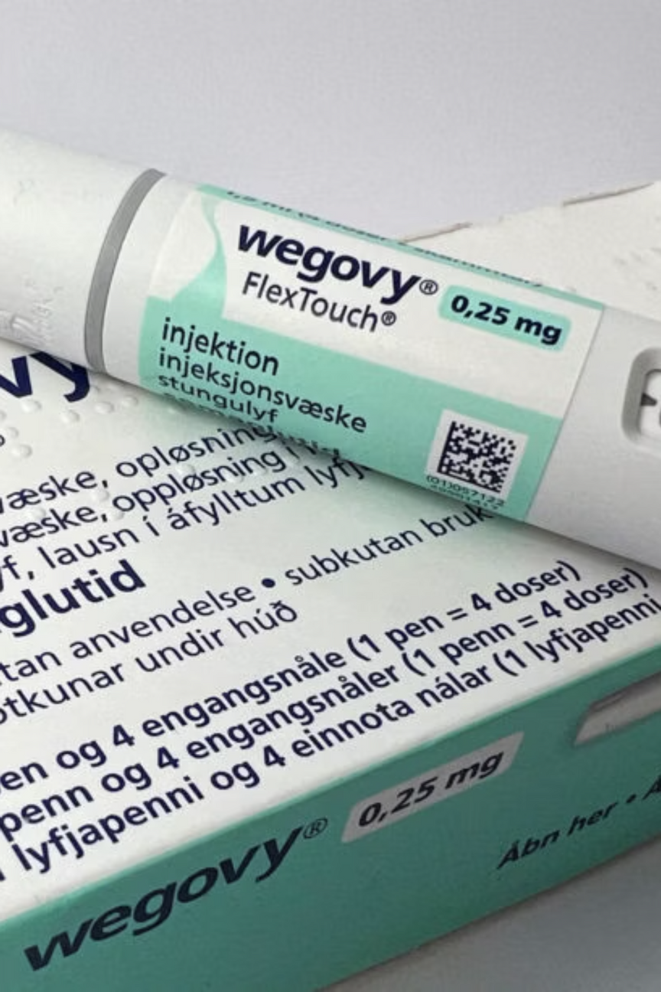
Wegovy Market Analysis
A comprehensive market analysis to quantify obesity prevalence, patient profiles, and treatment patterns in India, providing data-driven insights to suggest the commercial strategy for Wegovy.
Presented by- Team St, MAHE

Slide 2


The Indian Obesity Crisis
Rising Challenge
India faces an unprecedented obesity epidemic with limited structured treatment adoption and widespread lack of awareness among both patients and healthcare providers.
Critical Gap: Traditional approaches are failing to address the scale and complexity of obesity management in India's diverse healthcare landscape.

Slide 3





Introducing Wegovy
Proven Efficacy
Competitive Landscape
Wegovy has been clinically proven to deliver significant weight-loss and metabolic benefits, achieving an average weight reduction of about 15% in adults
Competing against Mounjaro, lifestyle interventions, bariatric surgery, and nutraceuticals
Patient-Friendly
Weekly once injectable format ensures optimal compliance and convenience
Eligible Patients
BMI ≥ 30, or BMI ≥ 27 with comorbidities including diabetes, hypertension, and cardiovascular risks
Source:- Wegovy. (n.d.). Weight‐Loss Prescription Medication | WegovyTM (semaglutide) Injection 2.4 mg. Www.wegovy.com. https://www.wegovy.com/

Slide 4



Target Population
Indicated for individuals aged 12 years and older who have obesity, or who are overweight with significant comorbidities requiring medical intervention.
Healthcare Facilities
Healthcare Providers
Patients
Hospitals, specialized obesity clinics, and wellness centers offering comprehensive weight management programs
Endocrinologists, obesity specialists, and primary care physicians managing complex metabolic conditions
Individuals seeking long-term, medically-supervised weight management solutions beyond traditional diet and exercise

Slide 5
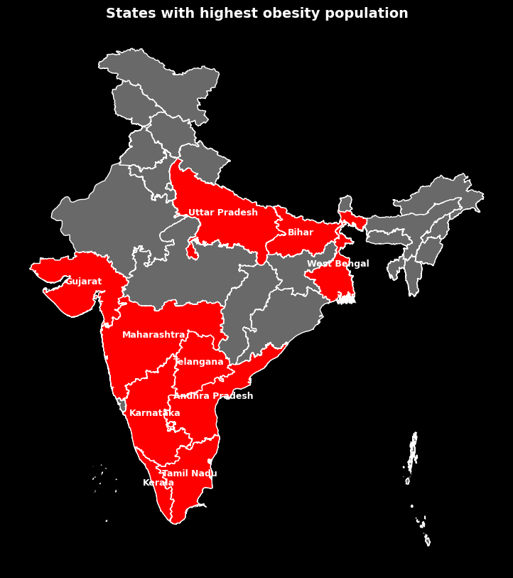
Obesity Prevalence Across India
Top States by Number of Obese Patients
Maharashtra (4.7M), Tamil Nadu (3.8M), Uttar Pradesh (3.7M), Karnataka (3.5M), and Andhra Pradesh (3.2M) lead in the obesity burden, followed by other states, with urban areas showing higher rates than rural areas.
Tier 1 & Tier 2 City Focus
City-level distribution data enables precise targeting of high-opportunity markets for optimal resource allocation and market penetration strategies.
Source:- Sung, M., Kumar, A., Mishra, R., Kulkarni, B., Kim, R., & Subramanian, S. V. (2024). Temporal change in prevalence of BMI categories in India: patterns across States and Union territories of India, 1999–2021. BMC Public Health, 24(1). https://doi.org/10.1186/s12889-024-18784-4
Streamlit:- https://novo-nordisk-hackathon2025-8adxnittedsk6gbmrfbgy3.streamlit.app/

Slide 6

Key Insights
*
*
*
*
85M
5.8%
2x
2-3x
Potential Patients
Obesity Prevalence (2021)
Urban-Rural Gap
Rising Trend
Adults eligible for Wegovy treatment across India based on Obesity
Urban areas having twice the obesity prevalence of rural areas
Increase since 2000 showing rapid growth in obesity rates over two decades
Women: 6.3% | Men: 4.2%
* Approximated values
Source:- Sung, M., Kumar, A., Mishra, R., Kulkarni, B., Kim, R., & Subramanian, S. V. (2024). Temporal change in prevalence of BMI categories in India: patterns across States and Union territories of India, 1999–2021. BMC Public Health, 24(1). https://doi.org/10.1186/s12889-024-18784-4

Slide 7

Strategic Recommendations

Slide 8

Obesity Awareness Initiatives
Free Health Camps
VR Awareness Campaign
General Blood Test & BMI
Provide informative brochures and materials
Providing Goodie Bags
Experience life with poor health choices
Overweight users feel long-term struggles
Builds empathy — shows impact on loved ones
Motivates lifestyle change through emotion & immersion
Awareness Posters
Potential Patient Target Strategy
Engaging posters & templates
Promote a healthy lifestyle
Share on social media & boards
Educate & motivate
Healthcare Professionals in camps checks the customers family history on obesity.
Promotion of doctor profiles to the customers.

Slide 9

Conferences & Workshops
Medical Conferences
Clinical Workshops
Partner with IMA, RSSDI, and Endocrine Society of India to host obesity summits.
Present Wegovy’s trial data on cardiovascular and weight-loss outcomes.
Feature expert panels with endocrinologists, cardiologists, and obesity specialists.
Conduct hands-on training in hospitals and medical colleges.
Train HCPs on eligibility, dosage, adherence & managing side effects.
Use demonstrations to visualize patient transformation journeys.

Slide 10



Other Strategy Recommendations
Collaborate with Influencers
Smart Wellness App & AI Chatbot
Reach millions through influencers and online platforms
Highlight obesity as a major health concern
Promote traditional & modern solutions to inspire action
Track weight loss journey & get AI health guidance.
Direct doctor contact & personalized symptom reminders
Log feedback & stay on track with lifestyle goals
Incentives Schemes
Patient Retention Strategy
Recognize top prescribers an opportunity to present at Novo Nordisk–supported medical forums.
Introduce a “Wegovy Care” program—with weekly consultations from dieticians and obesity specialists, dose reminders, and reward points.
Offer tier-based trade incentives (e.g., silver, gold, platinum tiers) for pharmacies achieving sales or refill milestones.
Earn wellness points for adherence milestones (3 months, 6 months, 1 year).

Slide 11

References
Sung, M., Kumar, A., Mishra, R., Kulkarni, B., Kim, R., & Subramanian, S. V. (2024). Temporal change in prevalence of BMI categories in India: patterns across States and Union territories of India, 1999–2021. BMC Public Health, 24(1). https://doi.org/10.1186/s12889-024-18784-4
2. Chakrabarty, M., & Let, S. (2024). Spatial clustering of overweight/obesity among women in India: Insights from the latest National Family Health Survey. PLoS ONE, 19(7), e0305205–e0305205. https://doi.org/10.1371/journal.pone.0305205
3. Stifel. (2023, July 1). Obesity drug review. Stifel Nicolaus & Company. https://www.stifel.com/
4. Stifel. (2024, July 8). Obesity market review. Stifel Nicolaus & Company. https://www.stifel.com/
5. L.E.K. Consulting. (2025). Future outlook for the anti-obesity medication (AOM) market. Author. https://www.lek.com
‌
‌
‌

Slide 12

Thank You!
Team Members
MANISH M KUMAR - Team Leader
ABHISHEK RAMESH SHETTIGAR
NEELA KS
ELNA SARA SANU
BEVEN NELSON
Acknowledgments
Varun Kumar S G (Faculty Mentor)
Dibyajyoti Samantaray (Mentor)
Vikas Agrawal (Mentor)

