Slide 1
The Rise of Supply Chain Attacks Updated 25 October 2021

Slide 2
TROSCA > Agenda
Vectors
Self-defense
Big Picture
Q/A

Slide 3
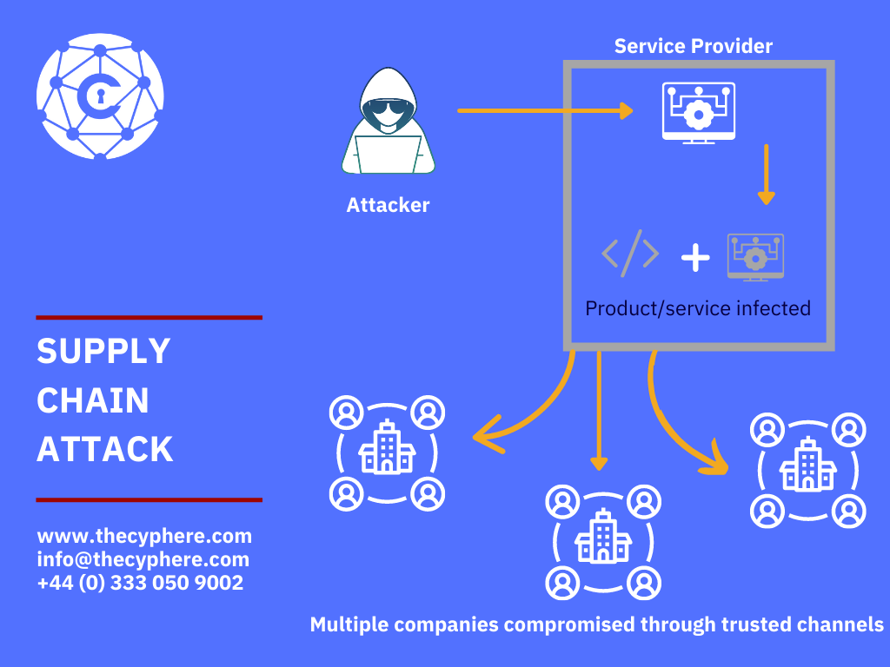
TROSCA > Big Picture > What is a supply chain attack?
A "supply chain attack" is a technique in which an adversary slips malicious code into a trusted piece of software or hardware
By compromising a single supplier, spies or saboteurs can hijack entire distribution network
Supply chain attacks were first demonstrated around four decades ago when Ken Thompson hide a backdoor in Unix's login function

Slide 4
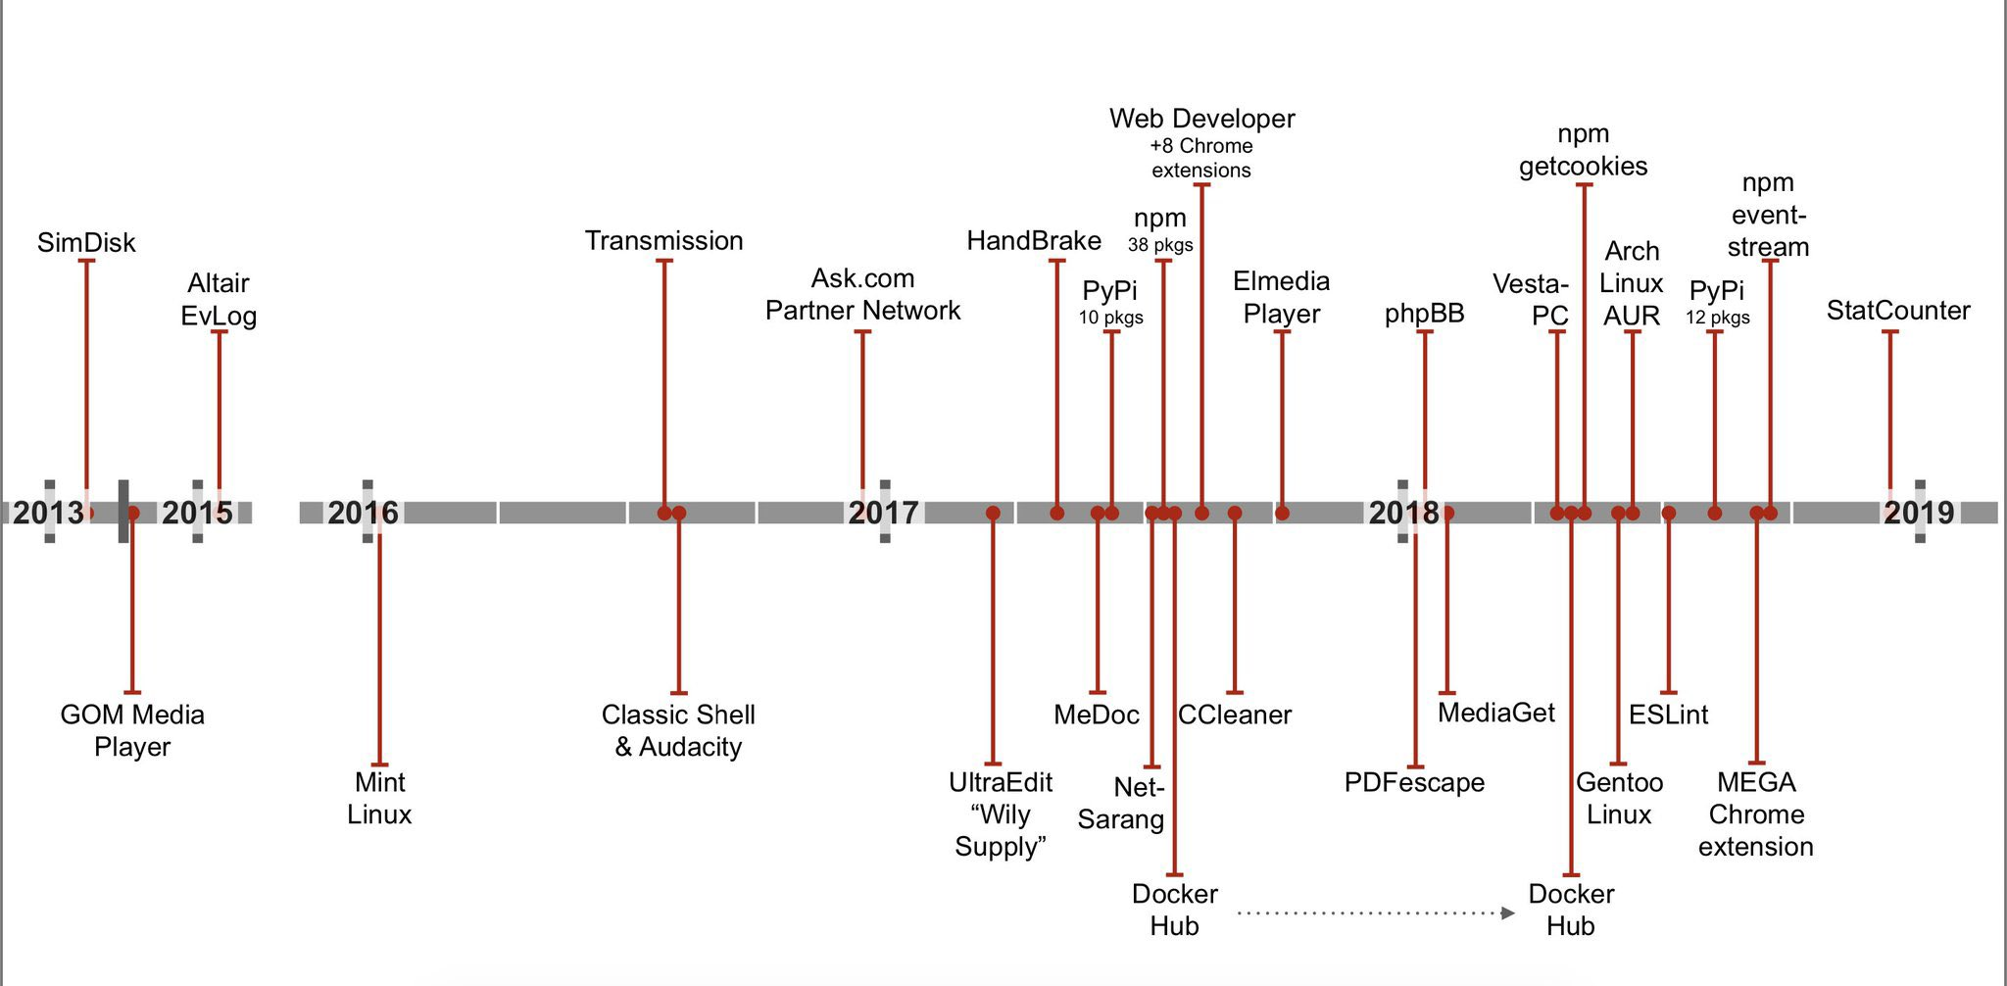
TROSCA > Big Picture > Brief history of supply chain attacks

Slide 5
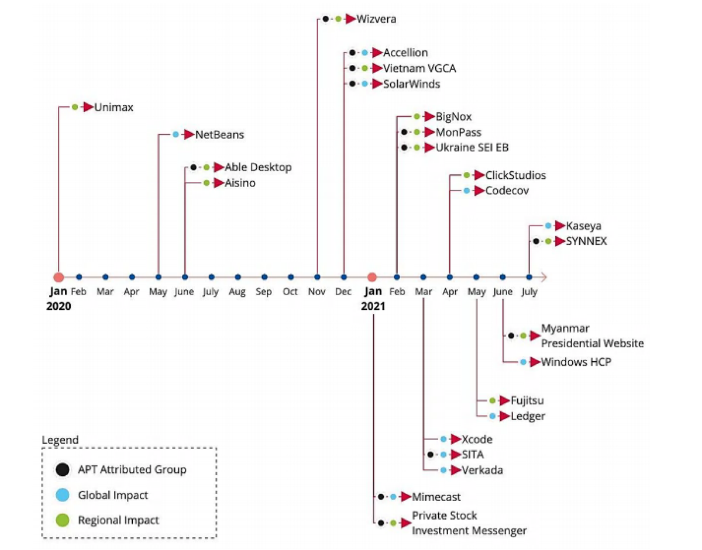
TROSCA > Big Picture > 2020/2021 was a record breaking season
66% of supply chain attacks were committed by exploiting an unknown vulnerability, while 16% leveraged known software flaws
Supply chain attacks most commonly targeted customer data (58%), followed by key people (16%) and financial resources (8%)
Most attacks during the specified timeline aimed to compromise code (66%), followed by data (20%) and processes (12%)

Slide 6
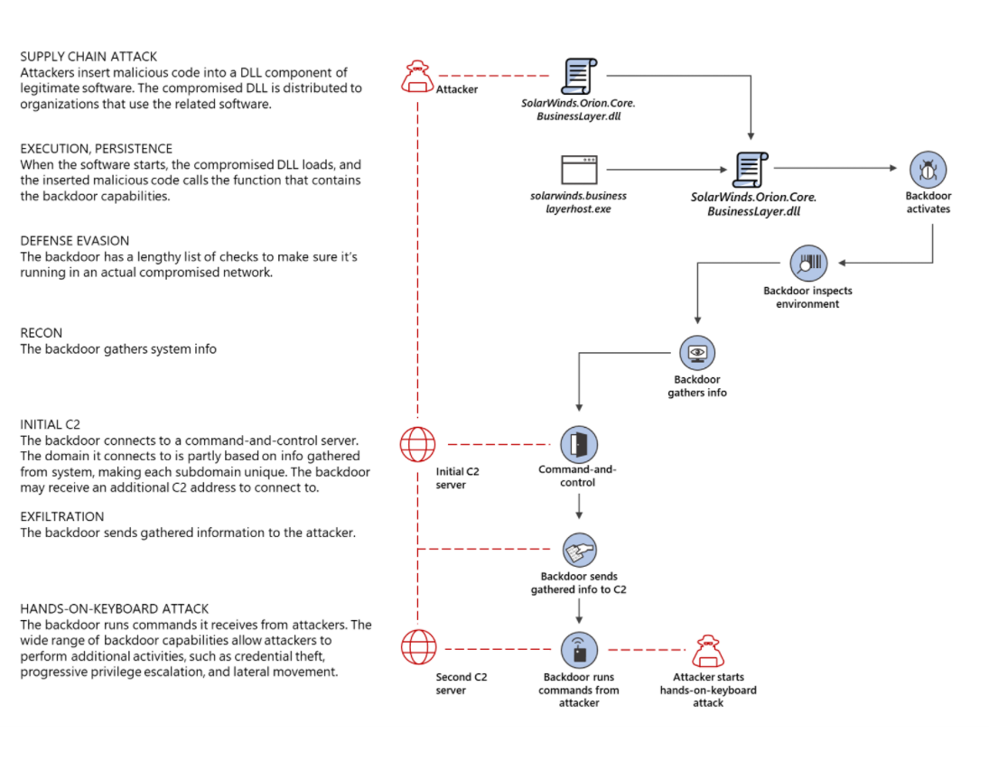
TROSCA > Big Picture > Disecting Solarwinds

Slide 7

TROSCA > Big Picture > Turtles all the way down

Slide 8

TROSCA > Vectors
[Text]

Slide 9
TROSCA > Self-defense
[Text]

Slide 10
TROSCA > Literature
The evolution of the software supply chain attack
The Enemy Within: Modern Supply Chain Attacks
https://www.wired.com/story/hacker-lexicon-what-is-a-supply-chain-attack/
https://portswigger.net/daily-swig/four-fold-increase-in-software-supply-chain-attacks-predicted-in-2021-report
https://thecyphere.com/blog/supply-chain-attack/
https://www.ncsc.gov.uk/collection/supply-chain-security/supply-chain-attack-examples

Slide 11

TROSCA > Q&A

