Slide 1
Impact mapping IN 5 simple steps Updated 23 September 2019

Slide 2
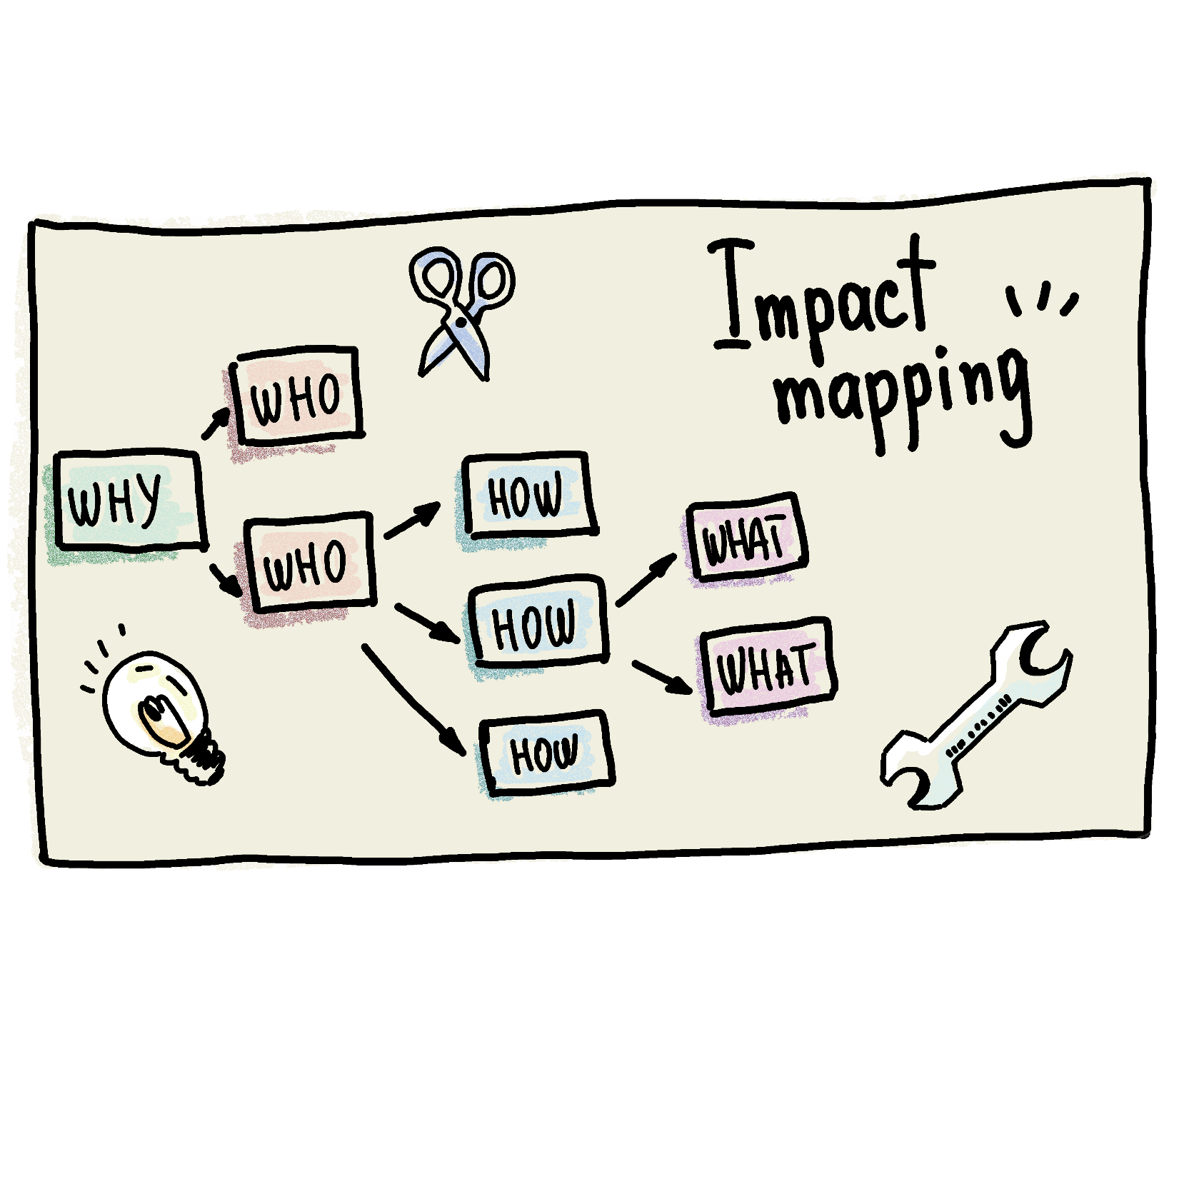
Impact Mapping

Slide 3
Impact Mapping > STEP #1 > WHY
Discuss & put in the center of a flip-chart a goal you want to achieve (satisfying SMART criteria would be great). It answers the first question: WHY do we do this?”. Good example: “Get 1M users”.

Slide 4
Impact Mapping > STEP #2 > WHO
Discuss and try to answer next questions: WHO can produce the desired effect? WHO can obstruct it? WHO are the consumers or users of our product? WHO will be impacted by it? Here we think about real groups of people, not tech abstracts. Good examples: “Active Users”, “Our Marketing Guys”, “External Advertising Agency”.

Slide 5
Impact Mapping > STEP #3 > HOW
Discuss and try to answer next questions: HOW should our actors’ behaviour change? HOW can they help us to achieve the goal? HOW can they obstruct or prevent us from succeeding?
Good examples: “Recommending/posting (by Active Users)” or “Organise PR event (by Our Marketing Guys)”. Notice that we still don’t talk about features. We talk about real people and their actions.

Slide 6
Impact Mapping > STEP #4 > WHAT
Discuss and try to answer next question: WHAT can we do, as an organisation or a delivery team, to support the required impacts?
Notice that even here we talk not only about features but try to open all possible ideas (because very often it’s much cheaper to achieve something without even writing a single line of code).
Good examples: “Content to share/post about (to support Posting)”, “Invites (to support PR event.

Slide 7

Impact Mapping > Step #5 > WHEN?
Remember that this technique shouldn’t be done by a lonely Product Owner. This technique is a very powerful facilitation method WHEN used in a rich group discussion (at least an overall product development team but ideally plus all more or less involved stakeholders).

Slide 8
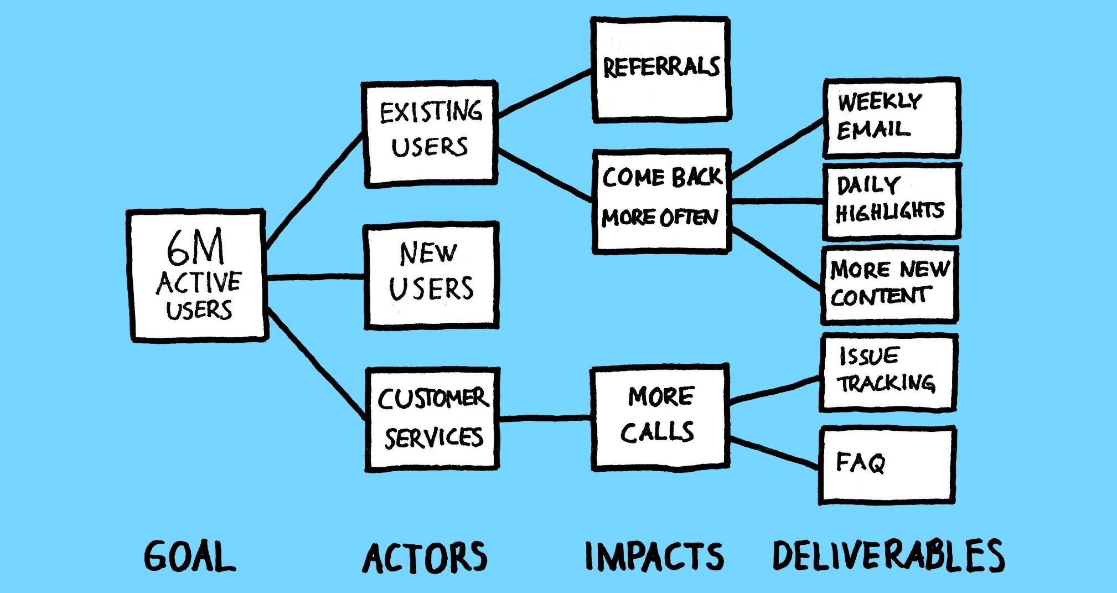
Impact Mapping > Examples

Slide 9
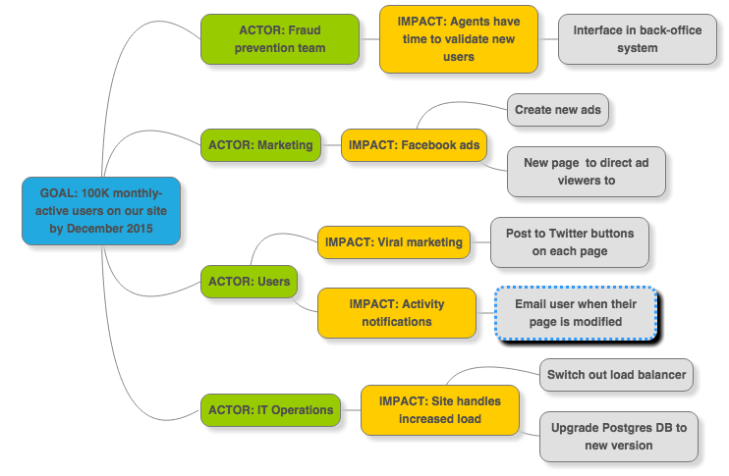
Impact Mapping > Examples

Slide 10
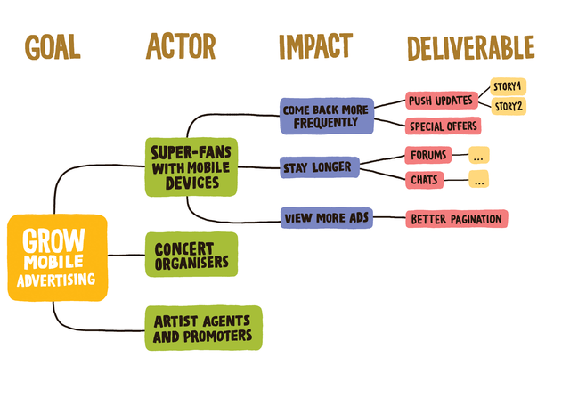
Impact Mapping > Examples

Slide 11

Impact Mapping > Q/A

Slide 12
Impact Mapping > Feedback
https://forms.office.com/Pages/ResponsePage.aspx?id=ZpSpcwWtIUKfkOcUKqL2wTFclz-gNvpNq3THAj1j3ZxUODk1TjlEWVNJNzUxNjAwTFhGQkQ2VkNTWi4u

Slide 13
Impact Mapping > Literature
impactmapping.org
https://medium.com/@antonzotin/5-simple-steps-to-run-your-first-impact-mapping-session-7d182acbf153
https://www.youtube.com/watch?v=oKx4nITZw-8

