Slide 1
Azure Monitoring Deep Dive Updated 5 Feb 2020

Slide 2
AMDD > Agenda
Big picture
Basics
Metrics
Alerts
Q&A
Logs

Slide 3

AMDD > Big Picture

Slide 4
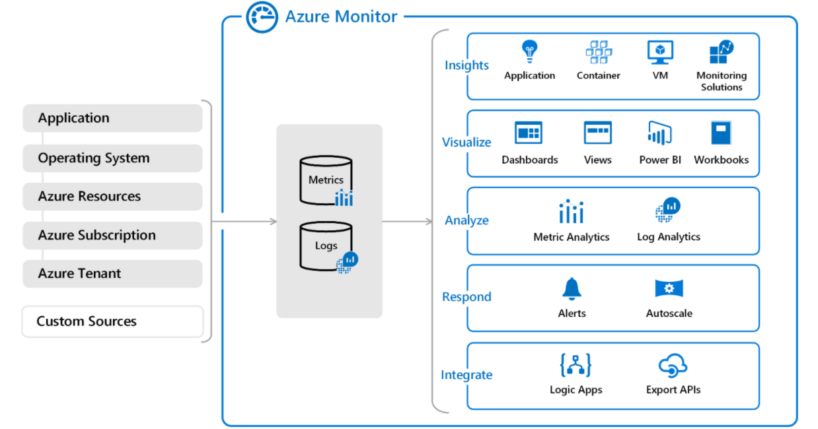
AMDD > Big Picture > Azure Monitor
Azure Monitor
data sources
Azure Monitor services
Log Analytics workspace

Slide 5
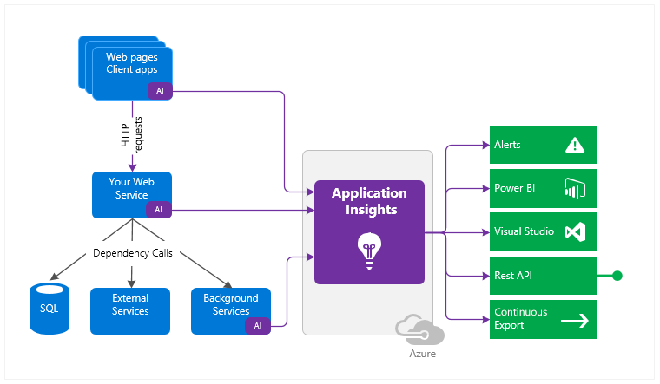
AMDD > Big Picture > Application Insights
Solutions instrumented via Application Insights SDK(s)
Integration Services
Azure Application Insights Resource

Slide 6

AMDD > Big Picture > Demo

Slide 7

Azure Monitor > Basics

Slide 8

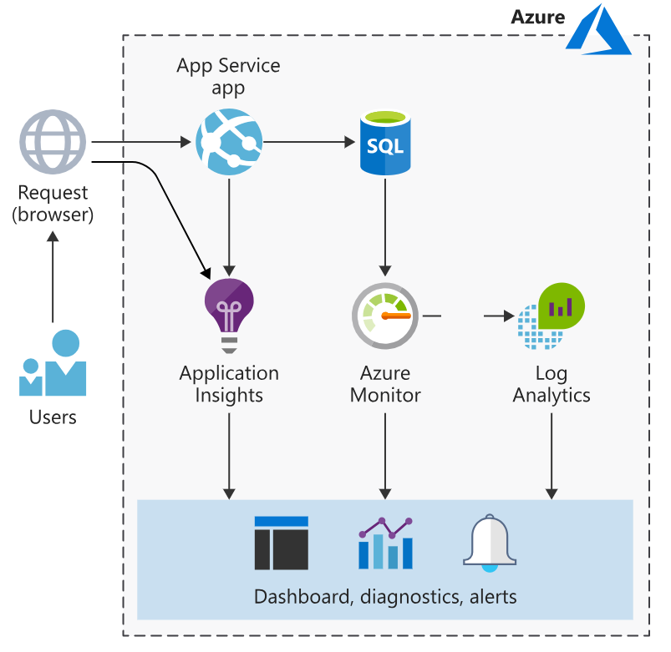
Azure Monitor > Basics
Resources… [TODO]
Data sources… [TODO]
Workspaces… [TODO]
Services… [TODO]
SDKs… [TODO]
Agents… [TODO]

Slide 9

Azure Monitor > Basics > Hands-on

Slide 10

Azure Monitor > Basics > Code Kata #1

Slide 11

Azure Monitor > Basics > Q/A

Slide 12
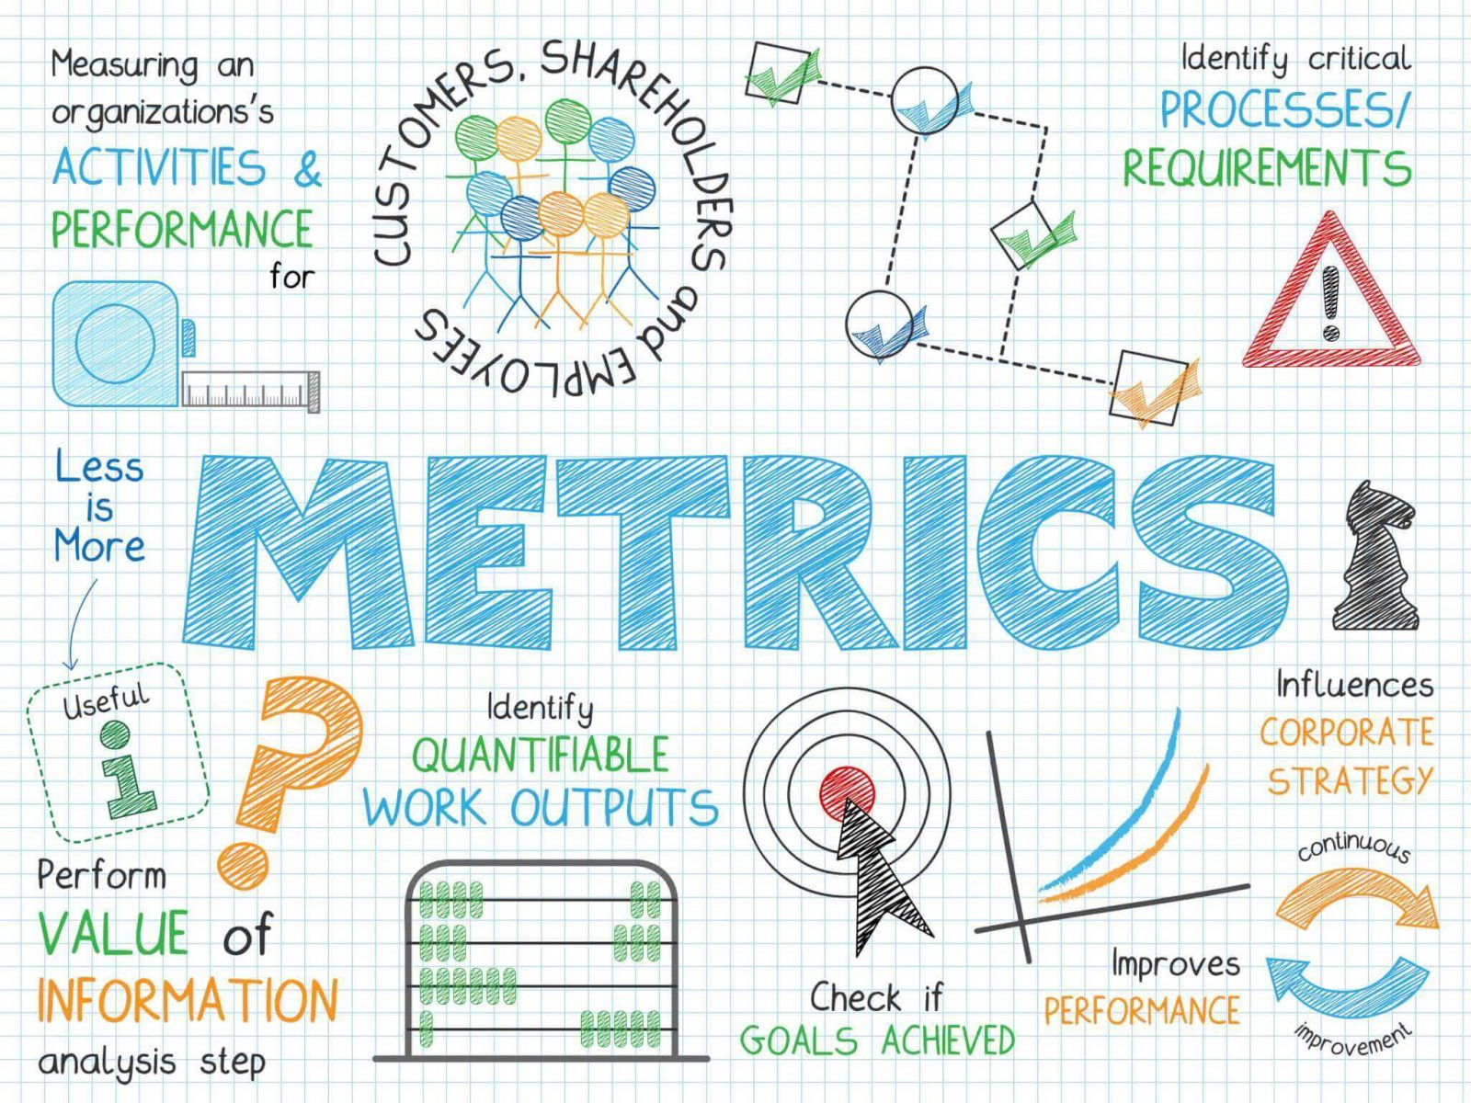
Azure Monitor > Metrics

Slide 13
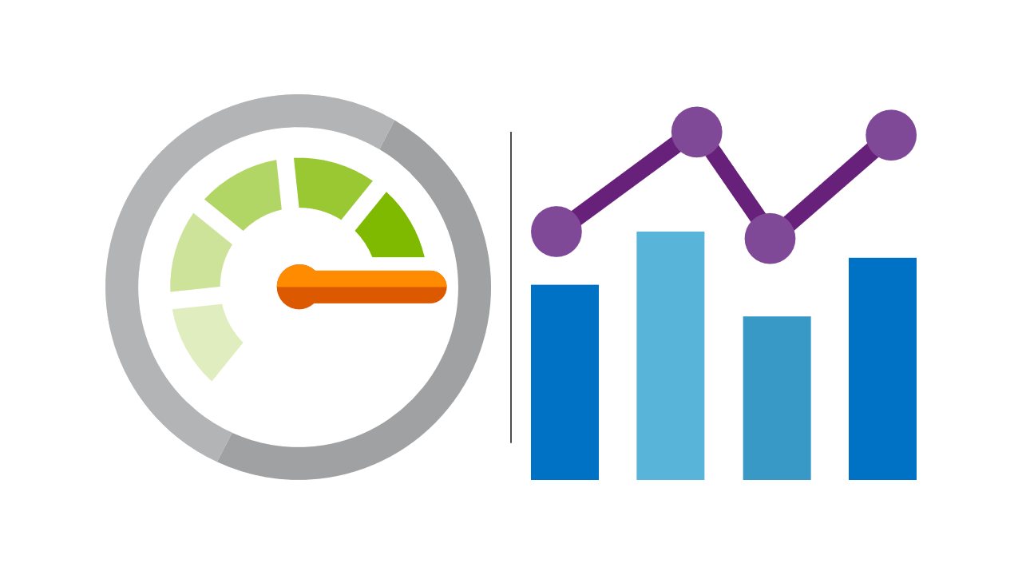
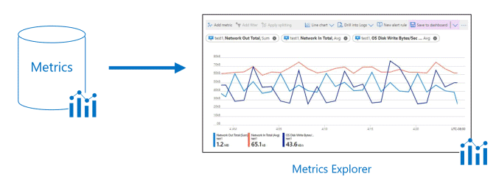
Azure Monitor > Metrics
DFDS metric guidelines… [TODO]
Standard metrics… [TODO]
Custom metrics… [TODO]

Slide 14
Azure Monitor > Metrics > Hands-on

Slide 15
Azure Monitor > Metrics > Code Kata #2

Slide 16
Azure Monitor > Metrics > Q/A

Slide 17

Azure Monitor > Logs

Slide 18
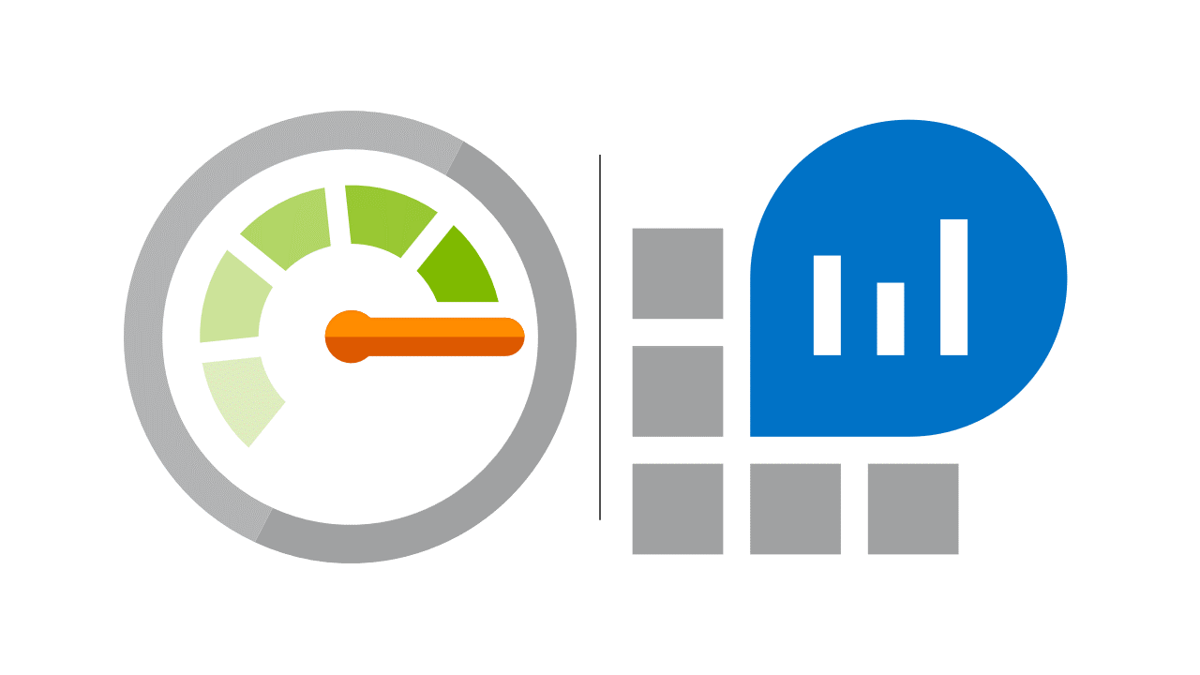
Azure Monitor > Logs
DFDS logging guidelines… [TODO]
Log levels… [TODO]
Log types… [TODO]

Slide 19
Azure Monitor > Logs > Hands-on

Slide 20
Azure Monitor > Logs > Code Kata #3

Slide 21
Azure Monitor > Logs > Q/A

Slide 22

Azure Monitor > Alerts

Slide 23

Azure Monitor > Alerts
DFDS alerting guidelines… [TODO]
Standard alerts… [TODO]
Custom alerts… [TODO]
Smart Groups… [TODO]

Slide 24
Azure Monitor > Alerts > Hands-on

Slide 25
Azure Monitor > Alerts > Code Kata #3

Slide 26
Azure Monitor > Alerts > Q/A

Slide 27
Azure Monitor > Feedback
https://forms.office.com/Pages/ResponsePage.aspx?id=ZpSpcwWtIUKfkOcUKqL2wTFclz-gNvpNq3THAj1j3ZxUODk1TjlEWVNJNzUxNjAwTFhGQkQ2VkNTWi4u

Slide 28
Azure Monitor > Literature
https://docs.microsoft.com/en-us/azure/azure-monitor/overview
https://docs.microsoft.com/en-us/learn/modules/azure-monitor/
https://docs.microsoft.com/en-us/learn/modules/design-solution-to-log-monitor-azure-resources/
https://docs.microsoft.com/en-us/learn/modules/analyze-infrastructure-with-azure-monitor-logs/
https://docs.microsoft.com/en-us/learn/modules/monitor-app-performance/
https://docs.microsoft.com/en-us/learn/modules/microservices-logging-aspnet-core/

