Slide 1
GIT & GitHUB DEEP-DIVE Updated 6 October 2020

Slide 2
G&GHDD > Agenda
Big picture
Github.com
Q&A
Git
Notes:
Big Picture => What is version control?
Git => What is Git?
Github.com => Why are we using Github.com?
Q/A => Questions?

Slide 3
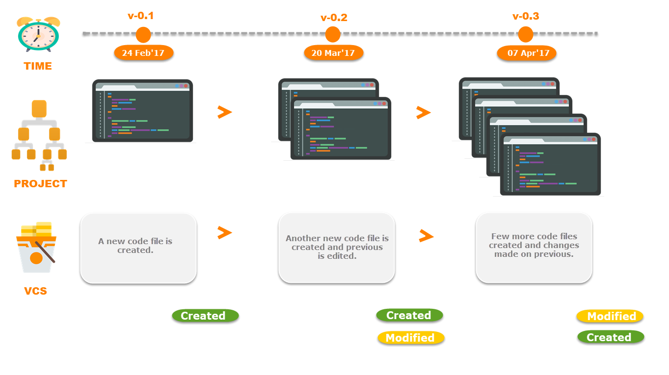
G&GHDD > Big Picture

Slide 4
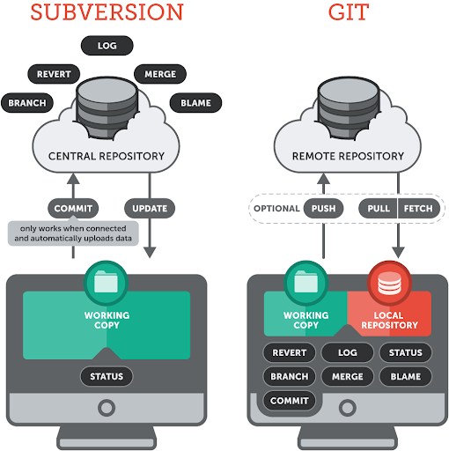
G&GHDD > Big Picture > Centralized vs Distributed
In centralized version control systems all the work is done on the server.
In distributed version control systems all the work is offloaded to the clients.

Slide 5
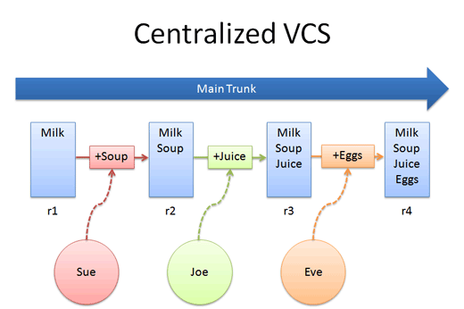
G&GHDD > Big Picture > Centralized Version Control Systems
Joe wants Juice but have to wait for Sue to be done eating.
Eve got up late and have to wait for Sue and Joe to finish eating before she can cook her Eggs.
Sue wants Soup.

Slide 6
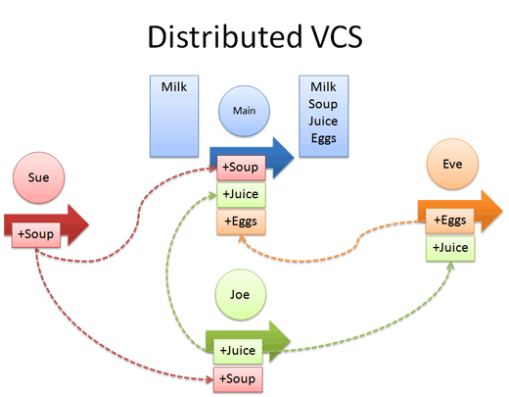
G&GHDD > Big Picture > Distributed Version Control Systems
Main doesn’t care cause it knows Sue, Joe and Eve will figure out the menu via a PR.
Sue only wants Soup.
Eve doesn’t like Soup so she wants Eggs with her Juice.
Joe wants Juice with his Soup.

Slide 7

G&GHDD > Big Picture > Demo

Slide 8


G&GHDD > Big Picture > Q/A

Slide 9
G&GHDD > Git
Git is a open source distributed version control system designed to handle everything from small to very large projects with speed and efficiency. It was created by Linus Torvalds in 2005 to support the development of the Linux Kernel. Defining characteristics of Git are:
Git is Free
Git is Fast
Git is Scalable
Git is Secure
Git is Economical
Notes:
Free => Git is released under GPL’s (General Public License) open source license.
Fast => Performance tests done by Mozilla showed it was an order of magnitude faster than other version control systems.
Scalable => Git is very scalable and will easily handle all the future needs of DFDS
Reliable => Every contributor has its own local repository, so in the events of a system crash, data can be recovered from any of the local repositories.
Secure => Git uses the SHA1 (Secure Hash Function) to name and identify objects within its repository. Every file and commit is check-summed and retrieved by its checksum at the time of checkout. The Git history is stored in such a way that the ID of a particular version (a commit in Git terms) depends upon the complete development history leading up to that commit. Once it is published, it is not possible to change the old versions without it being noticed.
Economical => In case of centralized version control systems, the central server needs to be powerful enough to serve requests of the entire team. For smaller teams, it is not an issue, but as the team size grows, the hardware limitations of the server can be a performance bottleneck. Decentralized version control systems don’t interact with the server unless they need to push or pull changes. All the heavy lifting happens on the client side.

Slide 10
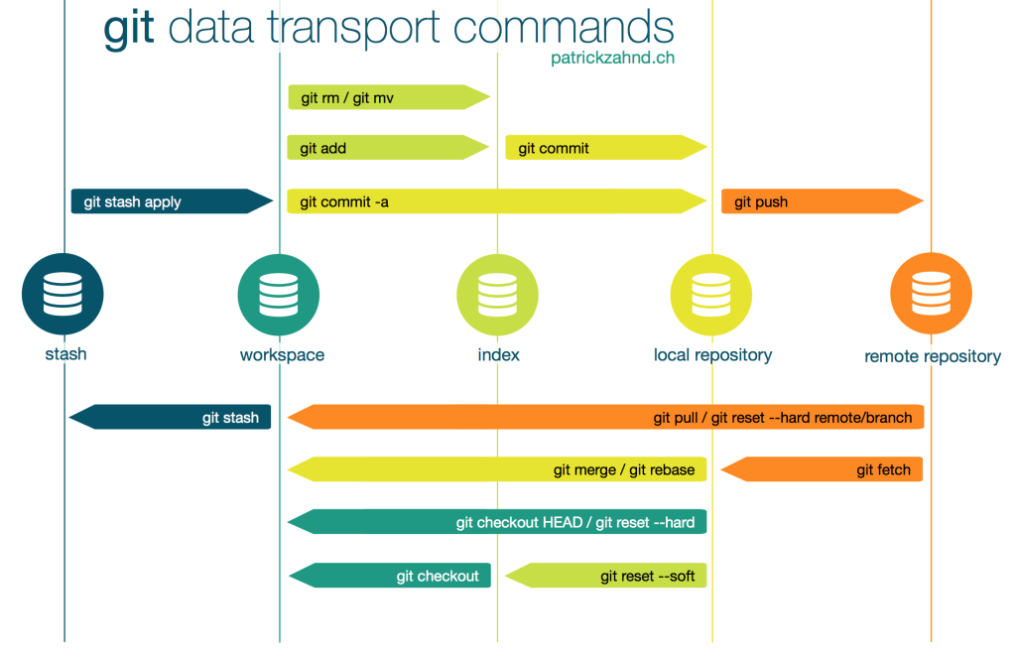
G&GHDD > Git > Workflow

Slide 11
G&GHDD > Git > Setup
Create a new Git repository: git init [workspace]
Clone an existing repository: git clone [workspace / URL] [workspace]

Slide 12
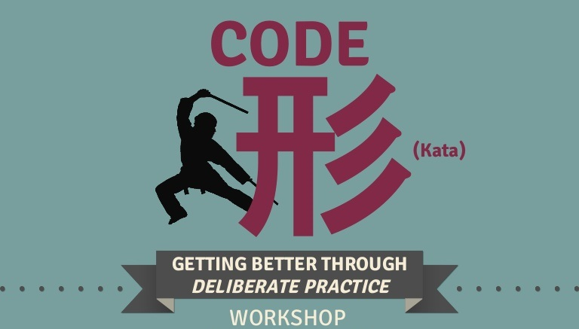
G&GHDD > Git > Setup > Code Kate #1

Slide 13
G&GHDD > Git > Configuration
Show your global configuration: git config --list
Attach a name to all commits: git config --global user.name [name]
Attach an email to all commits: git config --global user.email [email]
Create a alias for a Git command: git config --global alias.[name] [command]
Auto-convert CRLF line endings into LF: git config --global core.autocrlf true
Auto-correct CLI mistakes: git config --global help.autocorrect true

Slide 14
G&GHDD > Git > Configuration > Code Kate #2

Slide 15
G&GHDD > Git > Files
Show the state of the workspace: git status
List the commit history of the current branch: git log
Compare two branches: git log [branch1]..[branch2]
Examine the difference between the workspace and the index: git diff
Compare the workspace and the local repository: git diff HEAD
Display the content and metadata of an object: git show [object]

Slide 16
G&GHDD > Git > Files > Code Kate #3
Notes:
https://docs.github.com/en/free-pro-team@latest/github/managing-files-in-a-repository

Slide 17
G&GHDD > Git > Branches
List all branches in the repository: git branch
List all remote branches: git branch -aa
Create a new branch: git branch [name]
Switch to a branch under a specified name: git checkout [name]
Delete a local branch: git branch -d [name]
Rename a branch: git branch -m [name]
Merge the specified branch with the current branch: git merge [name]

Slide 18
G&GHDD > Git > Branches > Code Kate #4
Notes:
https://git-scm.com/book/en/v2/Git-Branching-Basic-Branching-and-Merging

Slide 19
G&GHDD > Git > Changes
Stage changes for the next commit: git add [file/directory]
Stage everything in the directory for an initial commit: git add .
Commit staged changes: git commit –m [message]
Undo changes: git revert [file/directory]
Unstage a file without overwriting changes: git reset [file]
Undo any changes introduced after the specified commit: git reset [commit]
Show untracked files: git clean -n
Remove untracked files: git clean -f

Slide 20
G&GHDD > Git > Changes > Code Kate #5
Notes:
https://www.git-tower.com/learn/git/commands/git-commit/

Slide 21
G&GHDD > Git > History
Replace the last commit with a combination of the staged changes and the last commit: git commit --amend
Rebase the current branch with the specified base: git rebase [base]
List changes made to the HEAD of the local repository: git reflog

Slide 22
G&GHDD > Git > History > Code Kate #6
Notes:
https://www.benmarshall.me/git-rebase/

Slide 23
G&GHDD > Git > Remote
Create a new connection to a remote repository: git remote add [name] [URL]
Fetch a branch from a remote repository: git fetch [remote_repo] [branch]
Fetch a repository and merge it with the local copy: git pull [remote_repo]
Push a branch to a remote repository: git push [remote_repo] [branch]

Slide 24
G&GHDD > Git > Remote > Code Kate #7
Notes:
https://git-scm.com/book/en/v2/Git-Basics-Working-with-Remotes

Slide 25
G&GHDD > Git > Q/A

Slide 26
G&GHDD > Github.com
The main purpose of GitHub.com is to facilitate the version control and issue tracking aspects of software development.
Labels, milestones, responsibility assignment and a search engine are available for issue tracking.
For version control, Git (and by extension GitHub.com) allows pull requests to propose changes to the source code.
Users with the ability to review the proposed changes can see a diff of the requested changes and approve them.

Slide 27
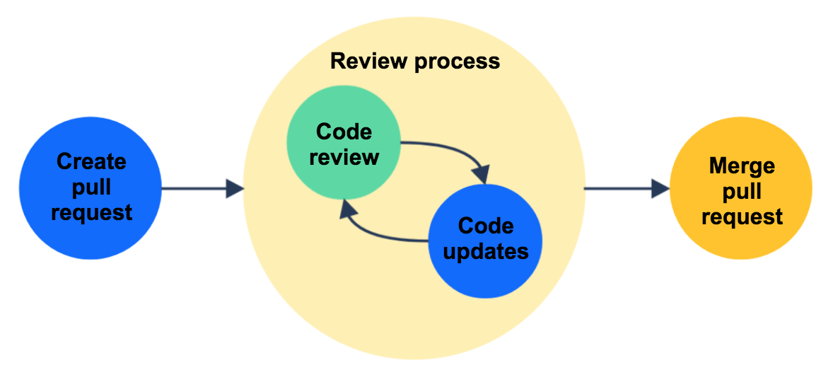
G&GHDD > Github.com > Pull Request

Slide 28
G&GHDD > Github.com > Pull Request > Workflow
Create “my-branch” based on “main”.
Add commits to “my-branch”.
Open a pull request from “my-branch” to “main”.
Discuss and review code in pull request.
Deploy “my-branch” to test environment for regression testing.
Approve pull request and merge code from “my-branch” into “main”.

Slide 29
G&GHDD > Big Picture > Pull Request > Demo
Notes:
Step 1 => https://github.com/pulls

Slide 30
G&GHDD > Github.com > SSH
Using the SSH protocol, you can connect and authenticate to remote servers and services.
With SSH keys, you can connect to GitHub.com without supplying your username or password at each visit.
To use your SSH key you'll need to add it to your account via GitHub.com.
If you haven't used your SSH key for a year, then GitHub.com will automatically delete your inactive SSH key as a security precaution.
If you're a member of an organization that provides SSH certificates, you can use your certificate to access that organization's repositories without adding the certificate to your GitHub account.

Slide 31
G&GHDD > Big Picture > SSH > Demo
Notes:
Step 1 => ssh-keygen -b 4096
Step 2 => https://github.com/settings/keys

Slide 32

G&GHDD > Github.com > Lab

Slide 33
G&GHDD > Github.com > Lab
Create a new organization.
Create a new account.
Create a new repository.
Create a new project in your repository.
Create the following milestones: poc, mvp, v1
Create the following labels: test, qa, prod.
Create three issues: A, B & C. Add labels, milestones and project to each issue.

Slide 34
G&GHDD > Github.com > Q/A

Slide 35
G&GHDD > Feedback
https://airtable.com/shrDUlkEelfraVzON

Slide 36
G&GHDD > Literature
https://github.com/
https://en.wikipedia.org/wiki/Version_control
https://medium.com/@shashankmohabia/up-and-running-with-version-control-systems-88c9857abe09
http://jr0cket.co.uk/slides/getting-started-with-git.html#/
https://phoenixnap.com/kb/git-commands-cheat-sheet

