Slide 1
Event Storming
Barış Tutakli
Notes:
This is a rapid group modeling approach.
This approach is fast because the event storming approach reduces the time it takes to create a comprehensive business domain model.
This approach is fast because straightforward because event storming makes easier to understand the process for technical and non-technical stakeholders.
Event storming engages people because this approach invites each person to participate and interact.
Effective: Event storming is not data modeling. Instead, it results in a fully behavioral model that can be quickly implemented and validated.

Slide 2
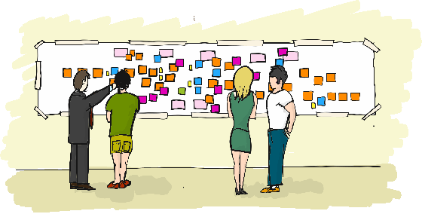
Invite the right people
Copywrite: Avanscoperta
Notes:
The first thing we need to do is to invite the right people. The number of the invited people may vary depending on the project.
It’s better to invite between 4 and 8 people.
What does the right people mean?
According to Brandolini, “they are the people who know the right questions to ask and the ones who have the answers.
This group will likely be a mixture of stakeholders representing user experience, business, architecture, development, and IT. We aren’t using UML, BPMN so everybody can join the conversation.”

Slide 3
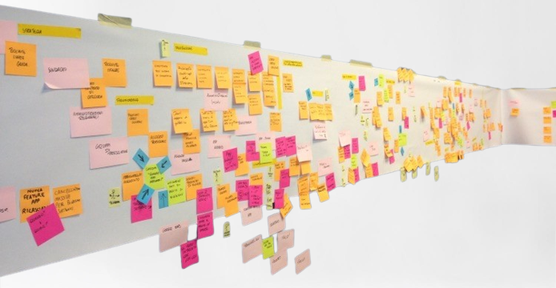
Unlimited modeling space
Notes:
We need an unlimited modeling space because the number of the events will increase. The more the domain is bigger the more space we need

Slide 4
Key Points
Event
Command
Reaction
Not clear
External
Notes:
First off all I identified keywords to meet our demands. There are different ways to apply event storming. We can also decide the sticky notes and their roles.

Slide 5
Event
Identify events
Events are always noted in the past tense
We will use orange sticky notes for events
Notes:
Primarily we need to do is to identify events. Events are noted at past tense to precise the time

Slide 6
Examples:
User registered
User logged in
Forgotten password
Ticket sold
Notes:
Here you see some examples

Slide 7
Caution!!!
User registered
User signed up
Notes:
Here you see two events. Some people may post the same event with different words. We need to create a common language to avoid duplicated events.

Slide 8
Establish a Timeline
Notes:
We have a timeline from left to right. We will order events locally then we will arrange it globally.

Slide 9
Command
The cause of the event is noted as a command
Commands are always noted in the simple tense
We will use blue sticky notes for commands
Notes:
Cause or trigger

Slide 10
Examples:
Register new user
Submit the order
Update user
Ship the product
Notes:
Commans = triggers

Slide 11
Timeline
Notes:
We added commands into our timeline

Slide 12
Reaction
The results of an event is noted as a reaction
Reactions are always noted in the present tense
We will use green sticky notes for reactions
Notes:
Then we have reactions. Reactions helps us to see the the result of an event.

Slide 13
Examples:
Send an email
Send a message
Show popup
Notify managers
Notes:
Commans = triggers

Slide 14
Timeline
Notes:
We added reactions into our timeline

Slide 15
Not clear
When we blocked and have trouble to understand the current state, we will use purple sticky notes.

Slide 16
Timeline
Notes:
If something is not clear, we will discuss about it later and post a purple sticky

Slide 17
External
We will use gray sticky notes for everything that we don’t control inside our system.

Slide 18
Timeline
Notes:
Everyone will have a clear vision about the whole project and will be aware of the other part of the project. Everything will be available and under control.

Slide 19
End of the flow
Notes:
If a flow ends, we will post an “x”

Slide 20
Timeline
Notes:
I created different event stormings and used different applications such as draw.io, lucid and miro to decide which one is better for our team. In the next step, I’m ganna show you all of them.

Slide 21
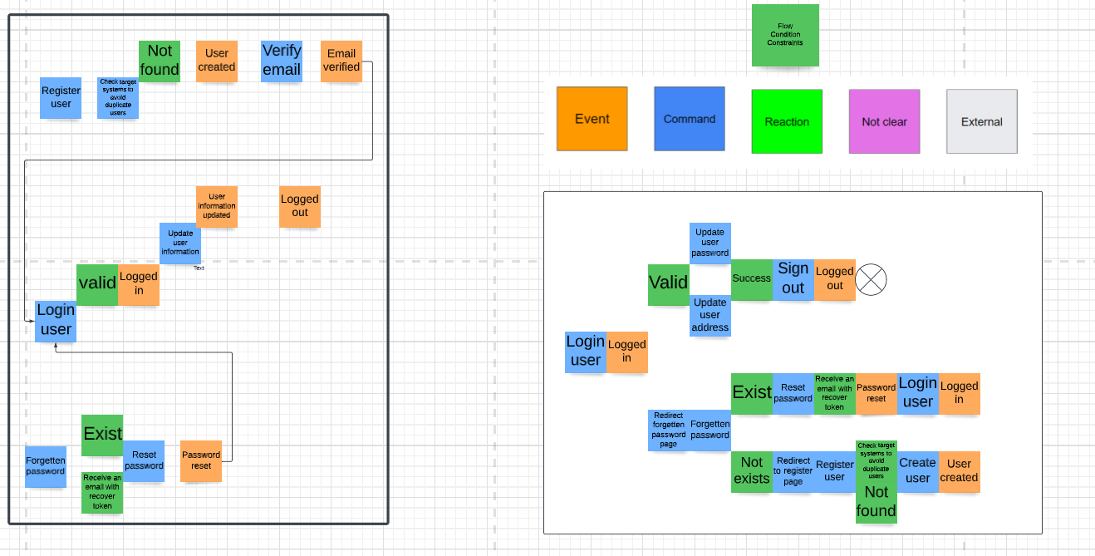
Lucid

Slide 22
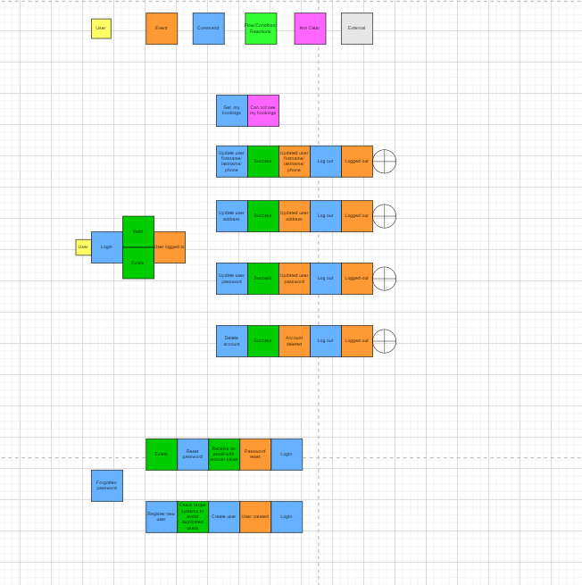
draw.io

Slide 23
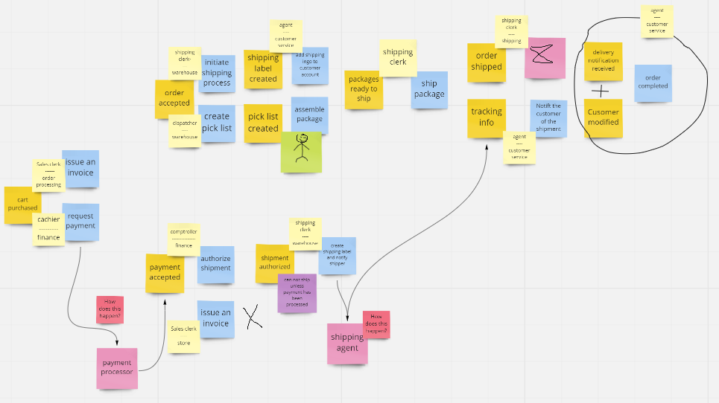
Miro

Slide 24
Samples
Layout
screenshot
Miro/eventstorming
Lucid.app/eventstorming

Slide 25
https://www.lucidchart.com/blog/ddd-event-storming
https://www.agilepartner.net/wp-content/uploads/Big-Picture.jpg
Event Storming - Alberto Brandolini - DDD Europe 2019

Slide 26
Thanks

