Slide 1
Micro frontend architecture Deep Dive Updated 24 September 2020

Slide 2
MFA > Agenda
Big picture
Web Components
Q&A
MinionsJS

Slide 3
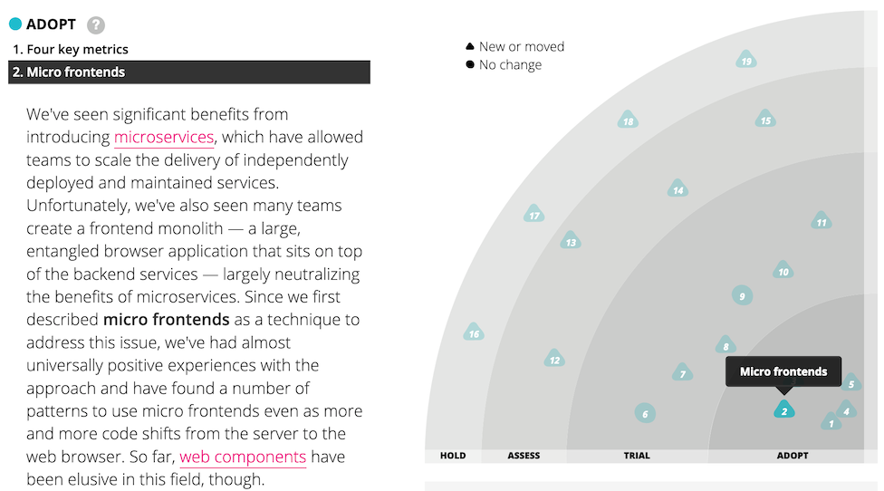
MFA > Big Picture

Slide 4
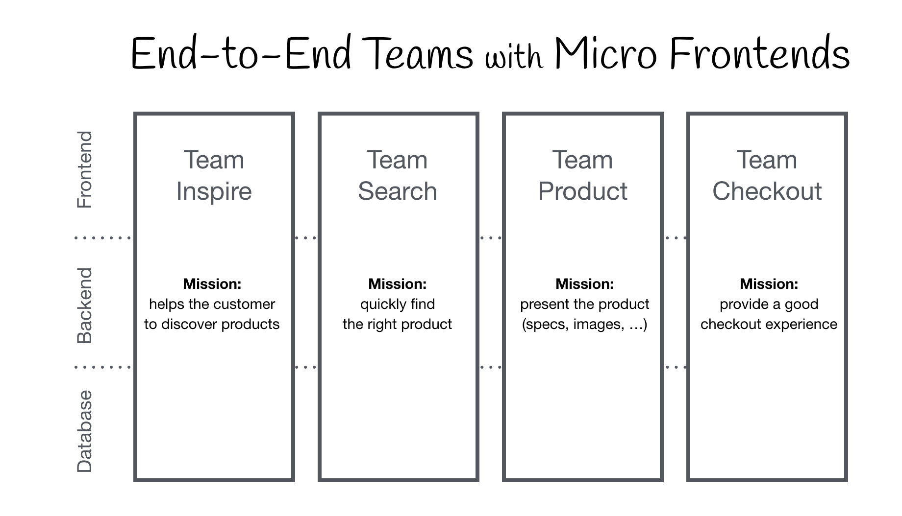
MFA > Big Picture > Proposal

Slide 5

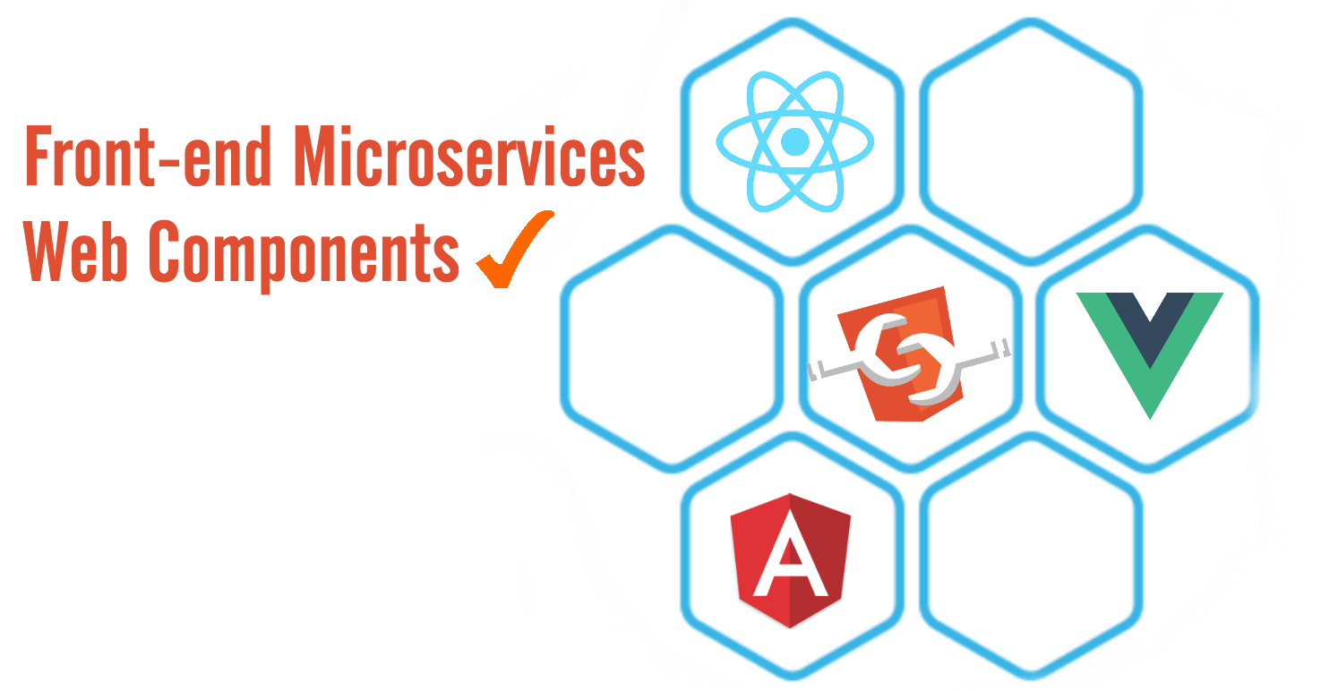
MFA > Big Picture > UI microservices

Slide 6
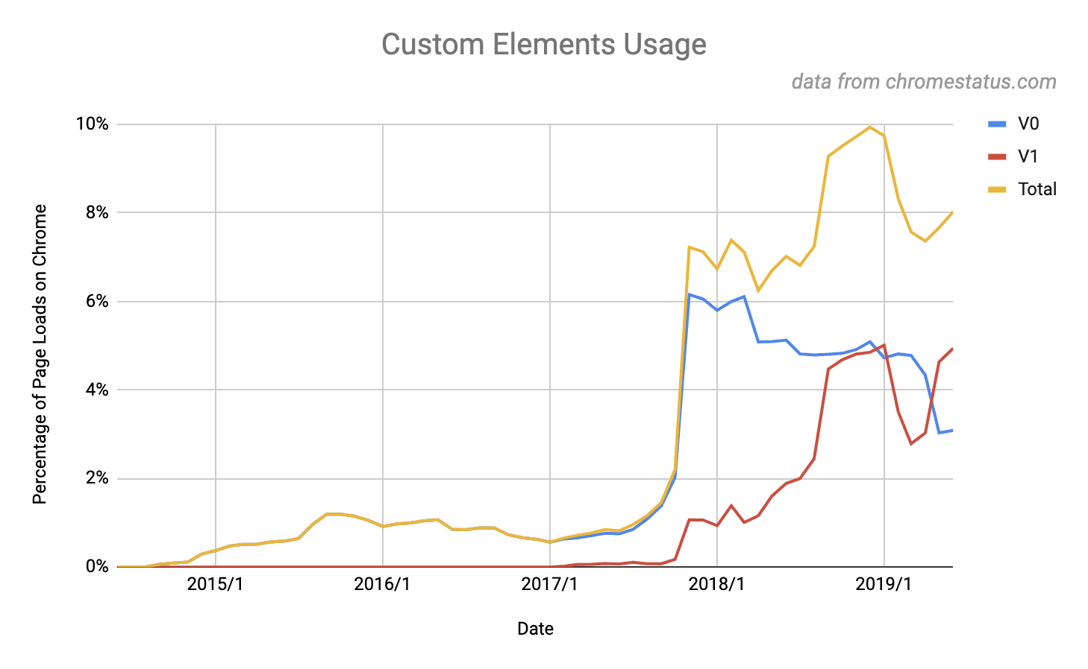
MFA > Big Picture > Usage metrics

Slide 7

MFA > Web Components
The W3C specifications can be used individually or combined to allow us to define our own tags, whose styles are encapsulated and isolated, which can be re-stamped many times and have a consistent integration model.
Web components is a meta-specification made possible by four other W3C specifications

Slide 8
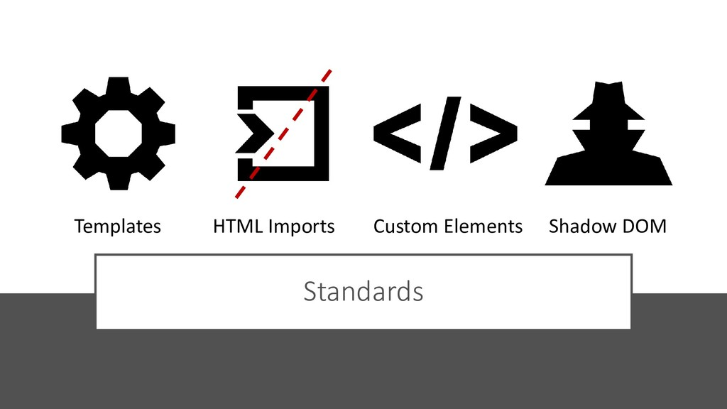
MFA > Web Components > A bundle of standards

Slide 9

MFA > Web Components > Interoperability

Slide 10

MFA > Web Components > Interoperability

Slide 11

MFA > Web Components > Demo

Slide 12
MFA > Web Components > Templates
The template specification allows us to declare fragments of HTML that can be cloned and inserted in the document by scripts.
Content within <template></template> tags:
Will not render until it is activated.
Has no effect on other parts of the page - scripts won’t run, images won’t load, audio won’t play - until activated.
Will not appear in the DOM.
Templates can be placed anywhere in <head>, <body> or <frameset> and can contain any content that is allowed in those elements.

Slide 13

MFA > Web Components > Templates > Hands-on

Slide 14

MFA > Web Components > Templates > Hands-on

Slide 15
MFA > Web Components > Imports
HTML Imports, or just imports, are HTML documents that are linked as external resources from another HTML document. As such the following logic applies when dealing with imports:
The document that links to an import is called an import referrer.
In each import referrer, an import is represented as a Document, called the imported document.
An import referrer that is not an import, thus is not associated with any import referrer, is called a master document.
Each import is associated with one master document. If the import referrer is a master document, it becomes the master document of the associated import.

Slide 16
MFA > Web Components > Imports > Hands-on

Slide 17
MFA > Web Components > Imports > Hands-on

Slide 18
MFA > Web Components > Custom Elements
The Custom Elements specification lays the foundation for designing and using new types of DOM elements that are fully-featured and re-usable. Thus enabling developers to create:
Autonomous custom elements with custom behaviors and styles, defined entirely by the author.
Plug & play components that can integrated in any HTML5-enabled context.
Extensions of existing HTML elements with new functionality as custom elements inherit semantics from the elements they extend.

Slide 19
MFA > Web Components > Custom Elements > Hands-on

Slide 20
MFA > Web Components > Custom Elements > Hands-on

Slide 21
MFA > Web Components > Shadow DOM
Shadow DOM is a specification designed as a tool for building component-based apps. Therefore, it brings solutions for common problems in web development:
Isolated DOM - A component's DOM is self-contained.
Scoped CSS - CSS defined inside shadow DOM is scoped to it. Style rules don't leak out and page styles don't bleed in.
Composition - Design a declarative, markup-based API for your component.
Simplifies CSS - Scoped DOM means you can use simple CSS selectors, more generic id/class names, and not worry about naming conflicts.
Productivity - Think of apps in chunks of DOM rather than one large (global) page.

Slide 22
MFA > Web Components > Shadow DOM > Hands-on

Slide 23
MFA > Web Components > Shadow DOM > Hands-on

Slide 24
MFA > MinionsJS
MinionsJS is a lightweight framework focused on providing simple abstractions for key concepts such as web components, “transient events” and UI telemetry via a set of “prototypes” that tie together modern web standards with the aim of empower developers that want to built re-usable UI components which can be used anywhere and adhere to the general principles of our Composable Architecture.
MinionsJS achieve its goals by providing an “opinionated wrapper” around the Google lit-elements framework and a simple plugin API.

Slide 25

MFA > MinionsJS > Lab

Slide 26
MFA > MinionsJS > Lab > Assignment
Decide on SimpleComponent theme.
Implement SimpleComponent using MinionsJS.
Distributed SimpleComponent package via NPM.
Create SimpleContainerApplication to consume SimpleComponent.
Demo SimpleContainerApplication.

Slide 27

MFA > Q/A

Slide 28
MFA > Literature
https://micro-frontends.org/
https://www.spec-india.com/blog/micro-frontend
https://www.webcomponents.org/specs
https://medium.com/the-web-tub/why-web-components-matter-interview-with-taylor-savage-googles-polymer-project-d25002729d3a
https://hackernoon.com/front-end-microservices-with-web-components-597759313393
https://github.com/dfds/micro-frontend-poc

