Slide 1
Azure Monitoring Deep Dive Updated 5 Feb 2020

Slide 2
AMDD > Agenda
Big picture
Basics
Metrics
Alerts
Q&A
Logs

Slide 3

AMDD > Big Picture

Slide 4
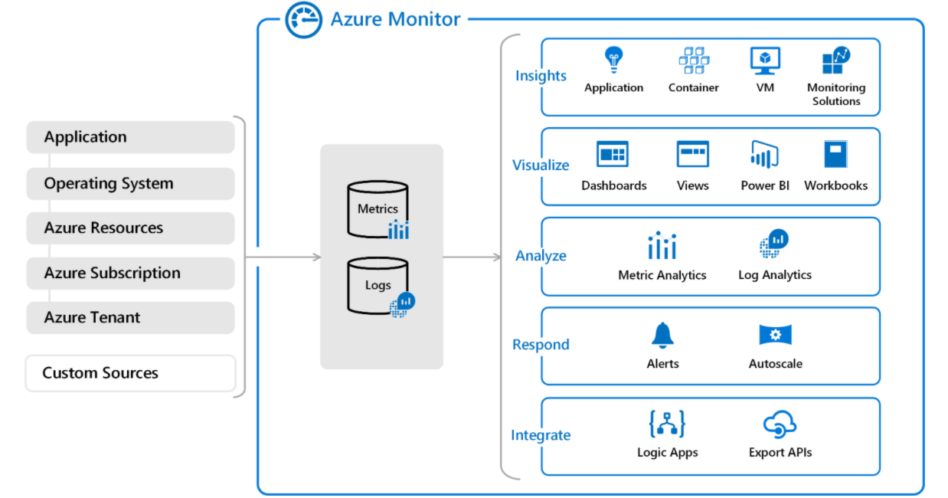
AMDD > Big Picture > Azure Monitor
Azure Monitor
data sources
Azure Monitor services
Azure Monitor Log Analytics workspace

Slide 5
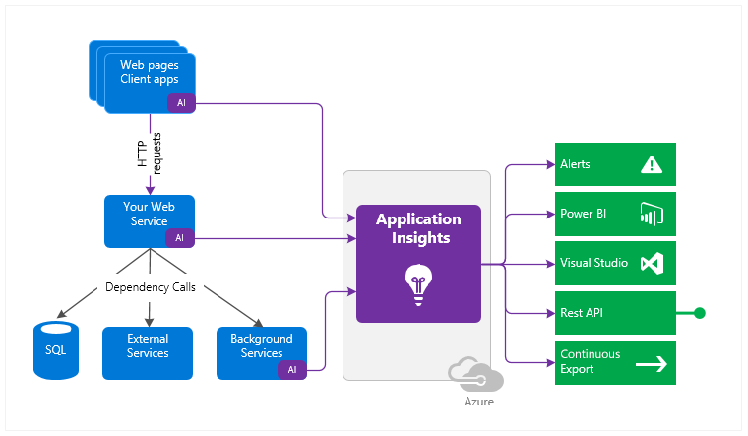
AMDD > Big Picture > Application Insights
Solutions instrumented via Application Insights SDK(s)
Integration Services
Azure Application Insights Resource in Azure

Slide 6

AMDD > Big Picture > Demo

Slide 7

Azure Monitor > Basics

Slide 8

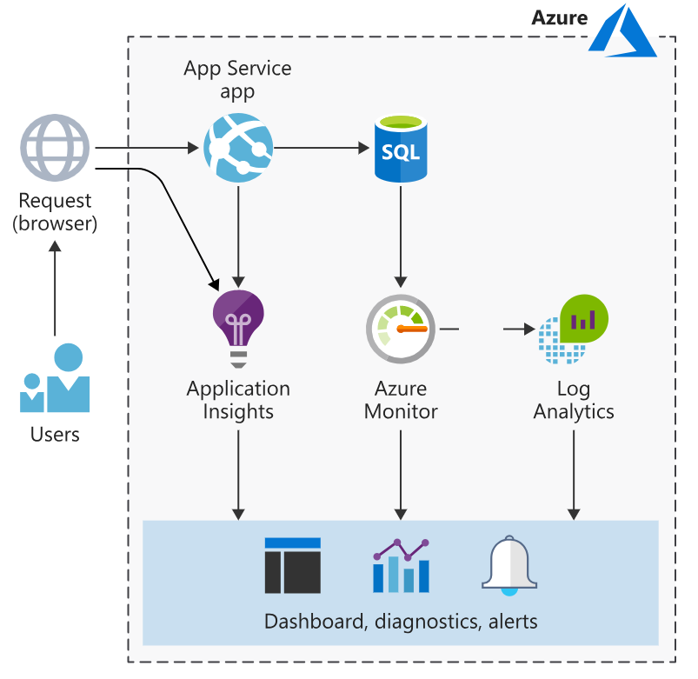
Azure Monitor > Basics > Taxonomy
Agents - are programs designed to ship metrics & logs to Azure Monitor.
Data sources – are processes sending metric & log data via agents and/or SDKs.
Resources – are services created in Azure that are observed by Azure Monitor.
Workspaces – are storage units for metrics & logs.
SDKs – are libraries used to control instrument of your distributed tracing.
Services – Integration services provided by Azure Monitor.

Slide 9
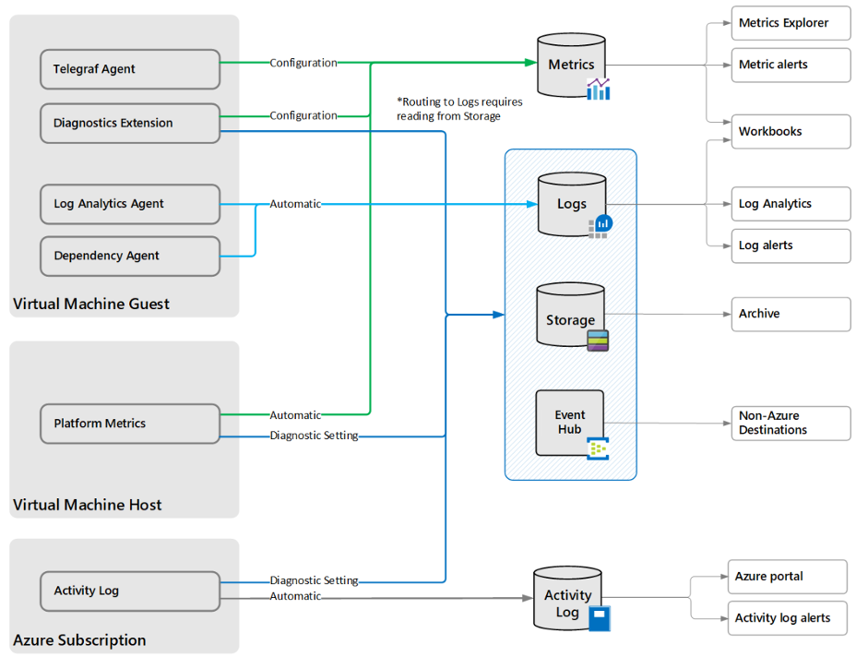
Azure Monitor > Basics > Agents
Log Analytics Agent - targets OS & VMs in Azure, other cloud providers, and on-premises machines.
Azure Diagnostics Extension – targets OS & workloads of VMs and other compute resources.
Telegraf Agent - targets Linux computers.
Azure Monitor Agent – replaces the above from 2024+
Dependency Agent - targets processes running on the machine and external process dependencies.

Slide 10
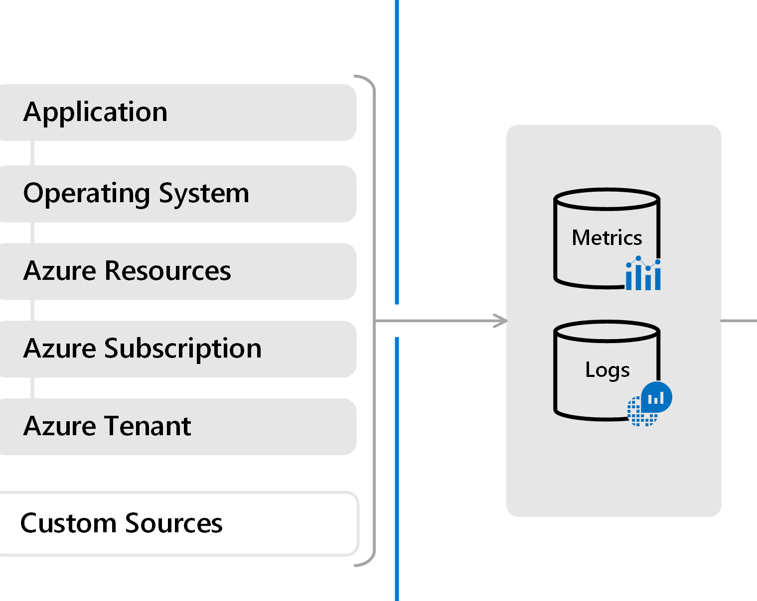
Azure Monitor > Basics > Data Sources
Application – Data from SDK-enabled processes.
OS – Data from OSs orchestrated by Azure.
Resource - Data about the operation and performance of Azure resources (SaaS/PaaS).
Subscription - Data related to the health and management of cross-resource services, e.g. Resource Manager and Service Health.
Tenant - Data about the operation of tenant-level Azure services, e.g. Azure AD.
Custom – Everything else.

Slide 11
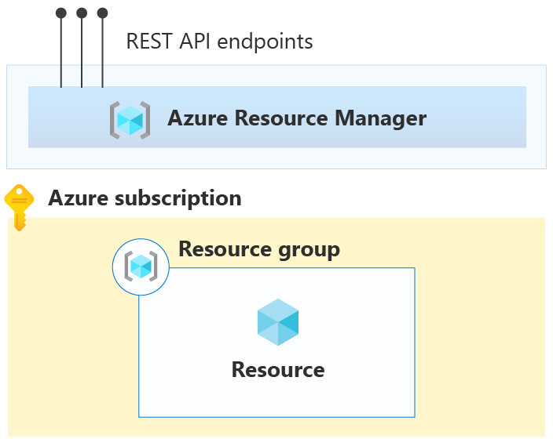
Azure Monitor > Basics > Resources
Activity log - Subscription level events that track operations for each Azure resource.
Platform metrics - Numerical values that are automatically collected at regular intervals and describe some aspect of a resource at a particular time.
Resource logs - Provide insight into operations that were performed by an Azure resource, for example getting a secret from a Key Vault or making a request to a database.

Slide 12
Azure Monitor > Basics > Workspaces
Are the logical storage unit where data is collected and stored.
Contain two databases: logs & metrics.
Provides extensible dashboards & widgets to visualize data.
Uses Kusto Query Language (KQL) to query databases.

Slide 13
Azure Monitor > Basics > SDKs
ASP.NET
ASP.NET Core
NodeJS
JavaScript
App Center (mobile SDK)

Slide 14
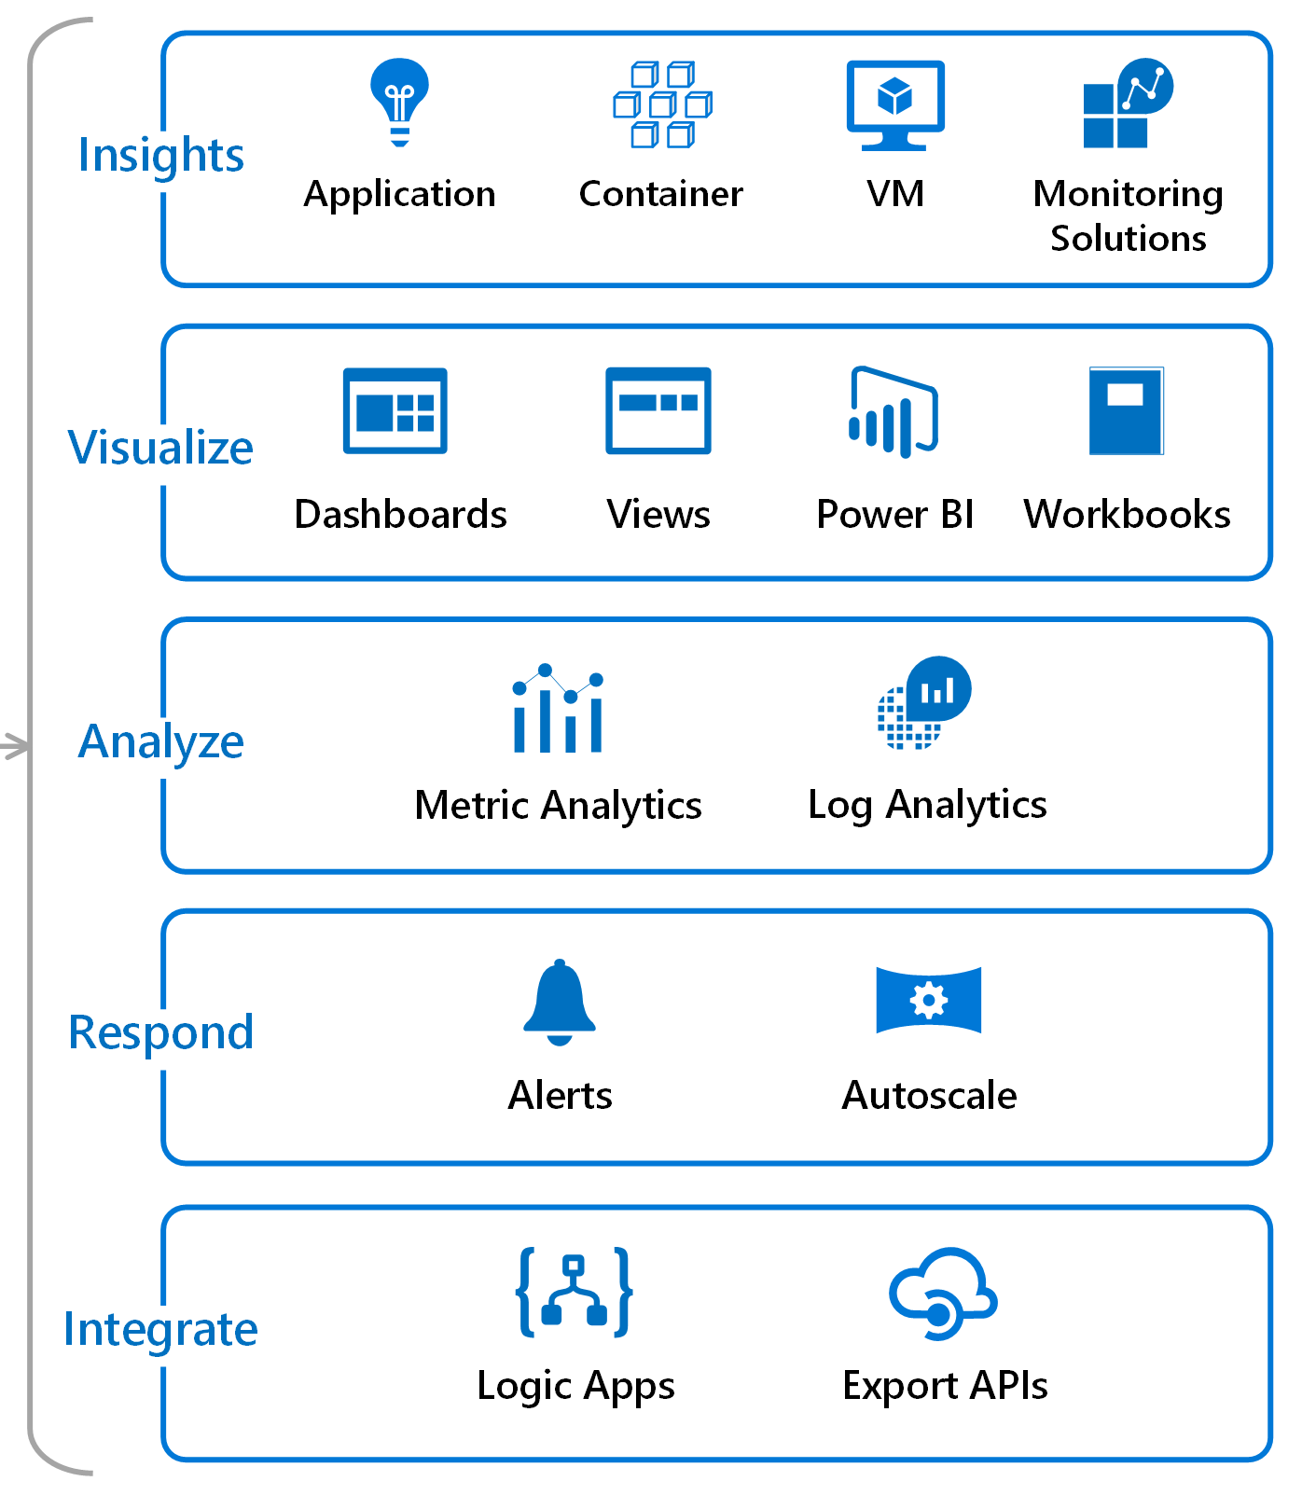
Azure Monitor > Basics > Services
Insights - services responsible for capturing application logs & metrics.
Visualize - services used to visualize data.
Analyze – services available for analyzing data.
Respond – services focused on responding to patterns identified in the data.
Integrate – services related to integrating Azure Monitor with third parties.

Slide 15

Azure Monitor > Basics > Hands-on

Slide 16

Azure Monitor > Basics > Code Kata #1
Notes:
https://www.serverless360.com/blog/azure-log-analytics-workspace (setup workspace)
Create a dashboard with standard CPU metrics
Create simple .net app w. instrumentation

Slide 17

Azure Monitor > Basics > Q/A

Slide 18
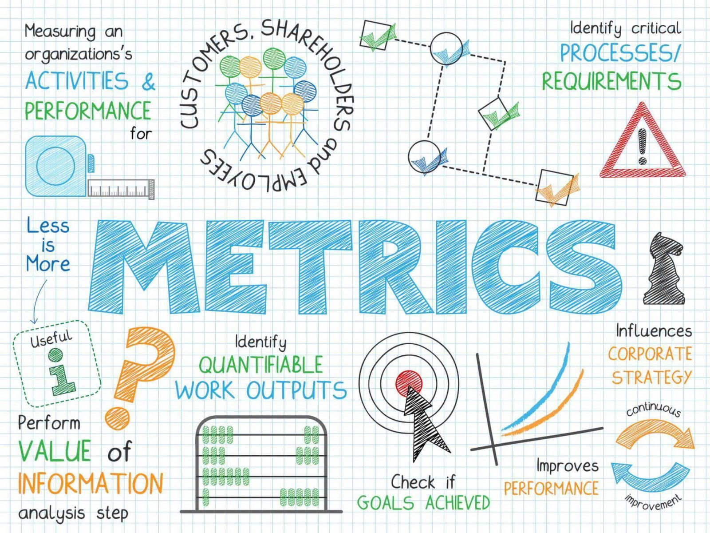
Azure Monitor > Metrics

Slide 19
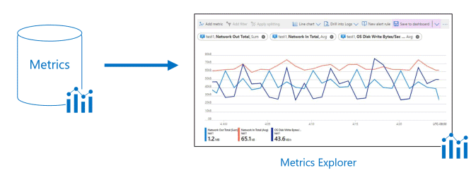
Azure Monitor > Metrics > Metric Explorer
Provides an easy-to-use editor for querying metrics data.
Allows plotting charts, visually correlating trends, and investigating spikes and dips in metrics values.
Support filtering and splitting that are powerful diagnostic tools for the metrics that have dimensions.

Slide 20
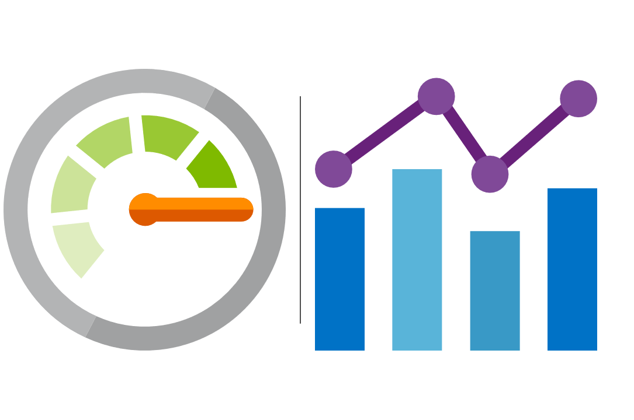
Azure Monitor > Metrics > Guidelines
Must be simple, objective and hard to misinterpret.
Collection should be automated and non-intrusive.
Contributes to quality assessment in the software development lifecycle.
Support RED-metrics when possible - Request Rate, Request Errors & Request Duration.

Slide 21
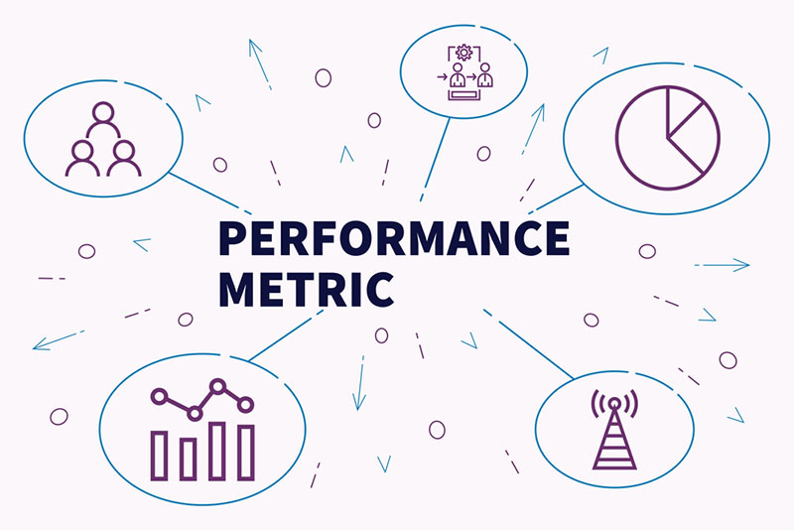
Azure Monitor > Metrics > Types
Log-based (Standard) - available by default in Azure Monitor.
Log-based (Custom) - created on demand via Application Insight SDKs or REST API.
Multi-dimensional - dimensions are name/value pairs that carry additional data to describe the metric value.
Pre-aggregated - are stored as pre-aggregated time series, and only with key dimensions, which makes them superior at query time.

Slide 22
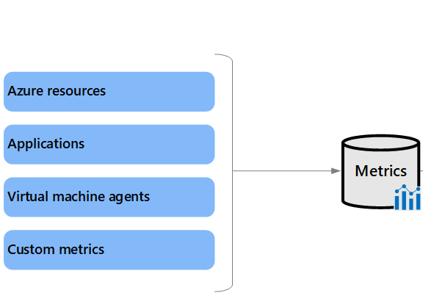
Azure Monitor > Metrics > Source
Azure resources - platform metrics provide visibility into resource health and performance.
Applications Insights - help you detect performance issues and track trends.
Virtual machine agents - collect metrics from the guest operating system of a virtual machine.
Custom metrics - extends the standard metrics that are automatically available in Azure Monitor.

Slide 23
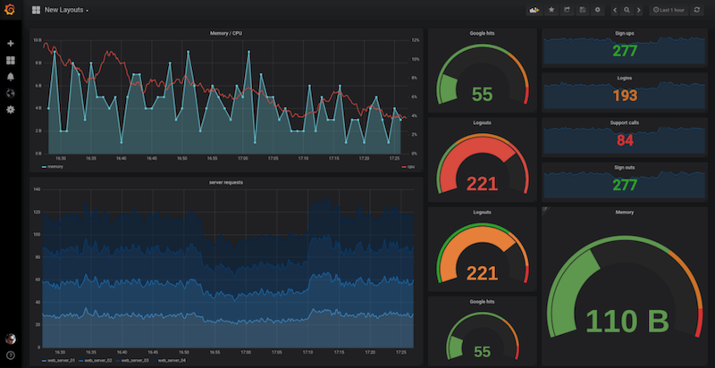
Azure Monitor > Metrics > Quotas and limits
Total active time series in a subscription (across all regions): 50,000
Dimension keys per metric: 10
String length for metric namespaces, metric names, dimension keys, and dimension values: 256 characters

Slide 24
Azure Monitor > Metrics > Hands-on

Slide 25
Azure Monitor > Metrics > Code Kata #2
Notes:
Create custom metrics in .NET app via NuGet package
Setup a simple alert in Azure Monitor based on metrics to send email

Slide 26
Azure Monitor > Metrics > Q/A

Slide 27

Azure Monitor > Logs

Slide 28
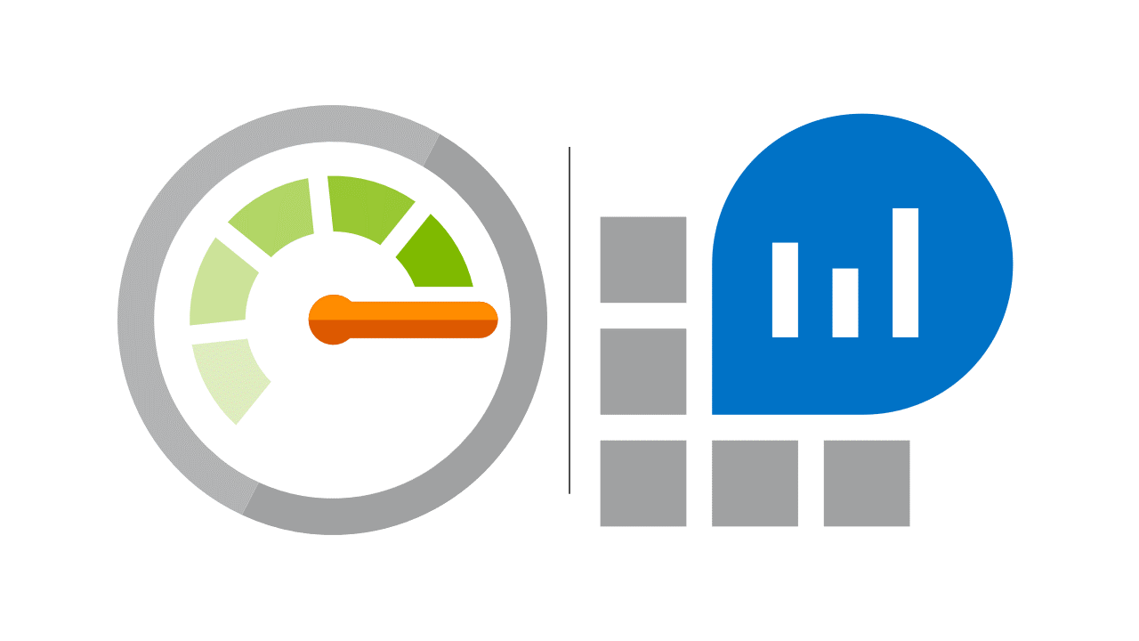
Azure Monitor > Logs
DFDS logging guidelines… [TODO]
Log levels… [TODO]
Log types… [TODO]

Slide 29
Azure Monitor > Logs > Hands-on

Slide 30
Azure Monitor > Logs > Code Kata #3
Notes:
Configure ApplicationInsights Serilog sink
Create a few trace logs
Setup a dashboard to visualize new trace logs

Slide 31
Azure Monitor > Logs > Q/A

Slide 32

Azure Monitor > Alerts

Slide 33

Azure Monitor > Alerts
DFDS alerting guidelines… [TODO]
Standard alerts… [TODO]
Custom alerts… [TODO]
Smart Groups… [TODO]

Slide 34
Azure Monitor > Alerts > Hands-on

Slide 35
Azure Monitor > Alerts > Code Kata #3
Notes:
Setup some advanced alerts in Azure Monitor based on metrics

Slide 36
Azure Monitor > Alerts > Q/A

Slide 37
Azure Monitor > Feedback
https://forms.office.com/Pages/ResponsePage.aspx?id=ZpSpcwWtIUKfkOcUKqL2wTFclz-gNvpNq3THAj1j3ZxUODk1TjlEWVNJNzUxNjAwTFhGQkQ2VkNTWi4u

Slide 38
Azure Monitor > Literature
https://docs.microsoft.com/en-us/azure/azure-monitor/overview
https://docs.microsoft.com/en-us/learn/modules/azure-monitor/
https://docs.microsoft.com/en-us/learn/modules/design-solution-to-log-monitor-azure-resources/
https://docs.microsoft.com/en-us/learn/modules/analyze-infrastructure-with-azure-monitor-logs/
https://docs.microsoft.com/en-us/learn/modules/monitor-app-performance/
https://docs.microsoft.com/en-us/learn/modules/microservices-logging-aspnet-core/

