Slide 1
Event API Deep Dive Updated 22 June 2020

Slide 2
EADD > Agenda
Big picture
Discovery
Q&A
Protocols
Tools

Slide 3
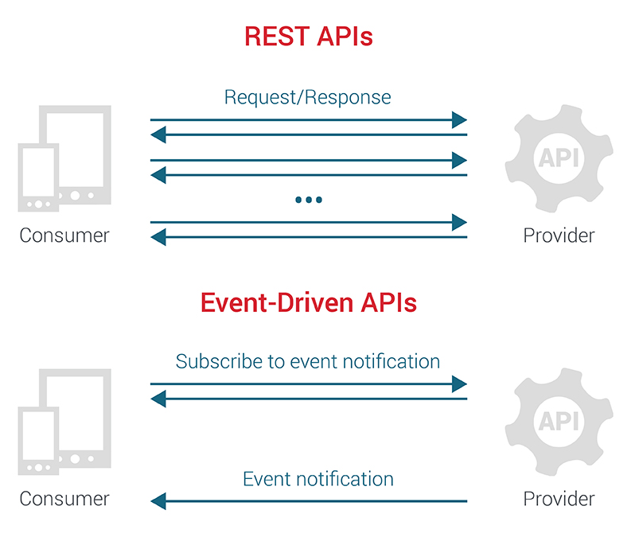
EADD > Big Picture
A mechanism that allows consumers to subscribe to events of their interest.
A mechanism that can deliver events to consumers in an asynchronous manner.
A mechanism that can provide discovery meta-data about its public interface in a standardized manner (e.g. AsyncAPI).
A mechanism that can support multiple protocols like XHR, SSE, WebSockets & gRPC.

Slide 4
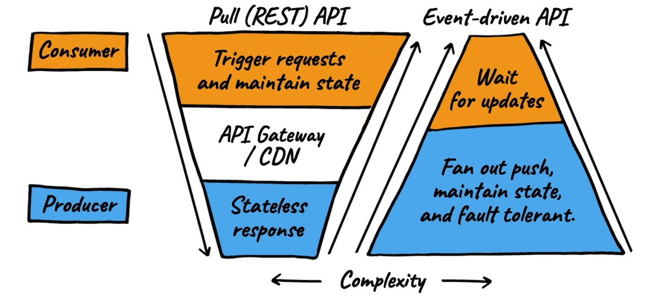
EADD > Big Picture > REST vs Event-driven

Slide 5
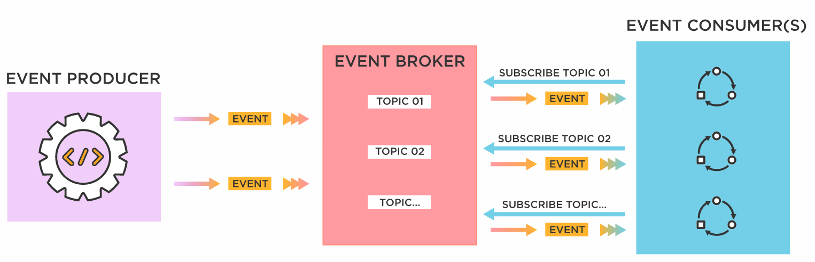
EADD > Big Picture > Event-driven APIs
One or more event producers collaborate to maintain an Event-driven API
Consumers listen events (messages) on topics (channels) from producers
An event broker provides an async delivery mechanism for consumers to subscribe to events from producers

Slide 6

EADD > Big Picture > Demo
Notes:
Websocat demo

Slide 7
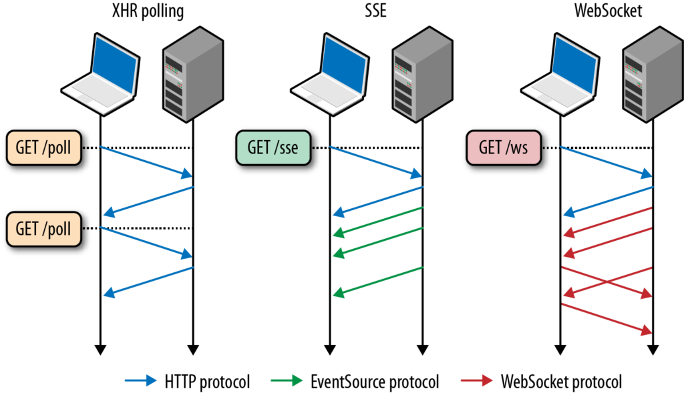
EADD > Protocols

Slide 8
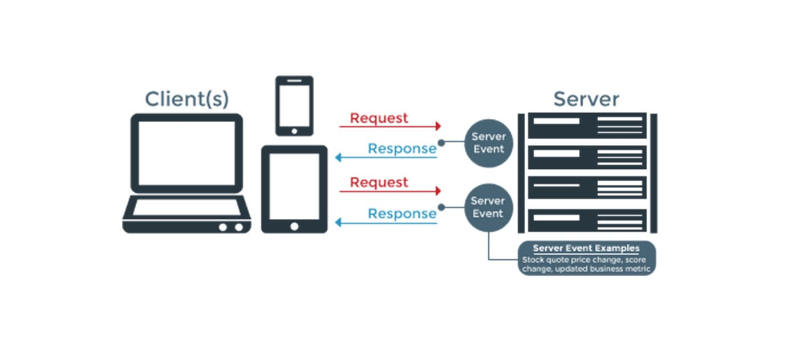
EADD > Protocols > XHR Pooling
A client initiates an XHR/AJAX request to a server.
The server does not immediately respond but waits until there is new information available.
The client receives the response and immediately sends another request to the server restarting the process.
When there is new information available the server responds.

Slide 9
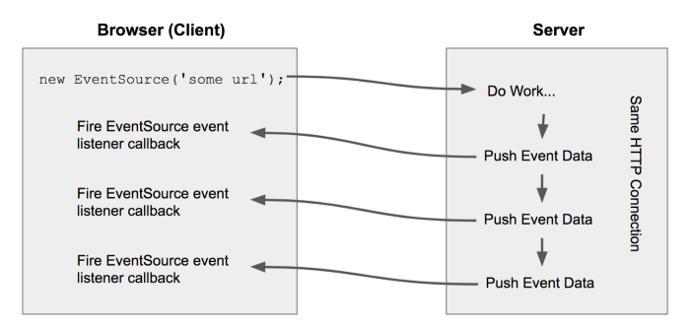
EADD > Protocols > Server Sent Events (SSE)
A client creates a connection to a server via the EventSource API.
The connection is kept alive until either the server or client sends a “close signal” at which point the connection is terminated.
The EventSource API ensures that the server receives a regular “keep-alive” HTTP request from the client to keep the connection open.

Slide 10
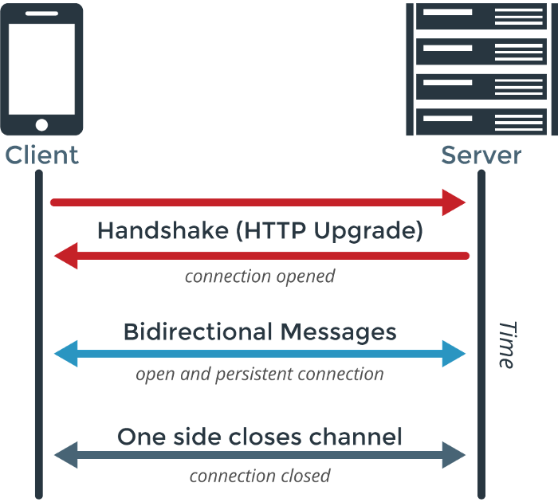
EADD > Protocols > WebSockets
A client initiates a WebSocket handshake process by sending a HTTP upgrade request to a server.
The server receives the HTTP upgrade request and tries to opens a connection to the web client.
If both connections are established successfully full-duplex communication is now available between client and server over TCP. The connection will close once either peer decides to do so.
Upon receiving a successful WebSocket handshake response the web client tries to open a connection to the server.

Slide 11
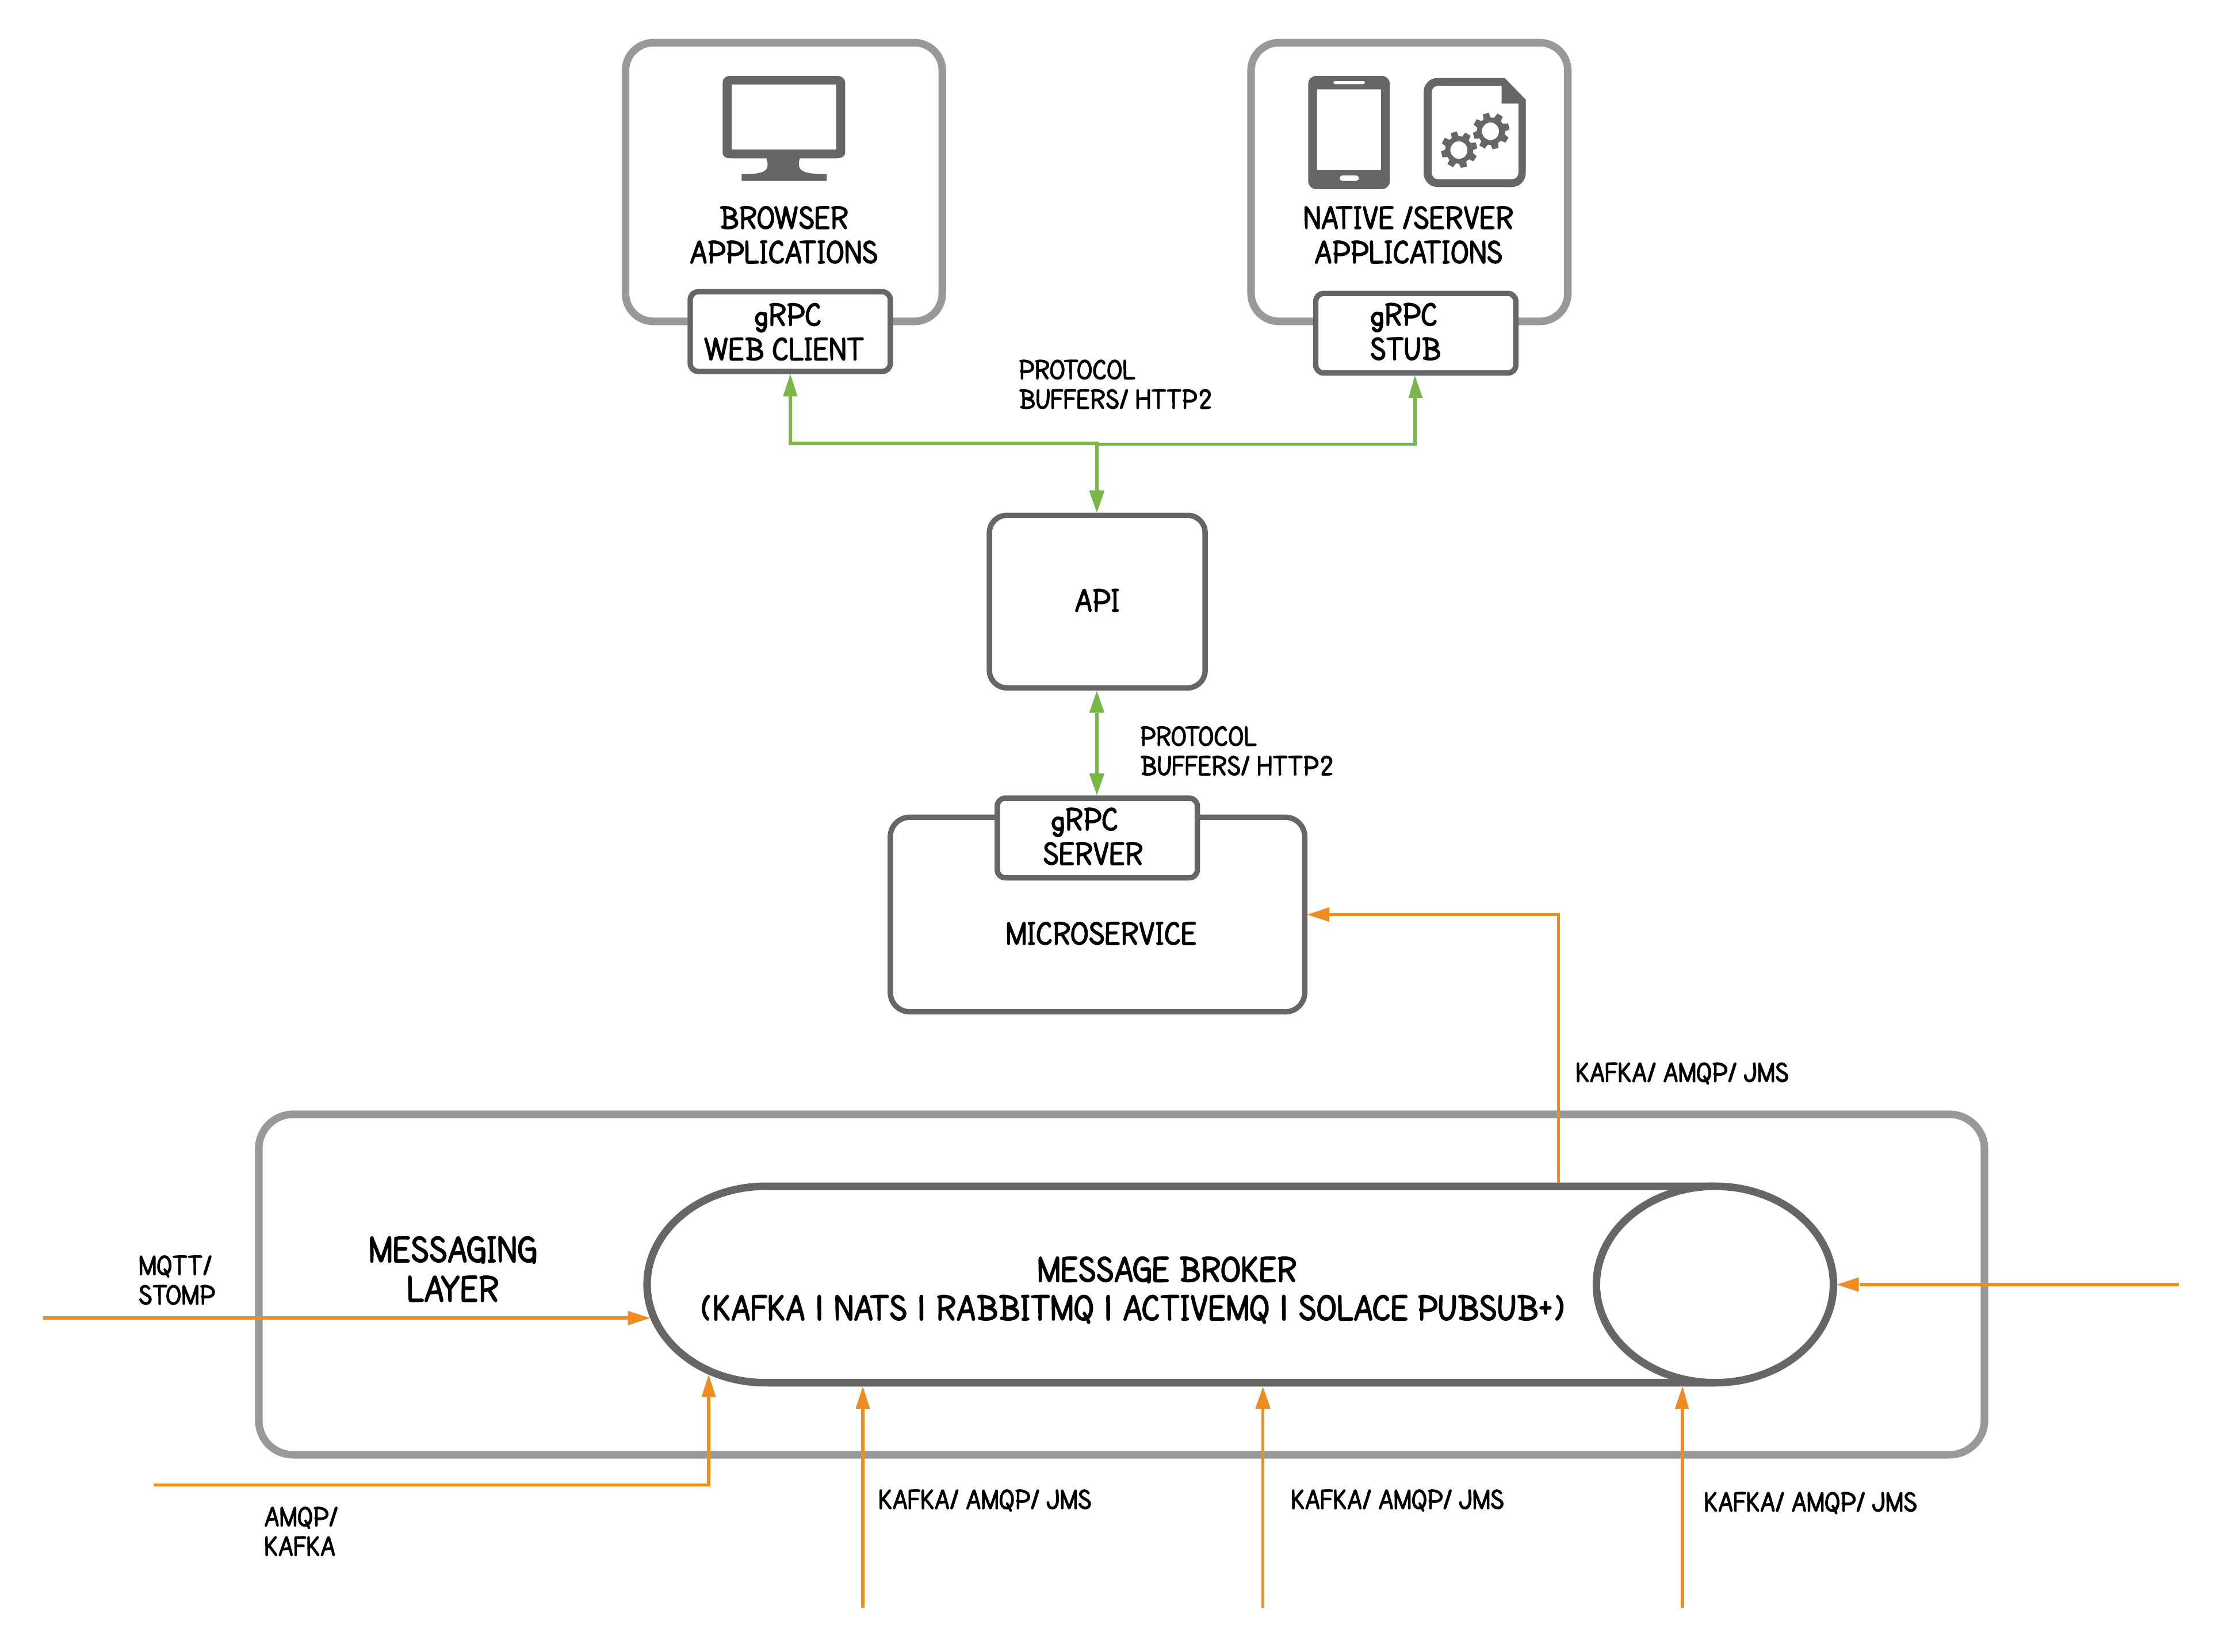
EADD > Protocols > gRPC
gRPC, unbeknownst to many, supports bi-directional streaming because of its ties to HTTP/2. In other words, it allows defining a service operation that either accepts an incoming stream or emits an outgoing stream, or both.
gRPC takes advantage of HTTP/2 and protocol buffers to ensure increased performance and maximum interoperability. In other words, the .proto file acts as the service definition (instead of a Swagger file) and can be used to generate client stubs and server-side skeletons.

Slide 12


EADD > Protocols > Hands-on

Slide 13
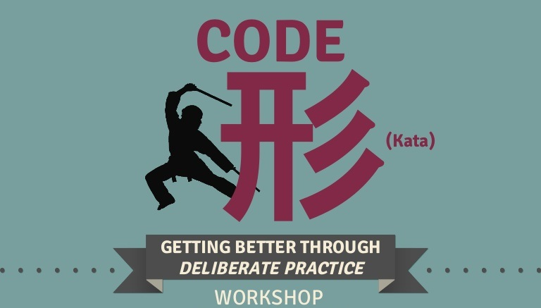
EADD > Protocols > Code Kata #1
Notes:
TODO: long-polling kata
TODO: SSE kata
TODO: WS kata
STRETCH: gRPC kata

Slide 14

EADD > Protocols > Q/A

Slide 15
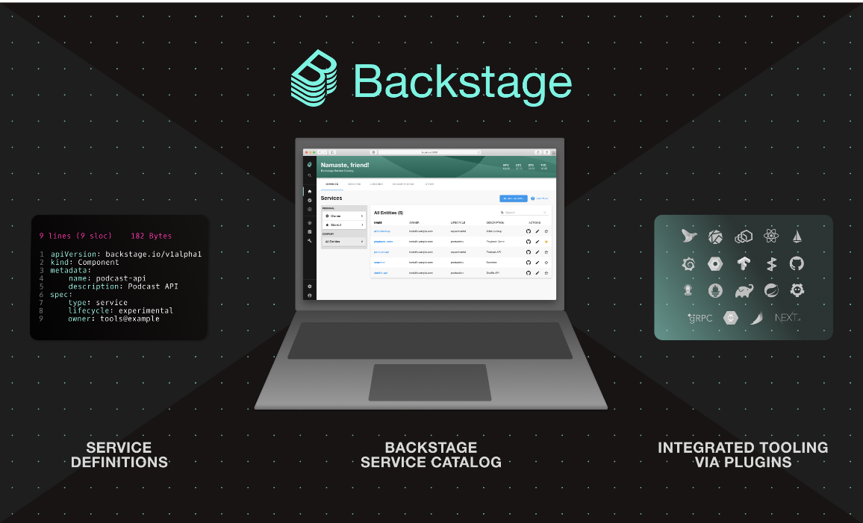
EADD > Discovery
API discovery focus on enabling development efficiency and innovation.
When an API is easy to find, understand & access downstream services become easier to manage.
Your API is your product and your developers and partners are your customers!
API discovery in this context also focuses on providing a service catalog where your downstream teams can find what you have to offer, e.g. Backstage

Slide 16
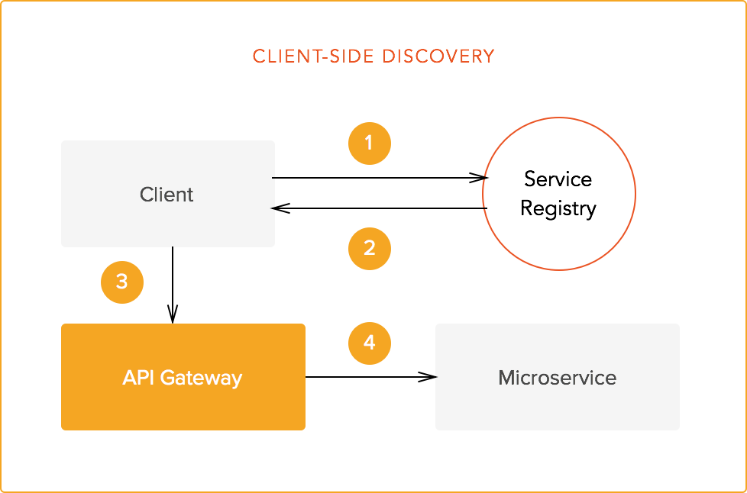
EADD > Discovery > Example
Client queries registry endpoint for API meta-data (swagger, saunter, custom)
Registry endpoints returns requested API meta-data.
Payload is consumed by API synchronously (REST) or asynchronously (Event)
Client sends API payload to service proxy (REST) or broker (Event)

Slide 17
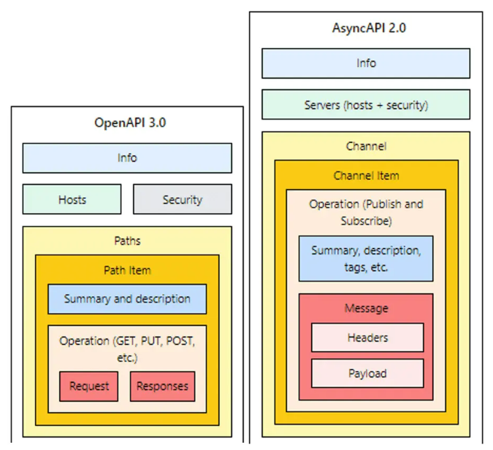
EADD > Discovery > AsyncAPI
AsyncAPI enables code generation in downstream application to create decorator-style-wrappers around upstream APIs which reduces maintenance overhead.
AsyncAPI allows downstream teams to easily validate messages and test upstream APIs via tools like Postman.
Technology-specific bindings defined within a AsyncAPI document can be used to dynamically establish connections and subscriptions to event brokers.

Slide 18
EADD > Discovery > Hands-on

Slide 19
EADD > Discovery > Code Kata #2
Notes:
TODO: Postman + AsyncAPI kata

Slide 20
EADD > Discovery > Q/A

Slide 21

EADD > Tools > kcat
kcat is a generic non-JVM producer and consumer for Apache Kafka >=0.8, think of it as a netcat for Kafka.
In producer mode kcat reads messages from stdin and produces them to the provided Kafka cluster, topic and partition.
In consumer mode kcat reads messages from a topic and partition and prints them to stdout.

Slide 22

EADD > Tools > wscat
wscat is a tool for connecting to and serving WebSockets from the command line.
wscat works on Linux, Windows & Mac.

Slide 23
EADD > Tools > Hands-on

Slide 24
EADD > Tools > Code Kata #3
Notes:
TODO: kcat kata
TODO: wscat kata

Slide 25
EADD > Tools > Q/A

Slide 26
EADD > Feedback
https://forms.office.com/Pages/ResponsePage.aspx?id=ZpSpcwWtIUKfkOcUKqL2wTFclz-gNvpNq3THAj1j3ZxUODk1TjlEWVNJNzUxNjAwTFhGQkQ2VkNTWi4u

Slide 27
EADD > Literature
https://docs.microsoft.com/en-us/dotnet/architecture/microservices/architect-microservice-container-applications/asynchronous-message-based-communication
https://github.com/wso2/reference-architecture/blob/master/event-driven-api-architecture.md
https://www.tibco.com/reference-center/what-is-event-driven-architecture
https://medium.com/system-design-blog/long-polling-vs-websockets-vs-server-sent-events-c43ba96df7c1
https://www.asyncapi.com/blog/async_standards_compare

