Slide 1
Micro frontend architecture Updated 9 January 2020

Slide 2
MFA > Agenda
Solution
Technologies
Roadmap
Benefits
Challenge
Q/A

Slide 3
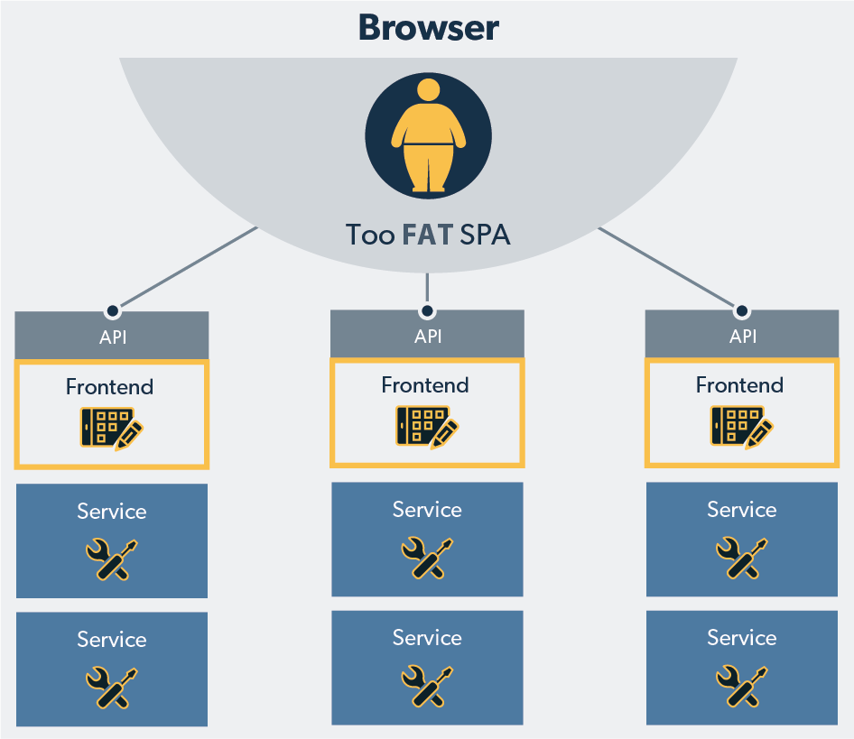
MFA > Challenge

Slide 4
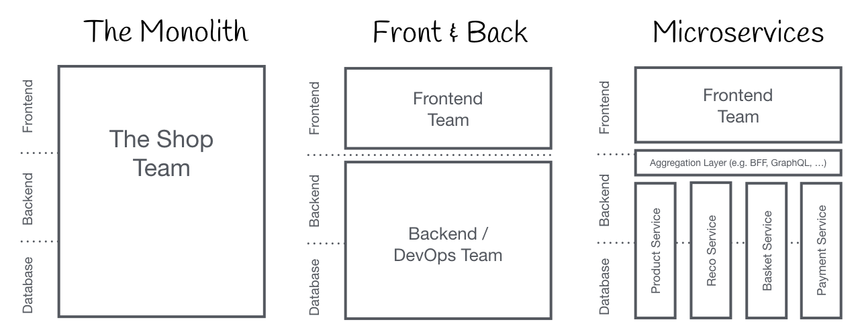
MFA > Challenge > Frontend Monolith

Slide 5
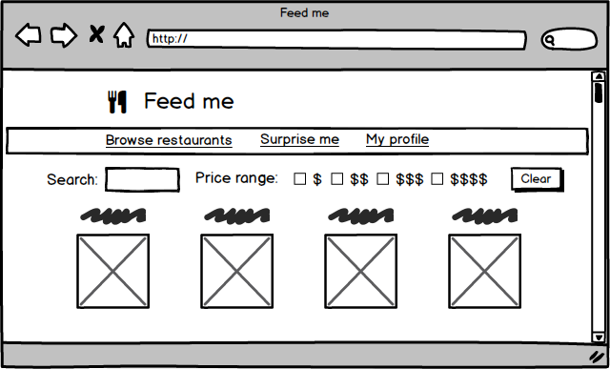
MFA > Challenge > Frontend Monolith

Slide 6
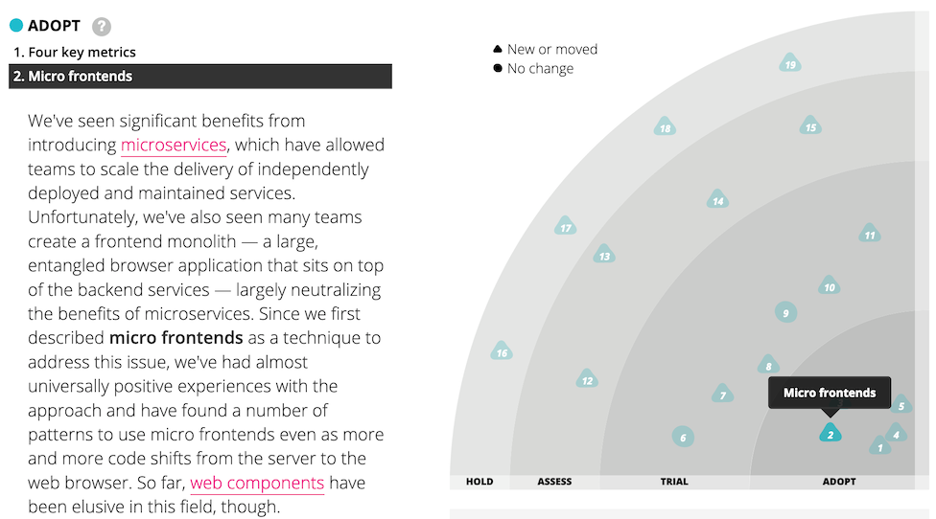
MFA > Solution

Slide 7
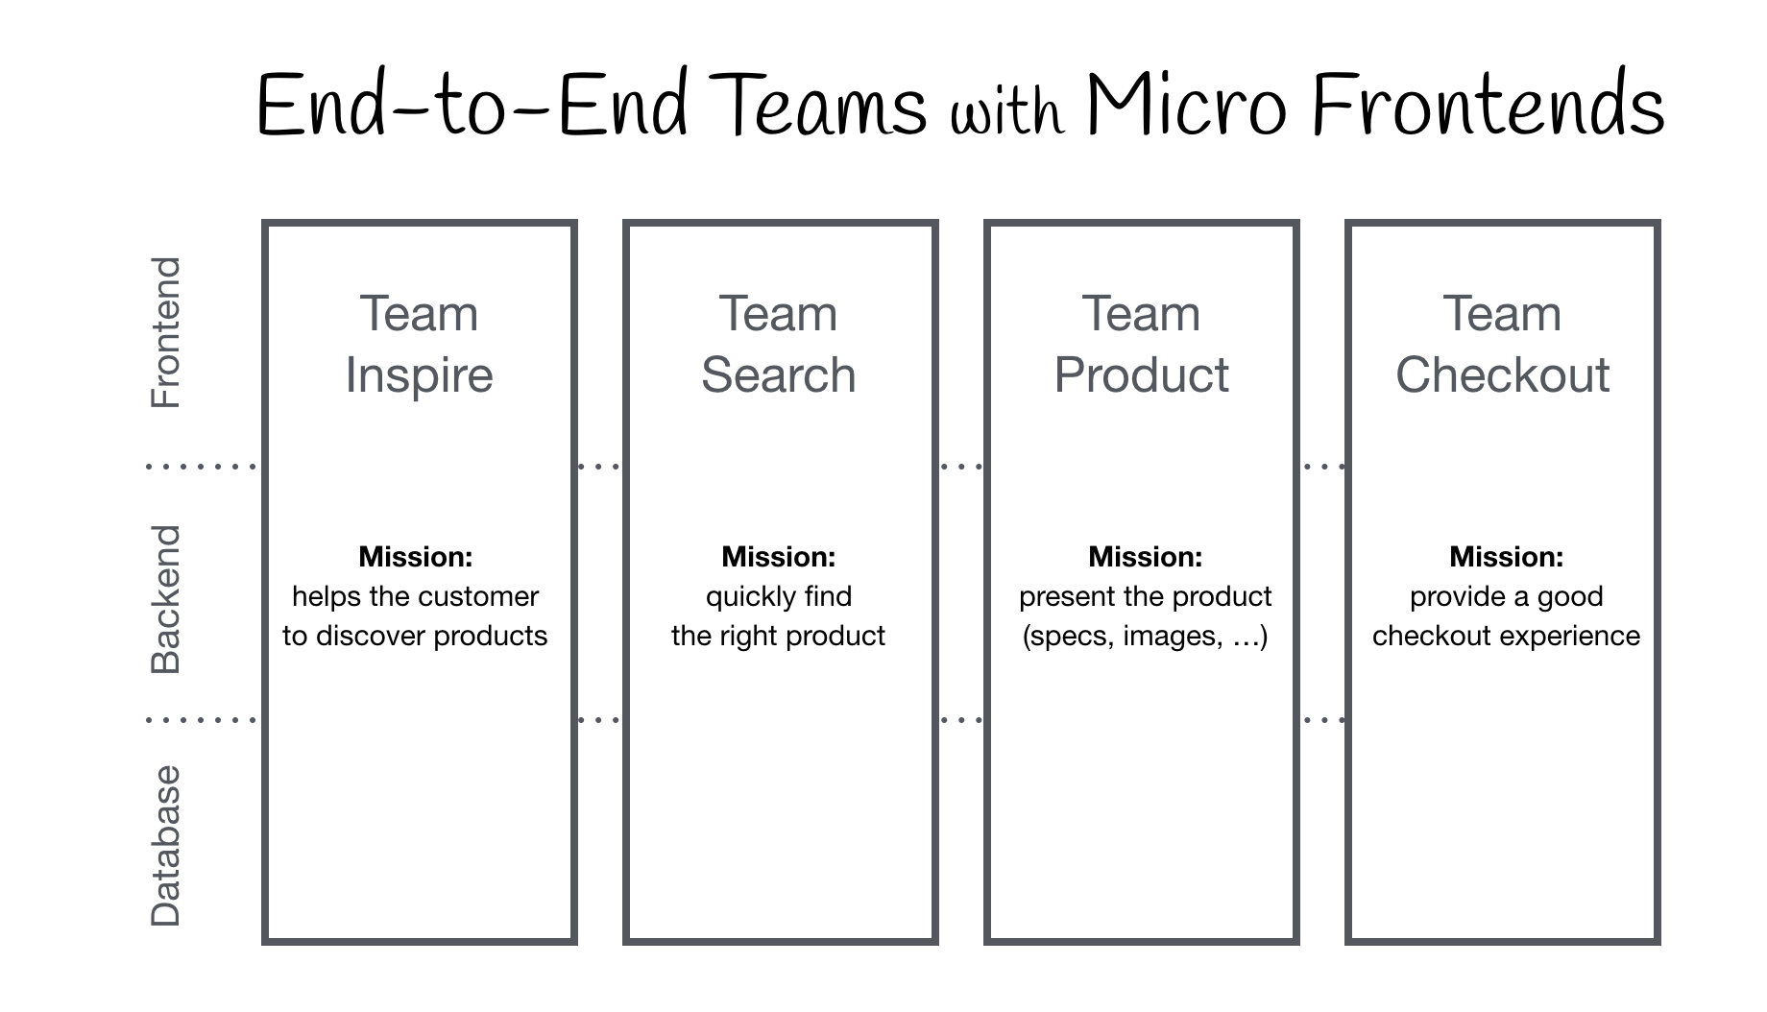
MFA > Solution > Micro Frontends

Slide 8
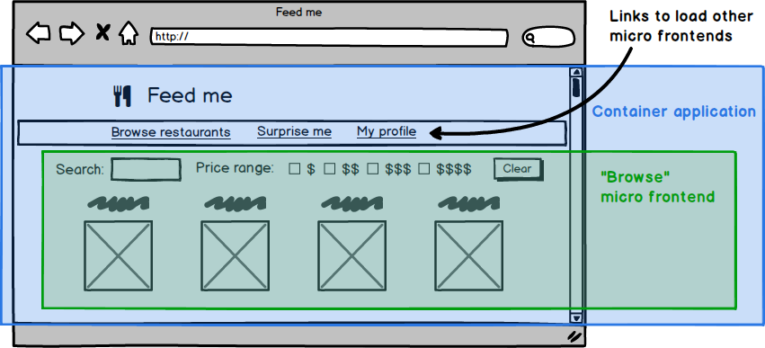
MFA > Solution > Micro Frontends

Slide 9

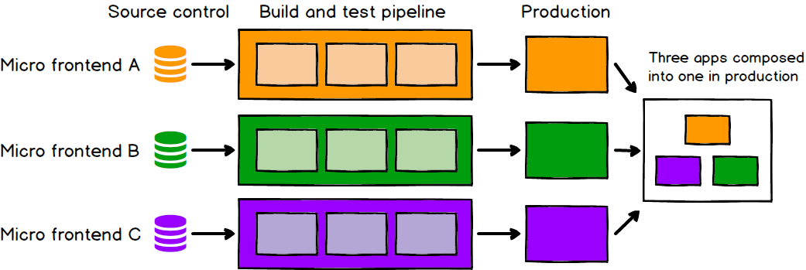
MFA > Benefits > Independent deployment

Slide 10
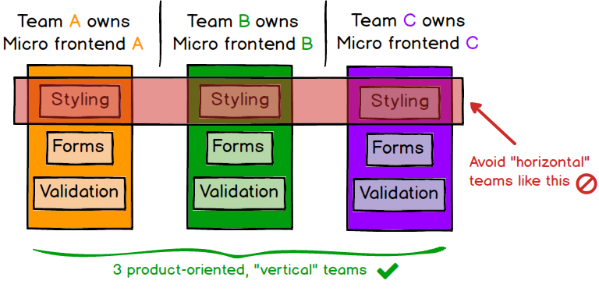
MFA > Benefits > Autonomous teams

Slide 11
MFA > Benefits > And more…
Incremental upgrades
Simple, decoupled codebases
Custom elements enable easy integration with legacy MDI application, modern web apps and native mobile applications
Isolation via shadow DOM protects everyone
Micro frontends communicate via integration events to avoid coupling (can be sourced from external sources as well, e.g. Kafka)
Responsive web design at the element level enables more ”elastic” UIs

Slide 12




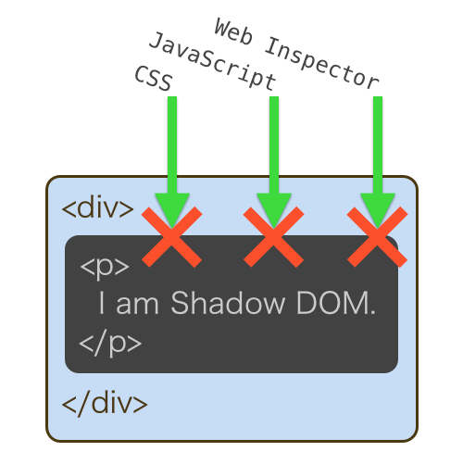

MFA > Technologies
Element Queries

Slide 13
MFA > Literature
https://martinfowler.com/articles/micro-frontends.html
https://micro-frontends.org/
https://www.thoughtworks.com/radar/techniques/micro-frontends
https://medium.com/@casperle13/brief-introduction-to-micro-frontends-architecture-ec928c587727

Slide 14

MFA > Q/A

