Slide 1
Crossplane hack-a-thon Updated 29 October 2021
Notes:
Recorded session

Slide 2
CHAT > Agenda
Agenda
Technology Stack
Q&A
Katas
Audience
Crossplane
Notes:
2 days workshop

Slide 3


CHAT > Agenda
Quick introduction to Crossplane architecture
Try provisioning AWS resources on your local machine via localstack
Create a simple Crossplane composition
Share your composition with the world via a configuration package

Slide 4

CHAT > Audience
Developers
DevOps specialists
Site Reliability Engineers
Data Engineers
System Administrators

Slide 5

CHAT > Crossplane

Slide 6

CHAT > Crossplane > Why?
Allows construction a Control Planes that:
Uses an API that already exists in the organization (Kubernetes)
Provides Out-of-the-box features:
Drift detection
Policy Enforcement
Access Control
Extends easily to provide custom solutions

Slide 7
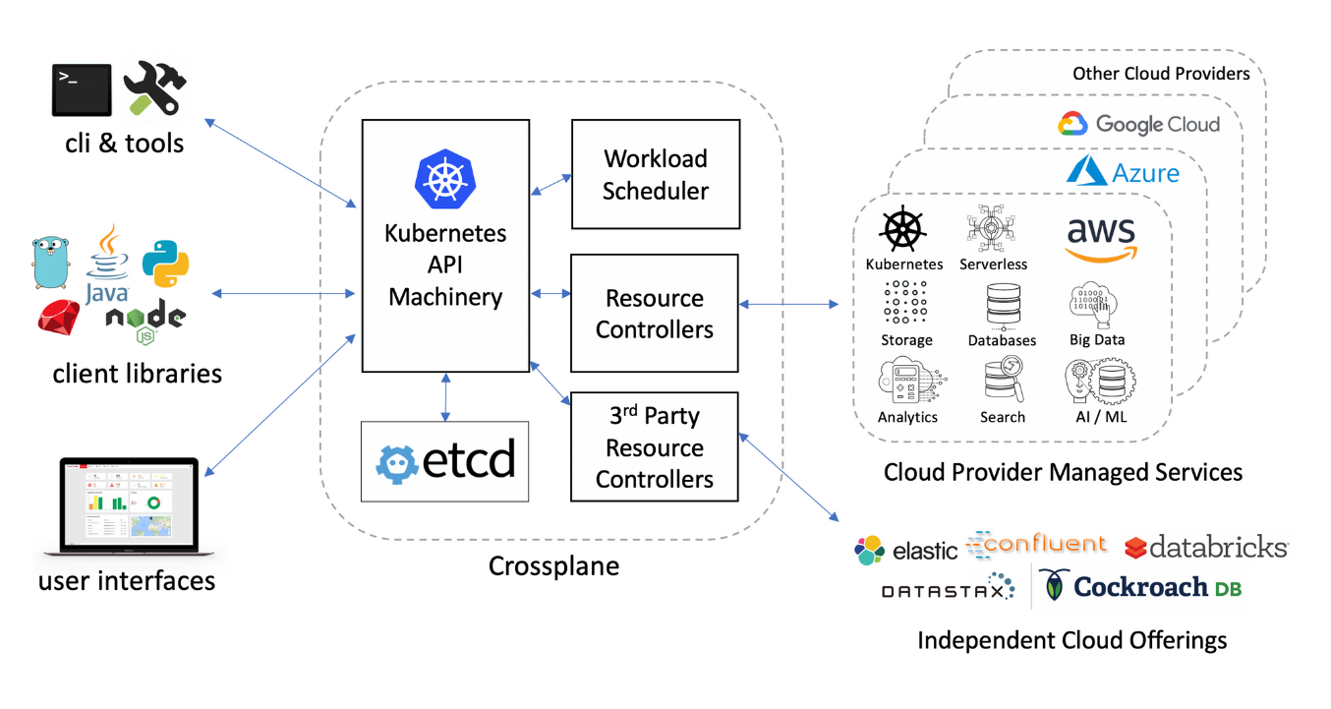
CHAT > Crossplane > What?
Existing tools and frameworks
Use Kubectl, GitOps, or any tools that can talk with the Kubernetes API
Expressing infrastructure in a declarative way, fx YAML manifests
RESTFUL principles
Everything treated as resources in the API (CRDs)
Well defined apis
Standard CRUD operations; GET, UPDATE, DELETE,..
Security and policies can be applied at resource level rather than the workspace level
RBAC
Extension via compositions
Granular resources can be composed into opinionated custome resources and easily consumed by developers e.g. using claim model
Minimal impact from refactoring work
Changes and Upgrades can be done behind the scenes without impacting end users
Dynamic resource provisioning
Eventual consistency model allows creating resources asynchronously
Kubernetes is responsible of keeping track of resource provisioning rather than relying on the pipeline.
No risk of drifting
Reconciliation loop ensures that resources always stays in desired state

Slide 8
CHAT > Technology Stack
KIND CLUSTER
Helm
Go
Localstack
AWS CLI
Crossplane
Provider-AWS
Crossplane CLI
k8scr

Slide 9
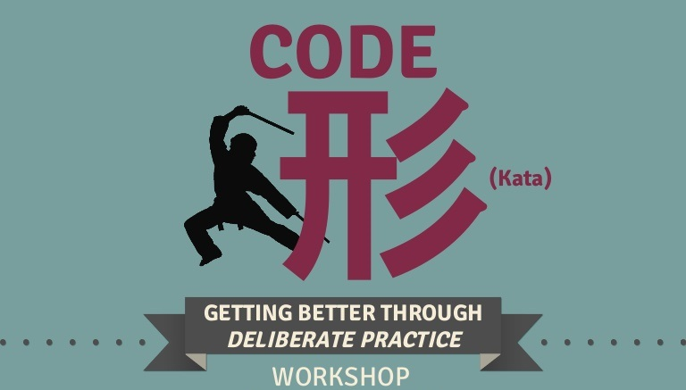
CHAT > Code Kata #1
Notes:
Simple s3 bucket

Slide 10
CHAT > Code Kata #2
Notes:
S3 bucket composition

Slide 11
CHAT > Code Kata #3
Notes:
Simple configuration package for s3 bucket composition

Slide 12

CHAT > Q/A

Slide 13
CHAT > Literature
https://github.com/hasheddan/crossplane-offline
https://github.com/dfds/dojo/tree/master/workshops/crossplane-hackathon
https://docs.microsoft.com/en-us/windows/wsl/install
https://helm.sh/docs/helm/helm_install
https://kind.sigs.k8s.io/docs/user/quick-start
https://golang.org/doc/install

Slide 14
CHAT > Feedback
https://forms.office.com/Pages/ResponsePage.aspx?id=ZpSpcwWtIUKfkOcUKqL2wTFclz-gNvpNq3THAj1j3ZxUMTExQjA2SEFOVjhGRVY3TFJTMk81SUUzSS4u

