Slide 1
Micro frontend architecture Deep Dive Updated 24 September 2020

Slide 2
MFA > Agenda
Big picture
Web Components
Q&A
MinionsJS

Slide 3
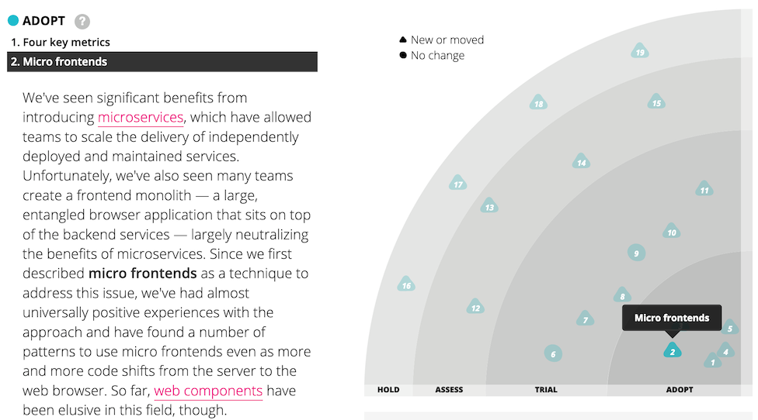
MFA > Big Picture

Slide 4
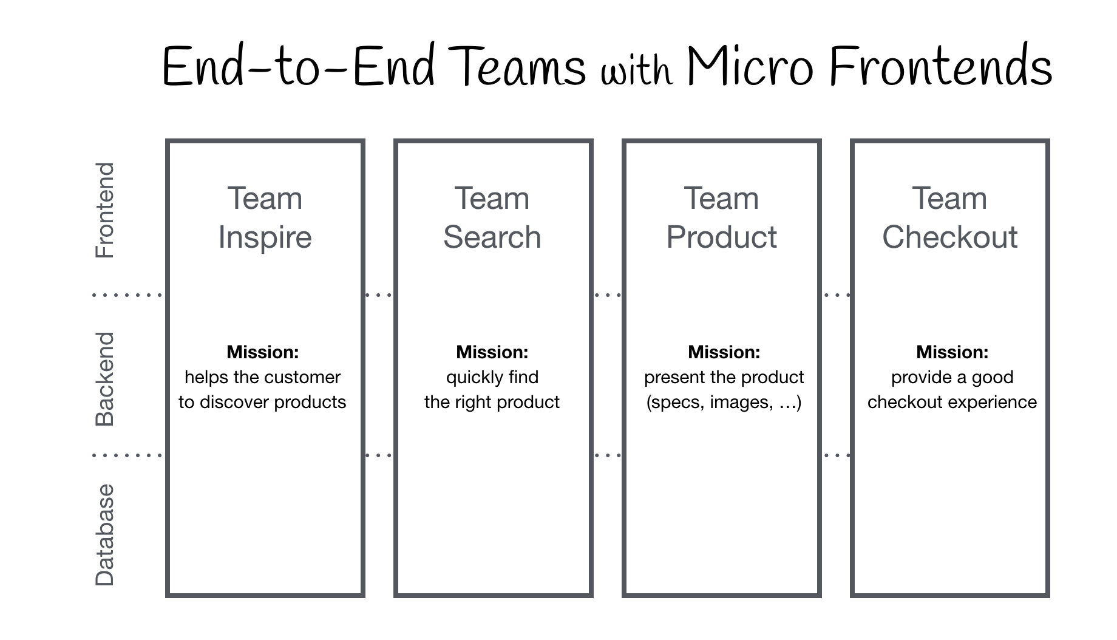
MFA > Big Picture > Proposal

Slide 5


MFA > Big Picture > UI microservices

Slide 6
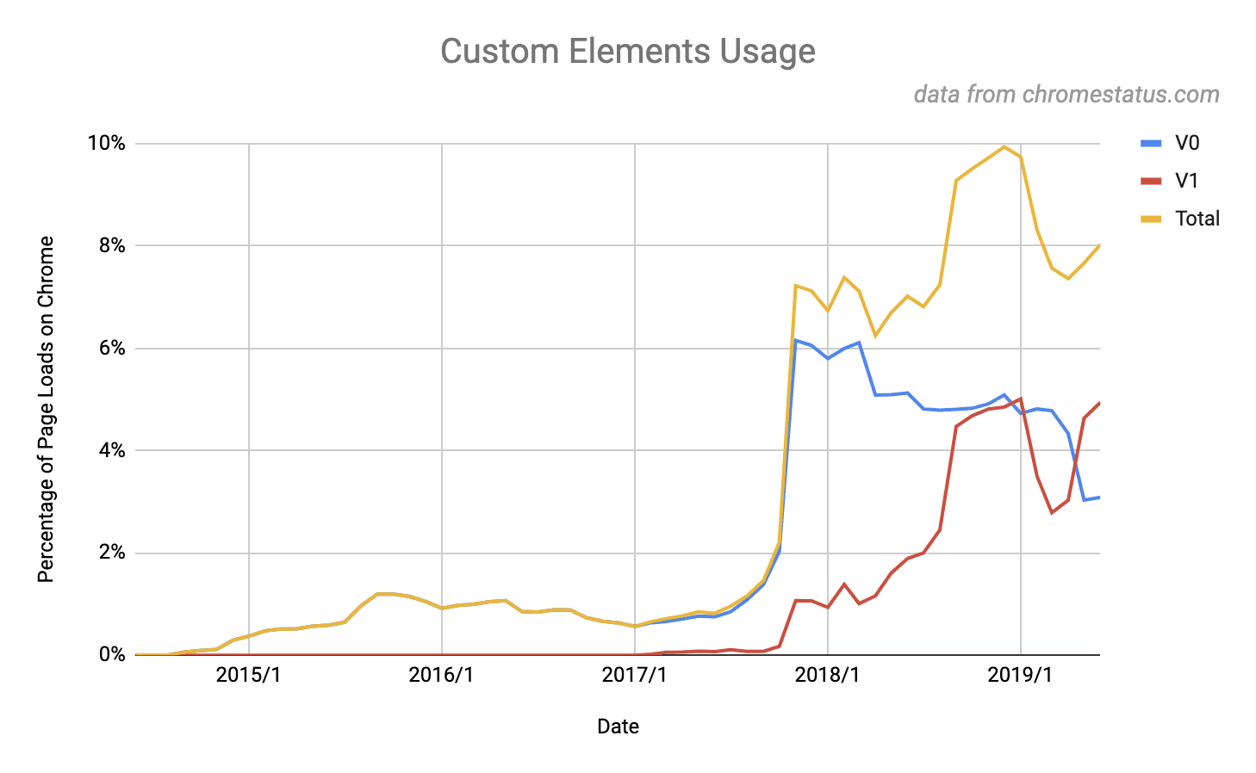
MFA > Big Picture > Usage metrics

Slide 7

MFA > Web Components
The W3C specifications can be used individually or combined to allow us to define our own tags, whose styles are encapsulated and isolated, which can be re-stamped many times and have a consistent integration model.
Web components is a meta-specification made possible by four other W3C specifications

Slide 8
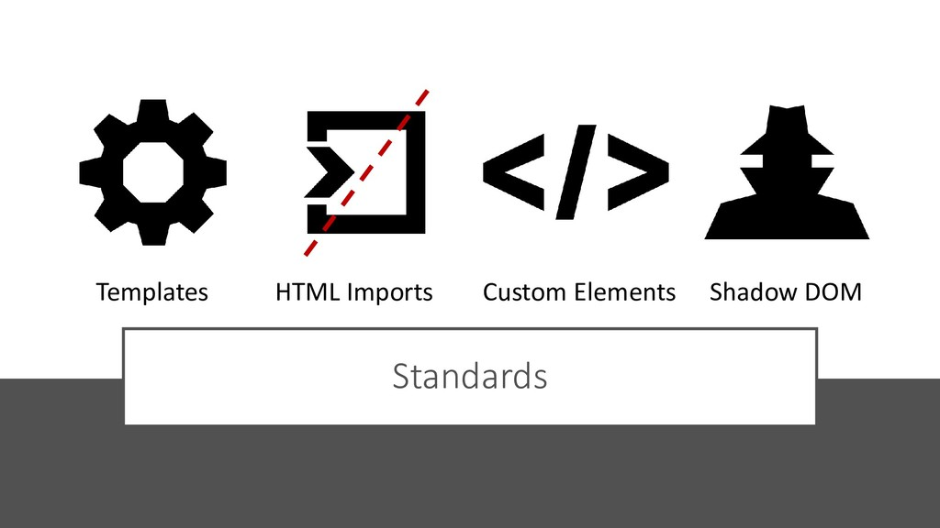
MFA > Web Components > A bundle of standards

Slide 9

MFA > Web Components > Interoperability

Slide 10

MFA > Web Components > Interoperability

Slide 11

MFA > Web Components > Demo

Slide 12
MFA > Web Components > Templates
The template specification allows us to declare fragments of HTML that can be cloned and inserted in the document by scripts.
Content within <template></template> tags:
Will not render until it is activated.
Has no effect on other parts of the page - scripts won’t run, images won’t load, audio won’t play - until activated.
Will not appear in the DOM.
Templates can be placed anywhere in <head>, <body> or <frameset> and can contain any content that is allowed in those elements.

Slide 13

MFA > Web Components > Templates > Hands-on

Slide 14

MFA > Web Components > Templates > Hands-on

Slide 15
MFA > Web Components > Imports
HTML Imports, or just imports, are HTML documents that are linked as external resources from another HTML document. As such the following logic applies when dealing with imports:
The document that links to an import is called an import referrer.
In each import referrer, an import is represented as a Document, called the imported document.
An import referrer that is not an import, thus is not associated with any import referrer, is called a master document.
Each import is associated with one master document. If the import referrer is a master document, it becomes the master document of the associated import.

Slide 16
MFA > Web Components > Imports > Hands-on

Slide 17
MFA > Web Components > Imports > Hands-on

Slide 18
MFA > Web Components > Custom Elements
The Custom Elements specification lays the foundation for designing and using new types of DOM elements that are fully-featured and re-usable. Thus enabling developers to create:
Autonomous custom elements with custom behaviors and styles, defined entirely by the author.
Plug & play components that can integrated in any HTML5-enabled context.
Extensibility of existing HTML elements with new functionality as custom elements inherit semantics from the elements they extend.

Slide 19
MFA > Web Components > Custom Elements > Hands-on

Slide 20
MFA > Web Components > Custom Elements > Hands-on

Slide 21
MFA > Web Components > Shadow DOM
Shadow DOM is a specification designed as a tool for building component-based apps. Therefore, it brings solutions for common problems in web development:
Isolated DOM - A component's DOM is self-contained.
Scoped CSS - CSS defined inside shadow DOM is scoped to it. Style rules don't leak out and page styles don't bleed in.
Composition - Design a declarative, markup-based API for your component.
Simplifies CSS - Scoped DOM means you can use simple CSS selectors, more generic id/class names, and not worry about naming conflicts.
Productivity - Think of apps in chunks of DOM rather than one large (global) page.

Slide 22
MFA > Web Components > Shadow DOM > Hands-on

Slide 23
MFA > Web Components > Shadow DOM > Hands-on

Slide 24
MFA > MinionsJS
MinionsJS is a lightweight framework focused on providing simple abstractions for key concepts such as web components, “transient events” and UI telemetry via a set of “prototypes” that tie together modern web standards with the aim of empower developers that want to built re-usable UI components which can be used anywhere and adhere to the general principles of our Composable Architecture.
MinionsJS achieve this through providing a “opinionated wrapper” around the lit-elements framework, a simple plugin API and a number of “extension points” to ensure compatibility with mainstream frameworks such as React, Angular and VueJS.

Slide 25
MFA > MinionsJS > Hands-on

Slide 26
MFA > MinionsJS > Hands-on

Slide 27

MFA > Q/A

Slide 28
MFA > Literature
https://micro-frontends.org/
https://www.spec-india.com/blog/micro-frontend
https://www.webcomponents.org/specs
https://medium.com/the-web-tub/why-web-components-matter-interview-with-taylor-savage-googles-polymer-project-d25002729d3a
https://hackernoon.com/front-end-microservices-with-web-components-597759313393
https://github.com/dfds/micro-frontend-poc

