Slide 1
Repository, Generic Repository, Unif Of Work, Façade
Barış Tutakli

Slide 2
Repository Pattern
The repository pattern is often used with ORM tools to handle the operations in the data access layer. When we use this pattern, we decrease the load in the application layer, separate concerns and make the test easier.
What is the difference between value a object and entity(model)?

Slide 3

Code Samples
Blog Project
Post
Tag
Entities
Comment
Category

Slide 4
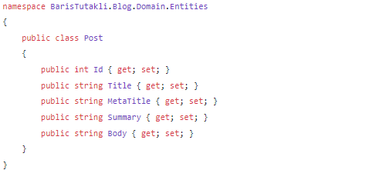
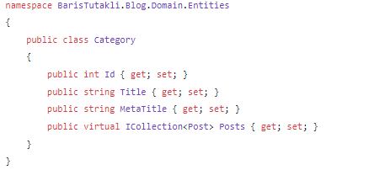
Post
Category
What is the next step?

Slide 5
What do we need to do in a blog Project?

Slide 6
What do we need to do in a blog Project?
Get a post by a specific id
Get all posts
Add a new post
Update a specific post
Delete a specific post

Slide 7
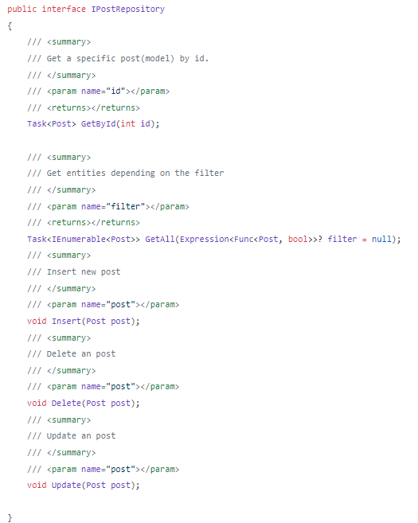

Slide 8
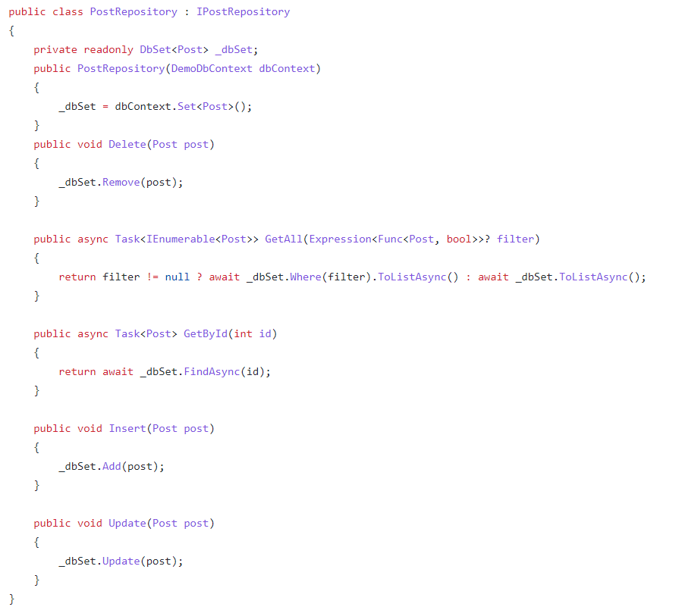
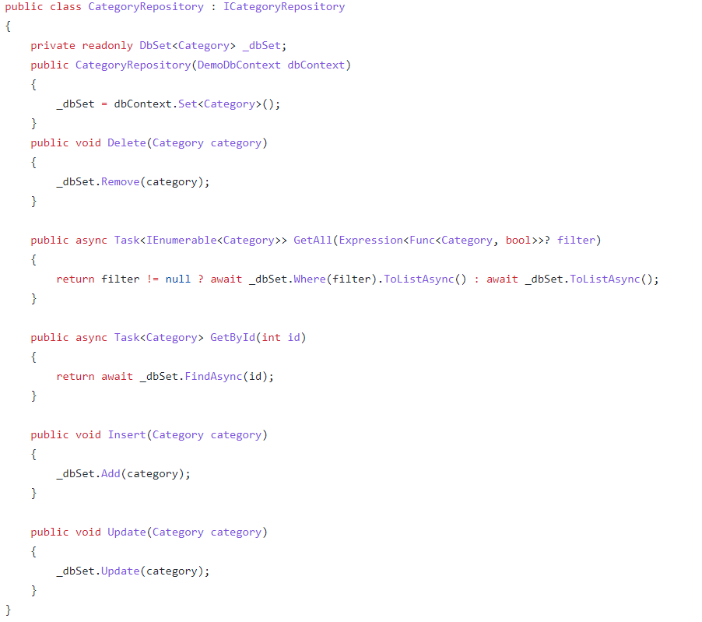
Find out the differences between them

Slide 9
If we make everything generic, what will happen?

Slide 10
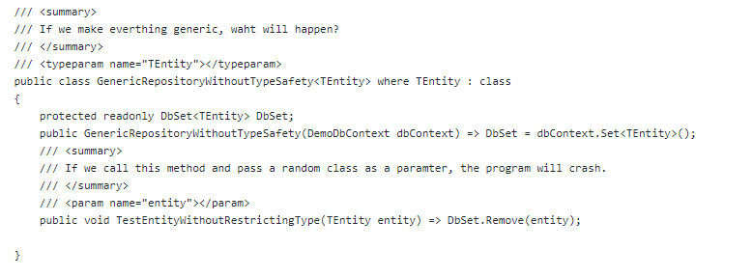
If we make everything generic, what will happen?

Slide 11
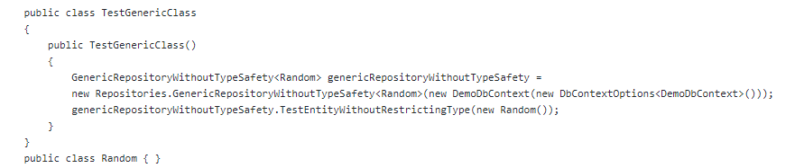
If we make everything generic, what will happen?

Slide 12
If we make everything generic, what will happen?
As our entities are classes, we can restrict our generic repository with class and new() keywords that will restrict someone to put any type. Why not restrict the generic repository by a base type? Let’s restrict again our generic class using a base entity type that will be inherited by all the entities

Slide 13
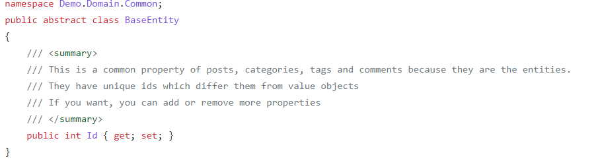
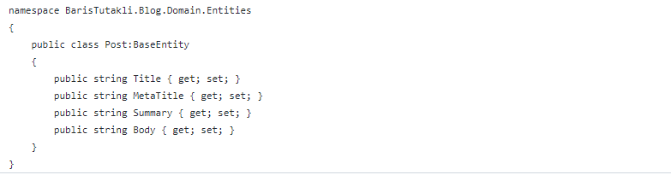

Slide 14
Imlpementation of generic repository Pattern

Slide 15
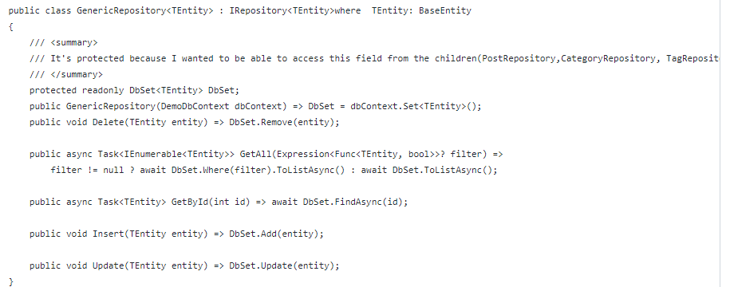

Slide 16
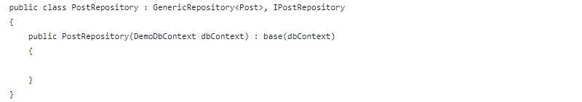

Slide 17
İnjection of DbContext Into Controller

Slide 18
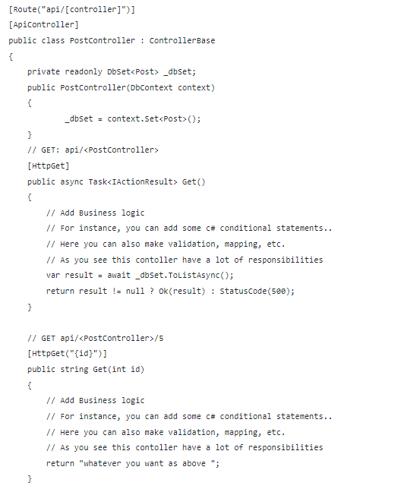

Slide 19
İnjection of Post Repository Into Controller

Slide 20
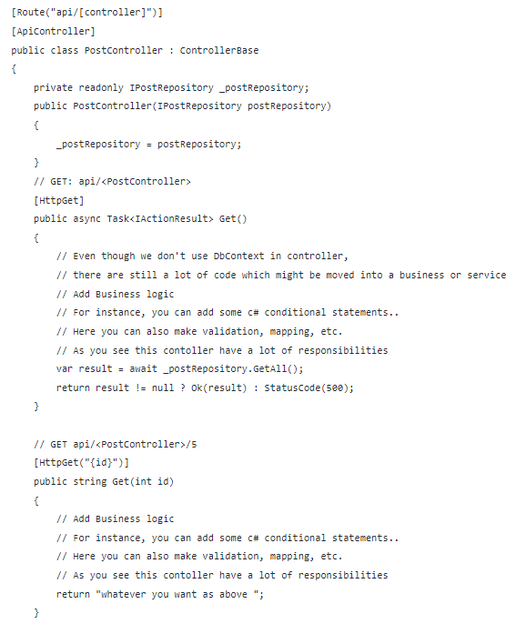

Slide 21
What will happen if you inject more than one repository Into Controller?

Slide 22
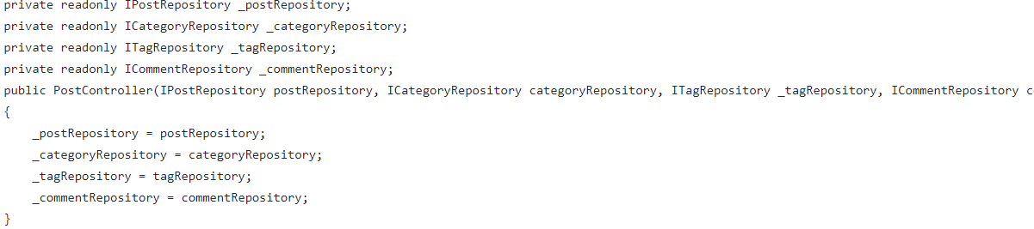
What will happen if you inject more than one repository into post controller?

Slide 23
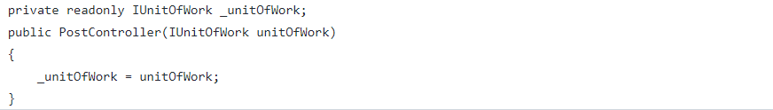
İnjection of Unit Of Work Into PostController
_unitOfWork.Posts.Get() and _postRepository.Get() will do the same thing
_unitOfWork.Categories.Get() and _categoryRepository.Get() will do the same thing

Slide 24
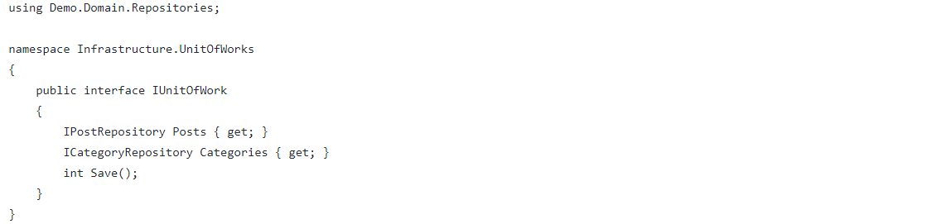
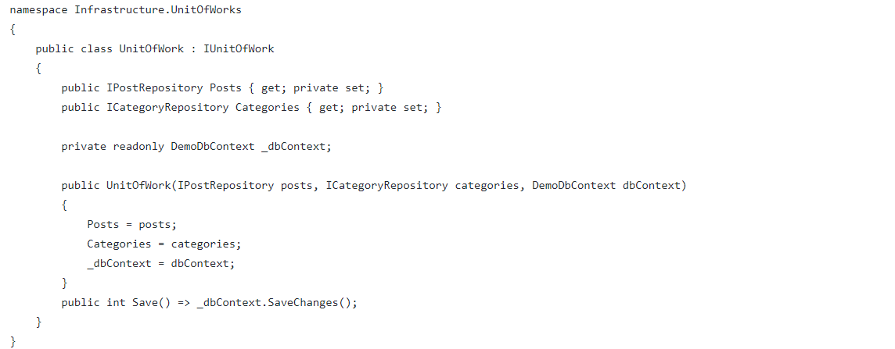

Slide 25
Thanks

