Slide 1
PTD Generator
From Protocol & eCRF to PTD Excel
Notes:
Introduce the PTD Generator: converts protocol and eCRF inputs into a consolidated Excel workbook.
Stack: Flask API, minimal frontend, modular pipeline.
Deck summarizes architecture, APIs, setup, demo and next steps.

Slide 2
Project Overview
Purpose: transform protocol/eCRF into a PTD workbook
Value: consistent handoff, faster study setup
Scope: JSON structuring + PTD generation
Status: old repo is reference; updated modules in PTD_Gen/
Notes:
Standardize how protocol and eCRF content becomes an actionable PTD.
Automation reduces manual errors in SoA and forms matrices.
JSON inputs build an Excel workbook combining schedule and study‑specific forms.
Endpoints preserved; pipeline reorganized under PTD_Gen for maintainability.

Slide 3
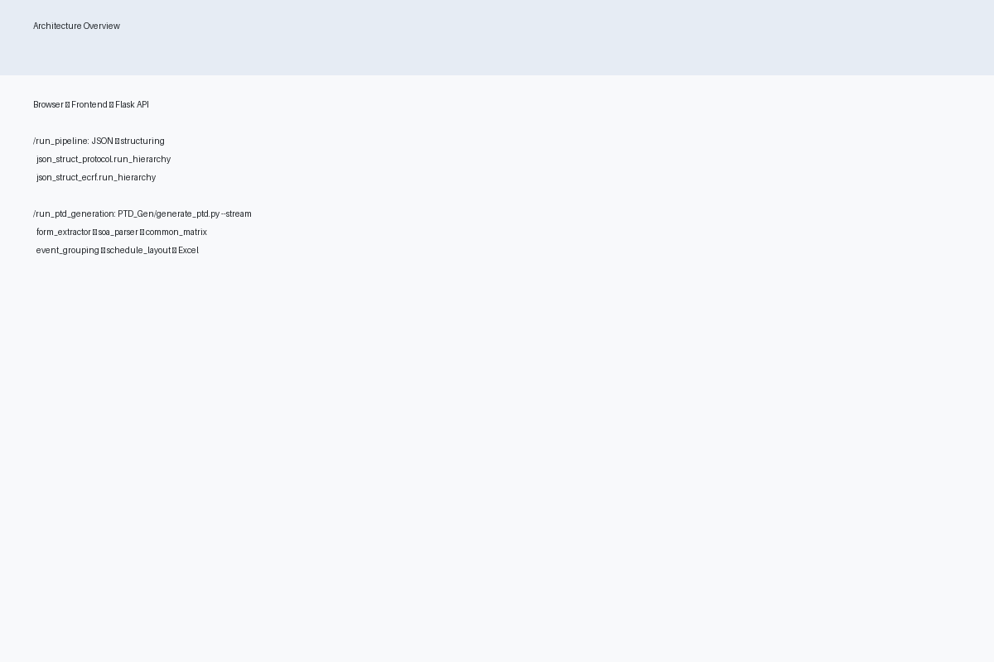
High‑level Architecture
Frontend posts to Flask API endpoints
Structuring: json_struct_protocol/json_struct_ecrf
Generation: PTD_Gen/generate_ptd.py --stream
Notes:
UI uploads files or posts JSON to routes also usable by scripts.
Structuring normalizes protocol and eCRF JSON into a consistent hierarchy.
Single CLI orchestrates extraction, parsing, merging, grouping, and layout via stream mode.

Slide 4
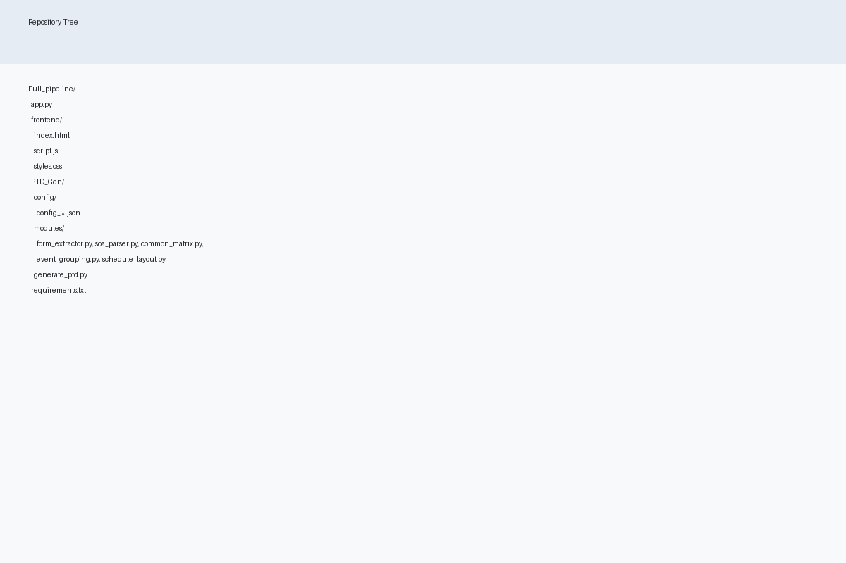
Repository Layout
Full_pipeline/: API, frontend, PTD_Gen/
PTD_Gen/modules: form_extractor, soa_parser, …
Configs under PTD_Gen/config
Notes:
Updated repo mirrors older structure with modules consolidated.
Each stage exposes clear inputs/outputs to simplify testing.
Behavior is tunable per study via JSON configs.

Slide 5
Key Modules — Extraction & Parsing
form_extractor: forms metadata from eCRF
soa_parser: visits/procedures from protocol
common_matrix: merge forms + schedule
Notes:
Form extraction detects labels, triggers, and required flags with rules/patterns.
SoA parsing locates visit headers and maps procedures via configurable markers.
Common matrix builds per‑visit ordering with fuzzy matching.

Slide 6
Key Modules — Grouping & Layout
event_grouping: visit groups, windows, offsets
schedule_layout: final grid (+stream writer)
Final_study_specific_form: CTDM‑style sheet
Notes:
Event grouping classifies visits and computes timing windows.
Schedule layout composes headers, group merges, and forms rows; streaming keeps memory low.
Study‑specific forms derive types and constraints, producing a grouped sheet.

Slide 7
Frontend Overview
index.html: layout and sections
script.js: drag/drop + fetch to /run_pipeline
styles.css: modern, responsive UI
Notes:
Simple file‑first flow; JSON submission via API also supported.
Posts FormData to /run_pipeline; backend tolerates legacy double‑slash path.
Progress/notifications aid longer steps.

Slide 8
API Endpoints
GET /health, /status
POST /run_pipeline (files or JSON)
POST /run_ptd_generation
GET /download/<file>
Notes:
Health/status for probes and local checks.
run_pipeline accepts uploads or JSON; JSON returns structured results.
run_ptd_generation creates Excel and returns a download URL.
Download serves artifacts from output/.

Slide 9
API Examples
POST /run_pipeline with JSON
POST /run_ptd_generation and download
Notes:
Use curl to submit minimal JSON with empty elements arrays for smoke tests.
Then trigger generation and download the spreadsheet.

Slide 10
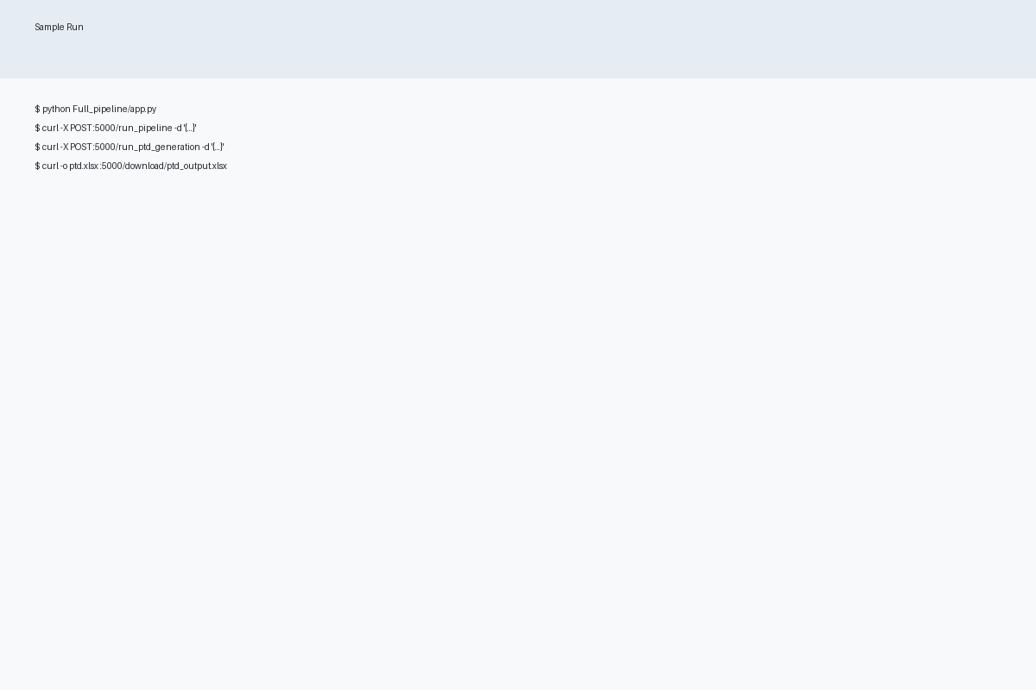
Setup & Run
Create venv, install requirements
python Full_pipeline/app.py
Open frontend or call API
Notes:
Use a local virtual environment.
Run the Flask app; defaults to port 5000 with CORS.
Either use the HTML UI or curl.

Slide 11
Troubleshooting
ModuleNotFoundError: run from repo root
Ports in use: change port/stop process
Missing deps: install both requirements files
No PTD file: inspect CLI stderr
PDF→JSON not implemented: use JSON path
Notes:
Ensure working directory includes app and modules on sys.path.
Change app.run port or free :5000.
Install Full_pipeline and PTD_Gen requirements.
Check subprocess output if generation fails.
During dev use JSON inputs instead of PDFs.

Slide 12
Demo / Run Flow
Health → JSON structuring
PTD generation → download
Review Schedule & Forms sheets
Notes:
Confirm server health, then submit JSON to test structuring.
Generate the PTD and download the Excel.
Check headers, grouping and mapping in the workbook.

Slide 13
Next Steps
Add CI and tests
Package PTD_Gen, pin versions
Add Dockerfile and compose
Publish docs (MkDocs/GitHub Pages)
Notes:
Tests prevent regressions and document behavior.
Packaging and pinning improves reproducibility.
Containerization standardizes environments for demos and dev.
Docs hosting eases onboarding and sharing.

Slide 14
References
Legacy: Full_pipeline (Copy)/
Updated: Full_pipeline/PTD_Gen/
API: Full_pipeline/app.py
Notes:
Old working app for endpoint semantics.
Use updated modules and configs for future work.
Rebuilt app mirrors legacy routes; adds stream generation.

