Slide 1
Computer Networking in Machine Learning Applications
Swapnil Narwade
M.Sc. CA - FY

Slide 2
AGENDA
01
02
03
04
Introduction To Computer Networking
Introduction To CN.
Computer networks are systems of interconnected computers and devices.
Enables data exchange, communication, and resource sharing
Introduction To CN.
Computer networks are systems of interconnected computers and devices.
Enables data exchange, communication, and resource sharing
Introduction To CN.
Computer networks are systems of interconnected computers and devices.
Enables data exchange, communication, and resource sharing

Slide 3
AGENDA
01
02
03
04
Introduction To Computer Networking
Introduction To CN.
Computer networks are systems of interconnected computers and devices.
Enables data exchange, communication, and resource sharing
Introduction To CN.
Computer networks are systems of interconnected computers and devices.
Enables data exchange, communication, and resource sharing
Introduction To CN.
Computer networks are systems of interconnected computers and devices.
Enables data exchange, communication, and resource sharing

Slide 4
AGENDA
01
02
03
04
Introduction To Computer Networking
Machine Learning Overview
Introduction To CN.
Computer networks are systems of interconnected computers and devices.
Enables data exchange, communication, and resource sharing
Introduction To CN.
Computer networks are systems of interconnected computers and devices.
Enables data exchange, communication, and resource sharing

Slide 5
AGENDA
01
02
03
04
Introduction To Computer Networking
Machine Learning Overview
Importance of Networking in Machine Learning Applications
Introduction To CN.
Computer networks are systems of interconnected computers and devices.
Enables data exchange, communication, and resource sharing

Slide 6
AGENDA
01
02
03
04
Introduction To Computer Networking
Machine Learning Overview
Importance of Networking in Machine Learning Applications
Case Studies / Challenges and Opportunities

Slide 7
AGENDA
01
02
03
04
Introduction To Computer Networking
Machine Learning Overview
Importance of Networking in Machine Learning Applications
Case Studies / Challenges and Opportunities

Slide 8
Introduction to Computer Networking

Slide 9
Introduction to Computer Networking
Computer networks are systems of interconnected computers and devices

Slide 10
Introduction to Computer Networking
Computer networks are systems of interconnected computers and devices
Enables data exchange, communication, and resource sharing.

Slide 11
Machine Learning Overview

Slide 12
Machine Learning Overview
Machine learning is a branch of artificial intelligence (AI) and computer science which focuses on the use of data and algorithms to imitate the way that humans learn, gradually improving its accuracy.

Slide 13
Machine Learning Overview
Machine learning is a branch of artificial intelligence (AI) and computer science which focuses on the use of data and algorithms to imitate the way that humans learn, gradually improving its accuracy.
We can develop ML systems to learn and improve from experience without explicit programming.

Slide 14
Machine Learning Overview
Machine learning is a branch of artificial intelligence (AI) and computer science which focuses on the use of data and algorithms to imitate the way that humans learn, gradually improving its accuracy.
We can develop ML systems to learn and improve from experience without explicit programming.
Image recognition, language translation, recommendations, etc.

Slide 15
Importance of Networking in ML

Slide 16
Importance of Networking in ML
Distributed Computing: Networking allows ML models to be trained over multiple machines.
Data Acquisition: Gathering vast datasets from various sources

Slide 17
Importance of Networking in ML
Distributed Computing: Networking allows ML models to be trained over multiple machines.
Data Acquisition: Gathering vast datasets from various sources
Deployment: Deploying trained models to multiple platforms and users.
Real-time Processing: Networking ensures quick data exchange for real-time ML applications.

Slide 18
Case Studies
01
Distributed Deep Learning

Slide 19
Case Studies
01
Distributed Deep Learning
Training complex deep learning models across multiple GPUs and servers.

Slide 20
Case Studies
01
Distributed Deep Learning
Training complex deep learning models across multiple GPUs and servers.
Speeds up training times, handles larger datasets.

Slide 21
Example Tutorial
01
Language Detection ML App ( Backend )

Slide 22
Example Tutorial
01
Language Detection ML App ( Backend )
requirements

Slide 23
Example Tutorial
01
Language Detection ML App ( Backend )
requirements
Python > 3.8
Fastapi, Pydantic
sklearn

Slide 24
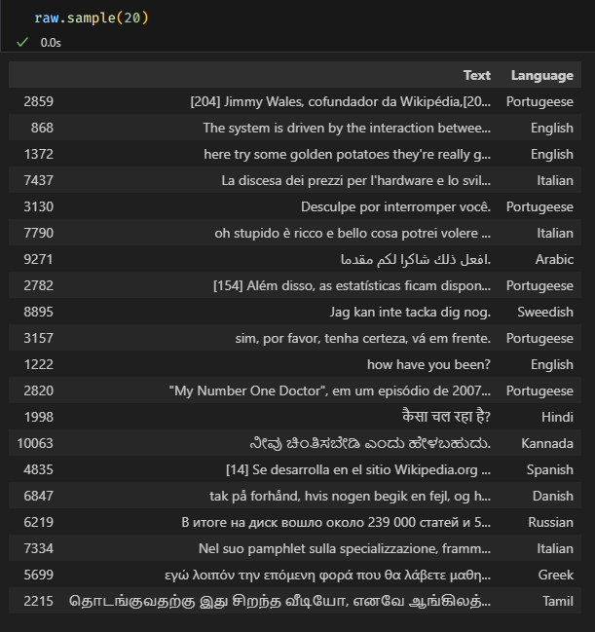
Dataset
www.kaggle.com/datasets/basilb2s/language-detection

Slide 25
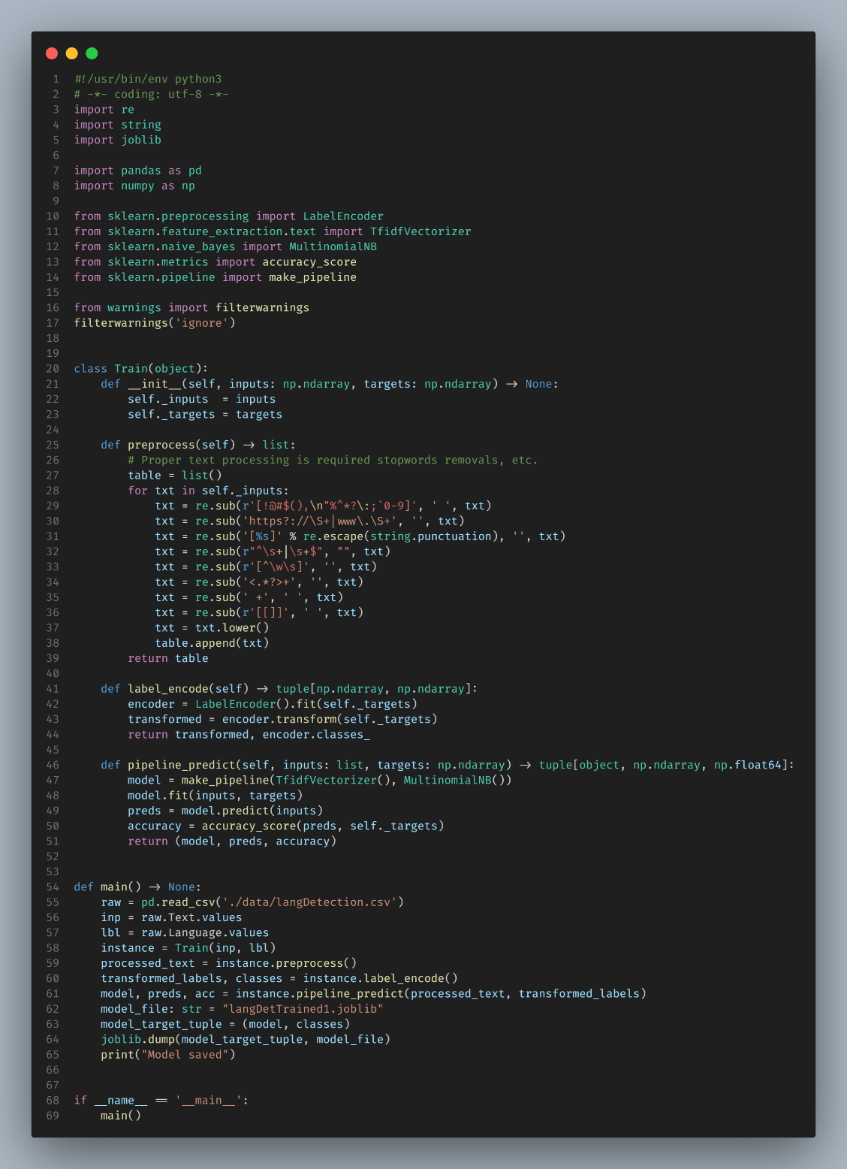
train.py
Code for the building the ML model that train on a dataset.

Slide 26
train.py
Code for the building the ML model that train on a dataset.
Trained model ( weights ) saved in the form of binaries.

Slide 27
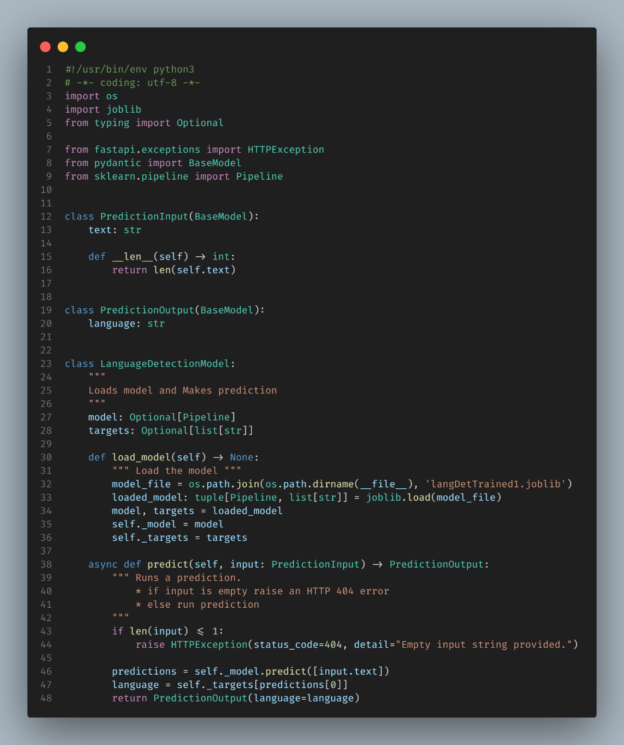

Slide 28
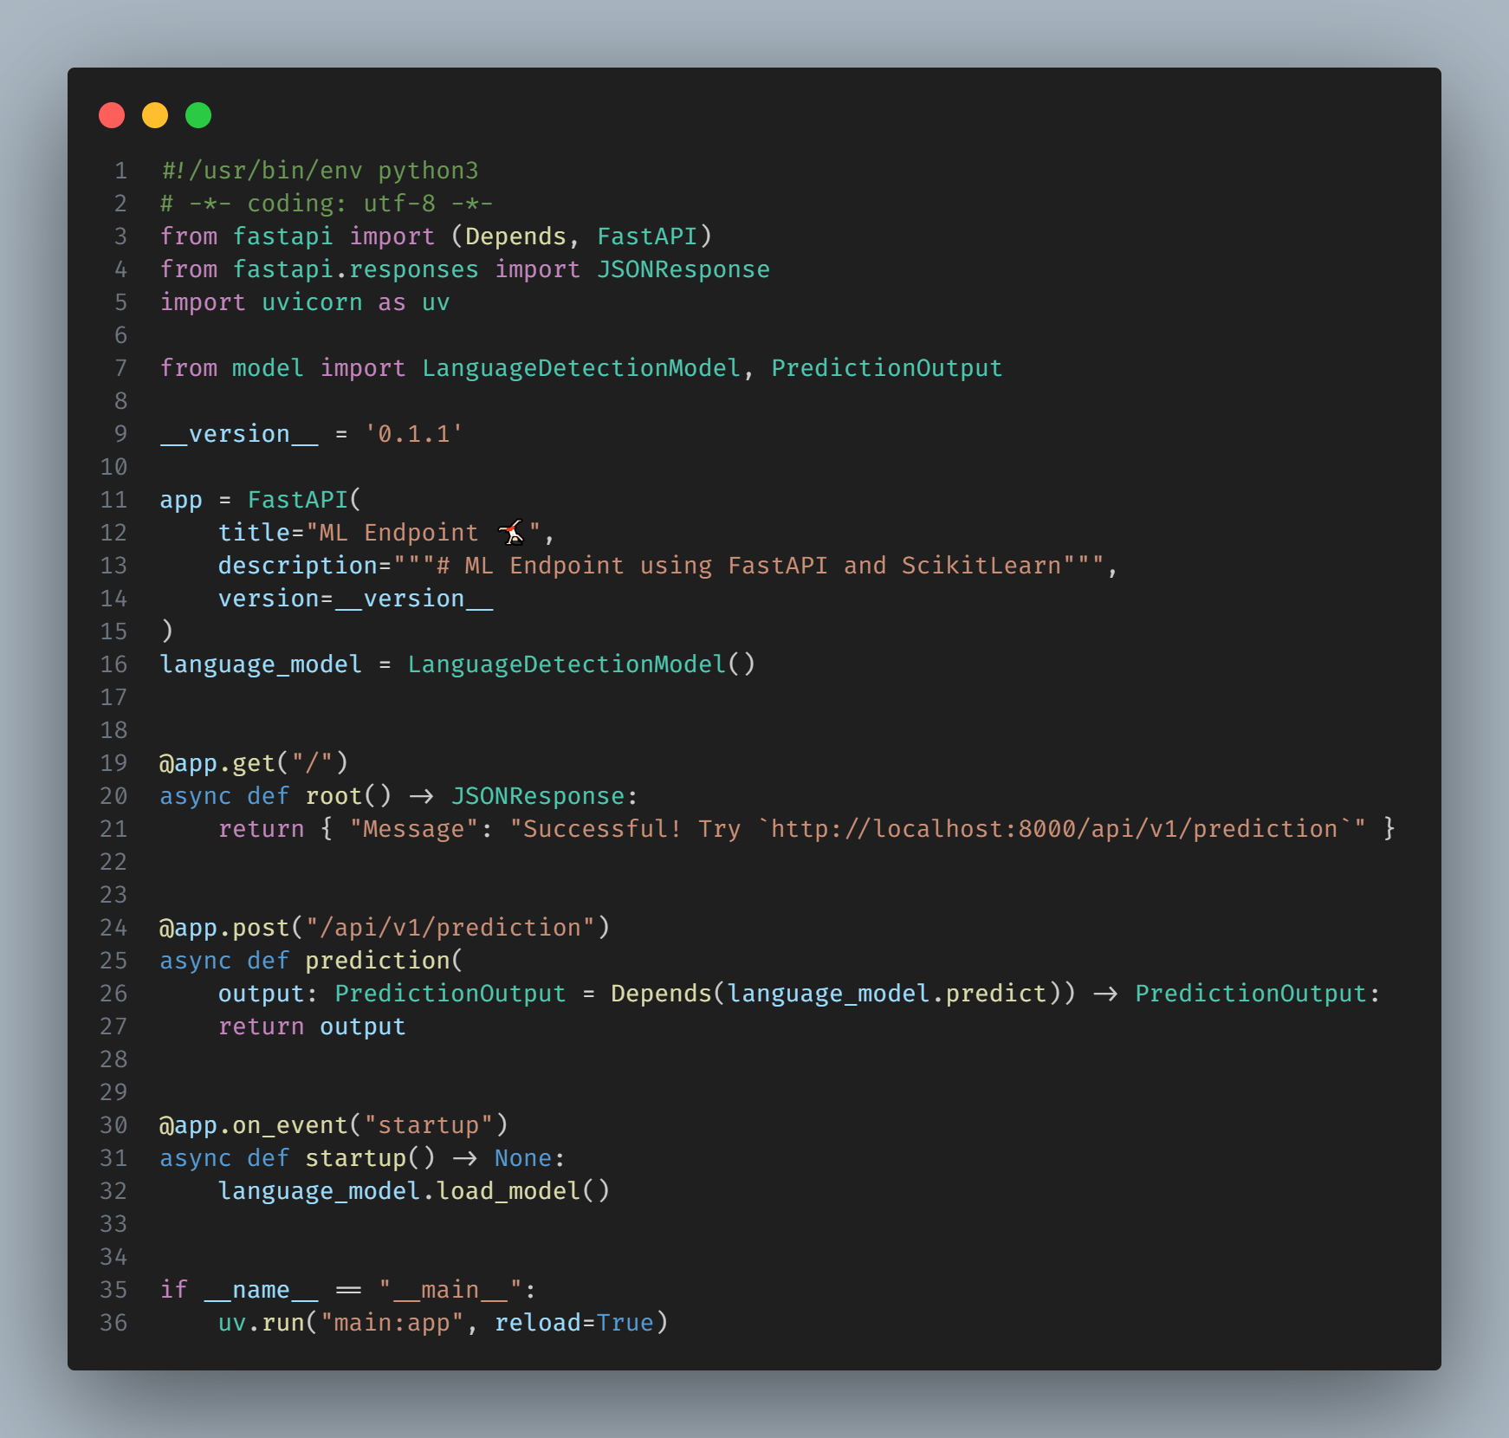
main.py
This FastAPI application serves as an endpoint for a Machine Learning model focused on language detection. Upon initialization, the application loads a pre-trained language detection model from LanguageDetectionModel in the model module. The main features include:

Slide 29
main.py
This FastAPI application serves as an endpoint for a Machine Learning model focused on language detection. Upon initialization, the application loads a pre-trained language detection model from LanguageDetectionModel in the model module. The main features include:
Root Endpoint (/): Provides a welcome message guiding users to the primary prediction endpoint.

Slide 30
main.py
This FastAPI application serves as an endpoint for a Machine Learning model focused on language detection. Upon initialization, the application loads a pre-trained language detection model from LanguageDetectionModel in the model module. The main features include:
Root Endpoint (/): Provides a welcome message guiding users to the primary prediction endpoint.
Language Prediction Endpoint (/api/v1/prediction): Accepts input data and returns predictions from the language detection model. The input format and prediction output are defined by the PredictionOutput class, ensuring structured and validated data exchange.

Slide 31
main.py
This FastAPI application serves as an endpoint for a Machine Learning model focused on language detection. Upon initialization, the application loads a pre-trained language detection model from LanguageDetectionModel in the model module. The main features include:
Root Endpoint (/): Provides a welcome message guiding users to the primary prediction endpoint.
Language Prediction Endpoint (/api/v1/prediction): Accepts input data and returns predictions from the language detection model. The input format and prediction output are defined by the PredictionOutput class, ensuring structured and validated data exchange.
Startup Event: Contains logic to load the machine learning model when the FastAPI application starts. This ensures the model is ready to serve predictions as soon as the server becomes operational.

Slide 32
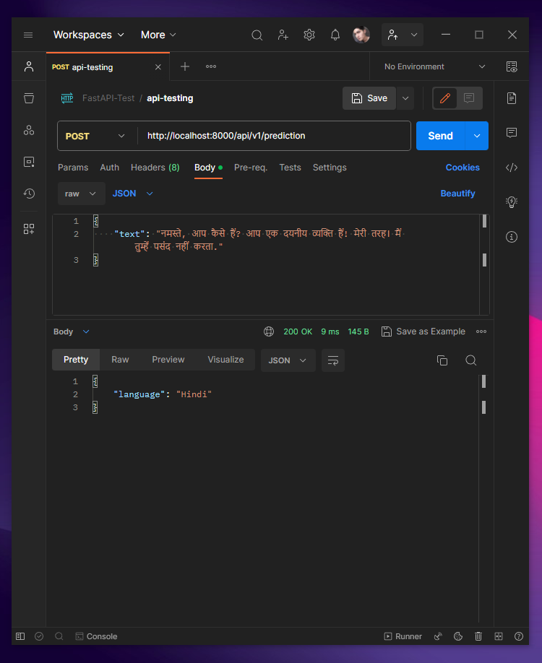
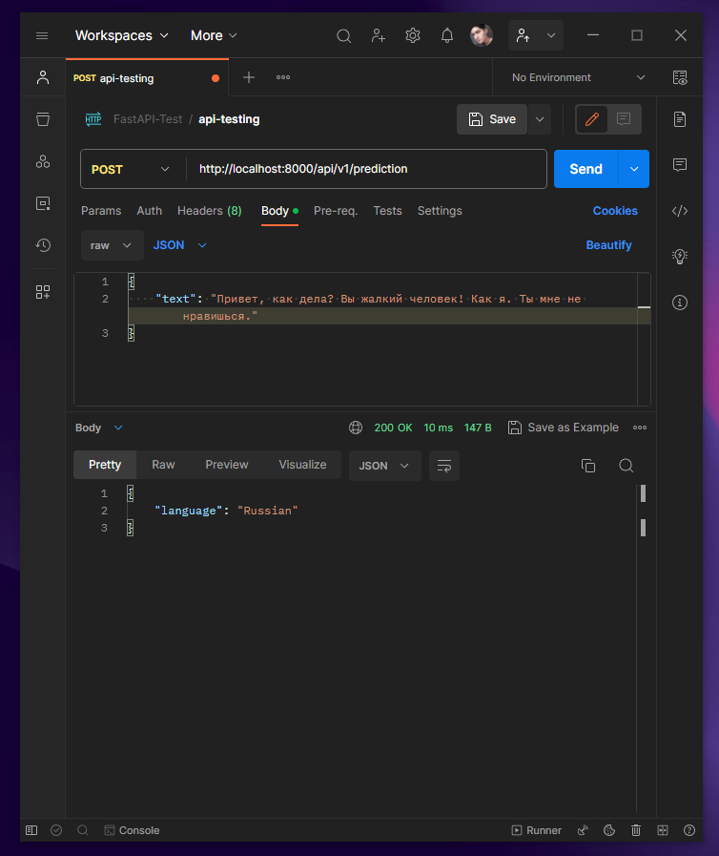
outputs

Slide 33
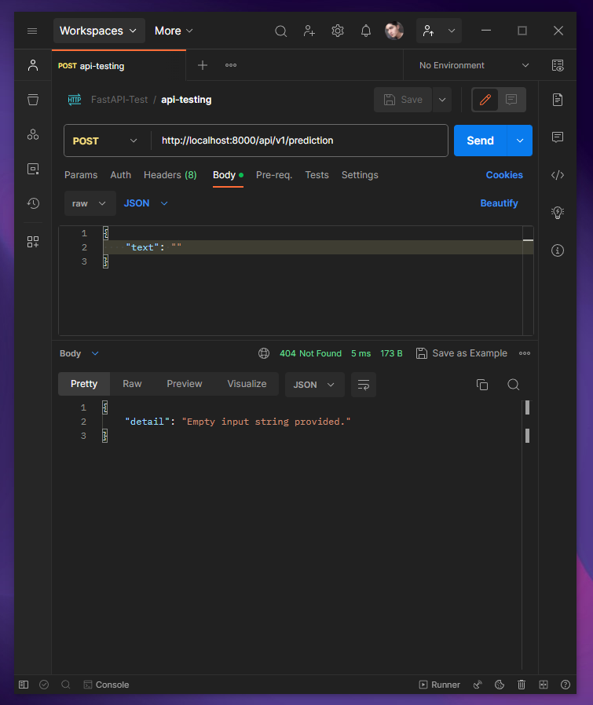
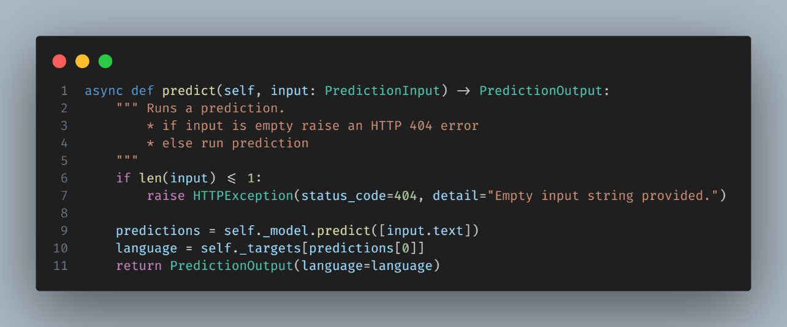

Slide 34
Challenges
Latency: Delays in data transmission affecting real-time processing.
Bandwidth: Managing large volumes of data transfer.
Security: Ensuring safe and encrypted data exchange.
Scalability: Ensuring networks can handle increased load

Slide 35
Conclusion
The synergy of Computer Networking and Machine Learning opens avenues for advanced applications.
As networks evolve, the scale and capabilities of ML applications will expand.
Emphasis on continued research in merging these fields for optimized results.

Slide 36
Useful Links
Code - https://github.com/Now-Tiger/FastAPI/tree/main/langModel
Fastapi - https://fastapi.tiangolo.com/
Kaggle - https://www.kaggle.com/code/swapnilnarwade/quora-text-classification

