Slide 1
Python Programming
4.3 Sorting

Slide 2
Sorting Algorithms
The basic sorting problem is to take a list and rearrange it so that the values are in increasing (or nondecreasing) order.

Slide 3
Naive Sorting: Selection Sort
To start out, pretend you’re the computer, and you’re given a shuffled stack of index cards, each with a number. How would you put the cards back in order?

Slide 4
Naive Sorting: Selection Sort
One simple method is to look through the deck to find the smallest value and place that value at the front of the stack.
Then go through, find the next smallest number in the remaining cards, place it behind the smallest card at the front.
Rinse, lather, repeat, until the stack is in sorted order!
This sorting algorithm is known as a selection sort.

Slide 5
Naive Sorting: Selection Sort
The algorithm has a loop, and each time through the loop the smallest remaining element is selected and moved into its proper position.
For n elements, we find the smallest value and put it in the 0th position.
Then we find the smallest remaining value from position 1 – (n-1) and put it into position 1.
The smallest value from position 2 – (n-1) goes in position 2.
Etc.

Slide 6
Naive Sorting: Selection Sort
When we place a value into its proper position, we need to be sure we don’t accidentally lose the value originally stored in that position.
If the smallest item is in position 10, moving it into position 0 involves the assignment: nums[0] = nums[10]
This wipes out the original value in nums[0]!

Slide 7
Naive Sorting: Selection Sort
We can use simultaneous assignment to swap the values between nums[0] and nums[10]: nums[0],nums[10] = nums[10],nums[0]
Using these ideas, we can implement our algorithm, using variable bottom for the currently filled position, and mp is the location of the smallest remaining value.

Slide 8
Naive Sorting: Selection Sort
def selSort(nums): # sort nums into ascending order n = len(nums) # For each position in the list (except the very last) for bottom in range(n-1): # find the smallest item in nums[bottom]..nums[n-1] mp = bottom # bottom is smallest initially for i in range(bottom+1, n): # look at each position if nums[i] < nums[mp]: # this one is smaller mp = i # remember its index # swap smallest item to the bottom nums[bottom], nums[mp] = nums[mp], nums[bottom]

Slide 9
Naive Sorting: Selection Sort
Rather than remembering the minimum value scanned so far, we store its position in the list in the variable mp.
New values are tested by comparing the item in position i with the item in position mp.
bottom stops at the second to last item in the list. Why? Once all items up to the last are in order, the last item must be the largest!

Slide 10
Divide and Conquer: Merge Sort
We’ve seen how divide and conquer works in other types of problems. How could we apply it to sorting?
Say you and your friend have a deck of shuffled cards you’d like to sort. Each of you could take half the cards and sort them. Then all you’d need is a way to recombine the two sorted stacks!

Slide 11
Divide and Conquer: Merge Sort
This process of combining two sorted lists into a single sorted list is called merging.
Our merge sort algorithm looks like:
split nums into two halves
sort the first half
sort the second half
merge the two sorted halves back into nums

Slide 12
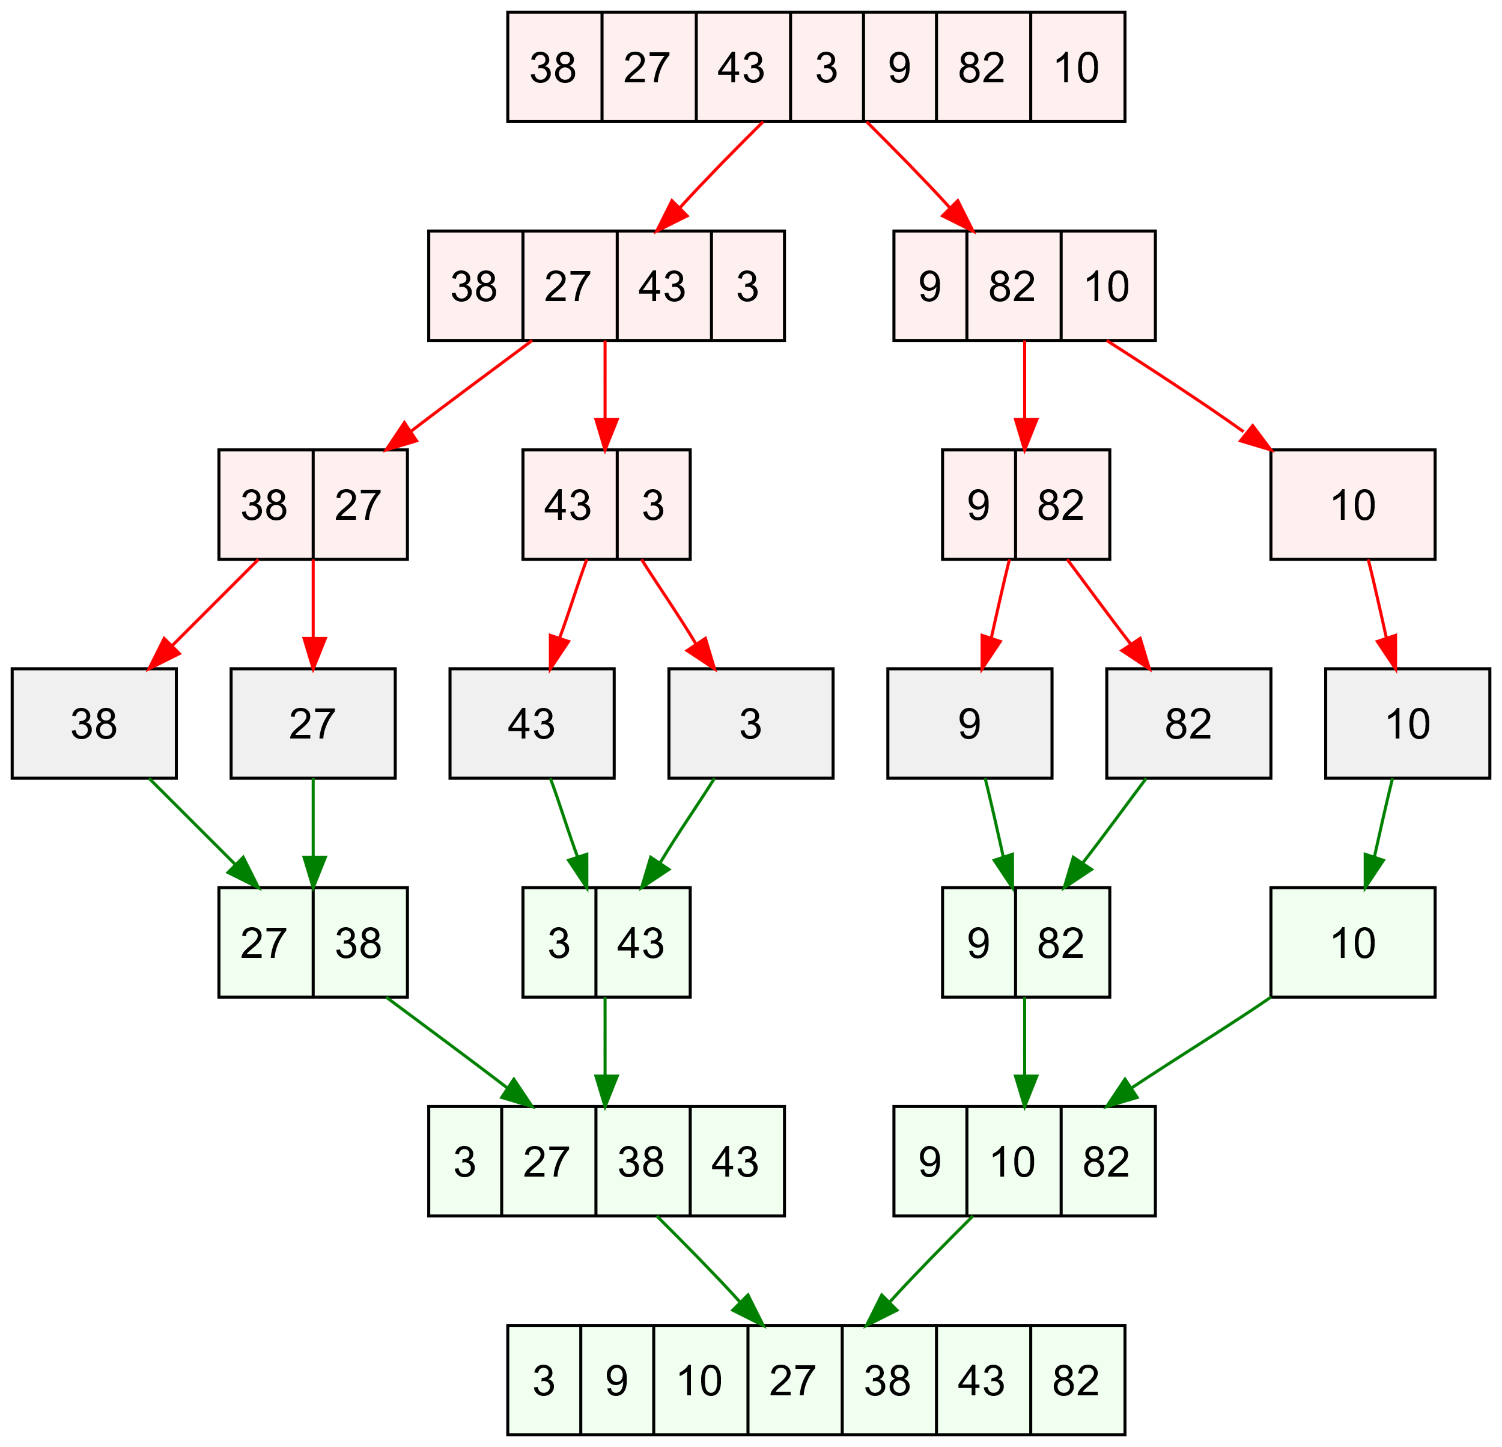

Slide 13
Divide and Conquer: Merge Sort
def merge(lst1, lst2, lst3):
# merge sorted lists lst1 and lst2 into lst3
# these indexes keep track of current position in each list
i1, i2, i3 = 0, 0, 0 # all start at the front
n1, n2 = len(lst1), len(lst2)
# Loop while both lst1 and lst2 have more items
while i1 < n1 and i2 < n2:
if lst1[i1] < lst2[i2]: # top of lst1 is smaller
lst3[i3] = lst1[i1] # copy it into current spot in lst3
i1 = i1 + 1
else: # top of lst2 is smaller
lst3[i3] = lst2[i2] # copy itinto current spot in lst3
i2 = i2 + 1
i3 = i3 + 1 # item added to lst3, update position

Slide 14
Divide and Conquer: Merge Sort
# Here either lst1 or lst2 is done. One of the following loops
# will execute to finish up the merge.
# Copy remaining items (if any) from lst1
while i1 < n1:
lst3[i3] = lst1[i1]
i1 = i1 + 1
i3 = i3 + 1
# Copy remaining items (if any) from lst2
while i2 < n2:
lst3[i3] = lst2[i2]
i2 = i2 + 1
i3 = i3 + 1

Slide 15
Divide and Conquer: Merge Sort
We can slice a list in two, and we can merge these new sorted lists back into a single list. How are we going to sort the smaller lists?
We are trying to sort a list, and the algorithm requires two smaller sorted lists… this sounds like a job for recursion!

Slide 16
Divide and Conquer: Merge Sort
We need to find at least one base case that does not require a recursive call, and we also need to ensure that recursive calls are always made on smaller versions of the original problem.
For the latter, we know this is true since each time we are working on halves of the previous list.

Slide 17
Divide and Conquer: Merge Sort
Eventually, the lists will be halved into lists with a single element each. What do we know about a list with a single item?
It’s already sorted!! We have our base case!
When the length of the list is less than 2, we do nothing.
We update the mergeSort algorithm to make it properly recursive…

Slide 18
Divide and Conquer: Merge Sort
if len(nums) > 1:
split nums into two halves
mergeSort the first half
mergeSort the second half
merge the two sorted halves back into nums

Slide 19
Divide and Conquer: Merge Sort
def mergeSort(nums):
# Put items of nums into ascending order
n = len(nums)
# Do nothing if nums contains 0 or 1 items
if n > 1:
# split the two sublists
m = n/2
nums1, nums2 = nums[:m], nums[m:]
# recursively sort each piece
mergeSort(nums1)
mergeSort(nums2)
# merge the sorted pieces back into original list
merge(nums1, nums2, nums)

Slide 20
Divide and Conquer: Merge Sort
Recursion is closely related to the idea of mathematical induction, and it requires practice before it becomes comfortable.
Follow the rules and make sure the recursive chain of calls reaches a base case, and your algorithms will work!

Slide 21
Comparing Sorts
We now have two sorting algorithms. Which one should we use?
The difficulty of sorting a list depends on the size of the list. We need to figure out how many steps each of our sorting algorithms requires as a function of the size of the list to be sorted.

Slide 22
Comparing Sorts
Let’s start with selection sort.
In this algorithm we start by finding the smallest item, then finding the smallest of the remaining items, and so on.
Suppose we start with a list of size n. To find the smallest element, the algorithm inspects all n items. The next time through the loop, it inspects the remaining n-1 items. The total number of iterations is: n + (n-1) + (n-2) + (n-3) + … + 1

Slide 23
Comparing Sorts
The time required by selection sort to sort a list of n items is proportional to the sum of the first n whole numbers, or .
This formula contains an n² term, meaning that the number of steps in the algorithm is proportional to the square of the size of the list.
If the size of a list doubles, it will take four times as long to sort. Tripling the size will take nine times longer to sort!
Computer scientists call this a quadratic or n² algorithm.

Slide 24
Comparing Sorts
In the case of the merge sort, a list is divided into two pieces and each piece is sorted before merging them back together. The real place where the sorting occurs is in the merge function.

Slide 25
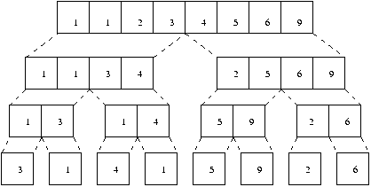
Comparing Sorts
This diagram shows how [3,1,4,1,5,9,2,6] is sorted.
Starting at the bottom, we have to copy the n values into the second level.

Slide 26
Comparing Sorts
From the second to third levels the n values need to be copied again.
Each level of merging involves copying n values. The only remaining question is how many levels are there?

Slide 27
Comparing Sorts
We know from the analysis of binary search that this is just log₂n.
Therefore, the total work required to sort n items is n log₂n.
Computer scientists call this an n log n algorithm.

Slide 28
Comparing Sorts
So, which is going to be better, the n² selection sort, or the n logn merge sort?
If the input size is small, the selection sort might be a little faster because the code is simpler and there is less overhead.
What happens as n gets large? We saw in our discussion of binary search that the log function grows very slowly, so nlogn will grow much slower than n².

Slide 29
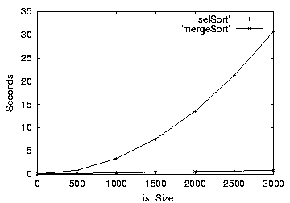
Comparing Sorts

